Slide 1



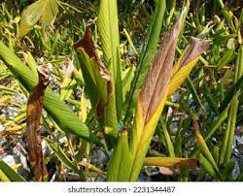
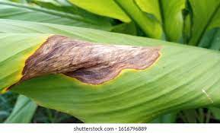
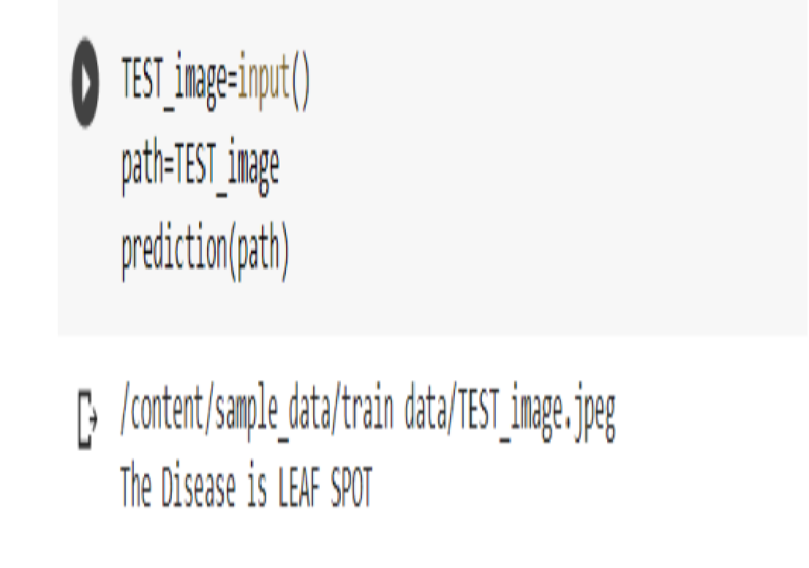
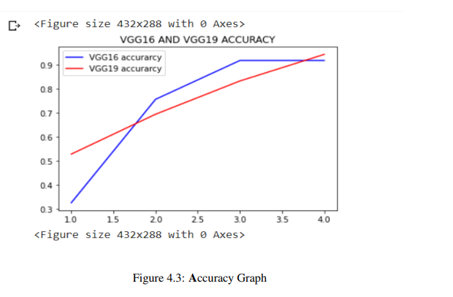
TURMERIC PLANT LEAF DISEASES DETECTION AND CLASSIFICATION USING DEEP LEARNING
Department of Computer Science & Engineering
School of Computing
10214CS602 MINOR PROJECT-II
WINTER SEMESTER(2023-2024)
ABSTRACT
INTRODUCTION
RESULTS
STANDARDS AND POLICIES
Turmeric is a widely cultivated crop with various medical and culinary uses. How- ever, leaf diseases pose a significant threat to turmeric plants, leading to reduced yield and quality. Various conventional methods are available for disease detection and classification, but they often lack accuracy and efficiency. In recent years, deep learning techniques have emerged as a promising approach for plant disease detection and classification. In this study, we propose a deep learning-based approach for automatic detection and classification of turmeric leaf diseases using a convolutional neural network (CNN) model. We evaluated the proposed approach on a publicly available dataset of turmeric leaf images containing three different types of diseases. The results demonstrate the superior performance of the proposed approach in terms of accuracy and efficiency.
In India, agriculture is a major source of income. The agricultural sector employs the majority of the country's people, either directly or indirectly. As a result, creating high-quality agricultural yields is essential for the country's economic progress to continue Farmers choose the proper products by monitoring and maintaining the necessary temperature, light, and humidity needs in order to generate harvests of higher quality and productivity [1]. Furthermore, due to population expansion weather fluctuations, and political instability, the agriculture business has begun to explore for new ways to enhance food production Famers are still grappling with issues such as early detection of plant diseases. Because serving the sort of dis- ease on a plant's leaf with the naked eye is not always possible, an automated expert system that can Help detect the disease in a timely manner would be very valuable Advances in technology, particularly the use of image processing in conjunction with a machine learning technique, will aid farmers in detecting plant disease in its early stages. Turmeric is the dried rhizome of Curcuma longa, a perennial herbaceous plant in the Zingiberaceae family, Turmeric contains up to 3 percent of curcumin, the most physiologically active phytochemical component Due of its high concentration, Indian numeric is regarded as the greatest in the world. It's extracted and studied for its well-known medicinal properties. The creation of an automated system for turmeric disease classification is motivated by the goal of integrating Information and Communications Technology (ICT) with the agriculture sector. Leaf spot leaf blotch, and rhizome rot are the three diseases that damage turmeric leaves.
Efficiency of the Proposed System:
We can predict the class for new data instances using our finalized classification model in Keras using the prediction(path) function. Note that this function is only www available on Sequential models, not those models developed using the functional API. There the output outline will be "The Disease is". The trained model will analyze the input with the data pretrained and make a prediction . We got 99 accuracy with the input. But with discombobulated data the model may not be accurate. But the accuracy stays between 96.
VGG16 vs VGG19 Accuracy and Loss Comparison:
The trained model with vgg16 will analyze the input with the data pretrained and make a prediction. We got 94.59459185600281 accuracy with the input the vgg19 model has the upper hand with 97 percent accuray with steady results as we observe from graphs.
Google Colab:
If you have used Jupyter notebook previously, you would quickly leam to use Google Colab. To be precise, Colab is a free Jupyter notebook environment that runs entirely in the cloud. www Most importantly, it does not require a setup and the notebooks that you create can be simultaneously edited by your team members - just the way you edit documents in Google Docs Colab supports many popular machine learning libraries which can be easily loaded in your notebook.
VGG Visual Geometry Group:
Let's explore what VGG19 is and compare it with some of the other versions of the VGG architecture and also see some useful and practical applications of the VGG architecture Before diving in and looking at what VGG19 Architecture is let's take a look at ImageNet and a basic knowledge of CNN
Figure 3. Test image results.
TEAM MEMBER DETAILS
< vtu 19521/ K. Lakshmi Nikhitha >
<vtu 20065/ P. Mahi Pranathi >
<vtu 19523/ P. Rekha Shanmukhi >
< Student 1. 9014526502>
<Student 2. 9392049282>
<Student 3. 9392682559>
<Student 1. vtu19521@veltech.edu.in>
<Student 2. vtu20065@veltech.edu.in>
<Student 3. vtu19523@veltech.edu.in>
Figure 1. Leaf Blotch
Figure 2. Leaf spot.
METHODOLOGIES
CONCLUSIONS
Image Acquisition:
This is the method of obtaining photos with a camera by visiting the location or using other available resources such as image databases or online repositories. The images are taken in three colors: Red, Green, and Blue (RGB), for which a color transformation structure is generated and a device independent color space transformation is applied.
Image Pre-processing:
The image in which we are interested, we use leaf image clipping. To remove the superfluous portions, the recovered plant leaf image is sent to a computer system. Resizing the image, noise reduction from the image, augmentation and smoothing of the image are all important phases in preprocessing.
Image Segmentation:
This image processing technique Processing is a technique for dividing an image into relevant parts. components based on shared traits Image segmentation can be done using a variety of approaches, such as a boundary and spot detection algorithm, or a region detection algorithm Otsu's approach, thresholding, and edge-based methods approaches, such as k-means clustering, and so on.The RGB extracted data is shown in figure
The annual lack of agricultural productiveness is as a result of intense plant sicknesses. As a result, diagnosing sicknesses in flora at an early level is vital for averting such intense losses withinside the future. The Monocotyledonous and Dicotyledonous plant families, in addition to the applicable method comprising the photograph processing phases had been included on this study. The maximum substantially used classification techniques for the identity and detection of sicknesses on plant leaves had been evaluated. The maximum current paintings has been tested and illustrated. It may be said that some of the techniques utilized withinside the preceding paintings, the deep studying principles. www especially the CNN approach, have received the highest accuracy.
ACKNOWLEDGEMENT
Dr. S. SRIDEVI M.E., Ph.D. PROFESSOR
9940963713
drsridevis@veltech.edu.in
Chart 1. Accuracy Graph.

