Slide 1
BIZTAB
BIZTAB INNOVATION LAB
ITASK UX DESIGN
PRESENTED BY
DEPARTMENT
DATE
VERSION
Someswar
BIL
12/10/202
v1.0
Notes:
Thank you for your time. We would now like to open the floor for questions and feedback, especially on the end-to-end flow, the evaluation criteria and the boundary between the Innovator Hub and iTASK. Agreed actions and comments will be consolidated and used to finalize the product definition.

Slide 2
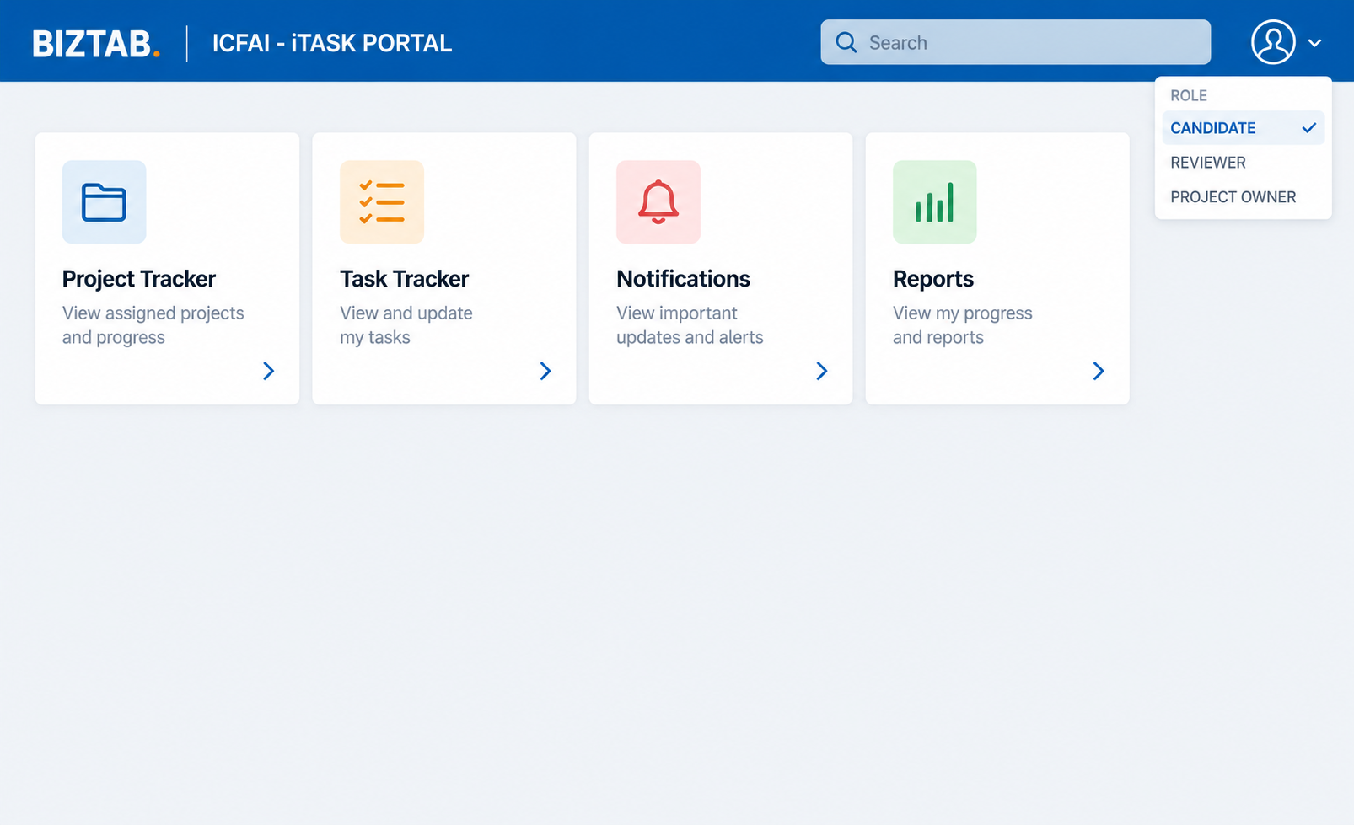
Dashboard Page
Comment
Type Comment
Notes:
This slide sets the product boundary, which is central to the design. The Innovator Hub owns everything up to approval: idea intake, assessment and scoring, the founder agreement, e-signature, and the approval and handover itself. iTASK owns everything after approval: project creation, epics, features and stories, sprint planning, tasks and daily activity, and evidence, testing and delivery. By keeping this line clear we avoid building project-management features twice and give each team a focused roadmap. If there are questions about where a specific capability belongs, this is the slide to come back to.

Slide 3
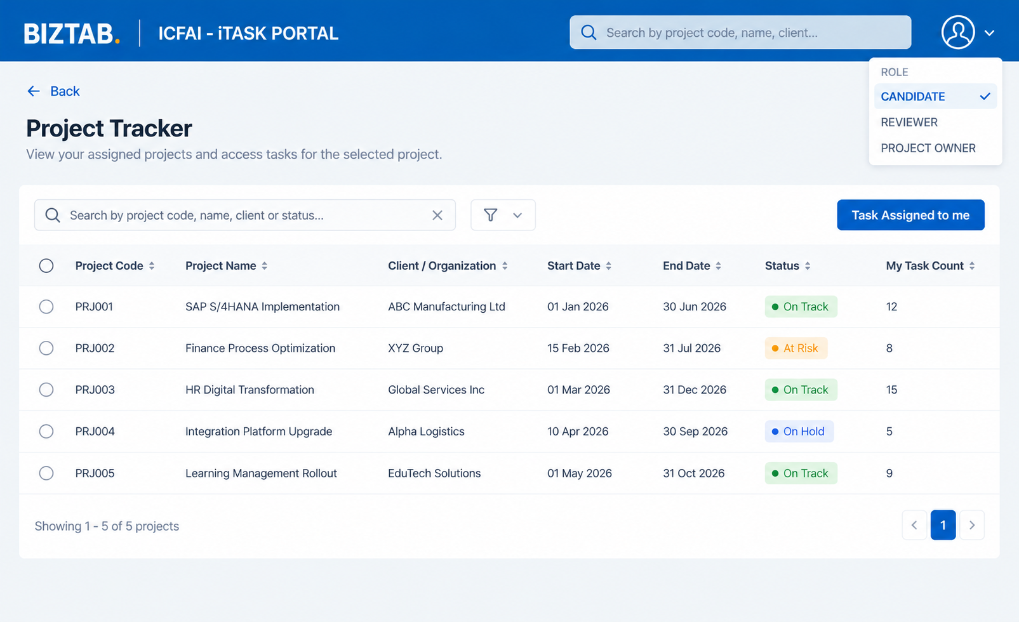
Project Tracker
Comment
Type Comment
Notes:
This slide sets the product boundary, which is central to the design. The Innovator Hub owns everything up to approval: idea intake, assessment and scoring, the founder agreement, e-signature, and the approval and handover itself. iTASK owns everything after approval: project creation, epics, features and stories, sprint planning, tasks and daily activity, and evidence, testing and delivery. By keeping this line clear we avoid building project-management features twice and give each team a focused roadmap. If there are questions about where a specific capability belongs, this is the slide to come back to.

Slide 4
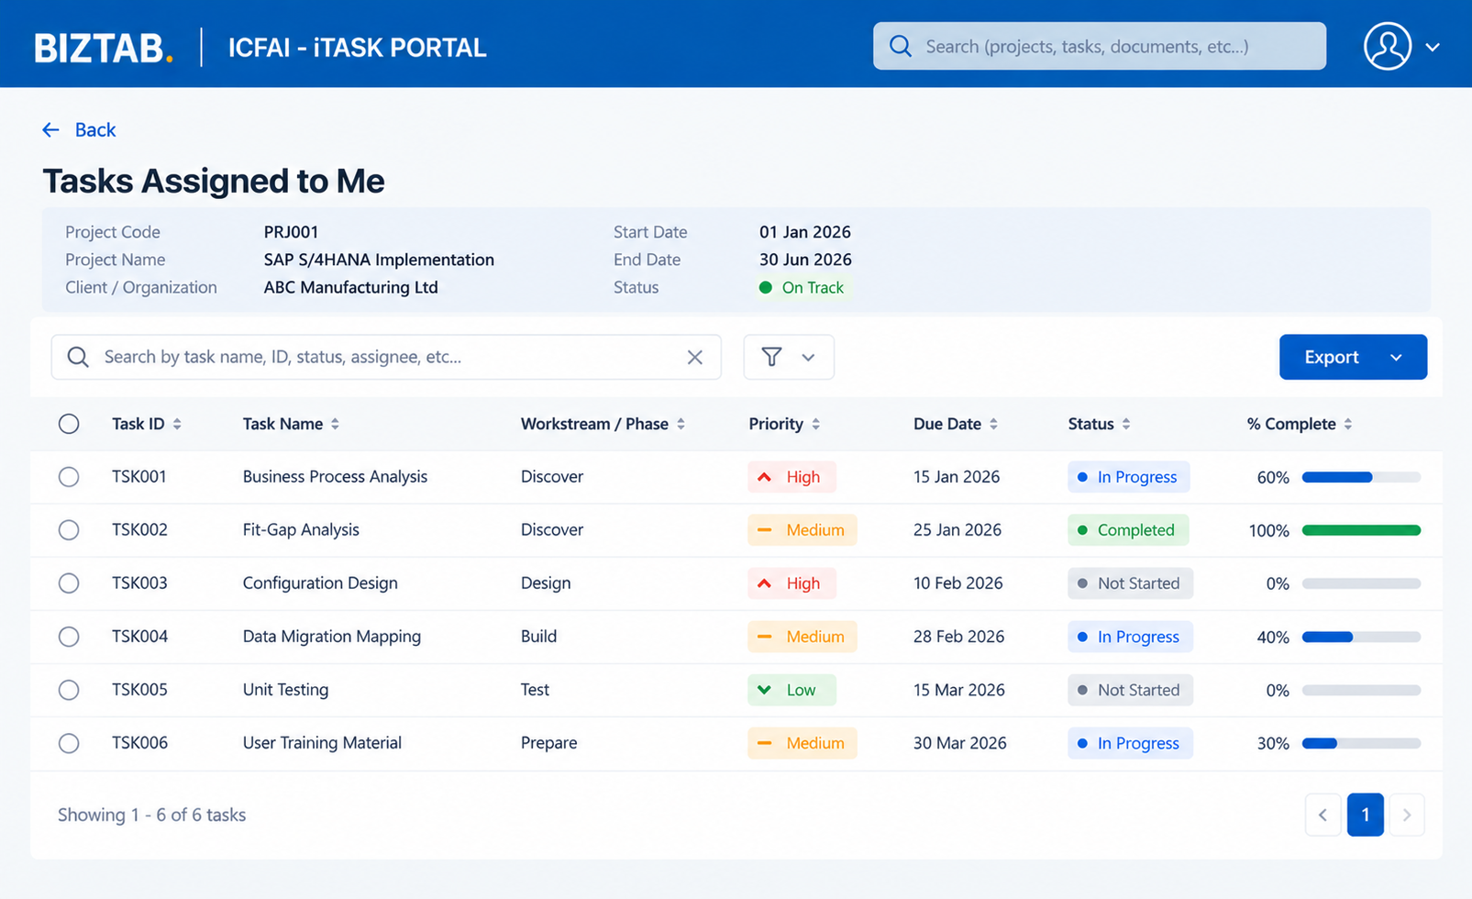
Project Tracker -> Task Assigned
Comment
Type Comment
Notes:
This slide sets the product boundary, which is central to the design. The Innovator Hub owns everything up to approval: idea intake, assessment and scoring, the founder agreement, e-signature, and the approval and handover itself. iTASK owns everything after approval: project creation, epics, features and stories, sprint planning, tasks and daily activity, and evidence, testing and delivery. By keeping this line clear we avoid building project-management features twice and give each team a focused roadmap. If there are questions about where a specific capability belongs, this is the slide to come back to.

Slide 5
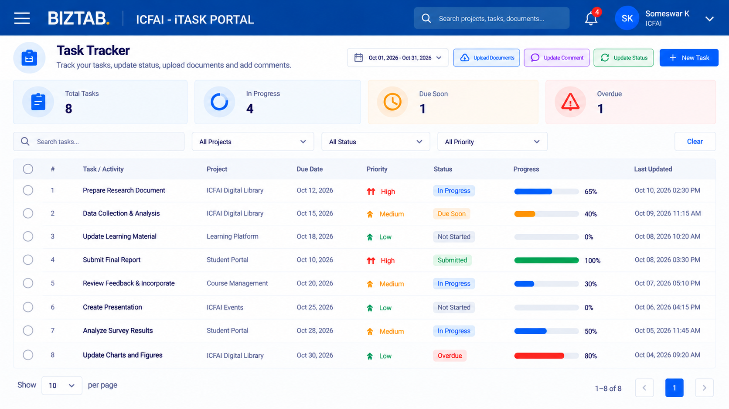
Task Tracker
Comment
Type Comment
Notes:
This slide sets the product boundary, which is central to the design. The Innovator Hub owns everything up to approval: idea intake, assessment and scoring, the founder agreement, e-signature, and the approval and handover itself. iTASK owns everything after approval: project creation, epics, features and stories, sprint planning, tasks and daily activity, and evidence, testing and delivery. By keeping this line clear we avoid building project-management features twice and give each team a focused roadmap. If there are questions about where a specific capability belongs, this is the slide to come back to.

Slide 6
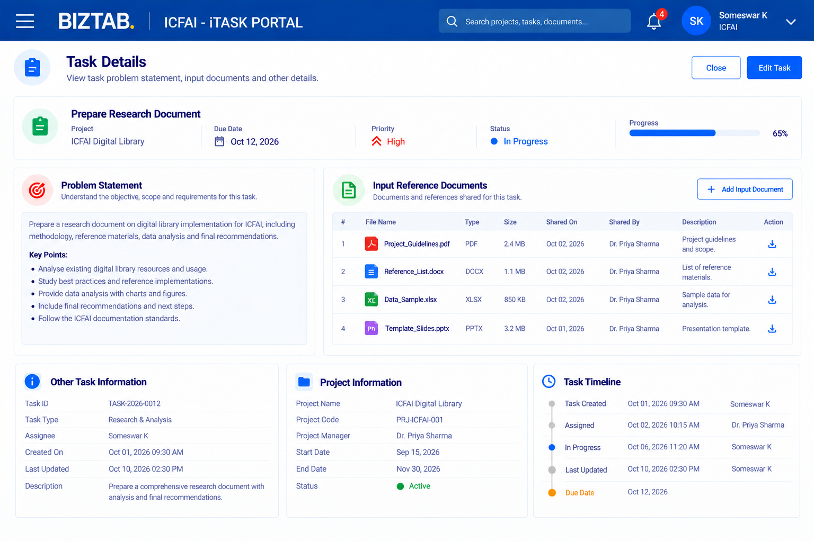
Task Tracker -> Task Details
Comment
Type Comment
Notes:
This slide sets the product boundary, which is central to the design. The Innovator Hub owns everything up to approval: idea intake, assessment and scoring, the founder agreement, e-signature, and the approval and handover itself. iTASK owns everything after approval: project creation, epics, features and stories, sprint planning, tasks and daily activity, and evidence, testing and delivery. By keeping this line clear we avoid building project-management features twice and give each team a focused roadmap. If there are questions about where a specific capability belongs, this is the slide to come back to.

Slide 7
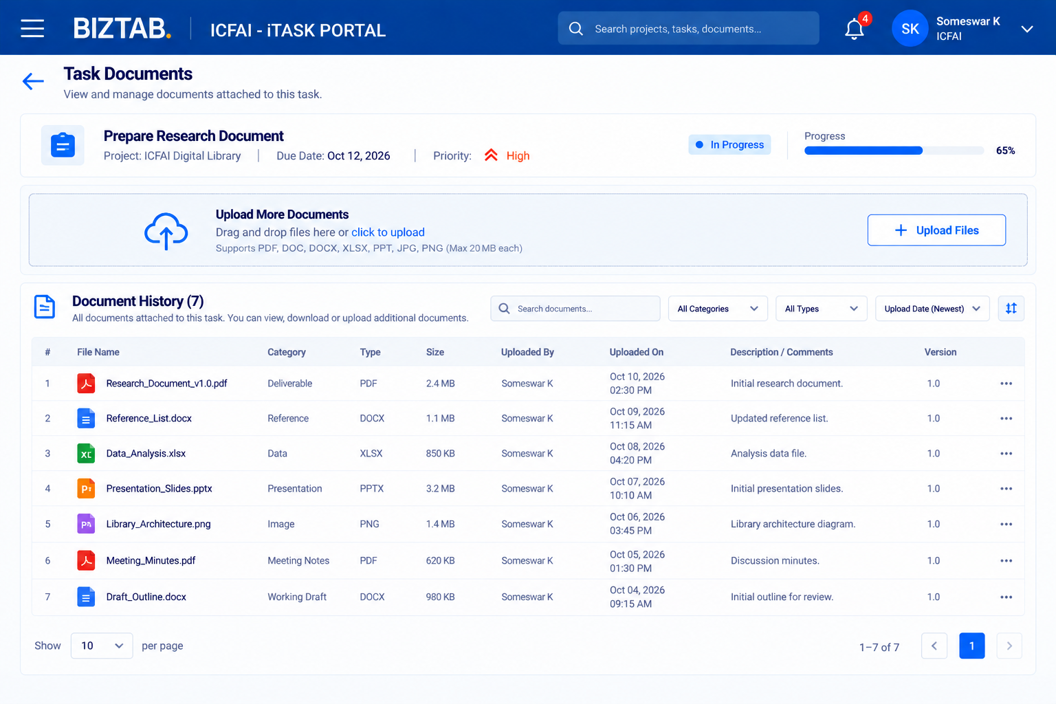
Task Tracker -> Document Upload
Comment
Type Comment
Notes:
This slide sets the product boundary, which is central to the design. The Innovator Hub owns everything up to approval: idea intake, assessment and scoring, the founder agreement, e-signature, and the approval and handover itself. iTASK owns everything after approval: project creation, epics, features and stories, sprint planning, tasks and daily activity, and evidence, testing and delivery. By keeping this line clear we avoid building project-management features twice and give each team a focused roadmap. If there are questions about where a specific capability belongs, this is the slide to come back to.

Slide 8
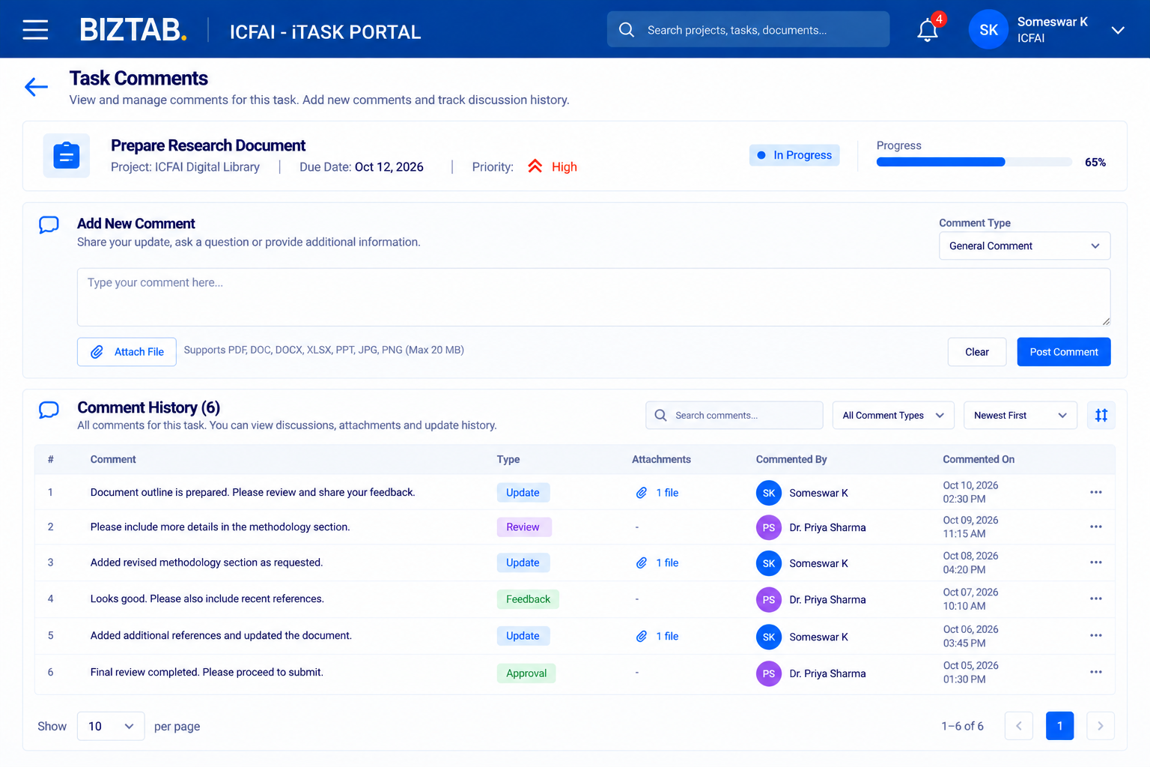
Task Tracker -> Post Comment
Comment
Type Comment
Notes:
This slide sets the product boundary, which is central to the design. The Innovator Hub owns everything up to approval: idea intake, assessment and scoring, the founder agreement, e-signature, and the approval and handover itself. iTASK owns everything after approval: project creation, epics, features and stories, sprint planning, tasks and daily activity, and evidence, testing and delivery. By keeping this line clear we avoid building project-management features twice and give each team a focused roadmap. If there are questions about where a specific capability belongs, this is the slide to come back to.

Slide 9
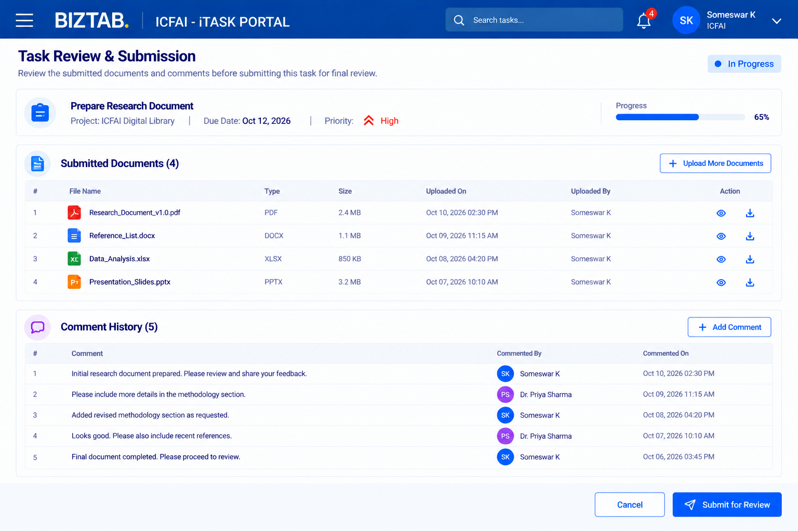
Task Tracker -> Submission for Review
Comment
Type Comment
Notes:
This slide sets the product boundary, which is central to the design. The Innovator Hub owns everything up to approval: idea intake, assessment and scoring, the founder agreement, e-signature, and the approval and handover itself. iTASK owns everything after approval: project creation, epics, features and stories, sprint planning, tasks and daily activity, and evidence, testing and delivery. By keeping this line clear we avoid building project-management features twice and give each team a focused roadmap. If there are questions about where a specific capability belongs, this is the slide to come back to.

Slide 10
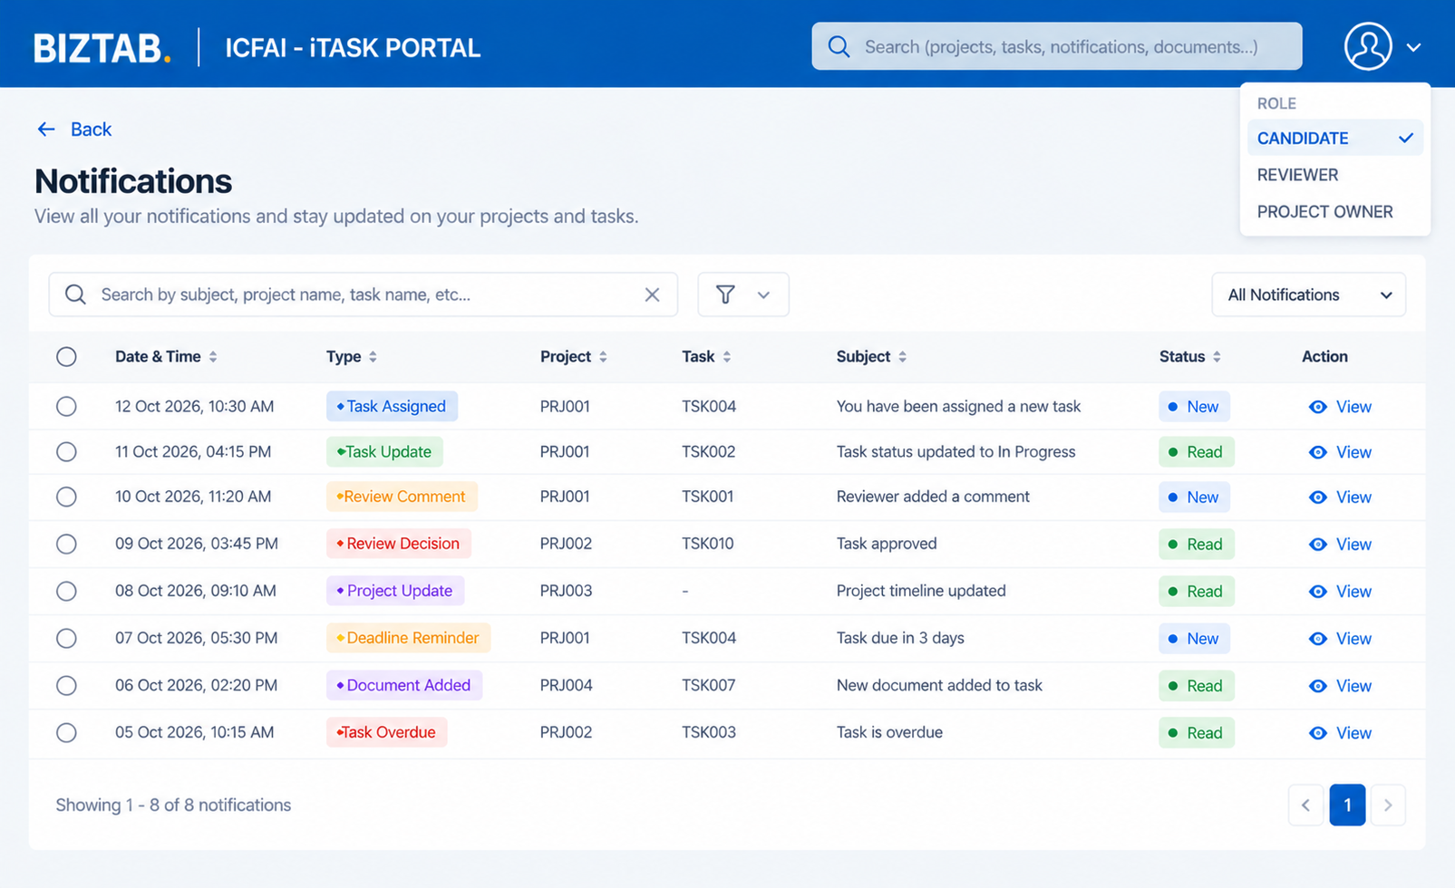
Notification
Comment
Type Comment
Notes:
This slide sets the product boundary, which is central to the design. The Innovator Hub owns everything up to approval: idea intake, assessment and scoring, the founder agreement, e-signature, and the approval and handover itself. iTASK owns everything after approval: project creation, epics, features and stories, sprint planning, tasks and daily activity, and evidence, testing and delivery. By keeping this line clear we avoid building project-management features twice and give each team a focused roadmap. If there are questions about where a specific capability belongs, this is the slide to come back to.

Slide 11
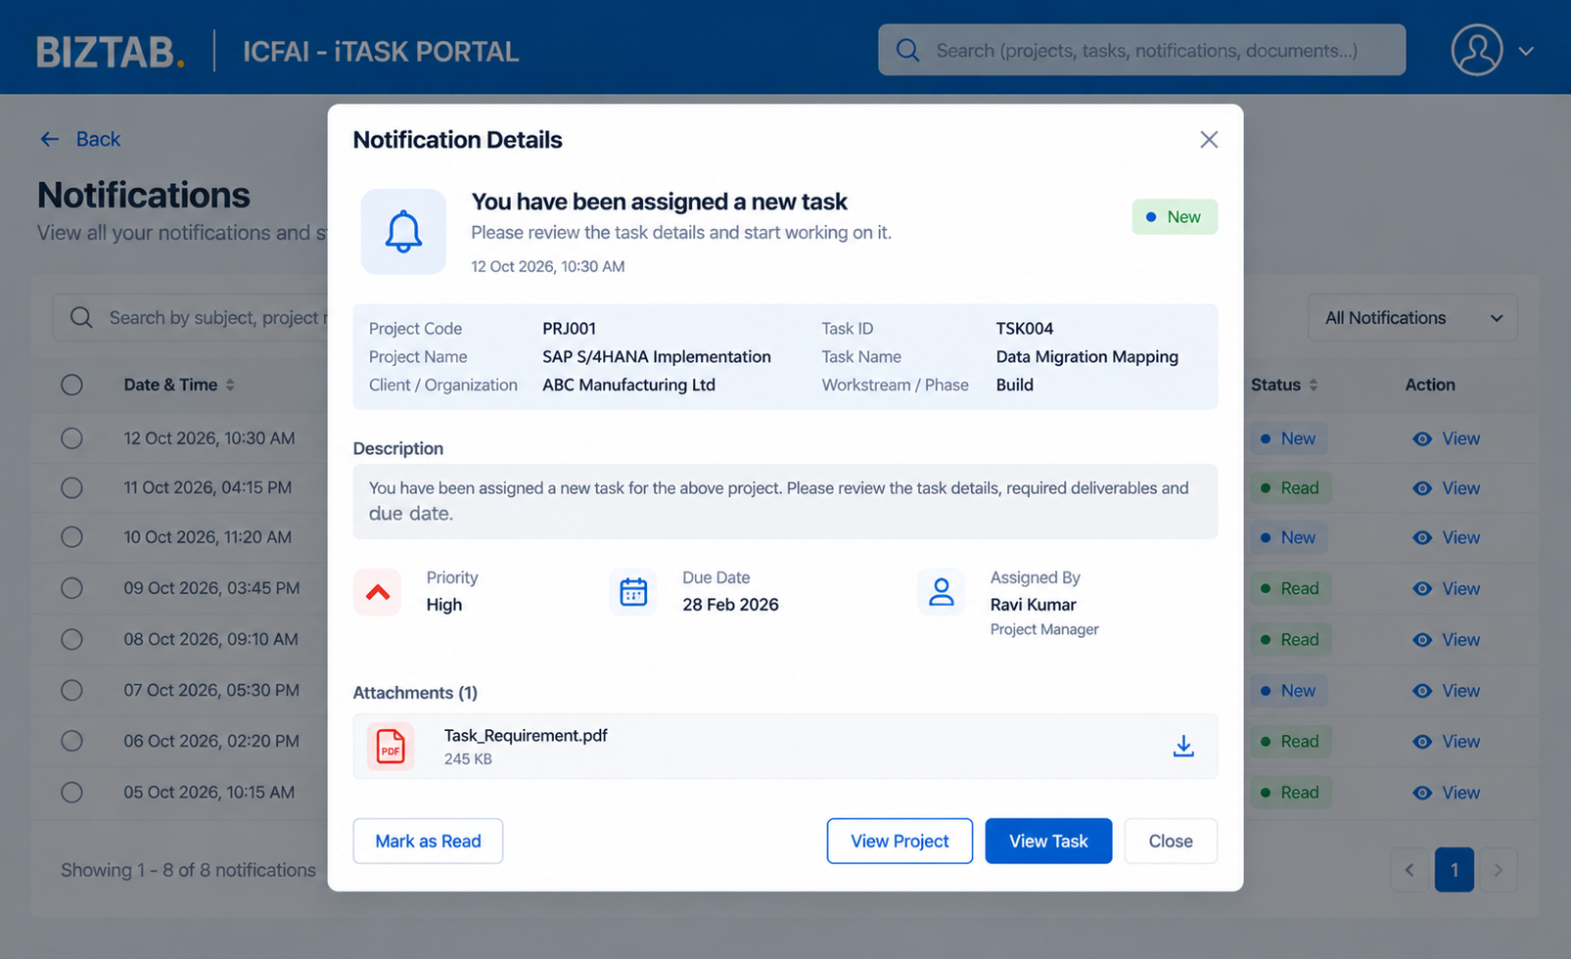
Notification -> View
Comment
Type Comment
Notes:
This slide sets the product boundary, which is central to the design. The Innovator Hub owns everything up to approval: idea intake, assessment and scoring, the founder agreement, e-signature, and the approval and handover itself. iTASK owns everything after approval: project creation, epics, features and stories, sprint planning, tasks and daily activity, and evidence, testing and delivery. By keeping this line clear we avoid building project-management features twice and give each team a focused roadmap. If there are questions about where a specific capability belongs, this is the slide to come back to.

Slide 12
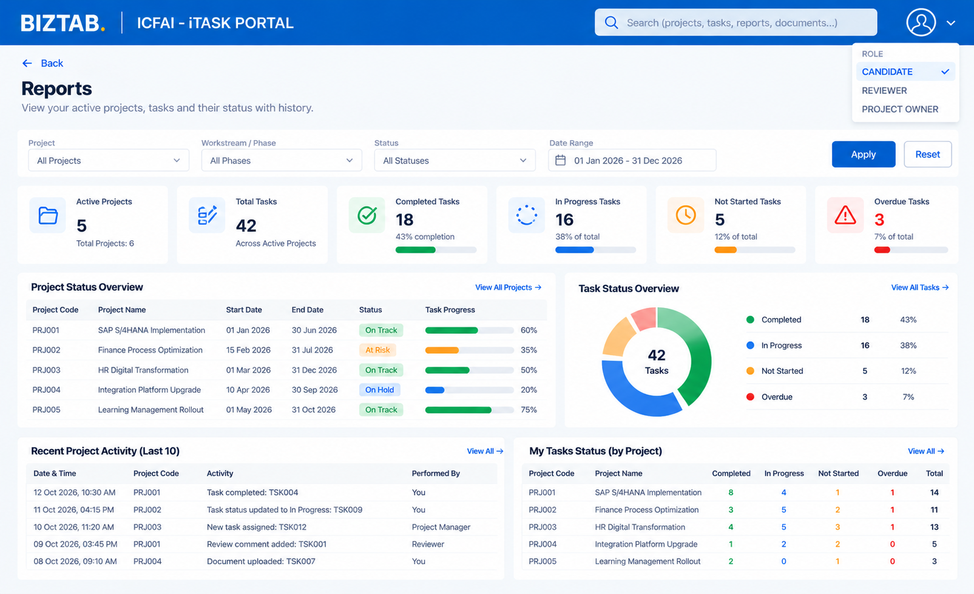
Reports
Comment
Type Comment
Notes:
This slide sets the product boundary, which is central to the design. The Innovator Hub owns everything up to approval: idea intake, assessment and scoring, the founder agreement, e-signature, and the approval and handover itself. iTASK owns everything after approval: project creation, epics, features and stories, sprint planning, tasks and daily activity, and evidence, testing and delivery. By keeping this line clear we avoid building project-management features twice and give each team a focused roadmap. If there are questions about where a specific capability belongs, this is the slide to come back to.

Slide 13
BIZTAB
Thank you
CONTACT
EMAIL
WEBSITE
Someswar
Someswar.Kottapili@biztab.ai
www.biztab.ai
BIZTAB Innovator Hub | INTERNAL USE ONLY – BIZTAB.AI
Notes:
Thank you for your time. We would now like to open the floor for questions and feedback, especially on the end-to-end flow, the evaluation criteria and the boundary between the Innovator Hub and iTASK. Agreed actions and comments will be consolidated and used to finalize the product definition.

