Slide 1
14.1 IMPLEMENTATION:
14.1.1 DESIGNER VIEW:
This views displays a pictorial representation of customer or the organization needs. Each button in the above diagram redirects to the links of respective domains and site. This is enabled through HTML and CSS in Microsoft Expression web, a simple software or application to create our own websites.

Slide 2
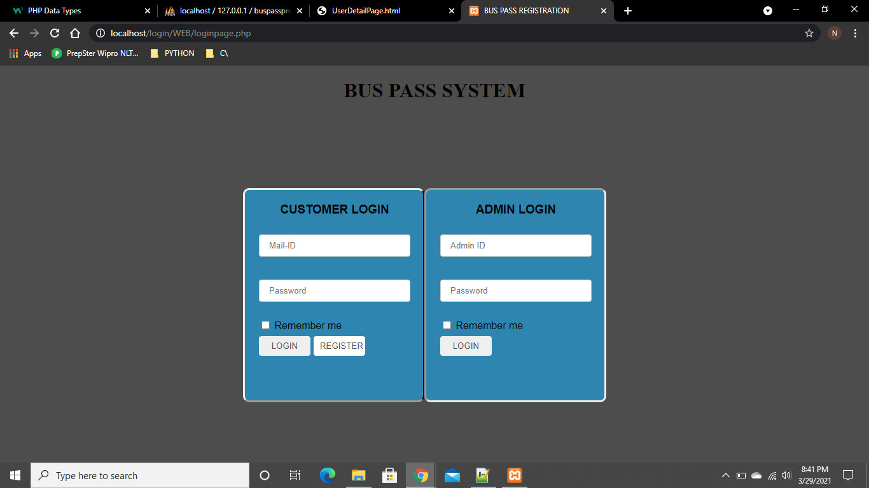

Slide 3


Slide 4
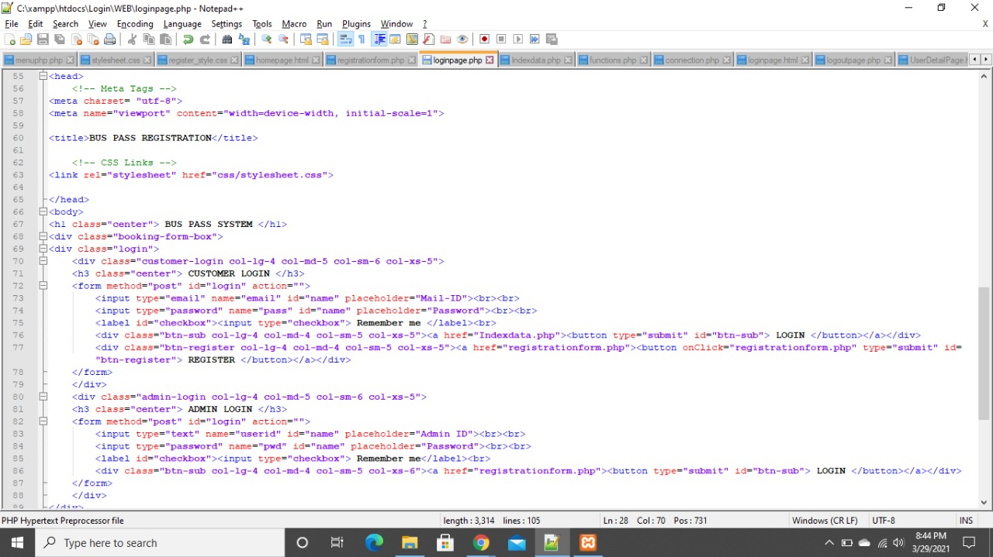

Slide 5
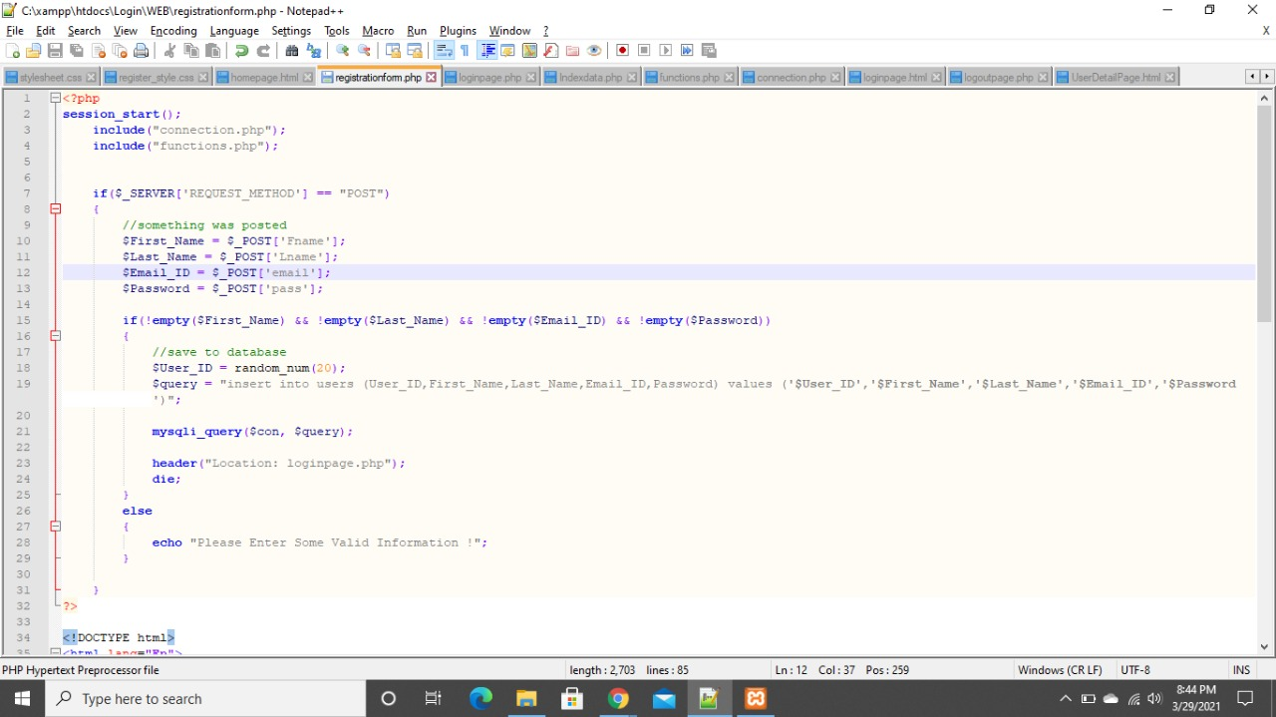

Slide 6
15.1 Estimation of Test Coverage Metrics & Structural complexity 15.1.1 Control Flow Graph
LOGIN
USER
ADMIN
TRUE
FALSE
FALSE
TRUE
HOME PAGE
REGISTER PAGE
REGISTER PAGE
HOME PAGE
MANAGE USER DETAILS
MANAGE USER DETAILS
MANAGE PASS DETAILS
MANAGE BUS DETAILS
PAYMENT
MANAGE PASS DETAILS
LOGOUT

Slide 7
15.1.2 McCabe's cyclomatic complexity
Cyclomatic complexity:
It is a software metric used to measure the complexity of a program. It is a quantitative measure of independent paths in the source code of the program. Independent path is defined as a path that has at least one edge which has not been traversed before in any other paths. Cyclomatic complexity can be calculated with respect to functions, modules, methods or classes within a program. This metric was developed by Thomas J. McCabe in 1976 and it is based on a control flow representation of the program. Control flow depicts a program as a graph which consists of Nodes and Edges.
Mathematical representation:
Mathematically, it is set of independent paths through the graph diagram. The Code
complexity of the program can be defined using the formula –
V(G) = E – N + 2
Where,
E - Number of edges
N - Number of Nodes
V(G) = P + 1 ,
Where P = Number of predicate nodes (node that contains condition).

Slide 8
CALCULATION:
E - Number of edges=16
N - Number of Nodes=14
V(G)=16-14+2=4
- Complexity =4
15.1.3 Optimum value of Cyclomatic complexity
Cyclomatic complexity is used to gauge the overall intricacy of an application or specific functionality within it. The software metric quantitatively measures a program's logical strength based on existing decision paths in the source code.
Complexity (M) = Edges (E) – Nodes (N) + Exit Nodes (P)
Complexity(M)=16-14+1=3;
Hence It is a Simple Module with low risk level.

Slide 9
15.1.3 Optimum value of cyclomatic complexity
Cyclomatic complexity is used to gauge the overall intricacy of an application or specific functionality
within it. The software metric quantitatively measures a program's logical strength based on existing
decision paths in the source code. For example, an application consisting of zero decision points (IF,
FOR, etc.) has an intricacy score of 1 because it contains a single path in the source code. If the
program contains an IF statement consisting of one condition, the code would contain a total of
two paths: TRUE or FALSE. The cyclomatic complexity algorithm is used to derive a measurable value
based on the number of edges and nodes within the graph as well as the total count of connected
components or exit nodes.

