Slide 1
IDENTIFYING THE REQUIREMENTS FROM THE PROJECT STATEMENT
REQUIREMENTS :
The requirement definition is concerned with the analysis of the existing system with the aim of determining and structuring the requirement of the proposed system. It is achieved with the aid of user requirement.
Requirement analysis determines the needs to be fulfilled and what the prepared document should do after completion. For the better understanding of the requirements we will draw the context diagram then build a prototype, analyse the requirements and lastly finalise them. In feasibility we analyses the feasibility of the project in terms of economic feasibility, technical feasibility and operational feasibility.
SYSTEM REQUIREMENTS :
List of City/Local Busses and Bus Stations.
GPS Tracker supported for the city busses.
Alert message generating System(For Renewal Process /Any maintenance Work).

Slide 2
FUNCTIONAL REQUIREMENTS :
REGISTERING USER
UPDATING INFORMATION
GENERATING PASS
RENEWING PASS
AUTHENTICATION OF USER
LOG IN
ONLINE PAYMENT
GENERATING PDF
GENERATING QR CODE
NON-FUNCTIONAL REQUIREMENTS :
RELIABILITY.
AVALIABILITY.
THIS WEB APPLICATION WILL BE AVALIABLE IN FEW LANGUAGES.
SECURITY.
STABILITY

Slide 3
PROJECT PLAN AND PROJECT EFFORT BASED ON RESOURSES
Project Name :
Online Registration of Bus Pass
Project Members :
VIGNESH P –RA1911003020468
NIKITH S -RA1911003020480
ROHITH S -RA1911003020474
The following budget is set according to the requirements :
Resource Requirements | Cost
Computer higher CPU and a Windows 10 or higher OS | Rs.30000
Printing | Rs.500
Node.Js | FREE
File | Rs.50
TOTAL | Rs.30550

Slide 4
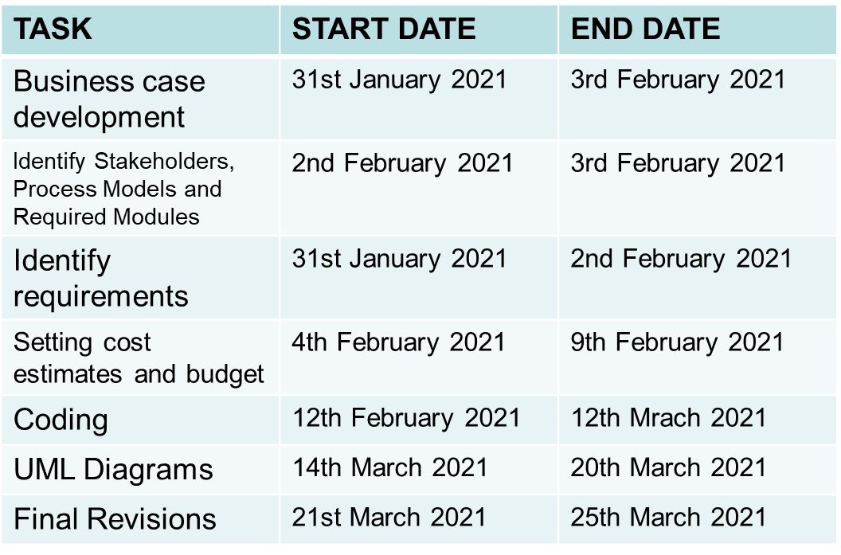
MODULES :
Login
Update
Display
Check
SCHEDULING :

Slide 5
Software and Hardware requirements for the system:
QR code Scanner.
Web Application.
PHP.
Any Operating System.
MySQL Databases.
JAVASCRIPT , HTML, Graphics Supported Browser.
System must be Connected to the Server.
Atleast 1GB RAM is required.
Identify Job Roles and Responsibilities :
Members | Roles and Responsibilities
VIGNESH P | Team Leader -Technical Lead -Web Developer
NIKITH S | Team Member -Web Developer
ROHITH S | Team Member -Tester

Slide 6
JOB ROLES AND RESPONSIBILITIES :
PROJECT SPONSOR:
Project sponsor is the one who provides the financial support for the whole project development and execution. They also monitor the process and clarifies scope questions. They also provide expert judgement and dictate milestones, key events, or the project end date.
SUBJECT MATTER EXPERTS (SME):
SME is a person who has a special skills or knowledge on particular job or topic. They have a deep understanding of particular process, function or machine and hence they help to solve the technical challenges faced by the project.
PRODUCT OWNER:
A Product Owner in the Scrum Framework is the single person who is responsible for the success of a Product and for maximizing the value of that Product. In the Scrum Framework, a few of the Product Owners' responsibilities are described, such as Product Backlog management, maximizing value and stakeholder management.
PROJECT MANAGER (PM):
A project manager is a professional in the field of project management. Project managers have the responsibility of the planning, procurement and execution of a project, in any undertaking that has a defined scope, defined start and a defined finish; regardless of industry.

Slide 7
TECHNICAL LEAD:
This person is responsible for overall planning, execution and success of overall complex software solutions to meet customers needs. They have to implement best practice and coding standards to the project. They have to manage the technical scope of the project during and after the delivery.
SOFTWARE DEVELOPERS:
Individual who builds and creates an application is called software developers. They write and debug and then execute the source code of the software application. They are also called as programmers since they are the ones that create the programs or the source code.
SOFTWARE TESTERS:
Their main role is to check if the actual result match the expected result and to ensure the software system is defect free. Software testing helps to identify the errors or the missing requirements due to which it becomes a vital role. It can be either manually or by using automated tools.
USER ACCEPTANCE TESTERS:
This testing is performed by end user or client to accept the software system before moving the software application to the moving environment. This is usually the last process involved in the project management.
WEB DEVELOPER:
A web developer is a programmer who specializes in, or is specifically engaged in, the development of World Wide Web applications using a client–server model. The applications typically use HTML, CSS and JavaScript in the client, PHP in the server, and http for communications between client and server. A web content management system is often used to develop and maintain web applications.

Slide 8
THANK YOU
.

