Slide 1

ONLINE REGISTRATION OF BUS PASS
Software Engineering and Project Management – 18CSC206J
BATCH NO : 13
NIKITH KUMAR S – RA1911003020480
VIGNESH P – RA1911003020468
ROHITH S – RA1911003020474

Slide 2
5.1 PROJECT EFFORT BASED ON RESOURCES
WORK BREAKDOWN STRUCTURE:
The work breakdown structure of the project is given below:
Online Registration of Bus Pass
Analysis
Requirement
System Design
Development
Testing
Implementation
Feasibility
Functional
System Requirements
Physical system design
QA testing
Acceptance Testing
Online
Users
Non Functional
Website
Maintenance
Designable
Programming
Database
Database
Network
Cost
Materials
Hire programmer
Hire database engineer
Hire network engineer
Update system
Train maintenance

Slide 3
5.2 RISK ANALYSIS:
PASSENGER PRIVACY AND DATA:
Passenger details should be provide information about the traveler. We do not sell or share any personally identifiable information volunteered on the bus pass website to any third party(public/private). Any information provided to this portal will be protected from loss, misuse, unauthorized access or disclosure, alteration, or destruction.
BUS PASS ELIGIBLE CRITERIA:
In pursuance of the policy of Central Government, Corporation has implemented the facility of issuing free bus passes to all the Students below 14 years of age, to travel free from the residence to school.
In order to carry their school ID card and Xerox copy of Aadhar card.

Slide 4
Issuing bus passes to the Physically challenged, mentally retarded, blind, deaf & dumb, dwarf persons and etc., and above 60 aged travelers, to travel free by the buses operating in cities / towns. In case of services operating in rural areas, these physically challenged persons are allowed 40%-50 % concession in normal fares.
CRIME:
If your Pass has been stolen, report it to the Police and they will give you a Crime Reference Number. There will be no charge if you order a replacement Bus Pass when you provide your Crime Reference Number. Please be aware you will need to submit a Crime Reference Number during the application.

Slide 5
6.1 ESTIMATION OF PROJECT MATRICES Function Point Analysis:
Objective of FPA:
The basic and primary purpose of the functional point analysis is to measure and provide the software application functional size to the client, customer, and the stakeholder on their request. Further, it is used to measure the software project development along with its maintenance, consistently throughout the project irrespective of the tools and the technologies.
Types of FP Attributes
Measurements Parameters Examples
1.Number of External Inputs(EI) - Input screen and tables
2. Number of External Output (EO) - Output screens and reports
3. Number of external inquiries (EQ) - Prompts and interrupts.
4. Number of internal files (ILF) - Databases and directories
5. Number of external interfaces (EIF) - Shared databases and shared

Slide 6
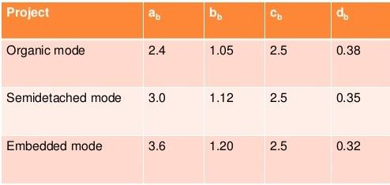
COCOMO Model:
E = ab(KLOC)bb
D = cb(E)b
P = E / D
Where E refers to the effort, D refers to the deployment time ,P refers to the productivity and ab,bb,cb,db are called as coefficients.

Slide 7
7.1 SYSTEM DESIGN:
Here we have used the basic software front end design model in order to represent the system architecture of our software model.
LOGIN
REGISTER/
RENEWAL PROCESS
VERIFICATION
LOGOUT
BUS PASS GENERATED
PAYMENT
The above is a simple form of system design diagram which uses front end design.
This shows a loop of functions that need to be executed when this project is implemented. This is a chain of operations through which this project is implemented.

Slide 8
8.1MODELING USE CASE DIAGRAM AND SCENARIOS Use Case Diagram Description
Here there are three actors
User
Admin
TTE
With QR Code:
The registration use case has the relation with both user and admin.
The ID Proof use case has the relation with User have to submit the ID Proof to admin for verification.
User have to pay the amount for the pass.
After payment, User will collect/generate the ticket from the admin.
QR Code use case is related to User, TTE and the admin.
Without QR Code:
If user has lost the QR code pass. User has to buy the ticket or pay the penalty.
In the TTE use case, TTE has submit the records of the travelers to the Admin.

Slide 9
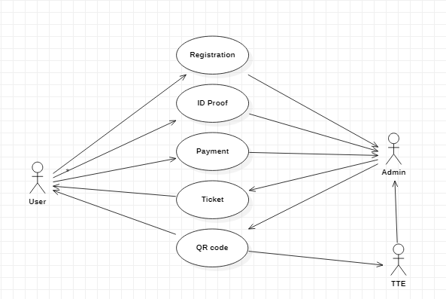
USE CASE DIAGRAM:
WITH QR CODE:

Slide 10
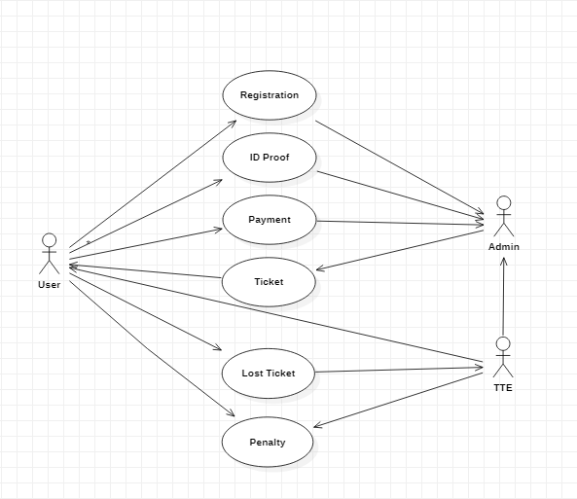
WITHOUT QR CODE:

Slide 11
9.1 ER MODELING FROM THE PROBLEM STATEMENT ER DIAGRAM DESCRIPTION:
An Entity-Relationship Model describes interrelated things of interest in a specify domain of knowledge. A basic ER Model is composed of Entity types and specifies relationship that can exist between entities.
The Details of the product are stored in the product tables
Each entity has a primary key and unique keys
The Entities set presented here are
User, Pass registration, Verification and Pass generation.
All the entities like user, type of registration, reduce duplicacy pass.
There is one to one relationship between travelers and the TTE.
The issue is araised when someone misuse the pass/ Stolen by someone.
Another Issues when the user pass has the date of expiration.
Then the request will be sent to the user for renewal of the pass.

Slide 12
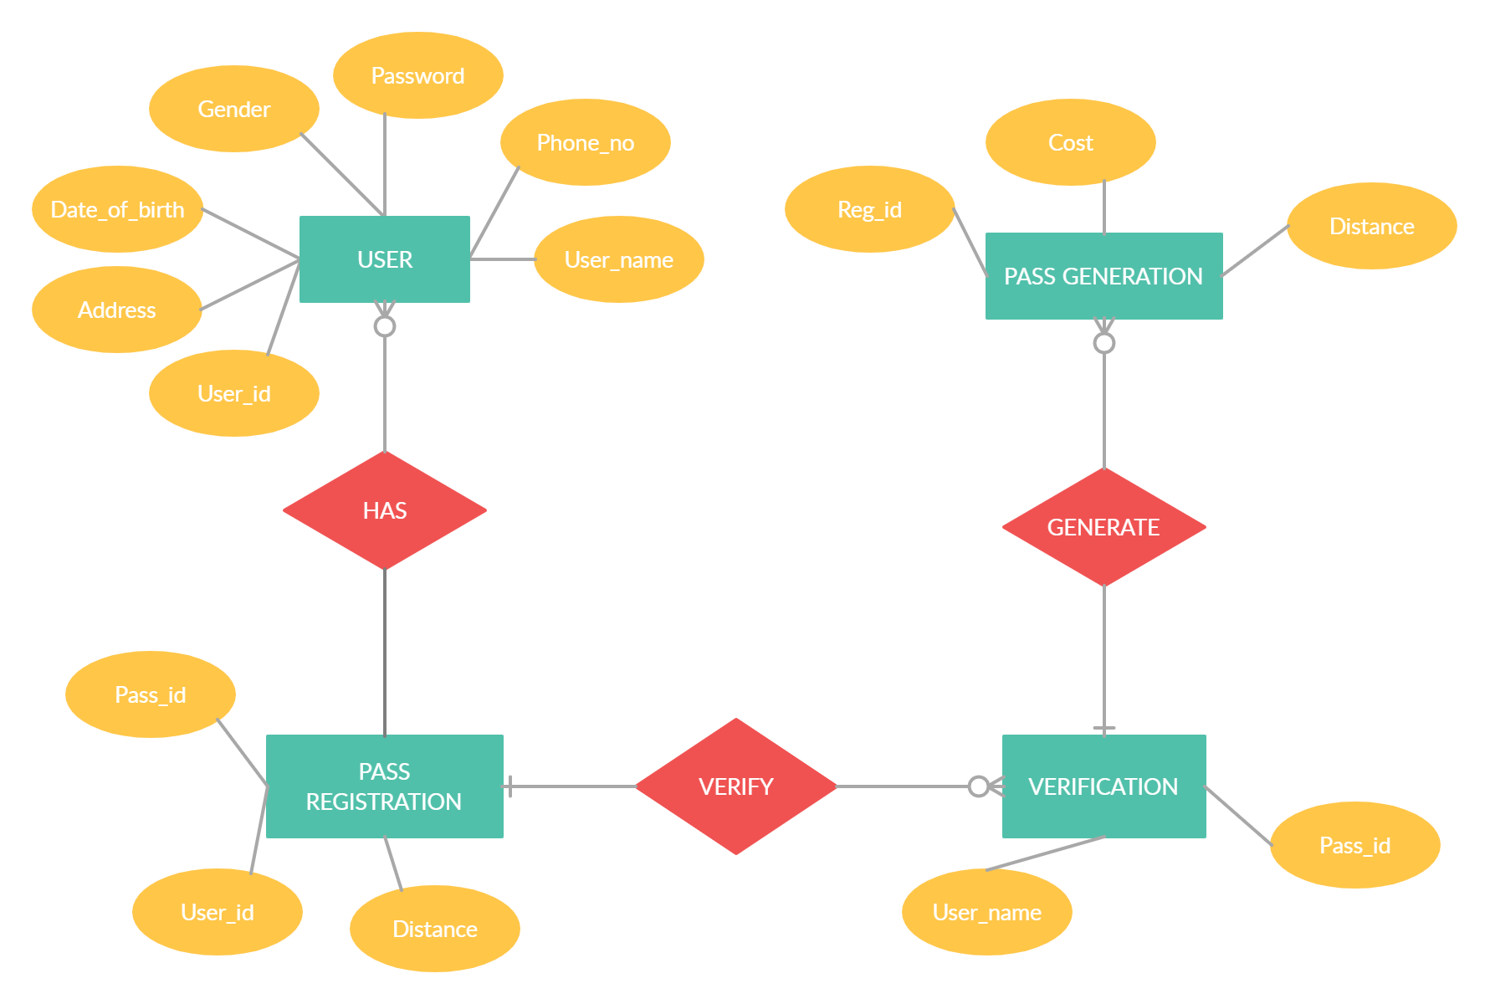
ER DIAGRAM:

Slide 13
THANK YOU

