Slide 1
MODELING USE CASE DIAGRAM AND SCENARIOS Use Case Diagram Description
Here there are three actors
User
Admin
TTE
With QR Code:
The registration use case has the relation with both user and admin.
The ID Proof use case has the relation with User have to submit the ID Proof to admin for verification.
User have to pay the amount for the pass.
After payment, User will collect/generate the ticket from the admin.
QR Code use case is related to User, TTE and the admin.
Without QR Code:
If user has lost the QR code pass. User has to buy the ticket or pay the penalty.
In the TTE use case, TTE has submit the records of the travelers to the Admin.

Slide 2
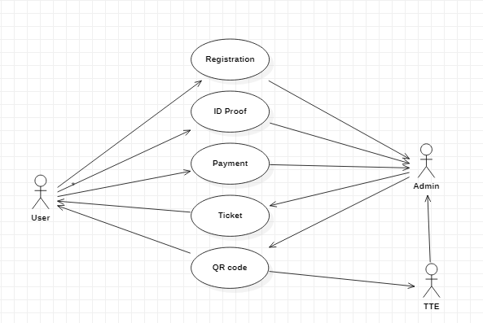
USE CASE DIAGRAM:
WITH QR CODE:

Slide 3
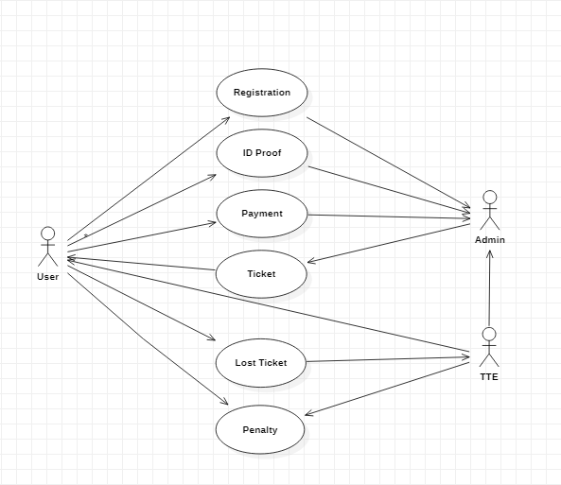
WITHOUT QR CODE:

Slide 4
ER MODELING FROM THE PROBLEM STATEMENT ER DIAGRAM DESCRIPTION:
An Entity-Relationship Model describes interrelated things of interest in a specify domain of knowledge. A basic ER Model is composed of Entity types and specifies relationship that can exist between entities.
The Details of the product are stored in the product tables
Each entity has a primary key and unique keys
The Entities set presented here are
User, Pass registration, Verification and Pass generation.
All the entities like user, type of registration, reduce duplicacy pass.
There is one to one relationship between travelers and the TTE.
The issue is araised when someone misuse the pass/ Stolen by someone.
Another Issues when the user pass has the date of expiration.
Then the request will be sent to the user for renewal of the pass.

Slide 5
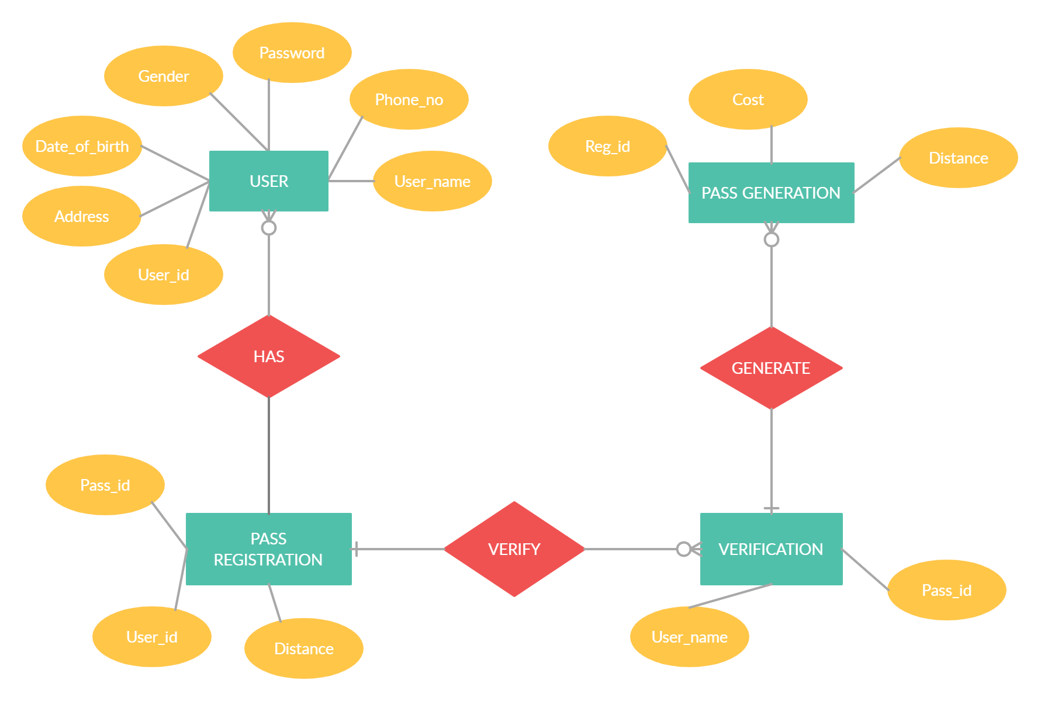
ER DIAGRAM:

