Slide 1

Ramireddy Subbarami Reddy
Engineering College
Department of ECE
Intelligent Speed Breaker System Design for Vehicles
using Internet of Things
By
Akula. Nikith Kumar(203R1A0449)
Under the guidance of
Mrs.N.Bhargavi
Assistant professor

Slide 2
CONTENTS
Abstract
Introduction
Existing Block Diagram
Existing Method Drawbacks
Proposed Block Diagram
Results
Conclusion
References

Slide 3
Abstract
Bad visibility conditions which occur due to fog in winters or night time driving are the major causes of road accidents in India. The principal cause for such accidents is the unintentional ignorance of speed breakers which may be due to the driver not being able to detect them or may be due to over speeding of vehicles.
This project brings an idea of an intelligent speed breaker system that helps in detecting speed breakers well in time so that such accidents can be avoided.
This system makes use of a RF module that warns the person who is driving about the existence of a speed breaker in proximity, with this it assists in automatically reducing the vehicle’s speed if no action is taken by the driver in time. Through Internet of Things (IoT), GPS Location (latitude & longitude) of speed breaker can be sent to cloud using GPS and stored on cloud to use it for future to avoid mishaps.

Slide 4
Introduction
India has the world's second largest road network as a developing country. Almost 97,991 km was provided by highways over a total length of 5 million km of road network. Because of its sheer magnitude, the Indian government already faces a great challenge to provide a world class path.
A person on average spends from 30 minutes to 2 hours a day driving anywhere. That's about 360 hours in one year. Imagine what type of stress the individual places on his body and unnecessary burden. Given all this, roads are India's biggest mode of transport.
Nearly 90% of transport by passenger and industry is done through roads. The fast-growing population raises traffic, and good traffic management is very necessary for safety and also decreases travel time.
The solution that is now available every day and that is widely used is a nice, but not the best solution. In short, all vehicles are collectively liable and the path dangerous or accessible.

Slide 5
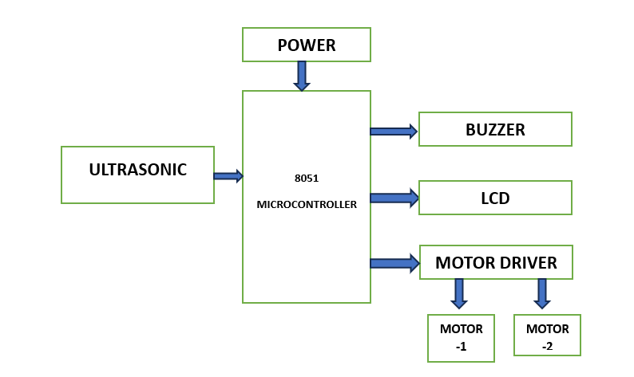
Existing Block Diagram

Slide 6
Existing Method Drawbacks
Robot Controlling using Ultrasonic sensor.
Very less distance to slow vehicle before to reach speed breaker.
No data storage.
No location sharing features.
It is very slow process because of more number of lines in coding.
For programming a microcontroller need a very strong foundation on Embedded C & C languages.

Slide 7
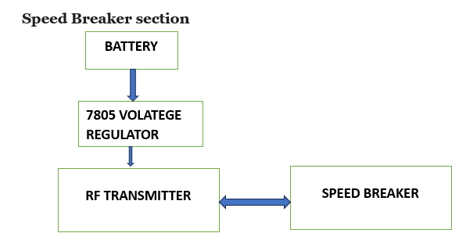
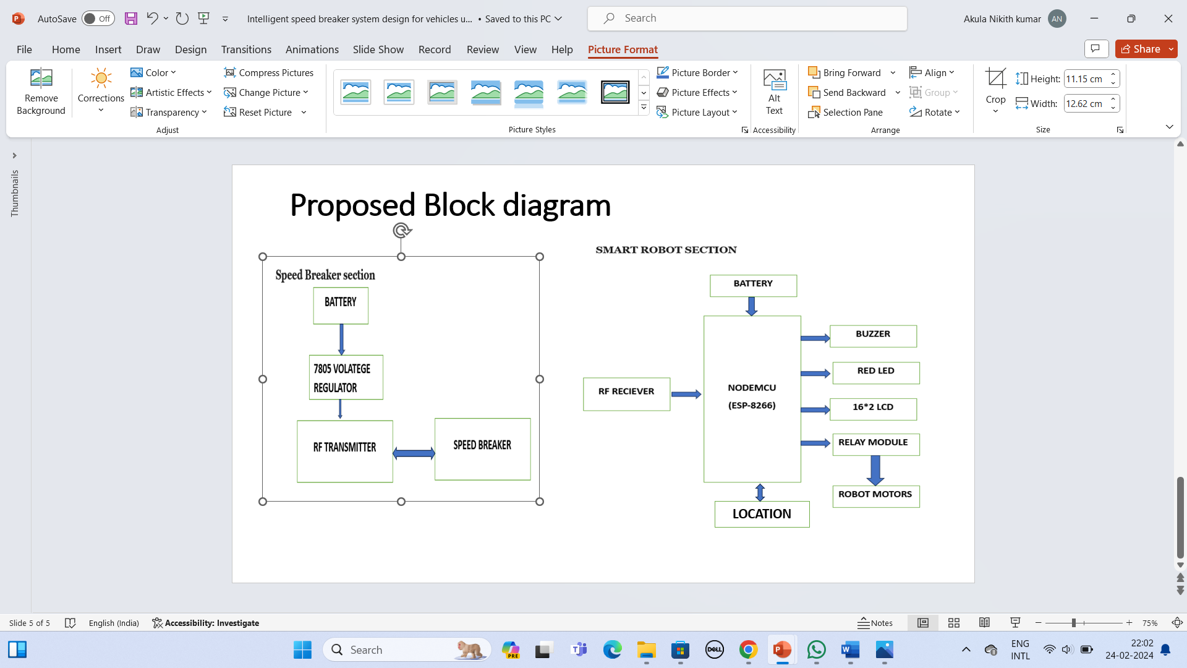
Proposed Block diagram

Slide 8
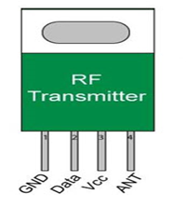
RF Transmitter
The radiofrequency (RF) transmitter is the generator of the radiofrequency current which is delivered to the transmitting coil.
This creates a signal which is used to excite protons in the imaging field. Radiofrequency coils can be both transmitters and receivers of the radiofrequency signal or receivers alone.
RF transmitter synchronized with RF receiver at 433MHz frequency.

Slide 9
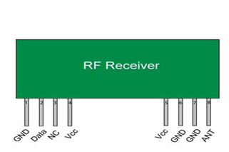
RF Receiver
RF receivers are electronic devices that separate radio signals from one another and convert specific signals into audio, video, or data formats.
RF receivers use an antenna to receive transmitted radio signals and a tuner to separate a specific signal from all of the other signals that the antenna receives.

Slide 10
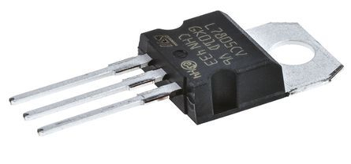
7805 Voltage Regulator
A 7805 voltage regulator is an integrated circuit designed to maintain a constant output voltage despite changes in input voltage and load.
Specifically, the 7805 is a positive voltage regulator that ensures a stable +5V output, making it a popular choice for powering various electronic components and circuits.

Slide 11
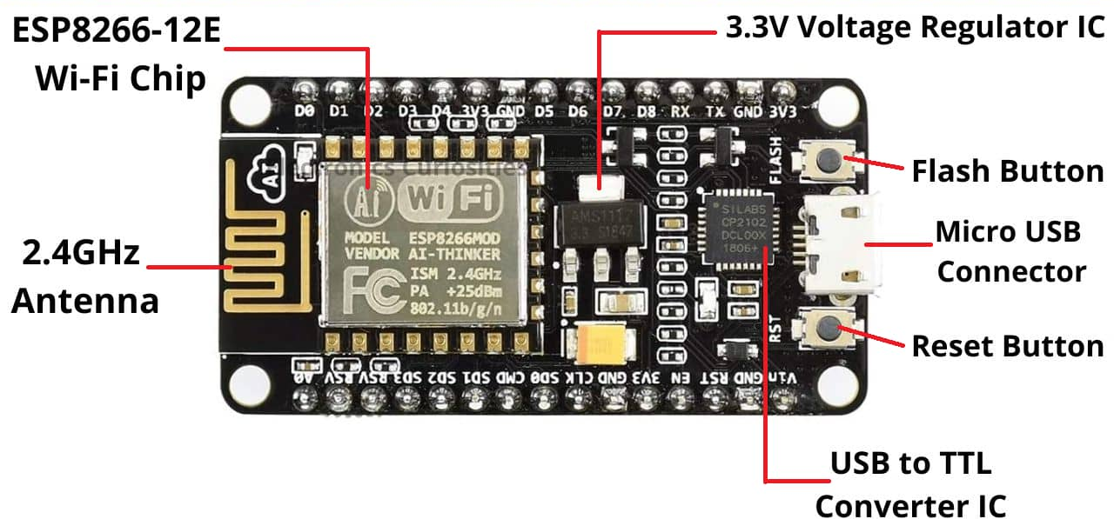
NodeMCU(ESP-8266)
ESP8266 is a Wi-Fi SOC (system on a chip) produced by Espressif Systems .
It is an highly integrated chip designed to provide full internet connectivity in a small package
It can be used with ESP-AT firmware to provide Wi-Fi connectivity to external host MCUs, or it can be used as a self-sufficient MCU by running an RTOS-based SDK.

Slide 12
Specifications and Features
Microcontroller: Tensilica 32-bit RISC CPU Xtensa LX106
Operating Voltage: 3.3V
Input Voltage: 7-12V
Digital I/O Pins (DIO): 16
Analog Input Pins (ADC): 1
UARTs: 1
SPIs: 1
I2Cs: 1
Flash Memory: 4 MB
SRAM: 64 KB
Clock Speed: 80 MHz
USB-TTL based on CP2102 is included onboard, Enabling Plug n Play
PCB Antenna
PinMode (D3,INPUT);
PinMode (D5,OUTPUT); //RELAY MODULE
PinMode (D6,OUTPUT); //BUZZER
PinMode (D7,OUTPUT); //BLUE LED

Slide 13
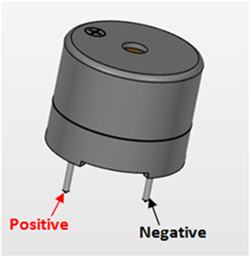
Buzzer
An audio signaling device like a beeper or buzzer may be electromechanical or piezoelectric or mechanical type.
The main function of this is to convert the signal from audio to sound.
Generally, it is powered through DC voltage and used in timers, alarm devices, printers, alarms, computers, etc.

Slide 14
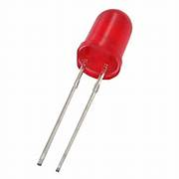
LED
LED stands for light emitting diode.
LED lighting products produce light up to 90% more efficiently than incandescent light bulbs.
It works as an electrical current passes through a microchip, which illuminates the tiny light sources we call LEDs and the result is visible light.

Slide 15
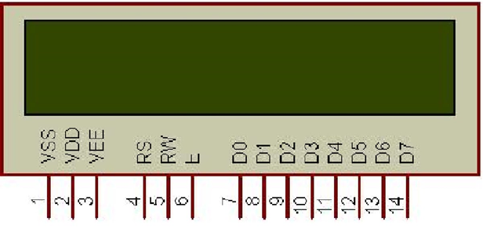
LCD
LCD 16x2 is a type of liquid crystal display (LCD) that can display up to 16 characters per line and 2 lines.
These displays are widely used in a variety of applications, such as displaying text or data in electronic projects.

Slide 16
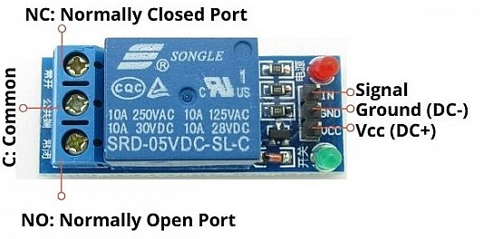
Relay Module
The primary function of a relay module is to switch electrical devices or systems on and off.
It also serves to isolate control circuits, ensuring that low-power devices, such as microcontrollers, can safely control higher voltages and currents.

Slide 17
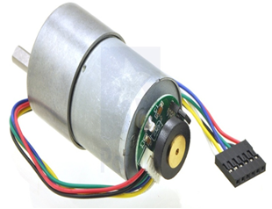
Geared DC Motors
One of the most common components in robotics is the geared DC motor.
Therefore, having a high-quality DC Motor is essential.
The torque and speed changeable of the DC gear motor, in addition to the use of batteries to aid movement, are what makes it so well suited for robotic applications.

Slide 18
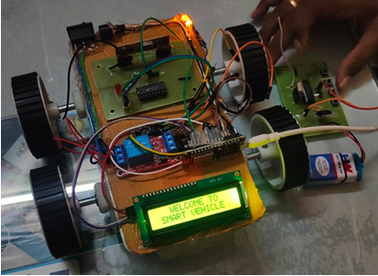
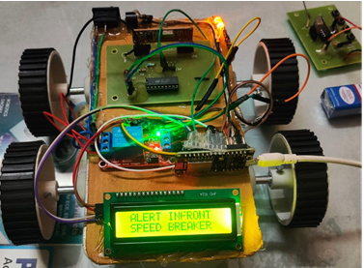
Results
Proposed system model
Detection of speed breaker using for proposed system

Slide 19
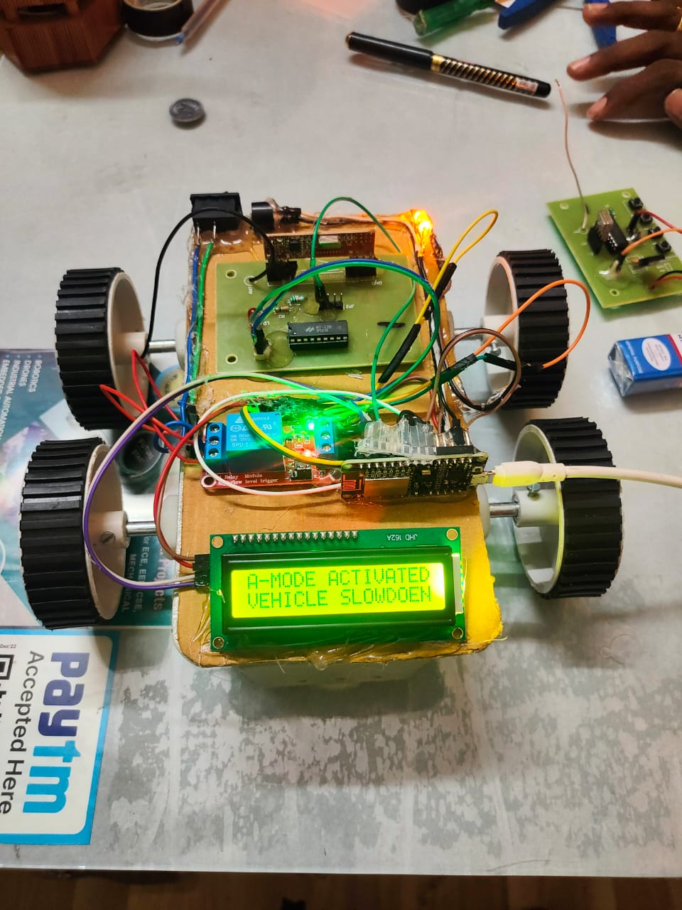
A-Mode activated vehicle slowdown

Slide 20
Conclusion
The speed breaker allows the emergency vehicle to lower the pace, but this new flat speed breaker device plays the main role in safeguarding human lives by flattening the speed breaker. Transportation is easier and more convenient for emergency vehicle. This device will be introduced in future in most emergency situations, where emergency vehicles need to reach quickly with the help of solar energy.

Slide 21
References
[1]Ajay s,Govind G.Dharmendhar S.parthasarathy J, “Automatic Speed Breaker on Time Demand Using Embedded Systems” , International Journal of Engineering and technology, Vol no 8, 2019 April.
[2]Rajeshwari Madli,Santhosh Heber,Praveenraj Pattar,G.V.Prasad,”Automatic Detection and Notification of Potholes and Humps on Roads to Aid Drivers” ,IEEE Sensors Journal , 2016.
[3]Vamsee Krishna Kiran M,Vimalkumar k,Vinodhini RE,Archanaa R,” An Early Detection Warning systems to Identify Speed Breakers and Bumpy Rods using Sensor in Smartphones”, International Journal of Electrical and Computer Engineering, Vol 7 No.3,2017 June.
[4]M.Suresh R.Jones Rexiya T,K.G.Santhosh R.Vignesh,”A Break Free Path or Ambulance using Speed Breaker”, International Journal for scientific Research and Development, Vol 5,2017 June.

Slide 22
[5]Asma Farheen,Dr.Raafiya,”Automated speed breaker to Control Speed of Vehicle based on IOT”, International Journal of Technical Innovation in Modern Engineering and science”, Vol 5 issue 06,2019 June.
[6]T Mahbuba Afrin, Md Redowan Mahmud, “Real time detection of speed breakers and warning system for onroad drivers”, 2015 IEEE International WIE Conference on Electrical and Computer Engineering (WIECON-ECE)
[7]zer-Ming Jeng, Sheg Chung Tzeng, Bo-Jun Yang and YiChun Li, “Design Manufacture and Performance Test of the Speed Breaker System” 2017 IEEE.
[8]Anchal Dewangan and Dr. N. K. Saikhedkar, “Experimental analysis of Different Types of Speed Breakers” 2018 IEEE.
[9]AravindKaruppaiah, Gansh.S, Dileepan.T, Jayabharathi.S, “Fabrication and Analysis of Automatic speed breakers” 2019 IEEE.
[10] P. Mohamed Shameer and D. Christopher, “high Efficiency See Back Device for Power System Design and Efficiency Calculation: A Review of Potential Application” 2019 IEEE.

Slide 23


