Slide 1
HeritageNest
Regional Folk Art Digital Archive | Hackathon Presentation
A community-driven platform preserving India's intangible cultural heritage.
Supports image, video, shorts, and audio artifacts with moderation and AI explanations.
Built for creators, learners, and cultural communities.
Team: Nikhil Kumar, Lachydeep, Sweta Sharma, Sneha Sharma, Aastha
Team Contact: Overall Manager nikk4645@gmail.com | Tech Support swetashr08@gmail.com

Slide 2
Problem Statement
Why this project matters
Traditional knowledge is scattered and often undocumented in digital form.
Audio/video folk practices are hard to discover and preserve in one place.
Youth engagement needs modern, searchable, social-first formats.
Hackathon 2026 | HeritageNest

Slide 3
Solution Overview
What HeritageNest delivers
Unified archive: Artcards + Shorts + Audio heritage library.
Category filtering across Folk Art, Dance, Music, Craft, Textile, and more.
Admin moderation workflow with pending/approved/rejected pipeline.
Role-aware access: public audience, contributors, and admins.
Hackathon 2026 | HeritageNest

Slide 4
System Architecture
Modern full-stack build
Frontend: Next.js App Router + React + CSS Modules
Auth + Database: Firebase Auth + Firestore
Media Storage: Supabase Storage (public bucket)
AI Layer: FastAPI endpoint + Groq Llama fallback
Deploy: Vercel (web) with managed environment variables
Hackathon 2026 | HeritageNest

Slide 5
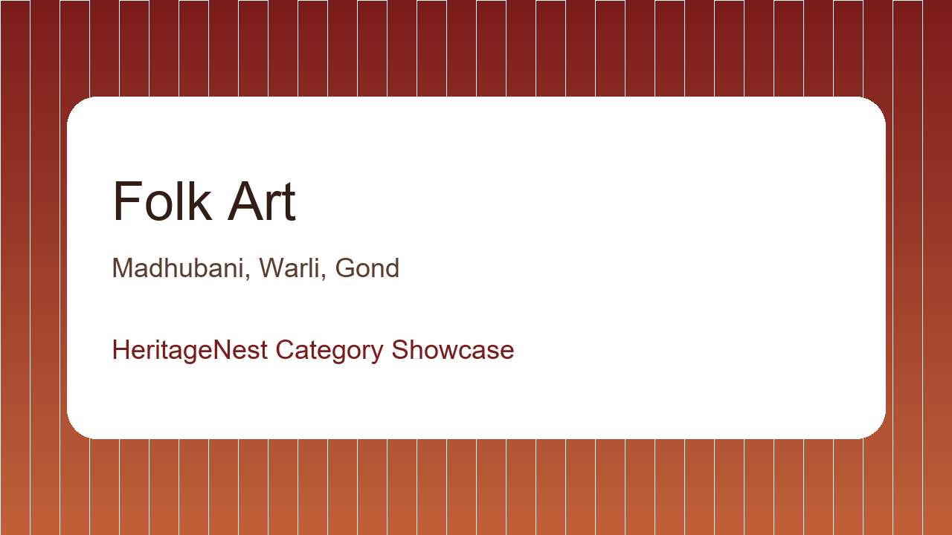
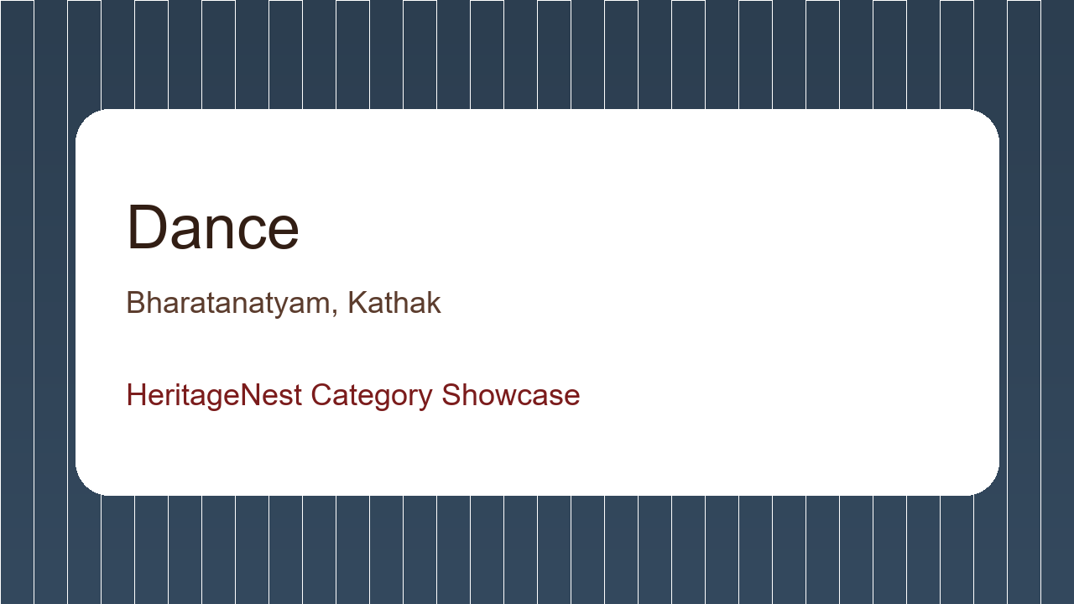
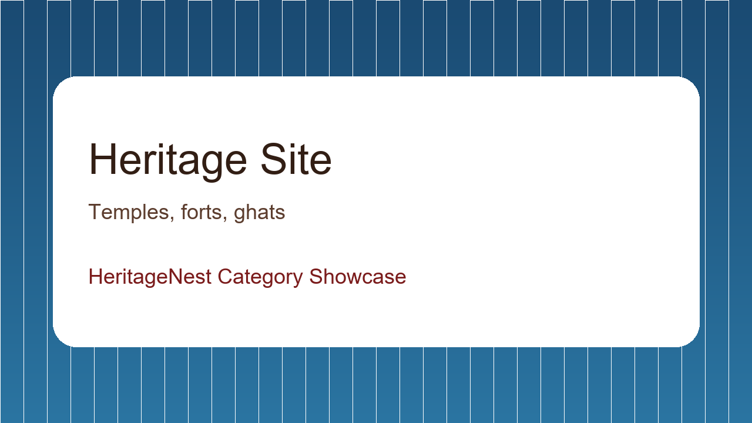
Category Artcard Showcase I
Different category visual cards
Hackathon 2026 | HeritageNest

Slide 6
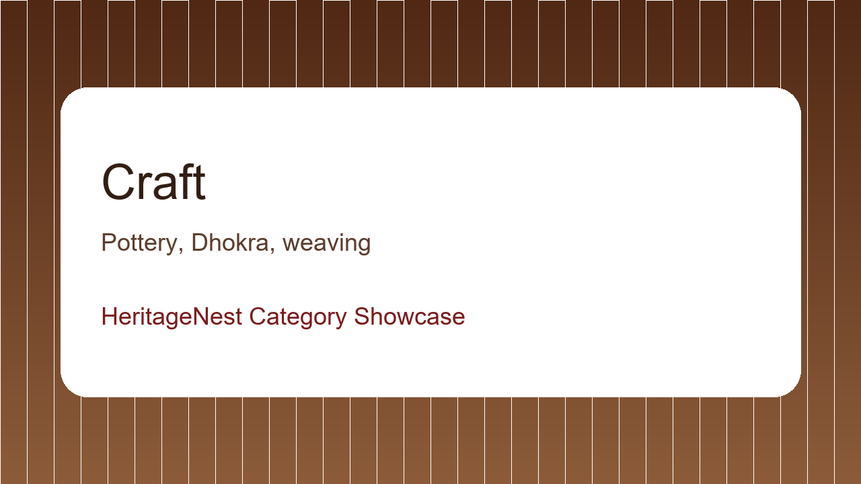
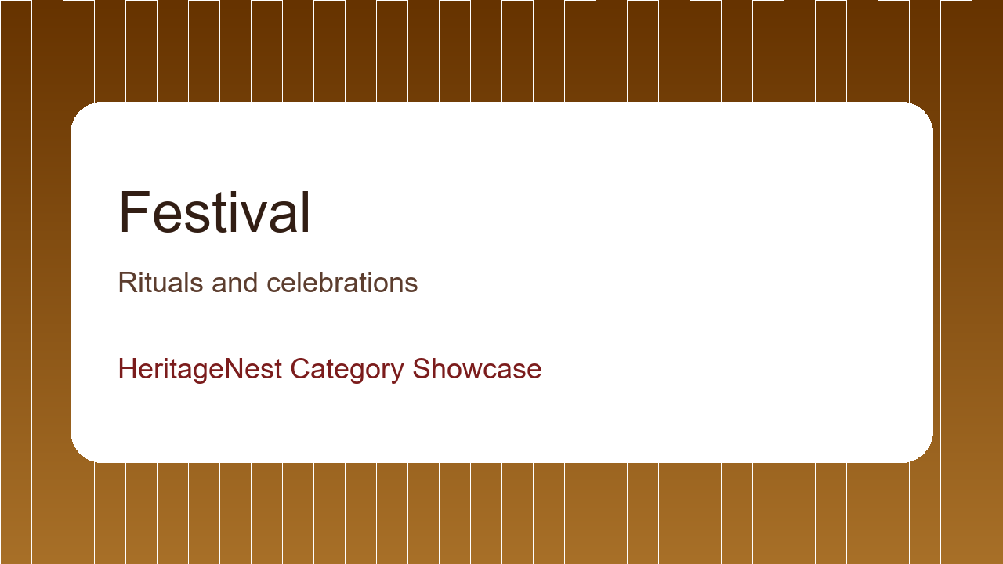
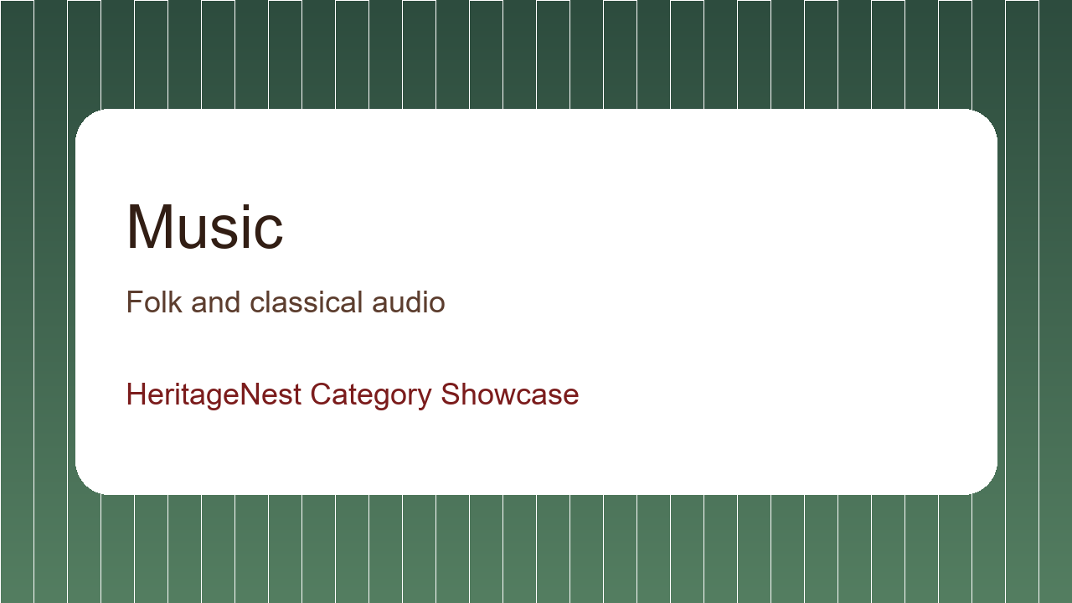
Category Artcard Showcase II
Different category visual cards
Hackathon 2026 | HeritageNest

Slide 7
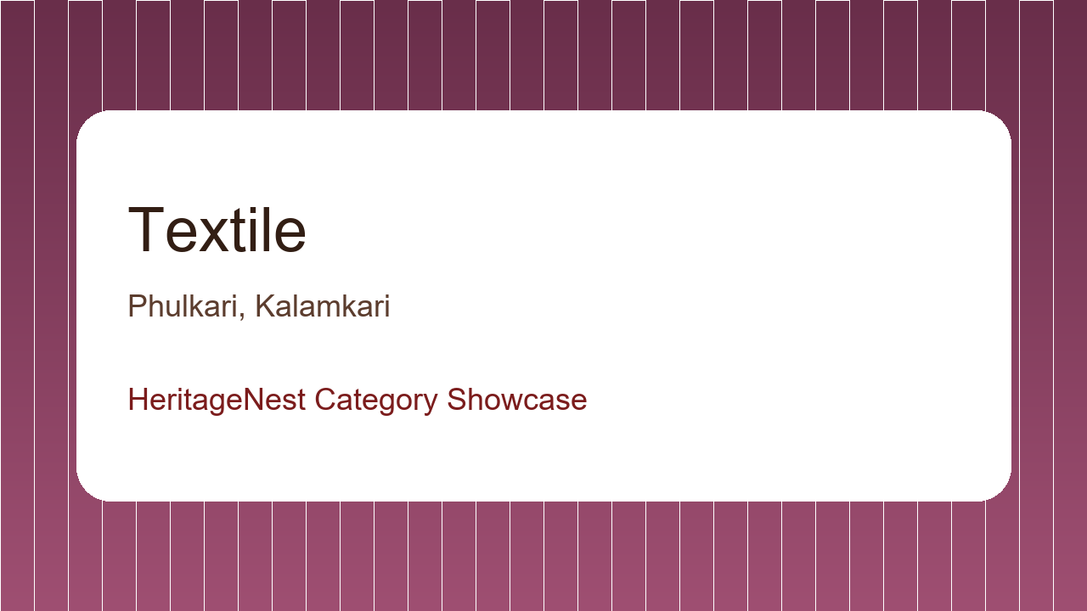
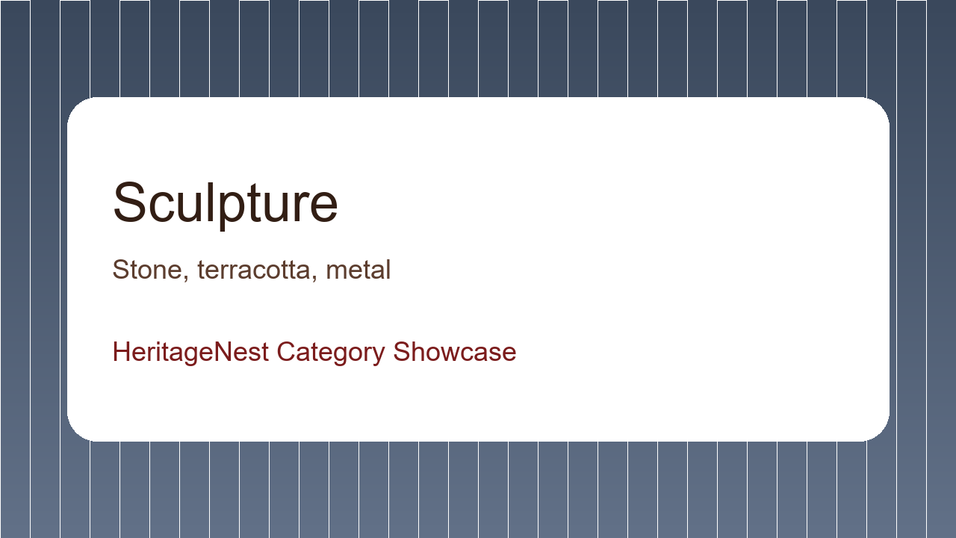
Category Artcard Showcase III
Textile and Sculpture categories
Hackathon 2026 | HeritageNest

Slide 8
Feature Walkthrough
User journeys in one platform
Creator upload modes: Artcard, Short Video, and Audio with metadata.
Discovery: Search, filters, category pages, and dedicated Audio section.
Engagement: Save/bookmark, share, and AI learning companion.
Admin tools: moderation queue, item management, and insights dashboard.
Hackathon 2026 | HeritageNest

Slide 9
AI Model Combination
Hybrid intelligence approach
Primary model path: FastAPI cultural assistant service.
Fallback model path: Groq Llama-3.1-8b-instant for resilience.
Rule model layer: scope guardrails for topic compliance and safe refusal.
Context model layer: item metadata grounding to reduce hallucinations.
Result: Reliable, domain-focused explanations for users.
Hackathon 2026 | HeritageNest

Slide 10
Hackathon Impact & Next Steps
Roadmap after MVP
Impact: stronger digital preservation and easier cultural discovery.
Next: multilingual assistant + regional script support.
Next: richer audio player analytics and creator performance insights.
Next: community verification and partner museum integrations.
Hackathon 2026 | HeritageNest

Slide 11
Thank You
Demo + Q&A
Live App: https://heritage-nest-rtm6.vercel.app
Team: Nikhil Kumar, Lachydeep, Sweta Sharma, Sneha Sharma, Aastha
Overall Manager: nikk4645@gmail.com
Tech Support: swetashr08@gmail.com
HeritageNest | Preserving culture through technology

