Slide 1
NYC HEALTH PROVIDER NETWORK
GROUP NAME - POWER VISUALIZATION SOLUTIONS

Slide 2




AGENDA
Exploratory Data Analysis
Project Sponsor- Dr.
Martinez Gomez
3-minute story
The Big Idea
Story Board
Conclusion

Slide 3




MEET THE TEAM
NIKKAT AFRIN
VEDANT PATEL
AKSHITA PHOGAT
ANOOSH KUMAR

Slide 4

INTRODUCTION
The data set we chose is the NYC Health provider network. The individual Provider Network Data displays information on individuals participating in health plan networks. Plan network data
is collected from Medicaid, Commercial, and Exchange plans quarterly by the Department of Health, including managed care plans, as well as PPO/EPO plans.

Slide 5
EXPLORATORY DATA ANALYSIS
We have cleaned the data set and separated all Numerical and Categorical Columns to do both Univariate Analysis and Multivariate Analysis, to extract some useful information from the dataset to understand it well .

Slide 6




PROJECT SPONSOR - DR. MARTINEZ GOMEZ
The CEO of Vital Care Insurance
She is actively researching cities known for their specialized health insurance offerings.
she aims to invest 1.1 million to improve and personalize insurance plans to ensure fairness in enrollment and accommodate preferences for every individual.

Slide 7
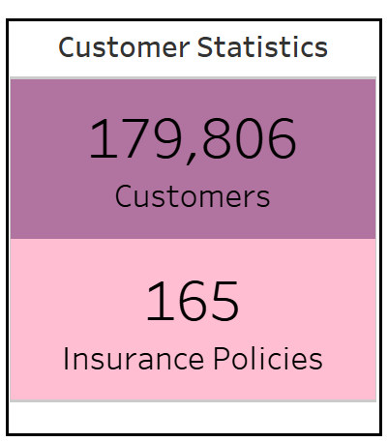
Customer’s and Plan’s Summary Statistics
This view represent the Customer statistics has revealed that total 179,806 customers has procured the insurance policies over the pool of 165 distinct Insurance policies.

Slide 8
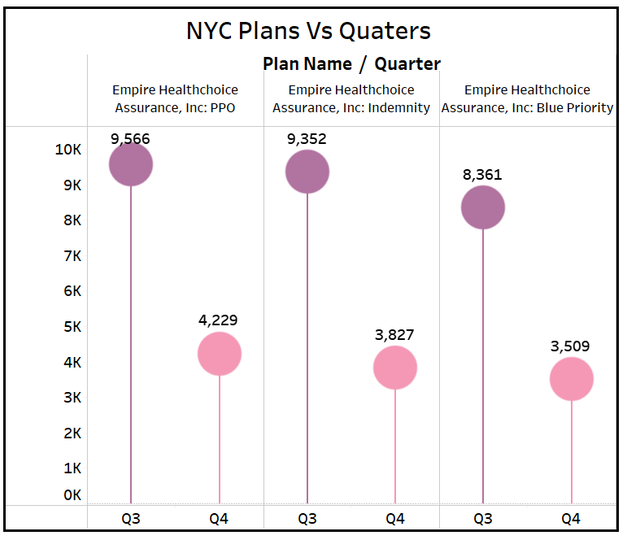
PLAN NAMES VS QUARTERS
The top 3 insurance plans. All affiliated by single brand Empire Healthchoice Assurance.
Empire Health Choice Assurance PPO dominated in Quarter 3 but saw a sharp decline in Q4.
Empire Health Choice Assurance's Indemnity plan faced low uptake.
Quarter 3 shows a more insurance plans purchased by customers.

Slide 9
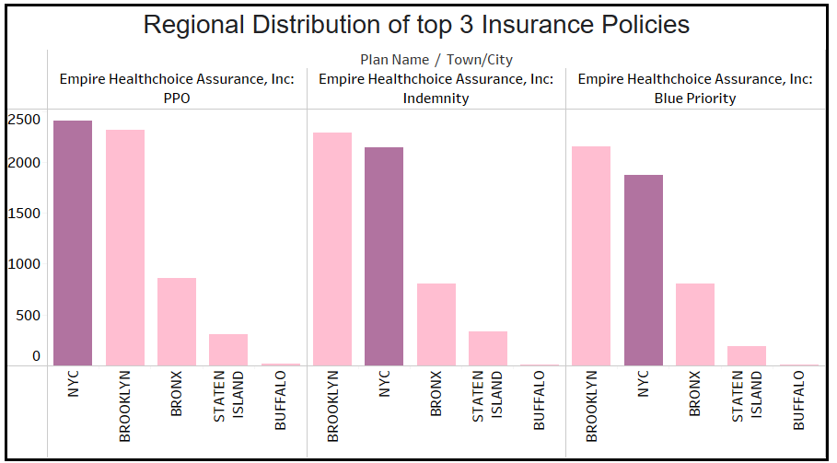
REGIONAL DISTRIBUTION OF INSURANCE POLICIES
New York City was identified as the primary hub for policy sales, and Buffalo shows the least sales.
The top five regions for policy distribution are New York, Brooklyn, the Bronx, States Island and Buffalo.
New York City is highlighted as Sponsor needs to focus on metropolitan area.

Slide 10
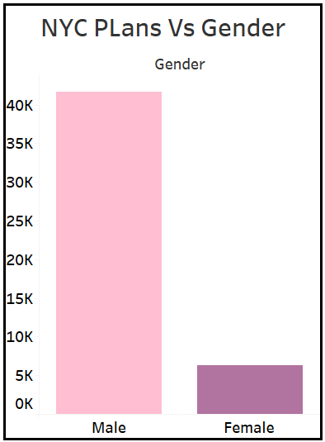
ALL PLANS VS GENDERS
More males than females are enrolled in the plans, indicating an imbalance
The sponsor aims to boost female enrolment by improving coverage benefits tailored for them. This strategy seeks to address the gender imbalance in plan enrolment.

Slide 11
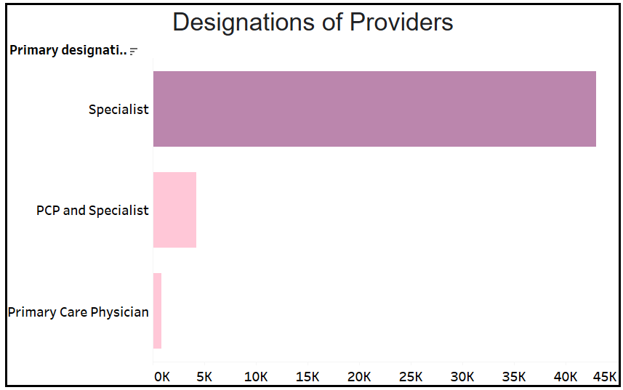
PRIMARY DESIGNATIONS OF PROVIDERS AND CORRESPONDING PLAN NAMES
Specialists comprise the majority of healthcare providers, potentially shaping patient access to specialized medical services.
Investing in specialist providers ensures patients get the best care in their chosen field, meeting their needs effectively.

Slide 12
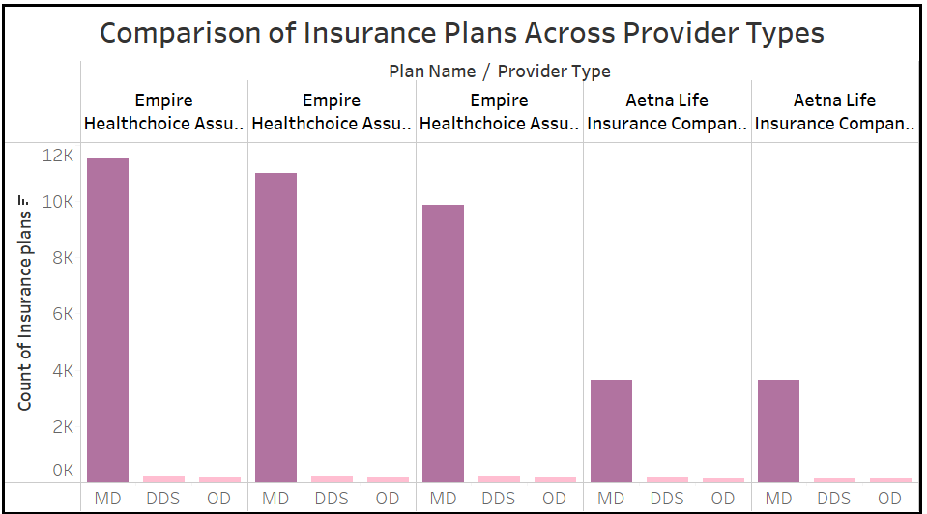
COMPARISON OF INSURANCE PLANS ACROSS PROVIDER TYPES
Empire Healthchoice Assurance has more Medial Doctors(MD) across various specialties than Aetna Life, suggesting broader coverage options.
Sponsors should focus on hiring more medical doctors (MD) for Empire Healthchoice Assurance to improve benefits and services for customers due to higher demand.

Slide 13

3-MINUTE STORY
Over the past few years, Healthcare Insurance Policies have gone through a drastic hike and a couple hundred policies were introduced in the market, with Vital Health Insurance struggling to ensure fairness in enrollment and accommodate preferences for specialized care. Fluctuations in plan purchases also hinder consistent coverage levels. Analyzing demographic trends and factors influencing healthcare preferences is crucial for understanding these challenges. By leveraging available data, Vital Health Care aims to develop targeted strategies to enhance insurance accessibility and optimize plan offerings, effectively meeting the diverse needs of its customer base.
Through careful analysis, we can uncover patterns in provider participation, the distribution of healthcare resources across New York City, and the prevalence of different types of insurance plans among various demographics. Interestingly, our analysis reveals that while approximately 80% of males opt for insurance policies, females show less interest in obtaining coverage. Furthermore, it appears that there is a preference for purchasing plans in Quarter 3 compared to Quarter 4, indicating potential seasonal trends in insurance uptake. Additionally, it's notable that over 30,000 individuals prefer specialist care over primary care providers for their health plans.
In conclusion, the selection of individual Provider Network Data proves crucial for Vital Care Health Insurance's mission to enhance healthcare access and coverage effectiveness. Focusing on the Designation of providers and their types may provide a competitive advantage over other insurance companies. Moreover, attracting female customers is imperative for achieving broader market penetration and success. By addressing these factors, Vital Care can strengthen its position in the insurance market and effectively contribute to improving healthcare access and outcomes for its customers.

Slide 14

THE BIG IDEA
Vital Care Health Insurance uses detailed information to improve healthcare plans for people in various parts of New York, ensuring they meet everyone's different healthcare needs effectively.

Slide 15
STORY BOARD
Introduction
Prioritizes understanding
healthcare needs
Active research on cities with health insurance plans
Plans for all age groups
Finding
NPIs location details
Plans for all age groups with gender identifications
Differentiate plans according to the Gender.
Different levels of coverage like silver gold bronze diamond platinum
Most highly taken plans according to the cities.
Conclusion
Addressing the top 10 healthcare insurance plans according to the cities.
Utilizing source data to enhance the plans across NY cities based on coverage level

Slide 16

SUMMARY
Our team is working together on the quest of Dr. Martiez to improve the Healthcare system by using the data and applying analytical skills. Our aim is to provide insight to Vital Care Health Insurance to addressing diverse healthcare needs effectively.

Slide 17


THANK YOU
POWER VISUALIZATION
SOLUTIONS

