Slide 1

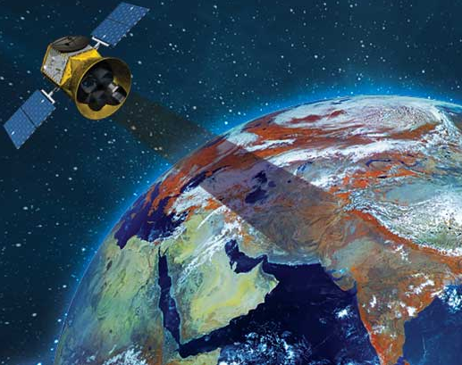
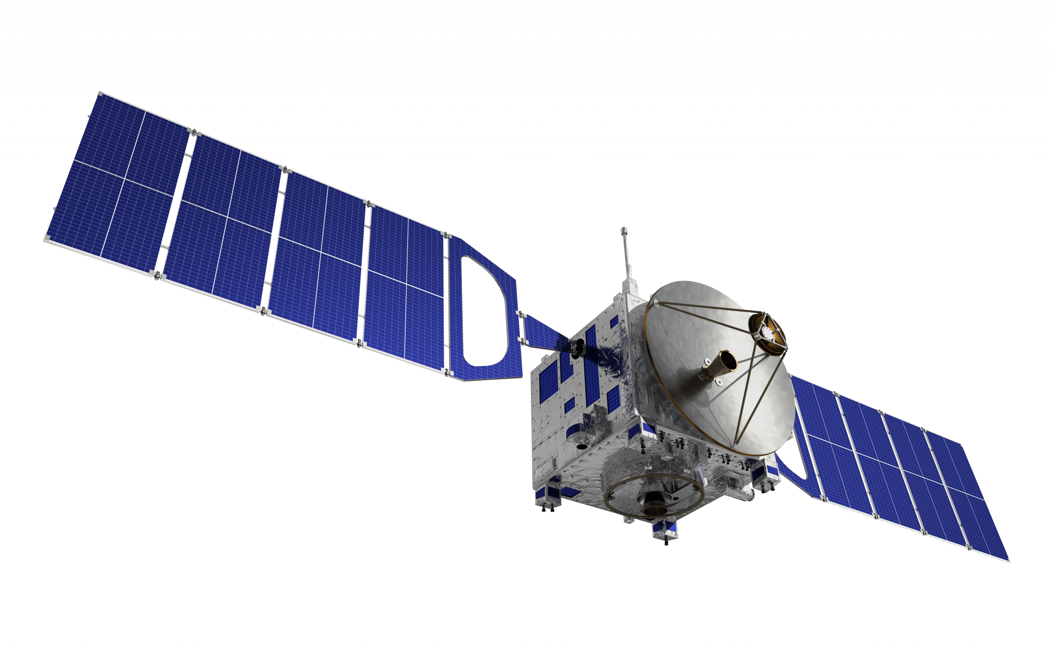

New Horizons for NewSpace
LEVERAGING DOWNSTREAM SPACE TO REVOLUTIONIZE PUBLIC SERVICE DELIVERY
Global Downstream Space Centre of Excellence| December 2024

Slide 2
The New Space Opportunity
Market Evolution
Key Drivers
Transformation
Value Creation
From $630B in 2023 , space economy to reach $1.8T by 2035, with a CAGR of 11.52% CAGR
73% driven by downstream space services (Add value)
Rising private investment: $12.5B invested in 2023, complemented by government budgets
Significant reduction in costs, and the size, weight and power (SWaP) capabilities of satellites and their subsystems
Hyper scaling and AI/ML integration for enhanced data analytics
Advancements in electronics, materials and propulsion systems
Shift from government-led to public-private cooperation
Satellites with fine resolution imaging, high bandwidth and low throughput enabling persistent and reliable global coverage
On-demand, subscription-based business models
Newer countries launching national space programs
Enhanced decision-making capabilities
Improved public service delivery
Data-driven governance solutions
Potential $47B yearly value-add to GPS by 2030, and $703B across all industries

Slide 3
New Horizons for NewSpace | CURRENT STATE OF SATELLITE SERVICES FOR GPS
Downstream satellite services are more convenient to use than ever before…
But governments across the world have different, often sub-optimal levels of adoption,
Therefore, there is a need of uptake of this unprecedented opportunity.
The international challenges previously limited to the world’s only space-capable superpowers will now extend to multiple state and non-state entities with competing interests. While these challenges are daunting, the profound and exciting changes over the past few years in making business in space the “new normal” may have proved at least one thing so far—the sky is no longer the limit.
The satellite industry is undergoing a transformation, making services more accessible and affordable. The private sector's involvement has driven innovation and reduced costs, benefiting users globally. While some governments like USA, Canada are much farther ahead than others in the adoption of these services, there is still sub-optimal usage in various sectors. But despite the varied geographies, all nations are moving towards achieving similar capabilities and services for their citizenry.
Hence, the vision for a more equipped government in each geography will be fulfilled in part by the increasingly useful and affordable insights from space. Diverse geographies can use the growing “Space for non-Space” services for the end goal of- achieving more equitable, effective and efficient citizen delivery models that increase citizen satisfaction and happiness.
“The establishment of Korea AeroSpace Administration (KASA )will be a milestone for South Korea becoming a powerhouse in the space economy by helping create a private-led space industry ecosystem,”
"We need to identify and prioritize resources, funding and personnel. We need requirements for the use of mobility and logistics. And we need roadmaps with prioritized lines of effort and initiatives."
“This journey necessitates steadfast policies, global collaboration, and cutting-edge technology. Recognizing space's multifaceted nature, we focus on advancing space tech, satellites, and situational awareness to enhance national security and readiness for the future”.
Yoon Young-bin,
Chief of Korea AeroSpace Administration (KASA), South Korea
Diane Howard,
Head of commercial space policy, National Space Council, USA
Lt Gen Anil Kumar Bhatt,
Director General, Indian Space Association

Slide 4
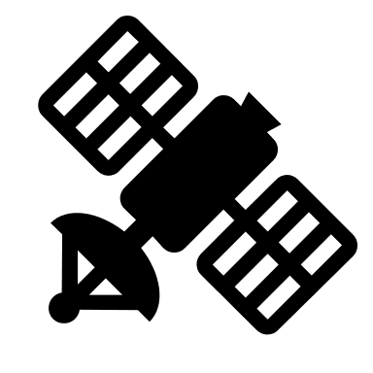








SATELLITE SERVICES ARE ALL AROUND US
Mapping, reconnaissance
Earth Observation and Imagery
PNT
Satellite Communication
Border surveillance, coastal erosion, terrain mapping
Weather, climate change
Aviation guidance
Disaster resilient Communication
Urban planning, Real Estate Evaluation, Building and bridge health, utility and pipeline monitoring, deforestation
Monitoring infrastructure construction, maintenance or collapse
Precision agriculture, insurance, crop health, land use, drought, soil health, remote area connectivity, Tele-medicine, digital education
Maritime domain awareness, flood monitoring
Navigation
Urban Areas
Areas in Transition and Semi-urban areas
Rural Areas
Borders
Water bodies

Slide 5






ORBIT: A FRAMEWORK FOR SPACE-ENABLED GOVERNANCE
O
Oversight
Enable continuous monitoring of natural and man-made assets for better governance and accountability.
R
Resilience
Strengthen disaster preparedness and recovery through early warnings, resource optimization and impact assessments.
B
Balance
Support sustainable development with precise data-driven insights.
I
Incisiveness
Empower targeted decision-making by providing actionable insights tailored to specific challenges.
T
Transformation
Drive innovation in public services by integrating space-based solutions into effective policy-making and service delivery.

Slide 6
New Horizons for NewSpace | Possibilities: Keeping OVERSIGHT
Satellite technology enables governments to leverage data-driven approaches for oversight, improving efficiency, transparency, and citizen satisfaction in public service delivery. By addressing key governance challenges, it plays a crucial role in decision-making and policy implementation.
Remote Monitoring and Land Management
Disaster Management and Response
Infrastructure Oversight and Urban Planning
Public Safety
and
Security
Governments often face challenges in monitoring land use, illegal encroachments, deforestation, and agricultural activities over vast areas.
Natural disasters like floods, earthquakes, or cyclones require rapid and effective responses, but governments often lack up-to-date situational awareness.
Tracking infrastructure development and ensuring compliance with zoning laws and environmental regulations can be resource-intensive.
Governments face difficulties in monitoring vast and remote regions, detecting unauthorized activities, and ensuring rapid responses to security threats and public safety incidents.
Challenge
Detect illegal construction, identify areas of deforestation, and monitor crop health.
Generate alerts to guide rescue teams and inform citizens.
Urban Sprawl assessments, flood extent maps, damage, and evacuation route suggestions.
Automated anomaly detection in real time and geospatial data for surveillance and critical infrastructure/ heritage protection.
Application
Example
Provide alerts to local authorities about unauthorized land encroachments
During floods, satellites can provide updated floodplain maps, helping authorities manage relief efforts and resource allocation
Generate reports highlighting non-compliance with urban planning guidelines and send alerts to regulatory bodies
Authorities can get alerts and act promptly to manage crowds and prevent damage to the public property

Slide 7
New Horizons for NewSpace | Possibilities: Enhancing RESILIENCE
Satellite technology enhances governmental resilience by delivering advanced insights for proactive risk mitigation, adaptive decision-making, and robust responses to evolving challenges, ensuring continuity and sustainability in public service delivery.
Readiness, Urban Planning and
Climate resilience
Infrastructure, Supply Chains and Economic Stability
Agriculture,
Food Security and Health
Connectivity
and Disaster Management
Urbanization, aging infrastructure and climate vulnerabilities pose challenges in planning, readiness and maintenance, leading to inefficiencies and risks
Governments face difficulties in tracking inventory levels and ensuring supply chain transparency across remote and large-scale operations.
Predicting disease outbreaks among humans or and pest infestations premeditated by environmental factors like humidity, temperature, moisture
Governments struggle to monitor remote or disaster-prone areas, prevent unauthorized activities, and ensure reliable communication networks in underserved regions.
Challenge
Amalgamating weather monitoring, topographical mapping and AI, to generate insights on vulnerable areas like heat islands, forest fires, flooding
Satellites provide imagery and data analytics to monitor stockpiles, track goods movement, and ensure supply chain efficiency.
Satellites can track environmental conditions such as water quality and temperature to guide farmers and health interventions
Satellites provide communication support to maintain connectivity during emergencies and surveillance for security threats
Application
Example
Satellites monitor water flow patterns, enabling urban planners to make provisions for drainage and prevent flooding, ensuring safer cities
Monitor container congestion at major ports, enabling rerouting of shipments to less crowded facilities
Alert the farmers about risk of drought and advise on sowing of time and type of crop OR Alerting the health department when it spots a mix of environmental factors associated with malaria
District authorities can use satellite phones during an earthquake for maintaining connectivity during a telecom outage

Slide 8
New Horizons for NewSpace | Possibilities: Maintaining BALANCE
Satellite technology supports governments in maintaining balance by offering precise data for sustainable resource management, equitable policy formulation, and harmonized development, ensuring economic growth aligns with environmental and societal well-being.
Inventory Management and Supply Chains
Precision farming
and
Agriculture
Sustainability, Climate Action & Conservation
Resource Management and Ecological Impact
Governments struggle with inconsistent data collection and manual reporting in monitoring large-scale inventory across remote ports, mines, and warehouses.
Governments face issues like data accessibility, high technology costs, and inadequate infrastructure that hinder the adoption of precision agriculture.
Creation of reliable carbon markets, enabling governments and organizations to meet climate goals more effectively
Governments struggle to balance between promoting national development and minimizing degradation of the environment.
Challenge
Tracking, high-resolution imaging, and data analytics to improve inventory management and streamline supply chain operations.
Satellites aid in crop monitoring, soil moisture management, and yield prediction, enhancing agricultural efficiency and sustainability.
Measuring atmospheric CO₂, and validating emission reductions. Track the effectiveness of carbon sinks projects - forest biomass maps
Monitor environmental changes in real time, assess the impact of projects, track and survey tree/ mangrove/ snow cover.
Application
Example
Monitor mining operations and port activities, reducing theft and improving the accuracy of inventory reporting, especially during peak export season.
Monitor crop health, detect early signs of drought, and provide targeted irrigation advice to farmers, boosting crop yields and saving water.
This data ensures transparency, enhances regulatory compliance to meet climate goals more effectively.
Monitor environmental impact of a new high-speed rail project, ensuring forest areas are preserved and carbon offsets are put in place.

Slide 9
New Horizons for NewSpace | Possibilities: Deciding with INCISIVENESS
Satellite technology empowers governments to decide with incisiveness by providing high-resolution data, advanced analytics, and actionable insights, enabling precise, informed, and impactful decision-making across complex domains.
Banking, Finance and
Insurance
Customized Monitoring for Environment
Resource Management and Mining
Border Management and Maritime Security
Governments face challenges in assessing insurance claims, monitoring agricultural risks for subsidies, and ensuring financial stability in volatile conditions.
The environmental sector is threatened by insufficient efforts to preserve the planet. These obstacles damage water quality, natural resources, and forest covers.
The mining industry is plagued by issues stemming from conventional techniques and a lack of proper insights. These problems compromise safety and sustainability.
Monitoring vast maritime zones around islands, detecting unauthorized vessels, and preventing illegal activities such as smuggling, illegal fishing, or traficking
Challenge
Processing with data analytics and machine learning to help financial institutions and banks with agricultural loans and other financial services
Localized data coverage for problem detection across diverse habitats, vegetation mapping, disease/ invasive species detection
Advanced mineral exploration for accurate identification, accurate mineralogical information about inaccessible targets, mitigating threats
Persistent monitoring of maritime zones, detect unauthorized vessels, and suspicious movements in real time, even in poor weather or at night
Application
Example
Analyzing flood damage to farmlands, enabling the government to process insurance claims quickly and allocate emergency funds
Detect illegal logging activity within a remote section of a protected rainforest, even if it was done in the past. The government can use this data to deploy enforcement teams and comply with global regulations
Map potential exploration sites, reduce field visits, detect the environmental impacts of operations
It is possible to detect an unauthorized vessel entering restricted waters near a critical port and alert the authorities, So that patrols can be deployed swiftly

Slide 10
New Horizons for NewSpace | Possibilities: Ushering TRANSFORMATION
Satellite technology drives governmental transformation by enabling innovative solutions, fostering data-driven strategies, and integrating cutting-edge capabilities, revolutionizing public service delivery and policy implementation.
Collection
of
tolls and taxes
Financial and
Risk
Management
Transportation, Navigation and
Logistics
Education
and
Health
Ensuring accurate and up-to-date property records is difficult due to manual surveys, unregistered properties, and land ownership disputes
Governments face challenges in accurately predicting commodity prices and insurance payouts due to unpredictable environmental conditions affecting yields
Governments face difficulties in optimizing traffic flow, reducing congestion, and ensuring efficient freight movement across vast and complex transportation networks
Governments face difficulty in delivering equitable access to quality education and healthcare in remote or underserved regions due to lack of infrastructure and resources
Challenge
Using imagery to track urban sprawl and new construction, ensuring accurate property tax assessments and reducing tax evasion
Predict yields, forecast potential shortages or surpluses, which aids in stabilizing commodity prices
Satellites provide traffic monitoring, route optimization, enabling smoother transit and efficient logistics management
Satellites enable telemedicine for remote health consultations, deliver educational content via satellite internet to underserved schools
Application
Example
Ensure landowners are paying appropriate taxes based on the actual size and use of their property
During an unexpected drought, predictive analytics can indicate a future corn shortage. Take preemptive action to stabilize market prices by securing imports
Identify bottlenecks at major urban intersections during rush hours, and adjust traffic signal timings dynamically, reducing commute times by 25% and improving mobility
In mountainous regions, a government health program can help enable telemedicine consultations. Doctors in urban centers provide real-time diagnoses and treatment plans to remote patients.

Slide 11
New Horizons for NewSpace | Possibilities: Ushering TRANSFORMATION
Satellite technology drives governmental transformation by enabling innovative solutions, fostering data-driven strategies, and integrating cutting-edge capabilities, revolutionizing public service delivery and policy implementation.
Collection
of
tolls and taxes
Financial and
Risk
Management
Transportation, Navigation and
Logistics
Education
and
Health
Ensuring accurate and up-to-date property records is difficult due to manual surveys, unregistered properties, and land ownership disputes
Governments face challenges in accurately predicting commodity prices and insurance payouts due to unpredictable environmental conditions affecting yields
Governments face difficulties in optimizing traffic flow, reducing congestion, and ensuring efficient freight movement across vast and complex transportation networks
Governments face difficulty in delivering equitable access to quality education and healthcare in remote or underserved regions due to lack of infrastructure and resources
Challenge
Using imagery to track urban sprawl and new construction, ensuring accurate property tax assessments and reducing tax evasion
Predict yields, forecast potential shortages or surpluses, which aids in stabilizing commodity prices
Satellites provide traffic monitoring, route optimization, enabling smoother transit and efficient logistics management
Satellites enable telemedicine for remote health consultations, deliver educational content via satellite internet to underserved schools
Application
Example
Ensure landowners are paying appropriate taxes based on the actual size and use of their property
During an unexpected drought, predictive analytics can indicate a future corn shortage. Take preemptive action to stabilize market prices by securing imports
Identify bottlenecks at major urban intersections during rush hours, and adjust traffic signal timings dynamically, reducing commute times by 25% and improving mobility
In mountainous regions, a government health program can help enable telemedicine consultations. Doctors in urban centers provide real-time diagnoses and treatment plans to remote patients.

Slide 12
Path to Adoption | Curate and Customise towards clear value creation
Space Data as a Service
Space Insights as a Service
Space Constellation as a Service
Partner with satellite data providers for basic access
Establish data storage and security infrastructure
Build foundational capabilities in data handling
Focus on standard data products and basic analytics
Typical timeframe: 1-2 years to establish
Low capital investment, quick start
Develop advanced analytics capabilities
Integrate satellite data with existing systems
Create customized solutions for specific needs
Build internal expertise and knowledge base
Co-create solutions with private providers
Medium investment, focused on creating a downstream ecosystem
Develop indigenous satellite capabilities
Establish complete control over data chain
Build comprehensive space infrastructure
Focus on long-term sustainability, plan for high gestation periods for new initiatives
High investment, strategic independence

Slide 13
New Horizons for NewSpace | A potential adoption pathway for agriculture
MICRO
MESO
MACRO
Develop mobile apps for farmers to access satellite imagery (e.g., Copernicus or Landsat) and historical data on crop health, yield estimates, and irrigation needs
.Integrate satellite data into farm management systems (FMS) to provide actionable alerts on crop health, soil moisture, and predictive analytics for irrigation and pest control.
Utilize machine learning to suggest fertilizer applications or adjust irrigation schedules based on satellite-detected changes in vegetation health.
Build a cloud-based platform to centralize satellite data on crop health, weather, soil moisture, and land-use changes, integrating data from multiple satellite constellations.
Offer customizable data solutions, including low-resolution for large-scale monitoring and high-resolution for field-specific assessments, with specialized datasets like NDVI and soil moisture.
Foster cross-border collaborations to ensure continuity of satellite data, especially in border areas where agriculture is critical
Partner with international space to gain access to global agricultural satellite data and share it with local governments for region-wide monitoring
Enable Space Data as a Service (SDaaS) for Agriculture
Deliver daily, location-specific updates via apps, SMS, or dashboards to alert farmers about crop health, irrigation needs, pest activity, and weather changes, using data and machine learning for personalized recommendations.
Integrate satellite data with market intelligence to offer farmers insights on when to harvest or which crops to grow, aligning production with market demand, weather, and crop conditions.
Leverage satellite insights for yield forecasting and supply chain optimization, enabling agricultural businesses to plan effectively, reduce waste, and enhance operational efficiency.
Provide regional cooperatives and agribusinesses with actionable insights for soil health monitoring, pest management, and resource allocation, while enabling predictive models for pest outbreaks, crop rotation, and irrigation scheduling.
Empower national agricultural agencies to leverage satellite insights for policy-making on land-use planning, crop insurance, subsidies, and food security, while monitoring policy impacts on sustainability
Use satellite data to model climate-resilient strategies, helping policymakers identify areas for adaptation, such as flood-prone zones requiring improved crop varieties or irrigation techniques
.Establish national data standards for integrating agricultural satellite data into policy, ensuring consistency in interpretation, sharing, and compliance with international regulations like GDPR and FAO guidelines.
Enable Space Insights as a Service for Agriculture
Provide high-resolution imagery via satellite constellations to monitor crop health, identify early signs of diseases or pests, and assist in precise irrigation management.
Enable continuous monitoring of agricultural fields, providing actionable insights to optimize water usage, fertilization, and harvesting schedules.
Establish regional constellations for agriculture, enabling higher revisit frequency and customized data products. Satellites in these constellations could focus specifically on agricultural metrics like soil moisture, vegetation health, land use changes, and irrigation patterns.
Provide tailored monitoring solutions to regional agricultural bodies or agribusinesses, ensuring that the data meets local needs and challenges, such as crop-specific insights or soil condition analysis.
Invest in national satellite constellations or partner with global providers for continuous agricultural monitoring, focusing on crop health, weather, and irrigation management, with high-frequency data to fill gaps, especially in underserved regions
Establish high-frequency satellite monitoring systems for tracking crops, land usage, and water resources, supporting long-term agricultural planning, disaster mitigation, and proactive management of environmental risks.
Enable Space Constellation as a Service for Agriculture

Slide 14
New Horizons for NewSpace | A path to your positioning
High level indicative path. Use-case/application requirements will determine course.
1
Define the business/governance challenge : Identification of the socio-economic cost of the underlying challenges
End
Buy* : 3<5 provided service levels meet requirements and supply is reliable
Ascertain whether space applications can help in mitigating the challenges
No
Yes
Define technical requirements based on your use case (bandwidth, accuracy, resolution, coverage, latency etc.)
Make* : 3>5 provided it aligns with organizational constraints and long-term strategy
Check availability of space services over your region: Coverage analysis + Service levels + User consultations
List out alternatives viz., fiber networks, ground-based positioning, aerial surveys and evaluate fit* for solution: Cost and Non-Cost criteria
2
* Compare cost and other parameters to design optimal fusion strategy of images from terrestrial and space-based assets will be required for final solutions.
Available
3
Service subscription costs + Data storage cost
3: Space Data as a Service
4
Equipment + Integration cost + Application DevOps
3+4 : Space Insights as a Service
Not Available and other challenges
5
Custom satellite development cost + Launch cost + Operations Cost (if building own constellation)
3+4+5 : Space Constellation as a Service
* Indicative : Investment horizon for space is long. This is for a 5-year evaluation. Other considerations viz., redundancy, security etc. Space solutions are part of broader technology stack. Cost-benefit ratio vs terrestrial alternatives should be factored for decision making.

Slide 15
Deloitte refers to one or more of Deloitte Touche Tohmatsu Limited, a UK private company limited by guarantee (“DTTL”), its network of member firms, and their related entities. DTTL and each of its member firms are legally separate and independent entities. DTTL (also referred to as “Deloitte Global”) does not provide services to clients. Please see www.deloitte.com/about for a more detailed description of DTTL and its member firms.
This material has been prepared by Deloitte Touche Tohmatsu India LLP (“DTTILLP”), a member of Deloitte Touche Tohmatsu Limited, on a specific request from you and contains proprietary and confidential information. This material may contain information sourced from publicly available information or other third party sources. DTTILLP does not independently verify any such sources and is not responsible for any loss whatsoever caused due to reliance placed on information sourced from such sources. The information contained in this material is intended solely for you. Any disclosure, copying or further distribution of this material or its contents is strictly prohibited.
Nothing in this material creates any contractual relationship between DTTILLP and you. Any mutually binding legal obligations or rights may only be created between you and DTTILLP upon
execution of a legally binding contract. By using this material and any information contained in it, the user accepts this entire notice and terms of use.
©2025 Deloitte Touche Tohmatsu India LLP. Member of Deloitte Touche Tohmatsu Limited

