Slide 1
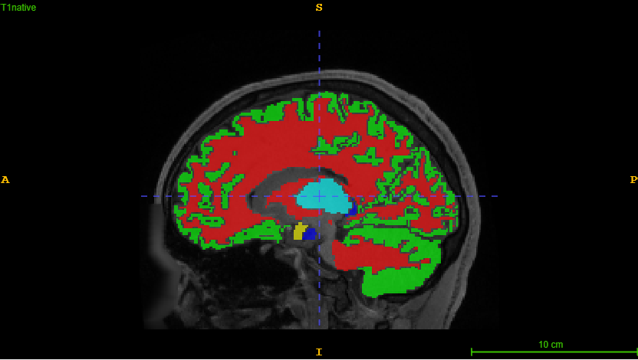
Hypothesis 6 - Feature Extraction -
Severin Willingsdorfer, Riccardo Dirnberger,
Niklas Freudiger

Slide 2
Hypothesis 6: A larger amount of features improves the segmentation performance

Slide 3

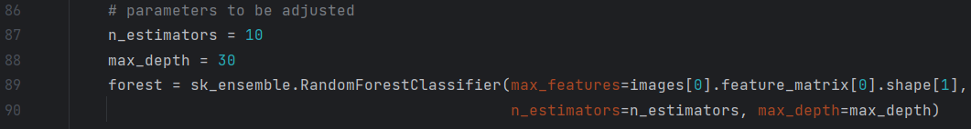
Constant Results

Slide 4
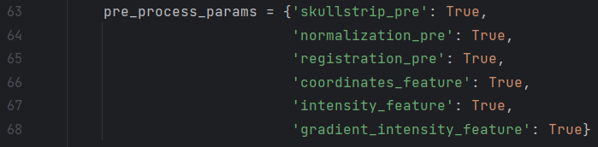
Different Feature Extractions

Slide 5
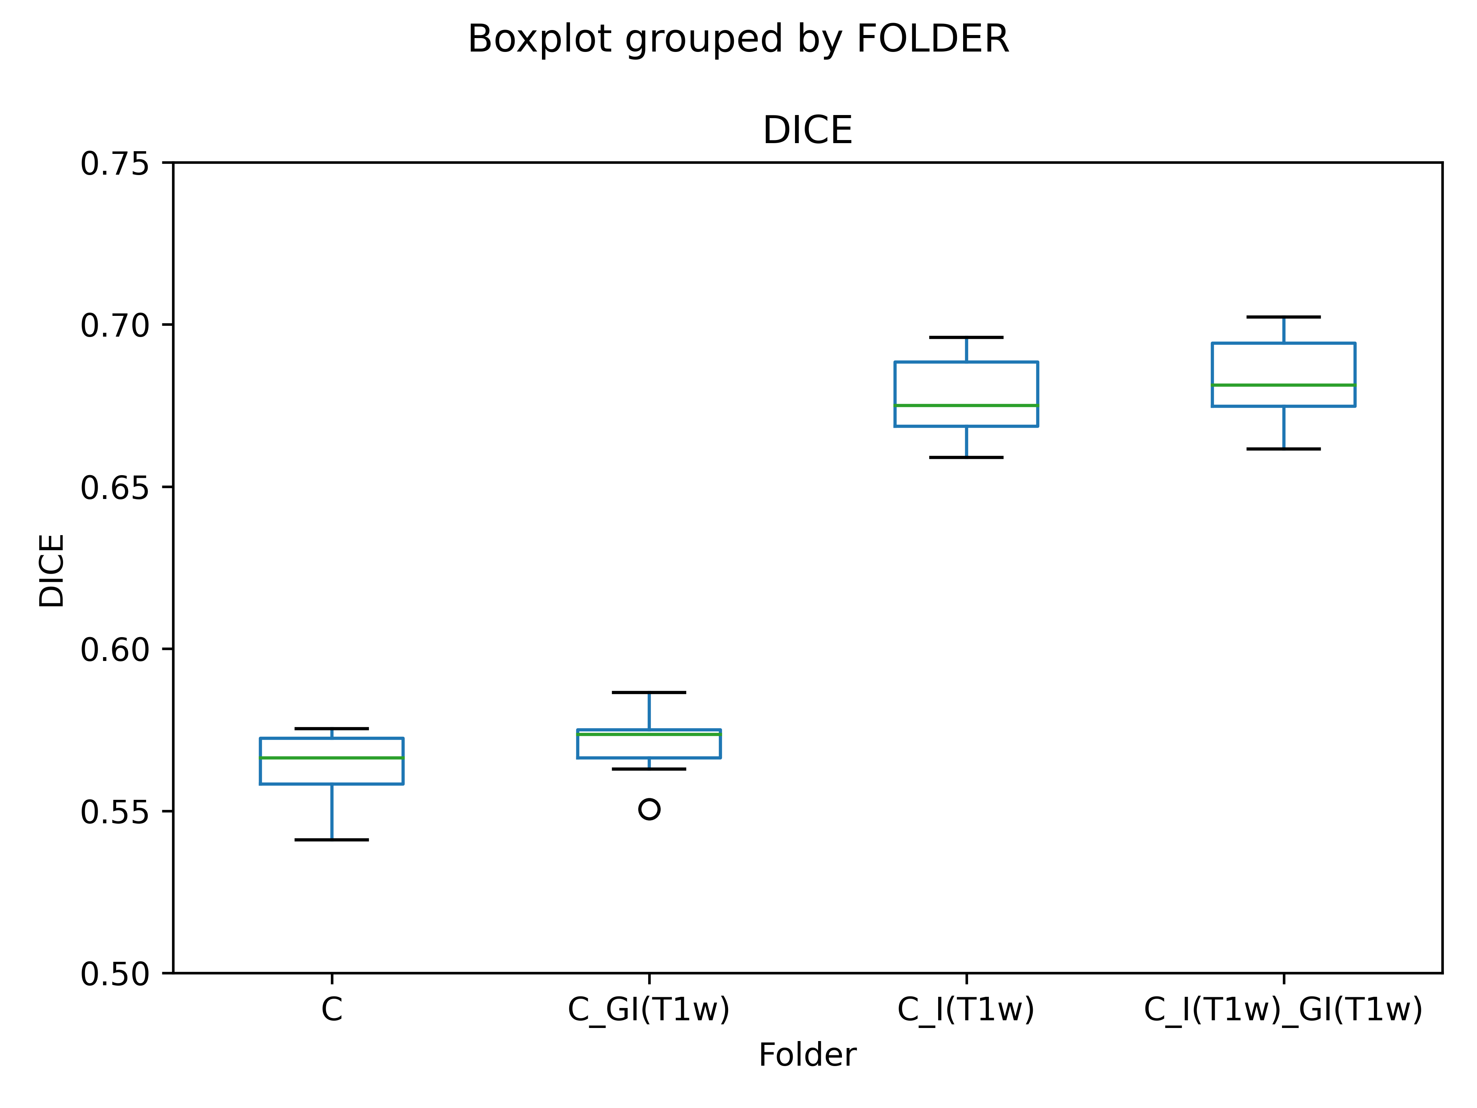
Compare Results

Slide 6
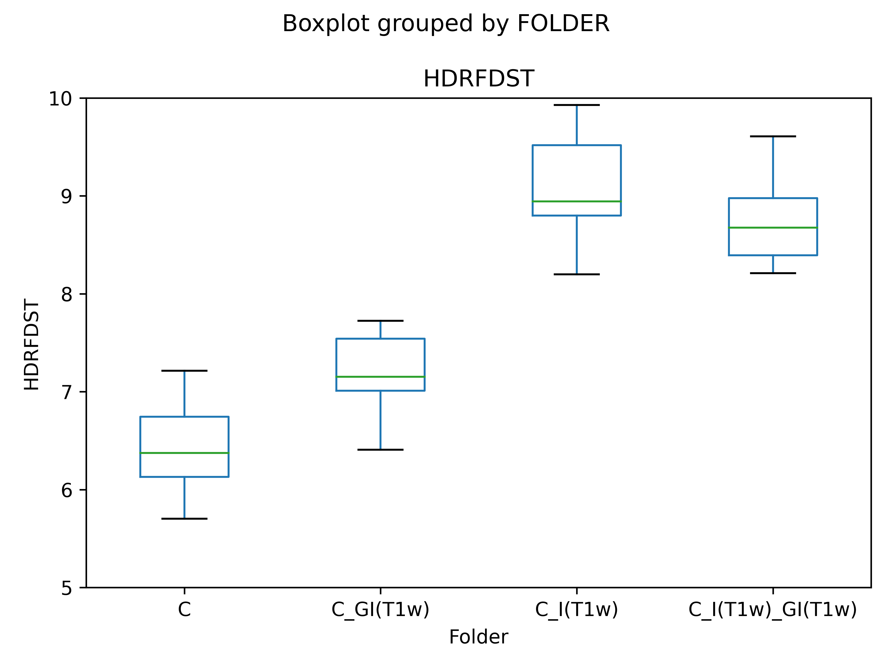
Compare Results

Slide 7
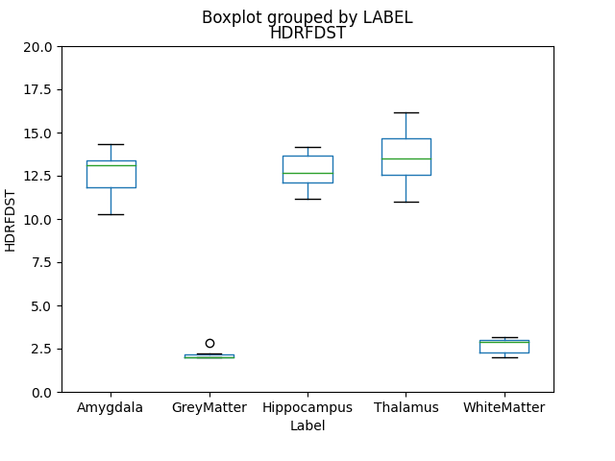
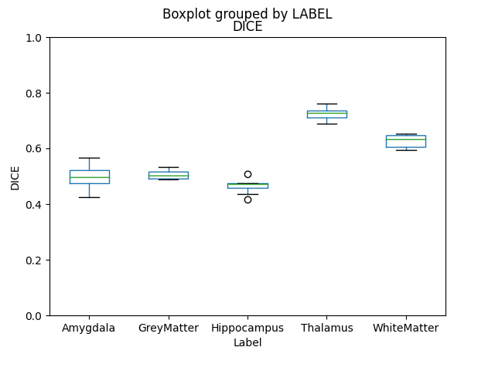
Compare Results
Feature: Coordinates, Gradient, Intensity Feature: Coordinates

Slide 8
Outlook
Apply features existing features on T2-weighted images
Add additional features (first order texture features)

Slide 9
Thanks for listening!

