Slide 1
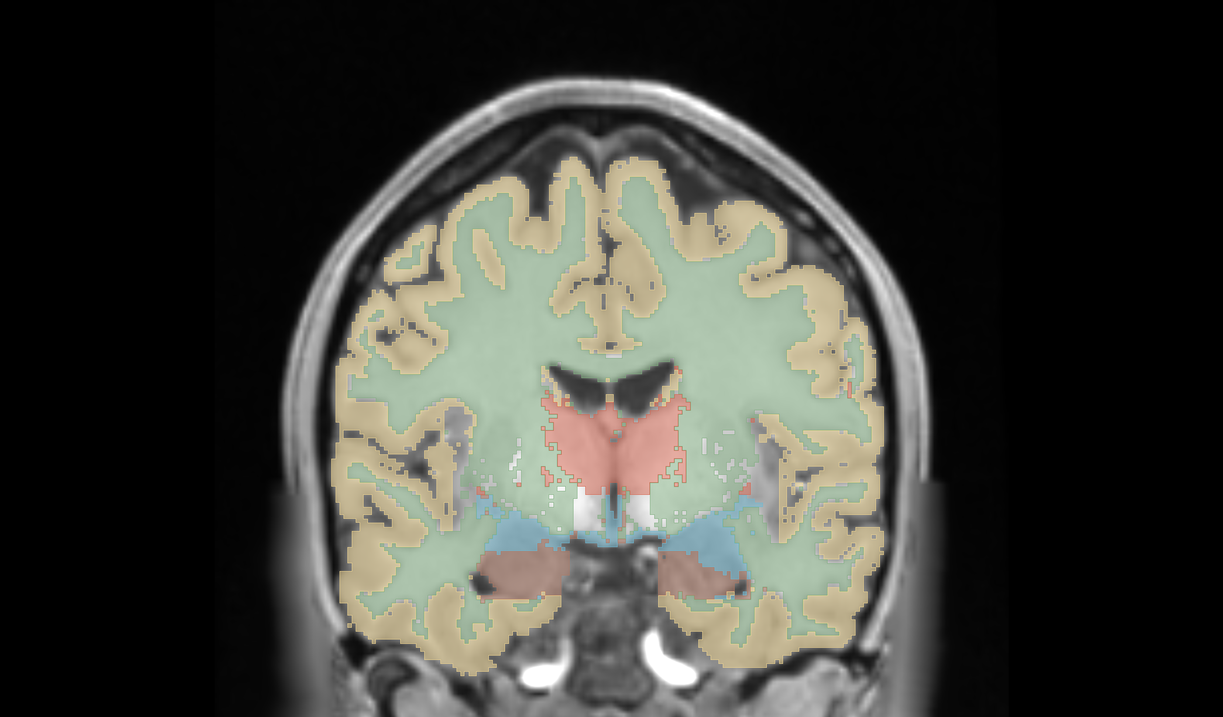
Hypothesis 6 - Feature Extraction -
Severin Willingsdorfer, Riccardo Dirnberger,
Niklas Freudiger

Slide 2
Hypothesis 6: A larger amount of features improves the segmentation performance

Slide 3
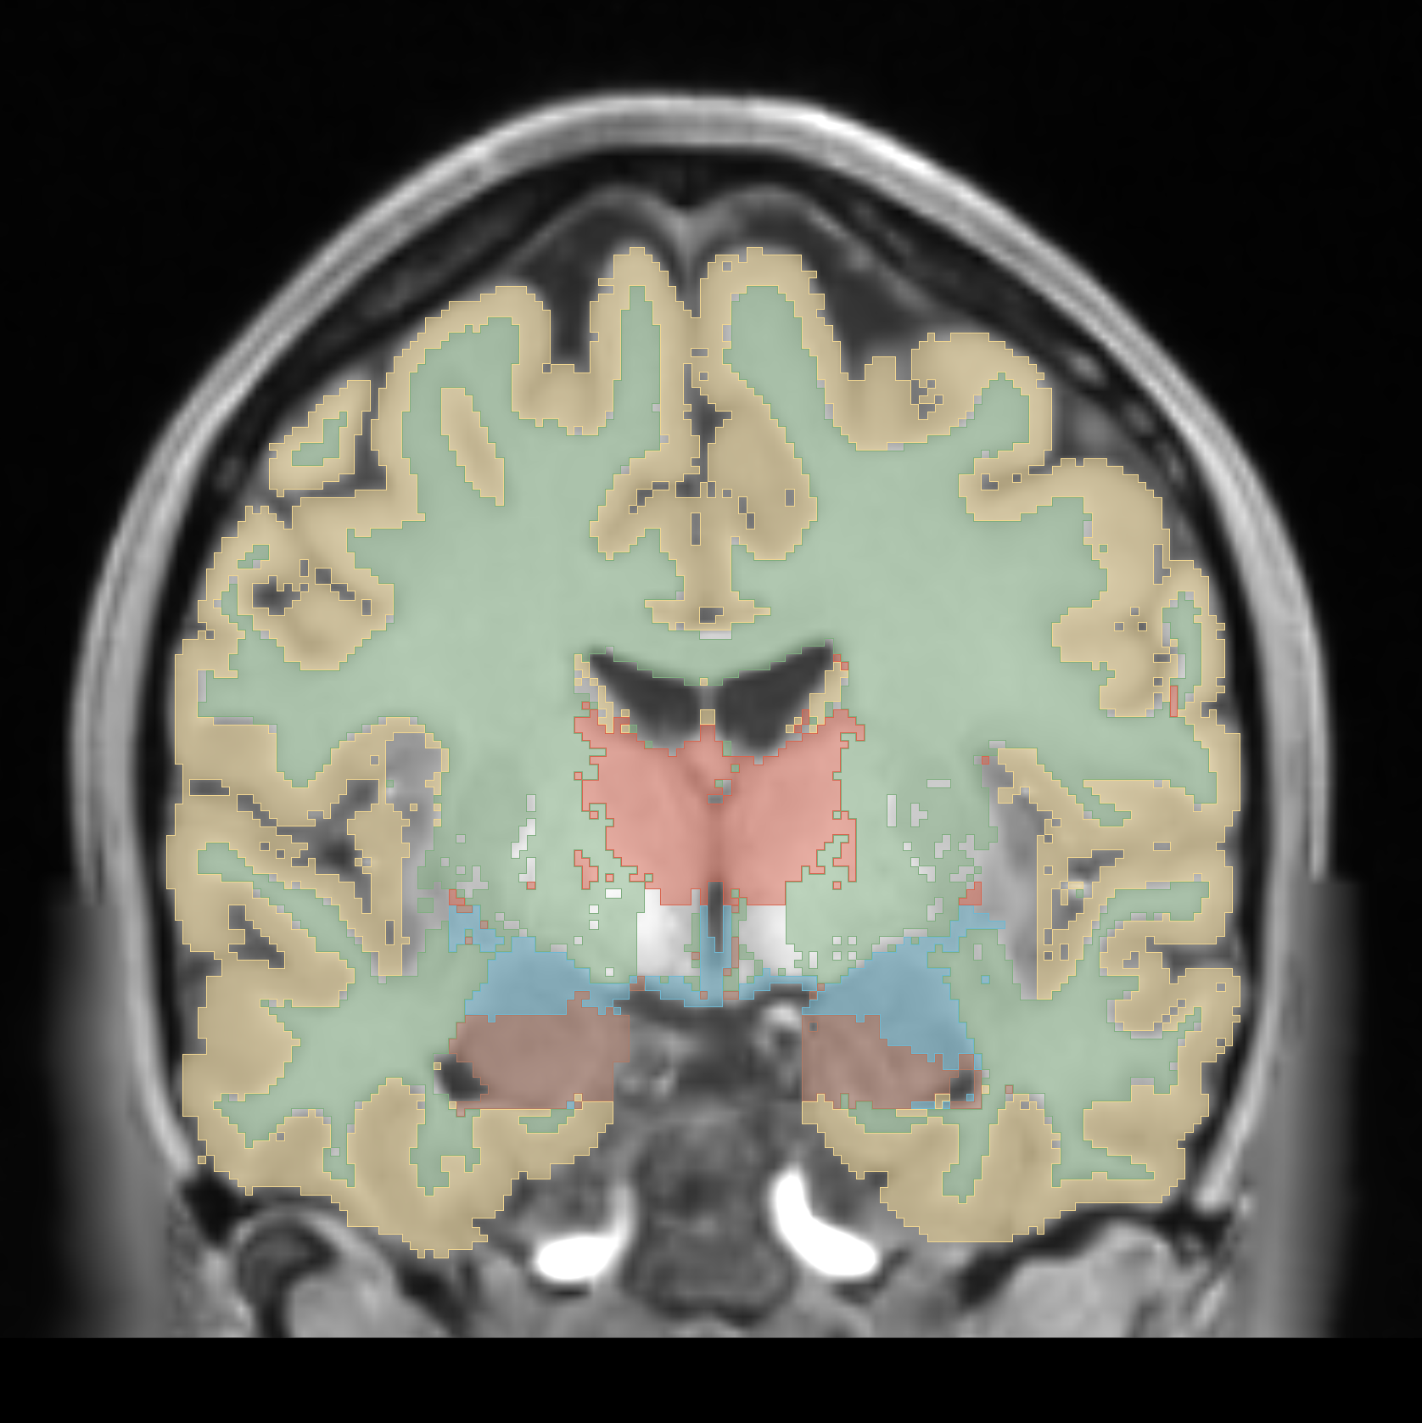
x

Slide 4
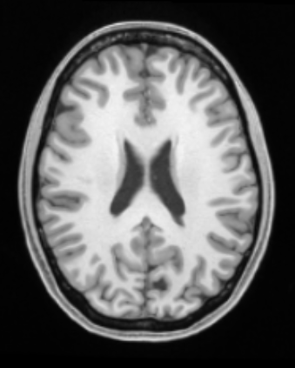
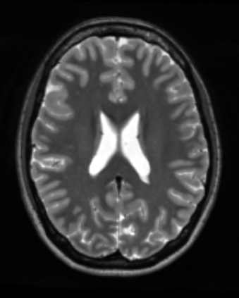

Training Data
Segmentation
T1w
T2w
Registration
Preprocessing
Feature Extraction
Classification
Postprocessing
Evaluation

Slide 5
Training Data
Segmentation
T1w
T2w
Registration
Preprocessing
Feature Extraction
Classification
Postprocessing
Evaluation

Slide 6
Training Data
Segmentation
T1w
T2w
Registration
Preprocessing
Feature Extraction
Classification
Postprocessing
1
2
3
Evaluation
4

Slide 7
1
2
Feature Extraction
3
4
Evaluation
Registration, Preprocessing
Classification
Training Data
Segmentation

Slide 8
1
2
Feature Extraction
3
4
Evaluation
Registration, Preprocessing
Classification
Features
T1w
T2w
Coordinate (C)
Intensity (I)
Gradient Intensity (G)
Neighbourhood (NH)
Training Data
Noise (GA & SP)
Segmentation

Slide 9
1
2
Feature Extraction
3
4
Evaluation
Registration, Preprocessing
Classification
Features
T1w
T2w
Coordinate (C)
Intensity (I)
Gradient Intensity (G)
Neighbourhood (NH)
Training Data
Noise (GA & SP)
Segmentation
Combinations
0.
1.
5.
2.
6.
3.
7.
4.
8.
9.
10.
11.
12.

Slide 10
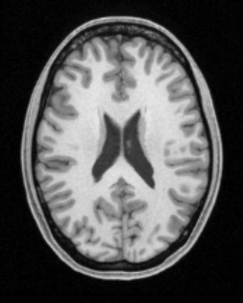
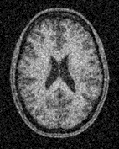

1
2
Feature Extraction
3
4
Evaluation
Registration, Preprocessing
Classification
Features
Testing Data
T1w
T2w
Coordinate (C)
Intensity (I)
Baseline
Gradient Intensity (G)
Neighbourhood (NH)
Training Data
Noise (GA & SP)
Segmentation
Combinations
Gaussian Noise
0.
1.
5.
2.
6.
3.
7.
Salt & Pepper Noise
4.
8.
9.
10.
11.
12.

Slide 12
Thanks for listening!

Slide 13
Thanks for listening!

