Slide 1
The Causal Effect of Special Elections on Media Internal Pluralism: A Historical Investigation
Niklas Haehn
Department of Political Science
University of California, San Diego
San Diego, 04/08/2026

Slide 2
Motivation
Classical models of voting in political science assume that voters make their electoral decisions based on (full) information.
(Downs 1957; Fiorina 1978)
The media constitute the central mediator between voters and political elites and, through selection and priming, determine which information reaches the electorate and how it is presented .
(Zaller 1992 and 1999; Iyengar and Kinder 1987; McCombs and Shaw 1972).
→ The quality of democratic accountability therefore depends crucially on the quality of media institutions.
This study makes several contributions:
Measurement: To my knowledge, this study constructs the first comprehensive dataset on special elections and vacancies and highlights measurement inconsistencies in existing and widely used datasets.
Measurement: The study also shows under which conditions special elections can be interpreted as an exogenous shock to the political agenda.
As an illustrative application, the study analyzes the effect of the political intensity of a special election on media coverage.

Slide 3
Research Question and Hypotheses
Research Question:
What influence does political intensity have on the media‘s behavior?
What influence do special elections in the United States have on the slant of media coverage?
Hypotheses:
H1: In times of stronger political competition, the number of political articles increases.
H2: In times of stronger political competition, internal political pluralism in the media decreases, thereby increasing political bias.

Slide 4
Literature and Mechanism
Demand-side: Campaigns increase demand for congenial information
Election campaigns heighten partisan identity and threfore the demand for attitude-consistent news
Lodge & Taber (2013); Huddy & Mason (2015); Mason (2016; 2018); Iyengar & Hahn (2009); Messing & Westwood (2014)
Media outlets respond strategically to audience demand; competition and confirmatory preferences shift outlet slant toward reader beliefs and “house line“.
Gentzkow & Shapiro (2010); Mullainathan & Shleifer (2005)
Supply-side: Campaigns structure news production
Campaigns produce a continuous flow of ready-made political content (events, PR, talking points), which journalists adopt under time and resource constraints.
Gans (1979); Shoemaker & Vos (2009)
Political actors strategically shape the news agenda through framing, agenda-setting, and priming.
McCombs & Shaw (1972); McCombs (2004); Iyengar & Kinder (1987); Krosnick & Kinder (1990); Aalberg, Strömbäck & de Vreese (2012); de Vreese (2005)

Slide 5
Research Design
Unit of analysis: Newspaper articles aggregated region ×week; newspaper outlet x week
Period of analysis: Special elections: 1789–2020; Mediaanalysis: 1900–2020
Causal Inference: Difference-in-Difference/Event-Study
Treated = Special election in the region of headquarter of the newspaper outlet
Control = No special election in the region of headquarter of the newspaper outlet
Assumptions and Risks:
Parallel Trends Assumption: Pre-trend test
SUTVA: Probably violated. Historical newspaper outlets are major outlets with readership across the entire U.S., not only regionally. An event-study design can partially test for such spillovers.
A risk is that the analysis may capture the resignation/death of the original member of Congress rather than the election campaign itself (co-treatment). I attempt to mitigate this problem by implementing a donut design that removes observations around the treatment date in order to avoid measuring the direct effect of the death/resignation.

Slide 6
Data
Independent Variable:
Vacancy time before the special election as proxy for the special election campaign.
Bio Guides (official data source of U.S. Congress)
MIT Election data
Extension of MIT Election data (1920 – 1974); Zhang, Sai. 2025. “U.S. Congressional Election Results, 1920-1974 (House and Senate).” Harvard Dataverse
Crossover data set from unitedstates.github.io
Special Election table (Wikipedia), Several Primary Sources
Causes of Death (Wikipedia), Primary Source: Memorial Addresses from HathiTrust
Dependent Variable:
Newspaper slant measured with an LLM tone analysis
Number of newspaper articles on politics
Proquest, TDM Studio

Slide 7
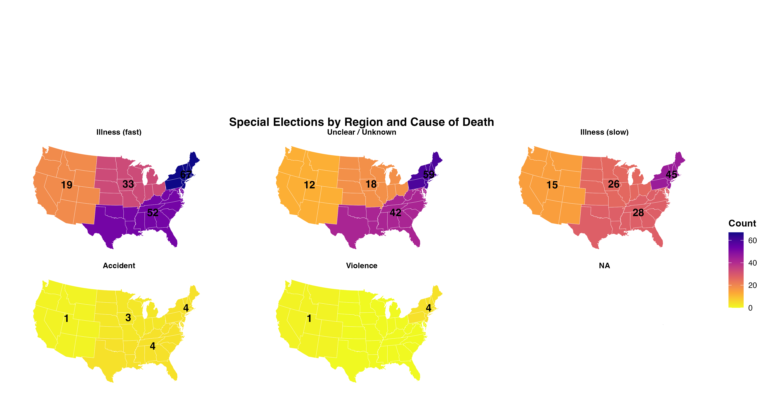
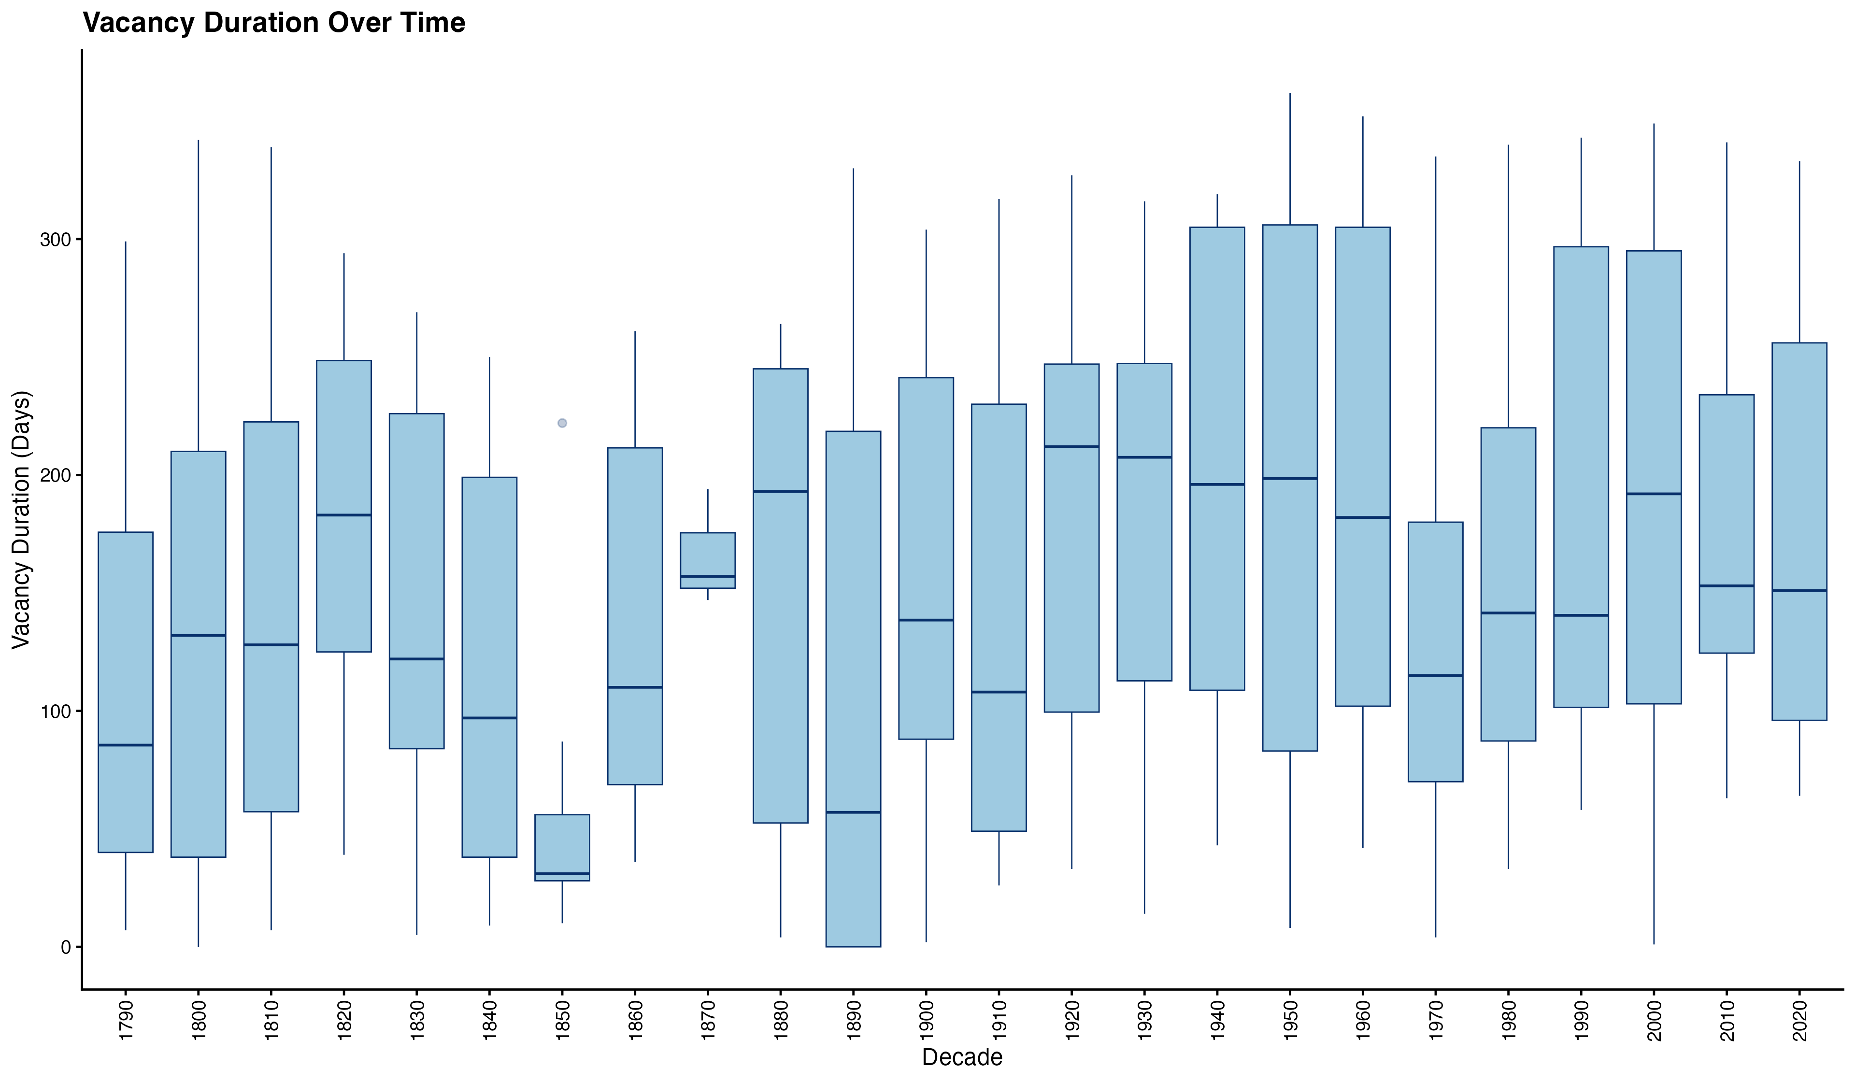
Descriptive Statistics

Slide 8
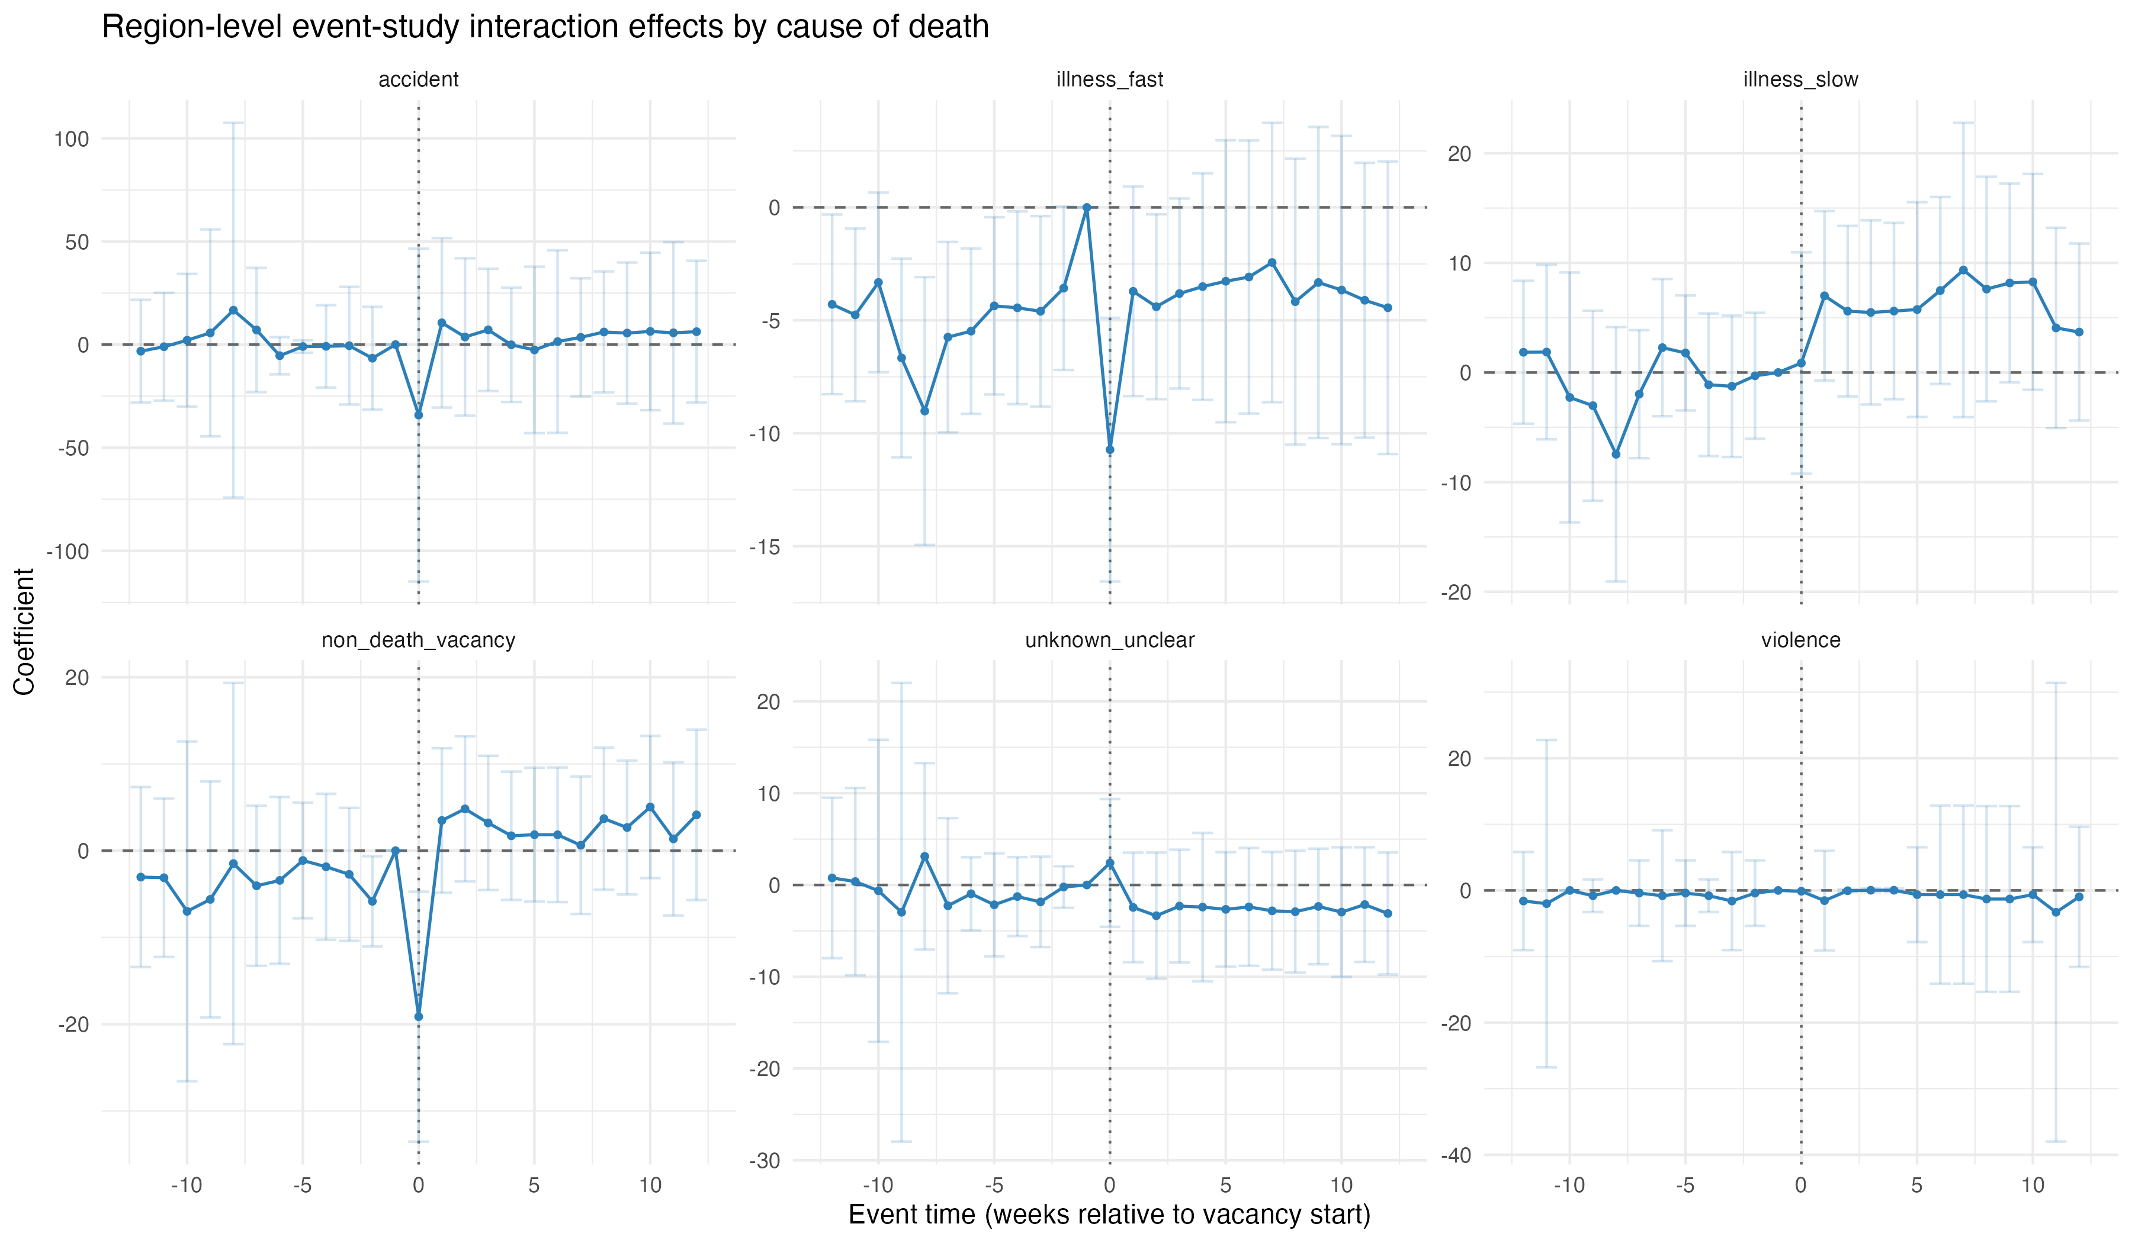
Event Study – Number of Articles

Slide 9
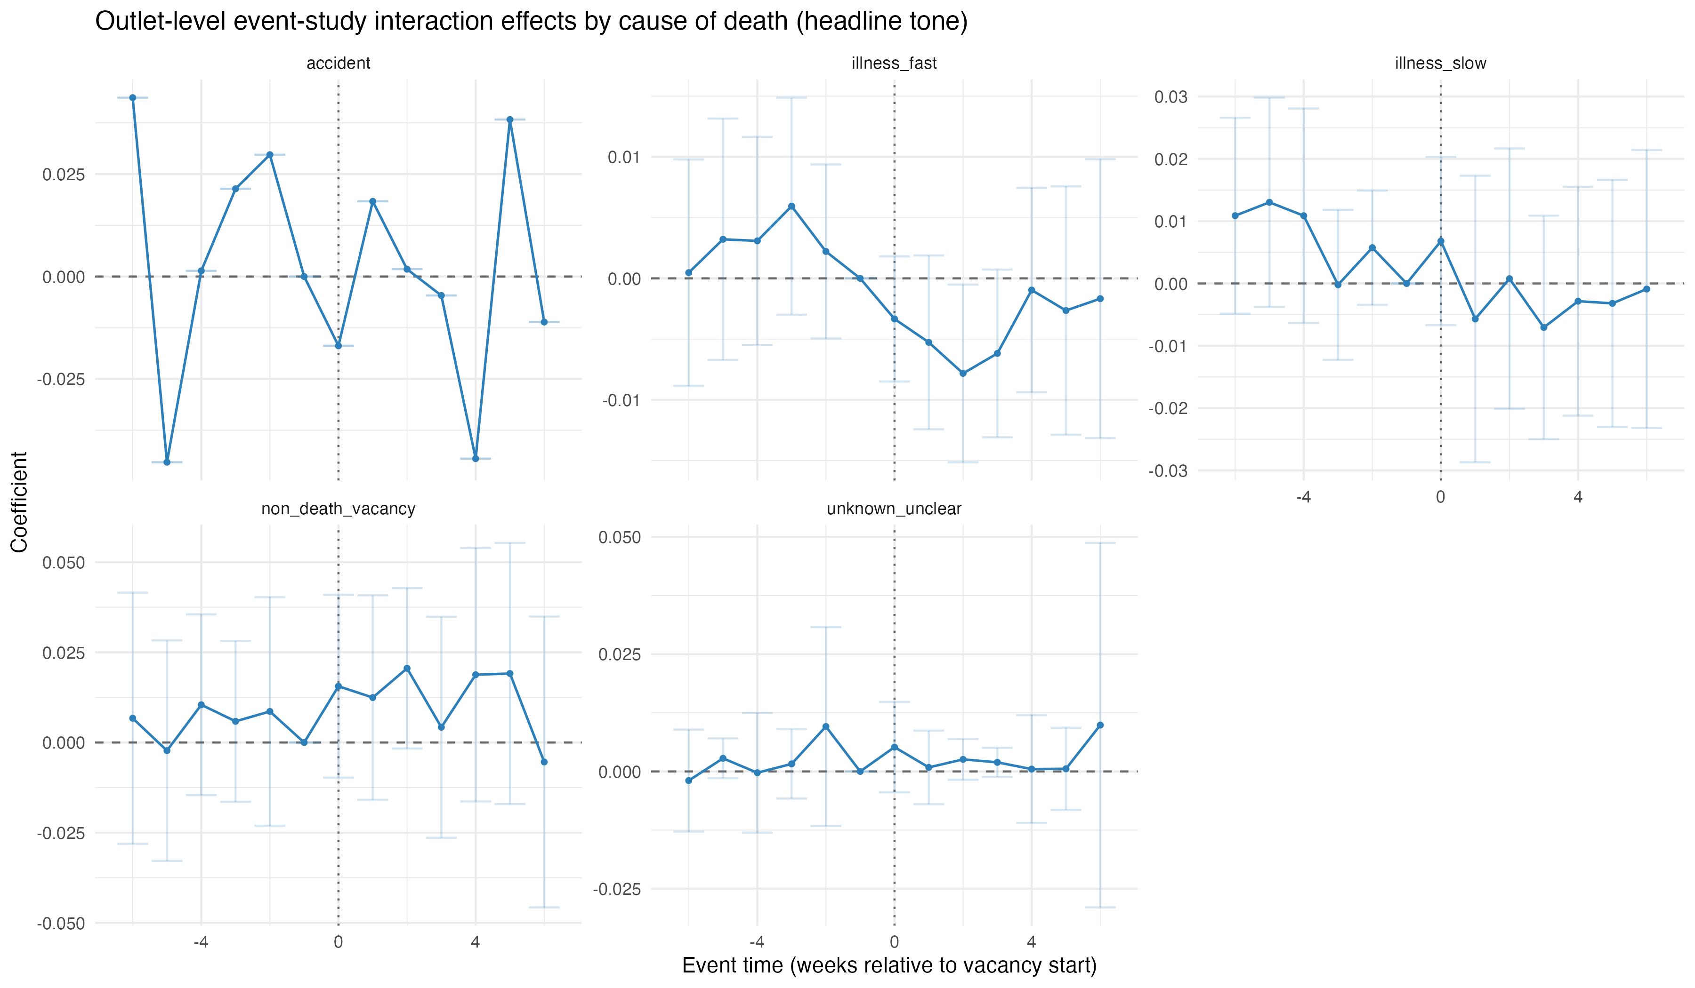
Event Study – Tone

