Slide 1
MRSP Project – Group 1
Sheikh Muhammad Mujtaba
Atif Iqbal
Niklas Nymark
Shaurya Kalia
Muhammad Behzad Hussain

Slide 2
Used audio & environments
Drum
Instrumental mix
Piano
Speech
Trumpet
Small office
Opera hall
Reverb hall

Slide 3
Objective measures
Perceptual Loss was used
Compares two audio files to each other
Output is a loss value
We used the python function provided to us by the professor

Slide 4
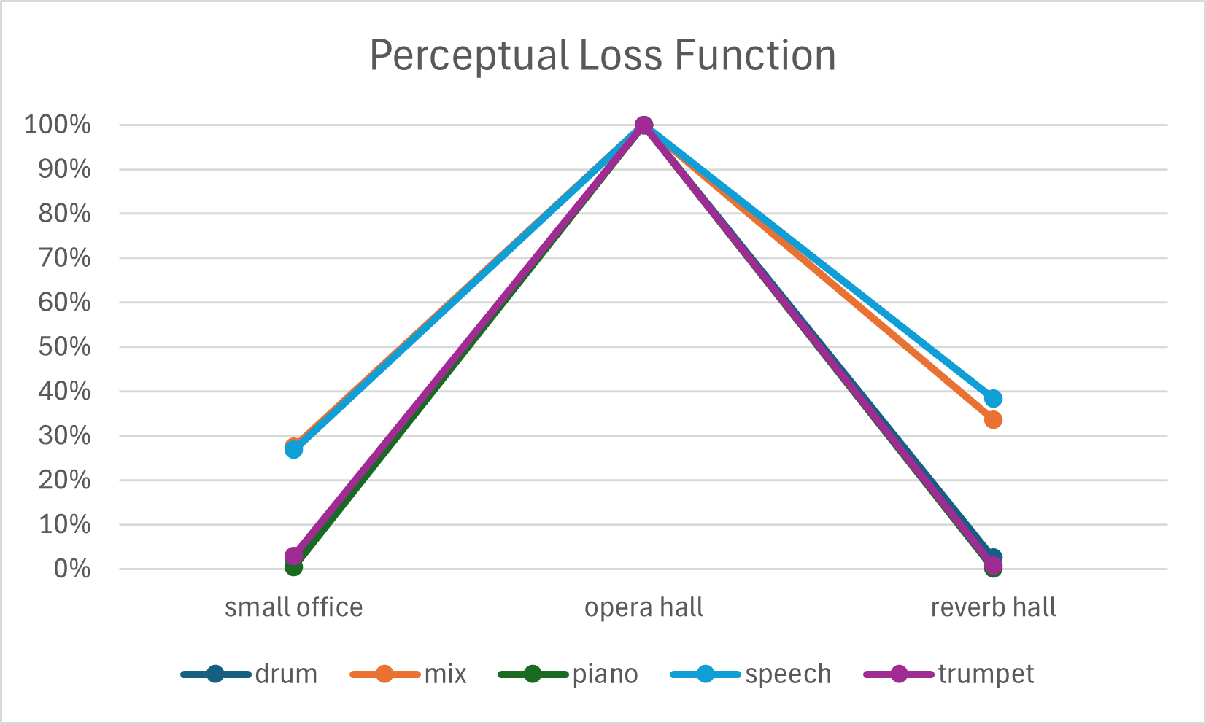
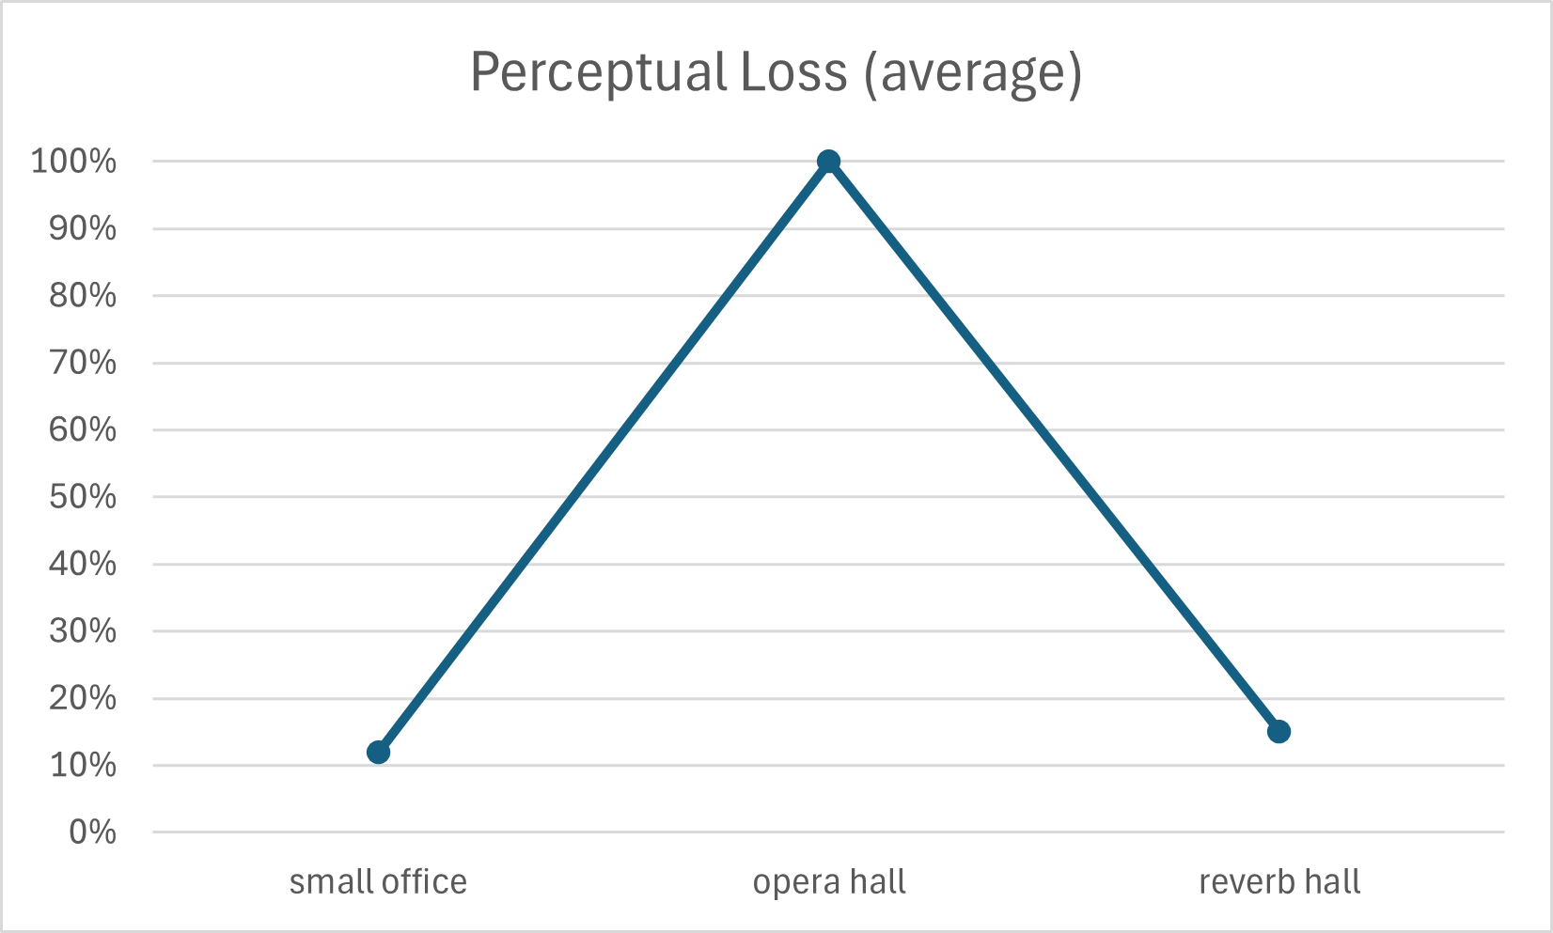
Perceptual Loss results
100%: most difference to original
0%: least difference to original

Slide 5
MUSHRA test software
“scale” app for Matlab was used
Results are stored as tables in .mat files
Figures are drawn by the application

Slide 6
MUSHRA listening experiment
18 participants
Listeners compared dry audio to modified environment audio
Asked to rate the similarity between 0 (least) – 100 (most)
We applied the ANOVA test to the results

Slide 7
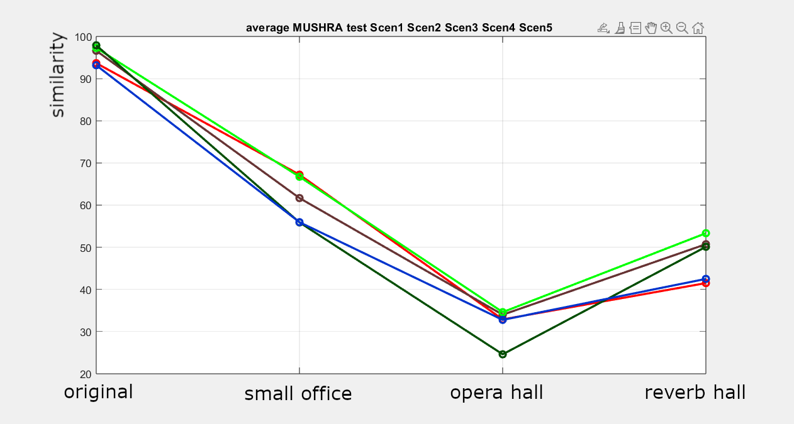
MUSHRA test results
drum: red
instrumental mix: brown
piano: light green
speech: dark green
trumpet: blue
100 means most similar to original
0 means least similar to original

Slide 8
Conclusion
Subjective results passed the ANOVA test with α=0.05
Results from objective and subjective were mostly similar
Opera hall was the most different environment
According to the subjective test, small office was most similar to the original audio
According to objective test, reverb hall and small office were equally similar to the original audio

