Slide 1
MRSP Project – Group 1
Task 1: Sheikh Muhammad Mujtaba
Task 2: Muhammad Behzad Hussain
Task 3: Atif Iqbal
Task 4: Shaurya Kalia
Task 5: Niklas Nymark

Slide 2
Goals of the project
Study how the environment a sound is played in affects it
Objective test: Perceptual Loss Function
Subjective test: MUSHRA test
Compare results of objective and subjective tests

Slide 3
Used audio & environments
Drum
Instrumental mix
Piano
Speech
Trumpet
Small office
Opera hall
Reverb hall

Slide 4
Perceptual Loss test
Compares two audio files to each other
Output is a loss value, bigger loss = bigger difference
We compared the sound in different environments to the original audio
We used the python function provided to us by the professor

Slide 5
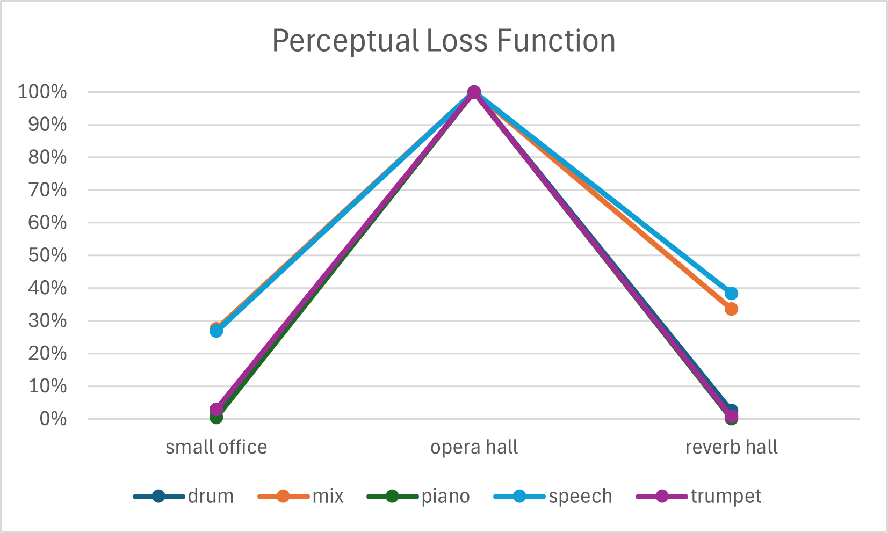
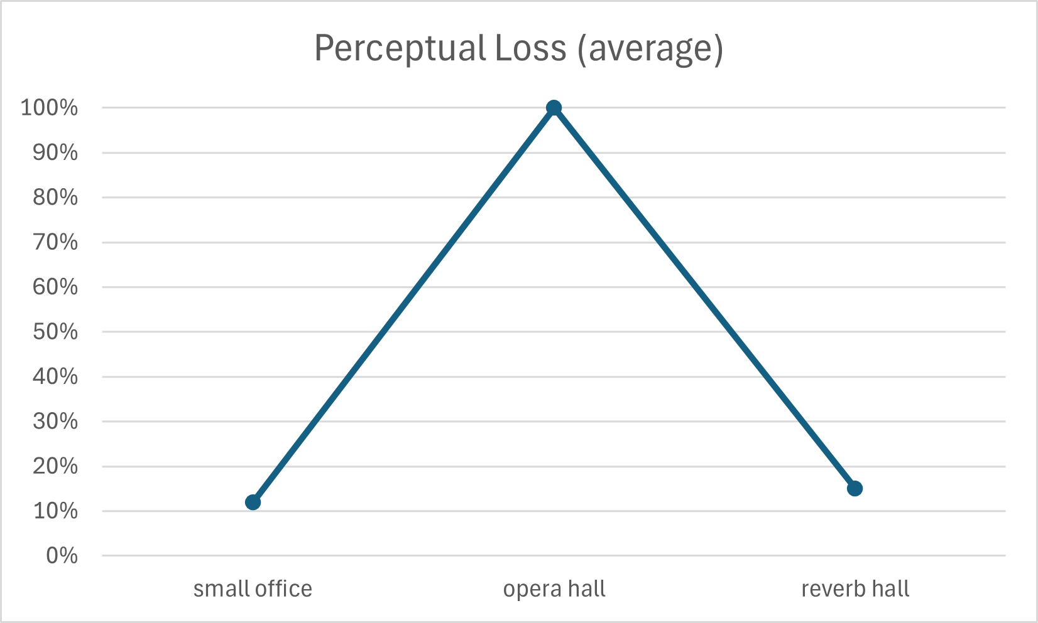
Perceptual Loss results
100%: most difference to original
0%: least difference to original

Slide 6
MUSHRA listening experiment
18 participants
Listeners compared dry audio to modified environment audio
Asked to rate the similarity between 0 (least) – 100 (most)
We applied the ANOVA test to the results

Slide 7
MUSHRA test software
“scale” app for Matlab was used
Results are stored as tables in .mat files
Figures are drawn by the application

Slide 8
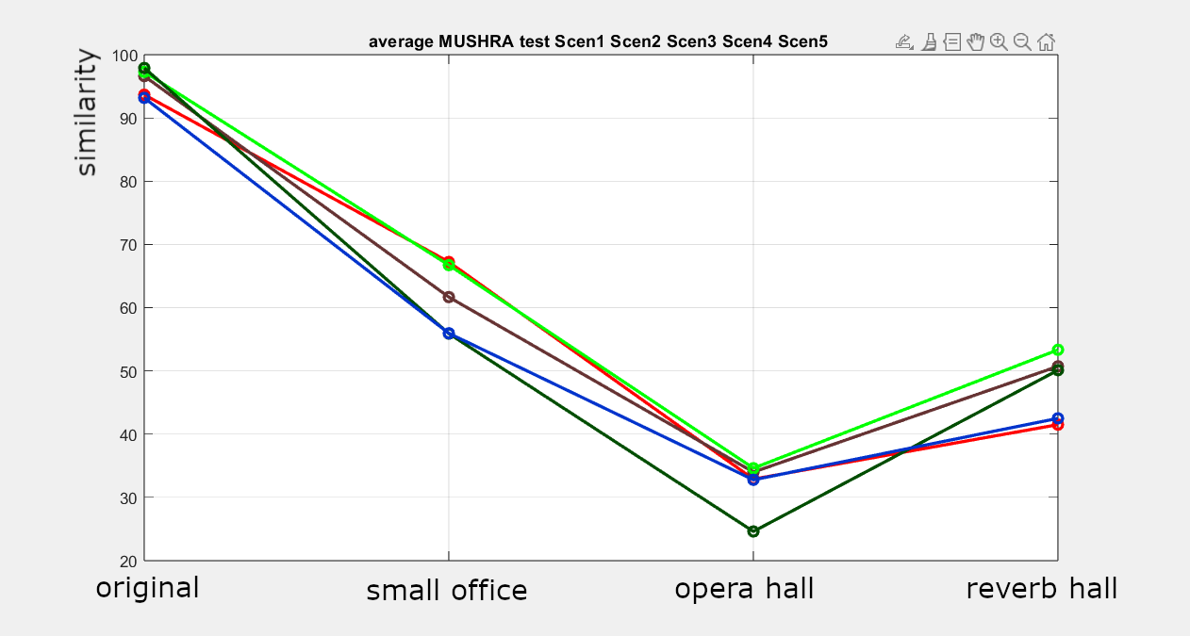
MUSHRA test results
drum: red
instrumental mix: brown
piano: light green
speech: dark green
trumpet: blue
100 means most similar to original
0 means least similar to original

Slide 9
ANOVA results
α=0.05
p-values:
0.00014818 for drum
0.003438 for instrumental mix
0.0001407 for piano
0.000092682 for speech
0.01008 for trumpet

Slide 10
Conclusion
Results from objective and subjective were mostly similar
Opera hall was the most different environment
According to the subjective test, small office was most similar to the original audio
According to objective test, reverb hall and small office were equally similar to the original audio

