Slide 1

WP3 High-dimensional profiling of drug effects in organoids
Michael Boutros, Niklas Rindtorff, Kim Boonekamp, Johannes Betge

Slide 2
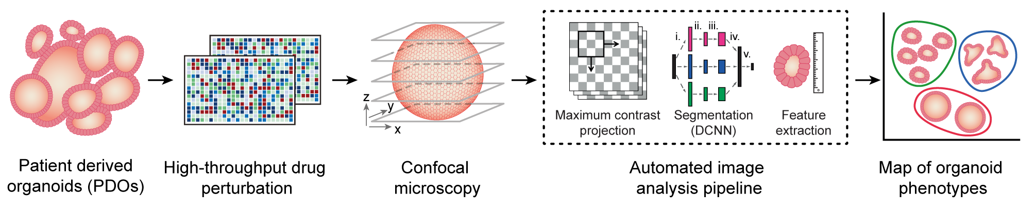
WP3 High-dimensional profiling of drug effects in organoids
PBMC addition
Map of PBMC tumor cell interactions
Experimental adaptations of
existing pipeline
Adaptations to
computational pipeline

Slide 3
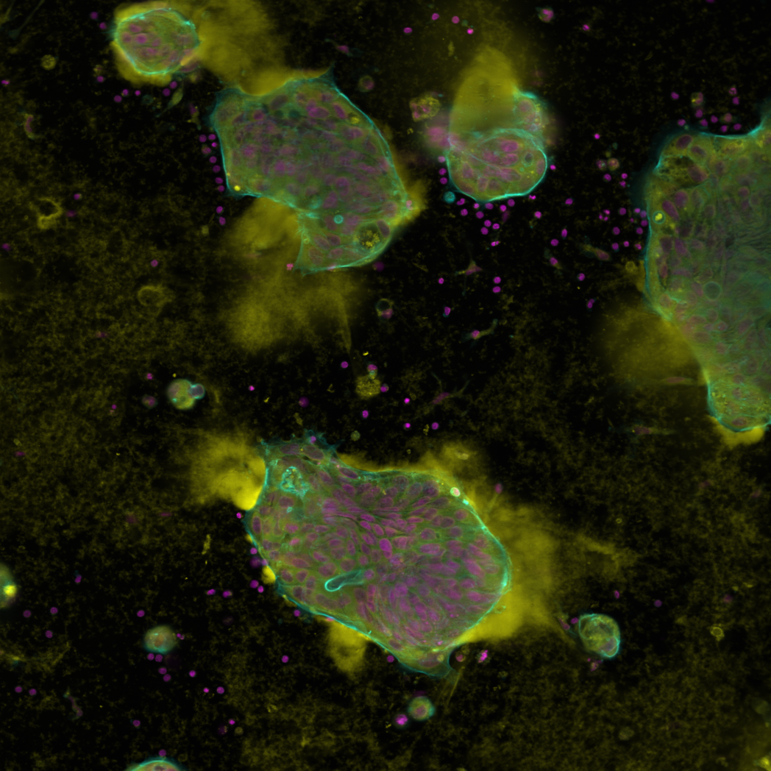
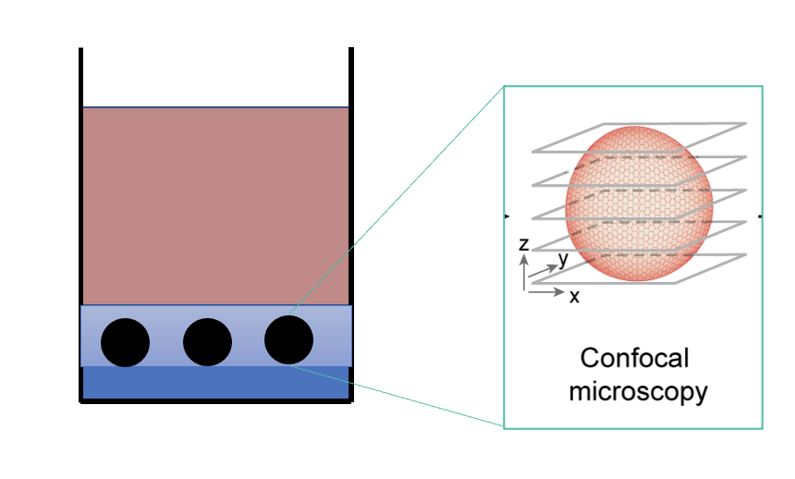
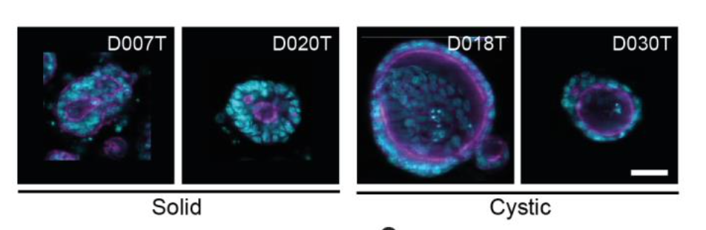
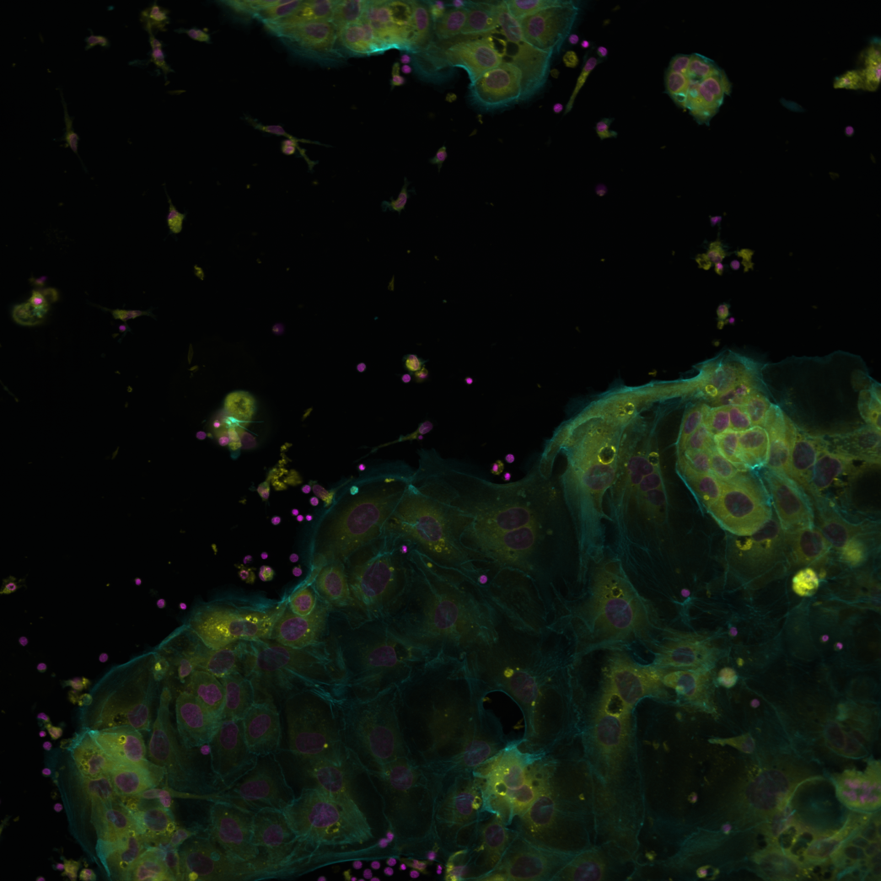
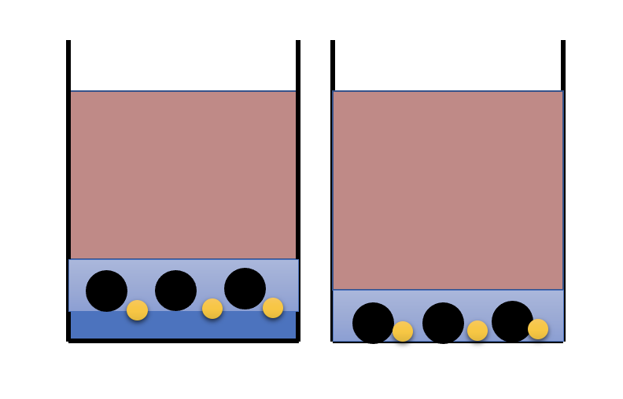
On-going adaptations of experimental pipelines
Maximum intensity projection
High hydrogel
1. Combining organoid
and immune cell culture conditions
2. Impact on high-content imaging
and image-analysis
Low/no hydrogel
Adapted projection and
segmentation methods

Slide 4
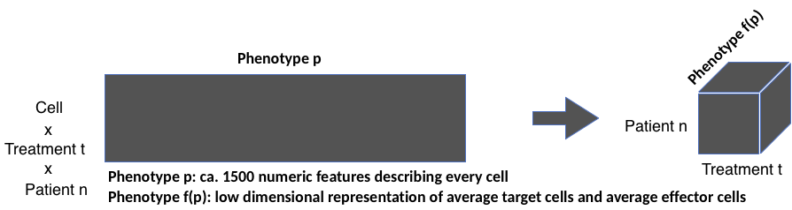
High-content imaging data properties
Raw Data properties
= 1 plate x 384 conditions x 6 fields x 5 focal planes x 3 channels
= 34560 images at 8.4MB / raw image
~ 2.9TB data / plate
Intermediate Data properties

Slide 5
Adaptation image-analysis pipelines
Image pre-processing
Preparation for segmentation
Segmentation
Quantify accuracy of segmentation
Feature extraction
Feature selection
Data normalization
Quantitative phenotype description
Scalability, Adaptability

Slide 6
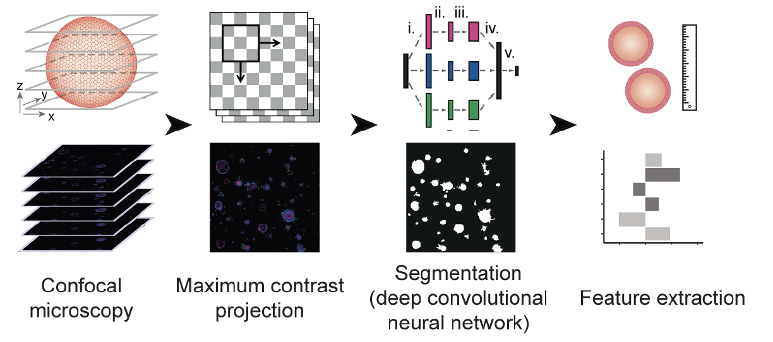
Current Goals WP3
Image analysis with drug perturbations & PBMC
QC alternative culture method
Goal: containerized organoid segmentation and phenotype-profiling
Optimize image-based profiling method for single-cell recognition (within and outside of organoid)

