Slide 1
Forensic Challenge
Team 3 - RK NK AN

Slide 2



Technologies

Slide 3
The Challenges

Slide 4
# Incomplete Vendors
Obtained by:
Counting rows with missing entries in
Observations:
Missing entries are largely unimportant parts of addresses.
Not immediately indicative of fraud.

Slide 5
2) Duplicate Transactions
Obtained by:
Group rows in , keeping those having a count > 1.
Observations:
Duplicate amounts were all rounded numbers (e.g 5000.00).
All approved by user u8284.

Slide 6
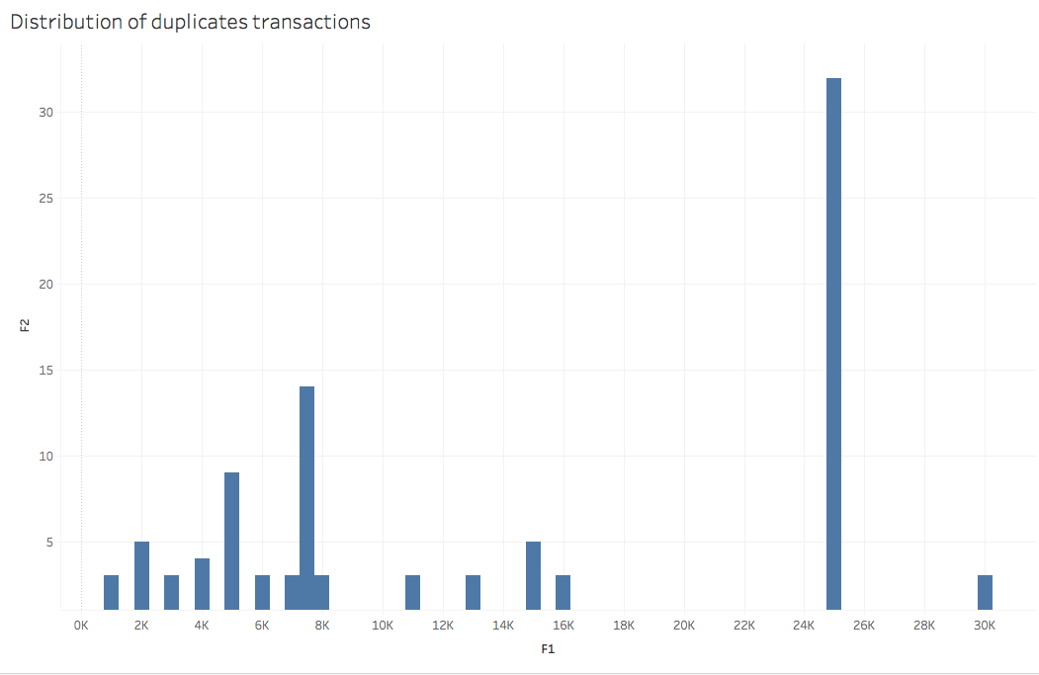

Slide 7
3) Split Payments
Obtained by:
Group rows in , having a count > 1.
Observations:
Split amounts were (again) all rounded numbers (e.g 5000.00).
Again, all approved by user u8284.

Slide 8
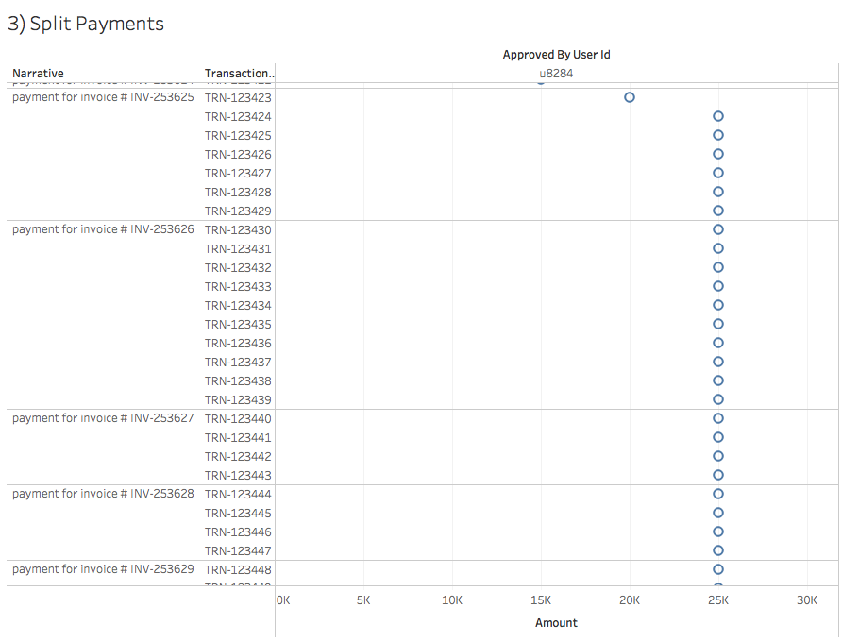

Slide 9
Why Split Payments?

Slide 10
4) First Invoice Fraud
Obtained by:
Checking first invoice in , received by u8248.
Observations:
User u8284 is most likely one of possibly several fraudsters.
Investigate vendor account (VD-0588) the first invoice is to.

Slide 11
4) First Invoice Fraud – Tracing Back
VD-0588 was created by a different user u8204 in 2002.
Precedes u8284, so probably irrelevant.
When was u8284 created?

Slide 12
5) Date of first fraud
Obtained by:
Checking creation date of u8248.
Observations:
User u8284 was created by another user u3977.
u3977 was the CFO.
However, u8284 was not listed under the CFO, but rather EMP-0011.
EMP-0011 had 2 user accounts u8204 & u8284.

Slide 13
5) Date of first fraud – Part 2
Was EMP-0011 aware?
Were they part of the fraud?

Slide 14
6) Suspicious log entries
Obtained by:
Querying log for Date/Time outside working hours (night, weekends).
Observations:
User u3977 logged on once on Sunday, created on account u8284.
User u8284 logged in out of office hours (typically at night).

Slide 15
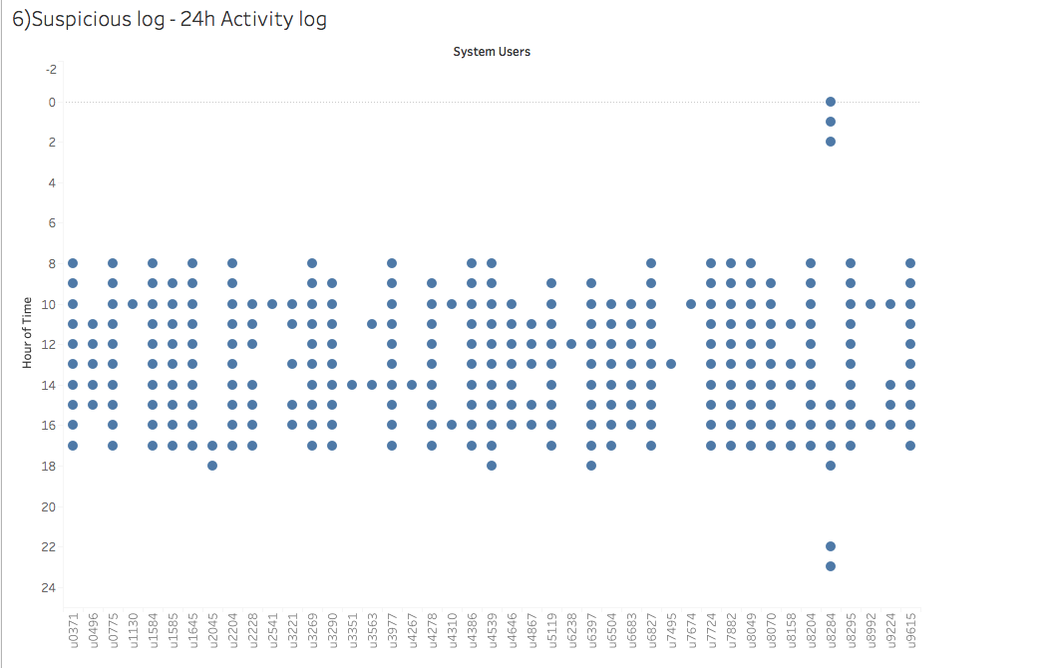
Strangely short delay between input and approval of transaction (21s or 58s), instead of a few days
Approved at random hour instead of midnight
Always late at night
By the same user

Slide 16
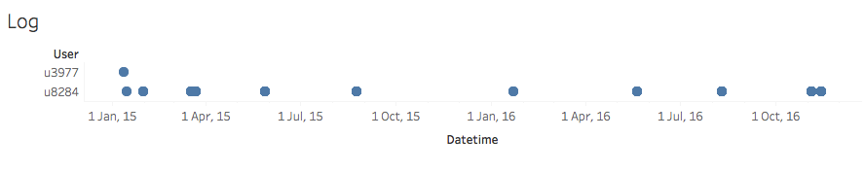

Slide 17
7) Total Amount of the fraud
Obtained by:
Summing , , where the receiving user was u8284.
Observations:
Fraud money was composed of:
1015000 CHF that left the company.
100 CHF submitted to initial vendor created by u8204.

Slide 18
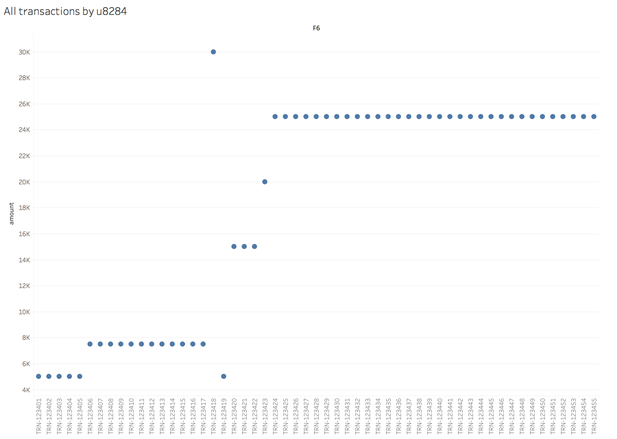
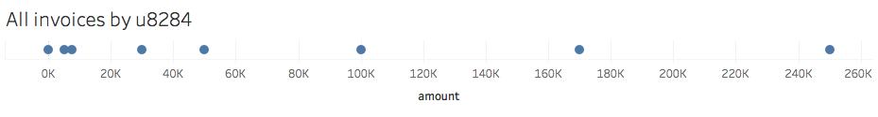

Slide 19
8) Suspicious Invoice Approvals
Noticed from:
Strangely short delay between input and approval of transaction (21s or 58s), instead of a few days.
Approved at random hour instead of midnight.
Always late at night, by u8284.

Slide 20
8) Suspicious Invoice Approvals – Part 2
Obtained by:
Counting distinct approved by u8284.
Observations:
Random approval times by u8284 deviate from norm batch approval at midnight.

Slide 21
9) Consecutive Purchase Orders
Obtained by:
Acquire
Determine consecutive po_ids
Eliminate consecutive po_ids not by the same vendor.
Observations:
Some consecutive purchase orders were by u8284, but not enough to stand out.

Slide 22
The Story of the Fraud

Slide 23
John Smith (CFO) creates u8248, registering it under another employee.
CFO adds an external account and sends it 5000 CHF.
Steals ~1 million CHF
Fraud activity stops.
12-01-2015
17-03-2015
11-01-2015
30-01-2015
13-11-2016
CFO tests waters by putting 100 CHF into old testing account.
CFO adds another 3 external accounts.

Slide 24
How to Prevent / Recommendations
Restrict rights to create users
Enforce Employee - SysemUser cardinality to 1:1
Clean up database
Set up notifications / alerts
for actions outside office hours
user creation
logins from unusual machines

