Slide 1
Chapter 12: Query Processing

Slide 2
Chapter 12: Query Processing
Overview
Measures of Query Cost
Selection Operation
Sorting
Join Operation
Other Operations
Evaluation of Expressions

Slide 3
Measures of Query (and sorting) Cost
Cost is generally measured as total elapsed time for answering query
Many factors contribute to time cost
disk accesses, CPU, or even network communication
Typically disk access is the predominant cost, and is also relatively easy to estimate. Measured by taking into account
Number of seeks * average-seek-cost
Number of blocks read * average-block-read-cost
Number of blocks written * average-block-write-cost
Cost to write a block is greater than cost to read a block
data is read back after being written to ensure that the write was successful

Slide 4
Measures of Query Cost (Cont.)
For simplicity we just use the number of block transfers from disk and the number of seeks as the cost measures
t_{T} – time to transfer one block
t_{S} – time for one seek
Cost for b block transfers plus S seeks b * t_{T} + S * t_{S}
We ignore CPU costs for simplicity
Real systems do take CPU cost into account
We do not include cost to writing output to disk in our cost formulae

Slide 5
Measures of Query Cost (Cont.)
Several algorithms can reduce disk IO by using extra buffer space
Amount of real memory available to buffer depends on other concurrent queries and OS processes, known only during execution
We often use worst case estimates, assuming only the minimum amount of memory needed for the operation is available
Required data may be buffer resident already, avoiding disk I/O
But hard to take into account for cost estimation
Notes:
5

Slide 6
Sorting
We may build an index on the relation, and then use the index to read the relation in sorted order. May lead to one disk block access for each tuple.
For relations that fit in memory, techniques like quicksort can be used. For relations that don’t fit in memory, external sort-merge is a good choice.

Slide 7
External Sort-Merge
Let M denote memory size (in pages).
Create sorted runs. Let i be 0 initially. Repeatedly do the following till the end of the relation: (a) Read M blocks of relation into memory (b) Sort the in-memory blocks (c) Write sorted data to run R_{i}; increment i. Let the final value of i be N
Merge the runs (next slide)…..

Slide 8
External Sort-Merge (Cont.)
Merge the runs (N-way merge). We assume (for now) that N < M.
Use N blocks of memory to buffer input runs, and 1 block to buffer output. Read the first block of each run into its buffer page
repeat
Select the first record (in sort order) among all buffer pages
Write the record to the output buffer. If the output buffer is full write it to disk.
Delete the record from its input buffer page. If the buffer page becomes empty then read the next block (if any) of the run into the buffer.
until all input buffer pages are empty:

Slide 9
External Sort-Merge (Cont.)
If N ≥ M, several merge passes are required.
In each pass, contiguous groups of M - 1 runs are merged.
A pass reduces the number of runs by a factor of M -1, and creates runs longer by the same factor.
E.g. If M=11, and there are 90 runs, one pass reduces the number of runs to 9, each 10 times the size of the initial runs
Repeated passes are performed till all runs have been merged into one.

Slide 10
Example: External Sorting Using Sort-Merge

Slide 11
External Merge Sort (Cont.)
Cost analysis:
Total number of merge passes required: ⎡log_{M–1}(b_{r}/M)⎤.
Block transfers for initial run creation as well as in each pass is 2b_{r}
for final pass, we don’t count write cost
we ignore final write cost for all operations since the output of an operation may be sent to the parent operation without being written to disk
Thus total number of block transfers for external sorting: b_{r} ( 2 ⎡log_{M–1}(b_{r} / M)⎤ + 1)
Seeks: next slide
Notes:
12 ∗ (4+1)
= 60

Slide 12
External Merge Sort (Cont.)
Cost of seeks
During run generation: one seek to read each run and one seek to write each run
2 ⎡b_{r} / M⎤
During the merge phase
Buffer size: b_{b} (read/write b_{b} blocks at a time)
Need 2 ⎡b_{r} / b_{b}⎤ seeks for each merge pass
except the final one which does not require a write
Total number of seeks: 2 ⎡b_{r} / M⎤ + ⎡b_{r} / b_{b}⎤ (2 ⎡log_{M–1}(b_{r} / M)⎤ -1)
Notes:
8 + 12 ∗
(2 ∗ 2 − 1) = 44

Slide 13
Basic Steps in Query Processing
1. Parsing and translation
2. Optimization
3. Evaluation

Slide 14
Basic Steps in Query Processing (Cont.)
Parsing and translation
translate the query into its internal form. This is then translated into relational algebra.
Parser checks syntax, verifies relations
Evaluation
The query-execution engine takes a query-evaluation plan, executes that plan, and returns the answers to the query.

Slide 15
Basic Steps in Query Processing : Optimization
A relational algebra expression may have many equivalent expressions
E.g., σ_{salary<75000}(∏_{salary}(instructor)) is equivalent to ∏_{salary}(σ_{salary<75000}(instructor))
Each relational algebra operation can be evaluated using one of several different algorithms
Correspondingly, a relational-algebra expression can be evaluated in many ways.
Annotated expression specifying detailed evaluation strategy is called an evaluation-plan.
E.g., can use an index on salary to find instructors with salary < 75000,
or can perform complete relation scan and discard instructors with salary ≥ 75000

Slide 16
Basic Steps: Optimization (Cont.)
Query Optimization: Amongst all equivalent evaluation plans choose the one with lowest cost.
Cost is estimated using statistical information from the database catalog
e.g. number of tuples in each relation, size of tuples, etc.
In this chapter we study
How to measure query costs
Algorithms for evaluating relational algebra operations
How to combine algorithms for individual operations in order to evaluate a complete expression
In Chapter 14
We study how to optimize queries, that is, how to find an evaluation plan with lowest estimated cost

Slide 17
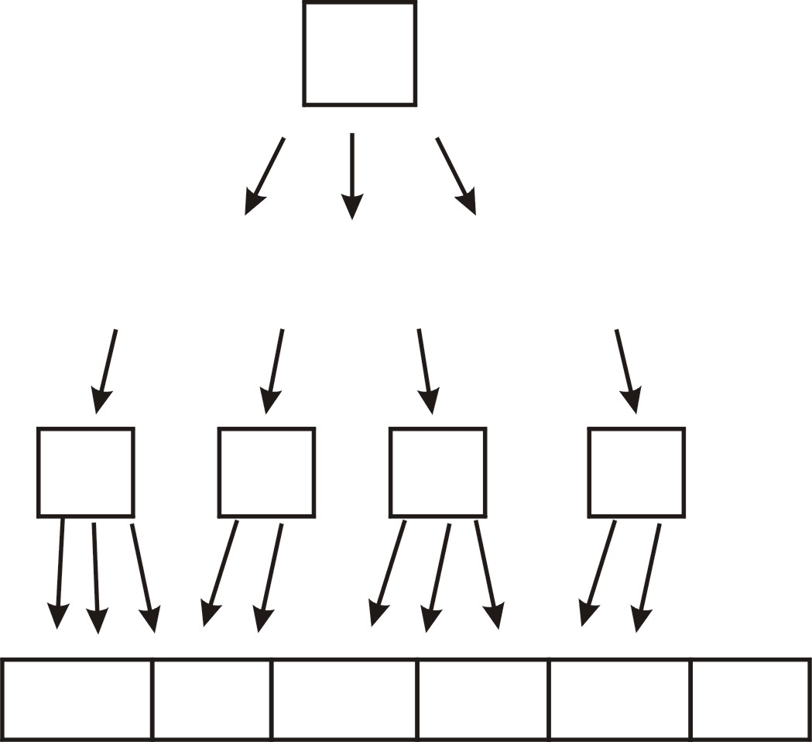
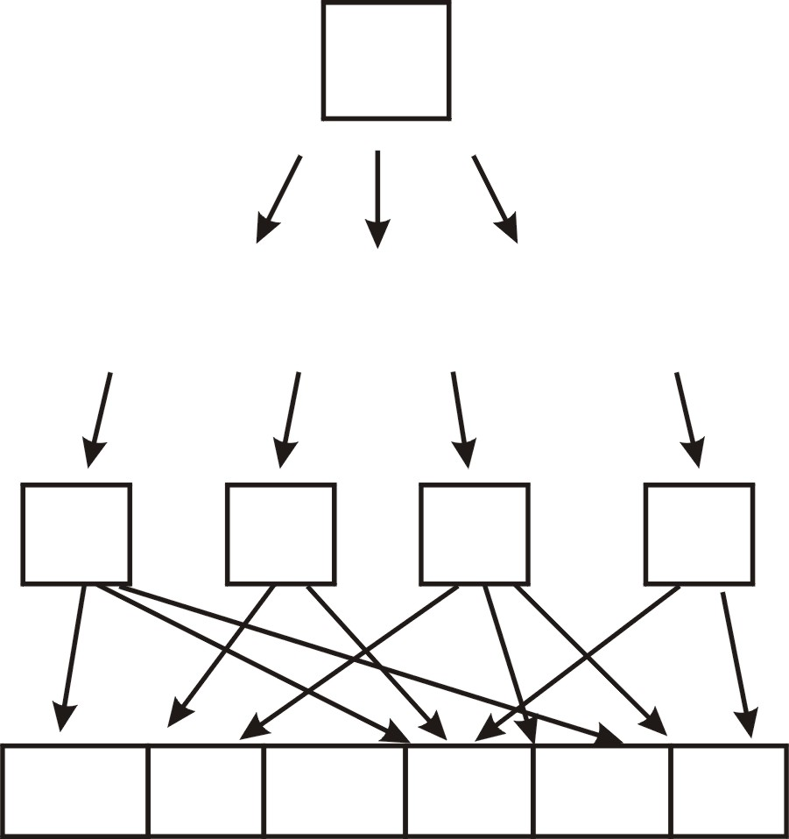
Access Path:
“A way of retrieving records from a relation”
Scan (all tuples and then filter)
or
Use index (for selected tuples)
Clustered Unclustered
Index (B⁺ tree)
Data entries
Relation

Slide 18
Selection Operation
File scan
Algorithm A1 (linear search). Scan each file block and test all records to see whether they satisfy the selection condition.
Cost estimate = b_{r} block transfers + 1 seek
b_{r} denotes number of blocks containing records from relation r
If selection is on a key attribute, can stop on finding record
cost = (b_{r} /2) block transfers + 1 seek
Linear search can be applied regardless of
selection condition or
ordering of records in the file, or
availability of indices
Note: binary search generally does not make sense since data is not stored consecutively
except when there is an index available,
and binary search requires more seeks than index search

Slide 19
Selections Using Indices
Index scan – search algorithms that use an index
selection condition must be on search-key of index.
A2 (primary index, equality on key). Retrieve a single record that satisfies the corresponding equality condition
Cost = (h_{i} + 1) * (t_{T} + t_{S})
A3 (primary index, equality on nonkey) Retrieve multiple records.
Records will be on consecutive blocks
Let b = number of blocks containing matching records
Cost = h_{i} * (t_{T} + t_{S}) + t_{S} + t_{T} * b

Slide 20
Selections Using Indices
A4 (secondary index, equality on nonkey).
Retrieve a single record if the search-key is a candidate key
Cost = (h_{i} + 1) * (t_{T} + t_{S})
Retrieve multiple records if search-key is not a candidate key
each of n matching records may be on a different block
Cost = (h_{i} + n) * (t_{T} + t_{S})
Can be very expensive!
Notes:
20

Slide 21
Selections Involving Comparisons
Can implement selections of the form σ_{A≤V} (r) or σ_{A ≥ V}(r) by using
a linear file scan,
or by using indices in the following ways:
A5 (primary index, comparison). (Relation is sorted on A)
For σ_{A ≥ V}(r) use index to find first tuple ≥ v and scan relation sequentially from there
For σ_{A≤V} (r) just scan relation sequentially till first tuple > v; do not use index
A6 (secondary index, comparison).
For σ_{A ≥ V}(r) use index to find first index entry ≥ v and scan index sequentially from there, to find pointers to records.
For σ_{A≤V} (r) just scan leaf pages of index finding pointers to records, till first entry > v
In either case, retrieve records that are pointed to
requires an I/O for each record
Linear file scan may be cheaper

Slide 22
Implementation of Complex Selections
Conjunction: σ_{θ1}∧ _{θ2}∧. . . _{θn}(r)
A7 (conjunctive selection using one index).
Select a combination of θ_{i} and algorithms A1 through A7 that results in the least cost for σ_{θi} (r).
Test other conditions on tuple after fetching it into memory buffer.
A8 (conjunctive selection using composite index).
Use appropriate composite (multiple-key) index if available.
A9 (conjunctive selection by intersection of identifiers).
Requires indices with record pointers.
Use corresponding index for each condition, and take intersection of all the obtained sets of record pointers.
Then fetch records from file
If some conditions do not have appropriate indices, apply test in memory.

Slide 23
Algorithms for Complex Selections
Disjunction:σ_{θ1}∨ _{θ2} ∨. . . _{θn} (r).
A10 (disjunctive selection by union of identifiers).
Applicable if all conditions have available indices.
Otherwise use linear scan.
Use corresponding index for each condition, and take union of all the obtained sets of record pointers.
Then fetch records from file
Negation: σ_{¬θ}(r)
Use linear scan on file
If very few records satisfy ¬θ, and an index is applicable to θ
Find satisfying records using index and fetch from file

Slide 24
Join Operation
Several different algorithms to implement joins
Nested-loop join
Block nested-loop join
Indexed nested-loop join
Merge-join
Hash-join
Illustrate main ideas, joining data from left side and right side of classroom
Choice based on cost estimate
Examples use the following information
Number of records of student: 5,000 takes: 10,000
Number of blocks of student: 100 takes: 400

Slide 25


Examples
Join large and small relation ➔
Does small one fit in memory ?
Does index exist on large one ?
Join two large relations ➔
Both large/small and large/large case important
But small/small does not matter
Equality joins (almost all of the time)

Slide 26
Nested-Loop Join
To compute the theta join r _{θ} s for each tuple t_{r} in r do begin for each tuple t_{s} in s do begin test pair (t_{r},t_{s}) to see if they satisfy the join condition θ if they do, add t_{r} • t_{s} to the result. end end
r is called the outer relation and s the inner relation of the join.
Requires no indices and can be used with any kind of join condition.
Expensive since it examines every pair of tuples in the two relations.

Slide 27
Nested-Loop Join (Cont.)
In the worst case, if there is enough memory only to hold one block of each relation, the estimated cost is n_{r} ∗ b_{s} + b_{r} block transfers, plus n_{r} + b_{r} seeks
If the smaller relation fits entirely in memory, use that as the inner relation.
Reduces cost to b_{r} + b_{s} block transfers and 2 seeks
Assuming worst case memory availability cost estimate is
with student as outer relation:
5000 ∗ 400 + 100 = 2,000,100 block transfers,
5000 + 100 = 5100 seeks
with takes as the outer relation
10000 ∗ 100 + 400 = 1,000,400 block transfers and 10,400 seeks
If smaller relation (student) fits entirely in memory, the cost estimate will be 500 block transfers.
Block nested-loops algorithm (next slide) is preferable.

Slide 28
Block Nested-Loop Join
Variant of nested-loop join in which every block of inner relation is paired with every block of outer relation.
for each block B_{r} of r do begin for each block B_{s} of s do begin for each tuple t_{r} in B_{r} do begin for each tuple t_{s} in B_{s} do begin Check if (t_{r},t_{s}) satisfy the join condition if they do, add t_{r} • t_{s} to the result. end end end end

Slide 29
Block Nested-Loop Join (Cont.)
Worst case estimate: b_{r} ∗ b_{s} + b_{r} block transfers + 2 * b_{r} seeks
Each block in the inner relation s is read once for each block in the outer relation
Best case: b_{r} + b_{s} block transfers + 2 seeks.
Improvements to nested loop and block nested loop algorithms:
In block nested-loop, use M — 2 disk blocks as blocking unit for outer relations, where M = memory size in blocks; use remaining two blocks to buffer inner relation and output
Cost = ⎡b_{r} / (M-2)⎤ ∗ b_{s} + b_{r} block transfers + 2 ⎡b_{r} / (M-2)⎤ seeks
If equi-join attribute forms a key or inner relation, stop inner loop on first match
Scan inner loop forward and backward alternately, to make use of the blocks remaining in buffer (with LRU replacement)
Use index on inner relation if available (next slide)

Slide 30
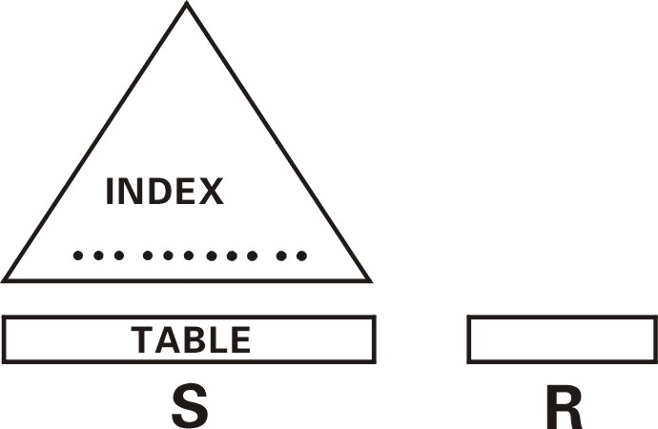
Index-Based Joins
Suppose you have index on S
For each tuple in R, look in
index for matching tuples in S
Need index on attribute used in join
Cost: |R| * (HT + 1) ≈ |R| * log_{d} (|S|)
does it matter if index is clustered?
does it matter if index is sparse or dense?

Slide 31
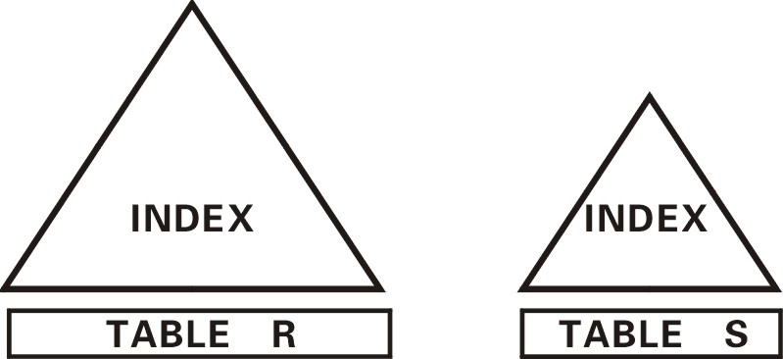
Index on R vs. Index on S
Lookup in R or in S? (which one is outer relation?)
Use index into large table
S.lg_{d} (|R|) < R * log_{d}(|S|)
More complicated if clustered vs. Non-clustered

Slide 32
Indexed Nested-Loop Join
Index lookups can replace file scans if
join is an equi-join or natural join and
an index is available on the inner relation’s join attribute
Can construct an index just to compute a join.
For each tuple t_{r} in the outer relation r, use the index to look up tuples in s that satisfy the join condition with tuple t_{r}.
Worst case: buffer has space for only one page of r, and, for each tuple in r, we perform an index lookup on s.
Cost of the join: b_{r} (t_{T} + t_{S}) + n_{r} ∗ c
Where c is the cost of traversing index and fetching all matching s tuples for one tuple or r
c can be estimated as cost of a single selection on s using the join condition.
If indices are available on join attributes of both r and s, use the relation with fewer tuples as the outer relation.

Slide 33
Example of Nested-Loop Join Costs
Compute student takes, with student as the outer relation.
Let takes have a primary B⁺-tree index on the attribute ID, which contains 20 entries in each index node.
Since takes has 10,000 tuples, the height of the tree is 4, and one more access is needed to find the actual data
student has 5000 tuples
Cost of block nested loops join
400*100 + 100 = 40,100 block transfers + 2 * 100 = 200 seeks
assuming worst case memory
may be significantly less with more memory
Cost of indexed nested loops join
100 + 5000 * 5 = 25,100 block transfers and seeks.
CPU cost likely to be less than that for block nested loops join

