Slide 1
Chapter 2: Intro to Relational Model

Slide 2
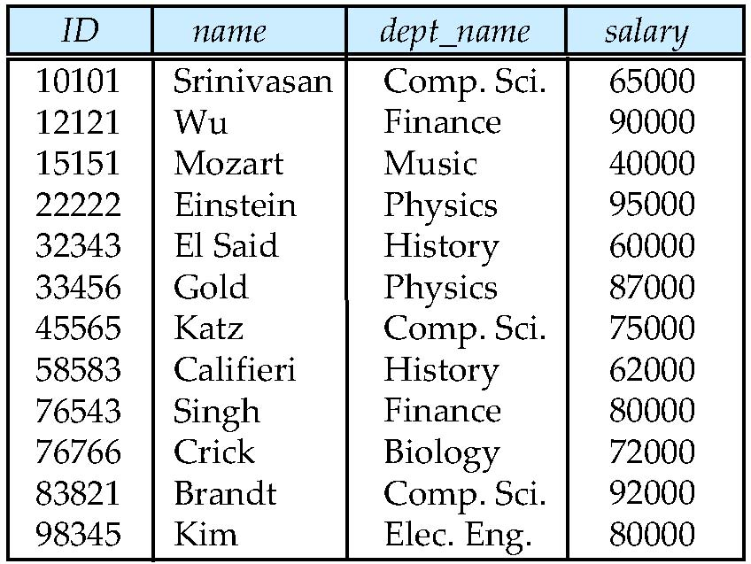
Example of a Relation
attributes
(or columns)
tuples
(or rows)

Slide 3
Attribute Types
The set of allowed values for each attribute is called the domain of the attribute
Attribute values are (normally) required to be atomic; that is, indivisible
The special value null is a member of every domain. Indicated that the value is “unknown”
The null value causes complications in the definition of many operations

Slide 4
Relation Schema and Instance
A₁, A₂, …, A_{n} are attributes
R = (A₁, A₂, …, A_{n} ) is a relation schema
Example:
instructor = (ID, name, dept_name, salary)
Formally, given sets D₁, D₂, …. D_{n} a relation r is a subset of D₁ x D₂ x … x D_{n} Thus, a relation is a set of n-tuples (a₁, a₂, …, a_{n}) where each a_{i} ∈ D_{i}
The current values (relation instance) of a relation are specified by a table
An element t of r is a tuple, represented by a row in a table

Slide 5
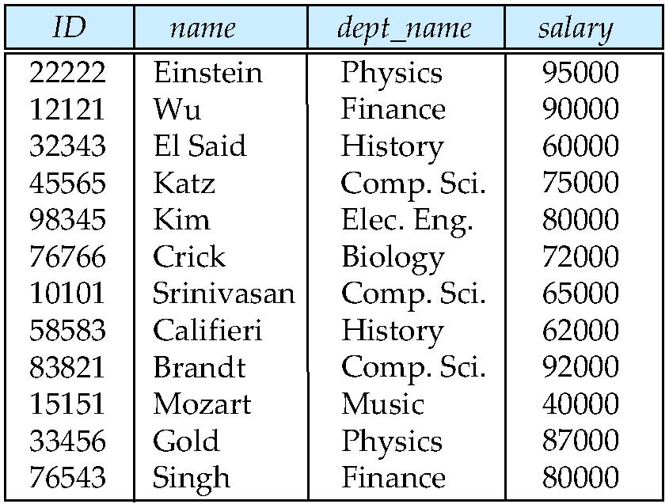
Relations are Unordered
Order of tuples is irrelevant (tuples may be stored in an arbitrary order)
Example: instructor relation with unordered tuples

Slide 6
Keys
Let K ⊆ R
K is a superkey of R if values for K are sufficient to identify a unique tuple of each possible relation r(R)
Example: {ID} and {ID,name} are both superkeys of instructor.
Superkey K is a candidate key if K is minimal Example: {ID} is a candidate key for Instructor
One of the candidate keys is selected to be the primary key.
which one?
Foreign key constraint: Value in one relation must appear in another
Referencing relation
Referenced relation
Example – dept_name in instructor is a foreign key from instructor referencing department

Slide 7
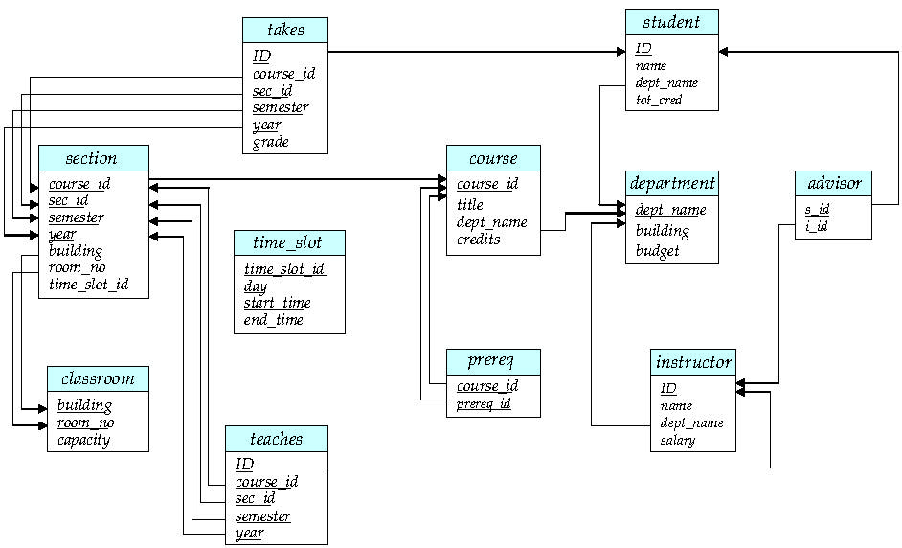
Schema Diagram for University Database

Slide 8
Relational Query Languages
Procedural vs .non-procedural, or declarative
“Pure” languages:
Relational algebra
Tuple relational calculus
Domain relational calculus
The above 3 pure languages are equivalent in computing power
We will concentrate in this chapter on relational algebra
Not turning-machine equivalent
consists of 6 basic operations

Slide 9
Select Operation
Notation: σ_{ρ} (r)
ρ is called the selection predicate
Defined as: σ_{ρ} (r) = {t | t ∈ r and ρ(t)}
Where
ρ is a formula in propositional calculus consisting of terms and
connected by : ∧ (and), ∨ (or), ¬ (not)
Each term is one of: op or where op is one of: =, ≠, >, ≥.

Slide 10
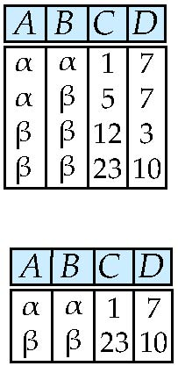
Select Operation – selection of rows (tuples)
Relation r
σ_{predicate}(r)
σ_{A=B ^ D > 5} (r)

Slide 11
Project Operation
Notation:
where A1 , A2 are attribute names and r is a relation name.
The result is defined as the relation of k columns obtained by erasing the columns that are not listed
Duplicate rows removed from result, since relations are sets
∏_{A1,A2,….,An} (r)

Slide 12
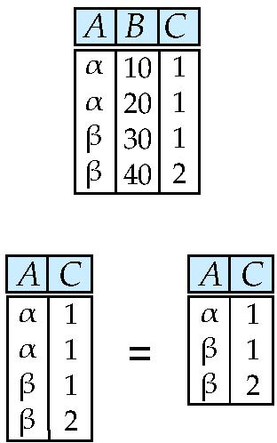
Project Operation – selection of columns (Attributes)
Relation r:
∏_{A,C} (r)

Slide 13
Union Operation
Notation: r ∪ s
Defined as: r ∪ s = {t | t ∈ r or t ∈ s}
For r ∪ s to be valid.
1. r, s must have the same arity (same number of attributes)
2. The attribute domains must be compatible (example: 2nd column of r deals with the same type of values as does the 2 nd column of s)

Slide 14
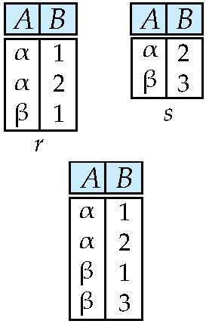
Union of two relations
Relations r, s:
r ∪ s:

Slide 15
Set Difference Operation
Notation r – s
Defined as: r – s = {t | t ∈ r and t ∉ s}
Set differences must be taken between compatible relations.
r and s must have the same arity
attribute domains of r and s must be compatible

Slide 16
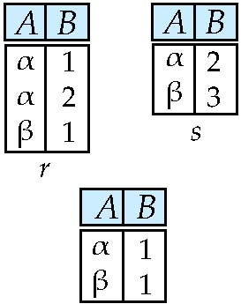
Set difference of two relations
Relations r, s:
r – s:

Slide 17
Intersection Operation
Notation: r ∩ s
Defined as: r ∩ s = {t | t ∈ r and t ∈ s}
For r ∩ s to be valid.
1. r, s must have the same arity (same number of attributes)
2. The attribute domains must be compatible (example: 2nd column of r deals with the same type of values as does the 2 nd column of s)

Slide 18
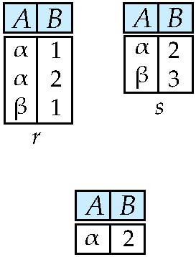
Set intersection of two relations
Relation r, s:
r ∩ s
Note: r ∩ s = r – (r – s)

Slide 19
Cartesian-Product Operation
Notation r x s
Defined as: r x s = {t q | t ∈ r and q ∈ s}
Assume that attributes of r(R) and s(S) are disjoint. (That is, R ∩ S = ∅).
If attributes of r(R) and s(S) are not disjoint, then renaming must be used.

Slide 20
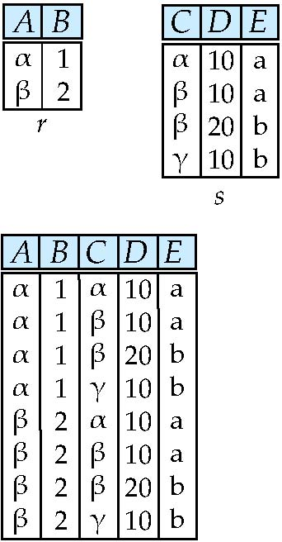
joining two relations -- Cartesian-product
Relations r, s:
r x s:

Slide 21
Cartesian-product – naming issue
B
Relations r, s:
r.B
s.B
r x s:

Slide 22
Renaming a Table
Allows us to refer to a relation, (say E) by more than one name.
ρ _{x} (E)
returns the expression E under the name X
Relations r
r.A r.B s.A s.B
r x ρ _{s} (r)
α
α
β
β
1
1
2
2
α
β
α
β
1
2
1
2

Slide 23
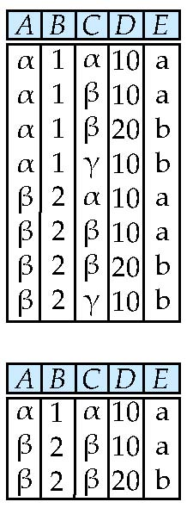
Composition of Operations
Can build expressions using multiple operations
Example: σ_{A=C} (r x s)
r x s
σ_{A=C} (r x s)

Slide 24
Joining two relations – Natural Join
Let r and s be relations on schemas R and S respectively. Then, the “natural join” of relations R and S is a relation on schema R ∪ S obtained as follows:
Consider each pair of tuples t_{r} from r and t_{s} from s.
If t_{r} and t_{s} have the same value on each of the attributes in R ∩ S, add a tuple t to the result, where
t has the same value as t_{r} on r
t has the same value as t_{s} on s

Slide 25
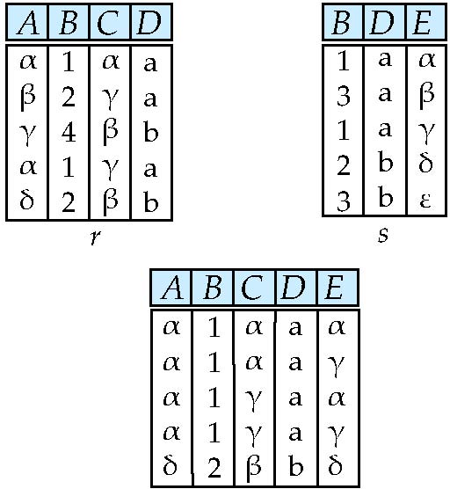
Natural Join Example
Relations r, s:
Natural Join
r s
∏ _{A, r.B, C, r.D, E} (σ _{r.B = s.B ˄ r.D = s.D} (r x s)))

Slide 26
Notes about Relational Languages
Each Query input is a table (or set of tables)
Each query output is a table.
All data in the output table appears in one of the input tables
Relational Algebra is not Turning complete
Can we compute:
SUM
AVG
MAX
MIN
Notes:
26

Slide 27
Summary of Relational Algebra Operators
Symbol (Name) Example of Use
σ
(Selection) ^{σ} salary > = 85000 ^{(instructor)}
Return rows of the input relation that satisfy the predicate.
Π
(Projection) ^{Π} ID, salary ^{(instructor)}
Output specified attributes from all rows of the input relation. Remove duplicate tuples from the output.
x
(Cartesian Product) instructor x department
Output pairs of rows from the two input relations that have the same value on all attributes that have the same name.
∪
(Union) ^{Π} name ^{(instructor) ∪ Π} name ^{(student)}
Output the union of tuples from the two input relations.
-
(Set Difference) ^{Π} name ^{(instructor)} ^{-- Π} name ^{(student)}
Output the set difference of tuples from the two input relations.
⋈
(Natural Join) instructor ⋈ department
Output pairs of rows from the two input relations that have the same value on all attributes that have the same name.

Slide 28
End of Chapter 2 Questions???

