Slide 1
Chapter 3: Introduction to SQL Part 2

Slide 2
Outline
Overview of The SQL Query Language
Data Definition
Basic Query Structure
Additional Basic Operations
Set Operations
Null Values
Aggregate Functions
Nested Subqueries
Modification of the Database
Notes:
1

Slide 3
Cartesian Product Example
Relation emp-super
person supervisor
Bob Alice
Mary Susan
Alice David
David Mary
Find the supervisor of “Bob”
Find the supervisor of the supervisor of “Bob”

Slide 4
Schema Diagram for University Database

Slide 5
Try Writing Some Queries in SQL
Refer to schema diagram on next slide and/or table definitions
Make up some problems for your partner to solve:
E.g., Write an SQL query to find the …. of all the students who …
all the data needed is in one table and where clause involves a single attribute
all the data needed is in one table and predicate in where clause involves conjunction or disjunction of two or more attributes
data needed is spread across two tables
Solve the problems your partner has posed and check your answers

Slide 6
Practice on University Schema
Find the titles of courses in the Comp. Sci. department that have 3 credits.
Find IDs of students who got a B+ in CS-101 in Spring 2010
Find IDs and names of students who got an B in CS-315
Find the names of all instructors whose salary is greater than at least one instructor in the Biology department
Increase the salary of each instructor in the Comp. Sci. department
by 10%. (Update)

Slide 7
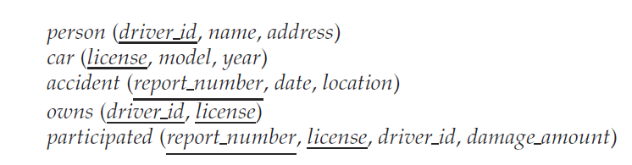
More Practices
Find name of the people who owned cars that were involved
in accidents in 2009.

Slide 8
Null Values
It is possible for tuples to have a null value, denoted by null, for some of their attributes
null signifies an unknown value or that a value does not exist.
The result of any arithmetic expression involving null is null
Example: 5 + null returns null
The predicate is null can be used to check for null values.
Example: Find all instructors whose salary is null.
select name from instructor where salary is null

Slide 9
Null Values and Three Valued Logic
Three values – true, false, unknown
Any comparison with null returns unknown
Example: 5 < null or null <> null or null = null
Three-valued logic using the value unknown:
OR: (unknown or true) = true, (unknown or false) = unknown (unknown or unknown) = unknown
AND: (true and unknown) = unknown, (false and unknown) = false, (unknown and unknown) = unknown
NOT: (not unknown) = unknown
“P is unknown” evaluates to true if predicate P evaluates to unknown
Result of where clause predicate is treated as false if it evaluates to unknown

Slide 10
Aggregate Functions
These functions operate on the multiset of values of a column of a relation, and return a value
avg: average value min: minimum value max: maximum value sum: sum of values count: number of values

Slide 11
Aggregate Functions (Cont.)
Find the average salary of instructors in the Computer Science department
select avg (salary) from instructor where dept_name= ’Comp. Sci.’;
Find the total number of instructors who teach a course in the Spring 2010 semester
select count (distinct ID) from teaches where semester = ’Spring’ and year = 2010;
Find the number of tuples in the course relation
select count (*) from course;

Slide 12
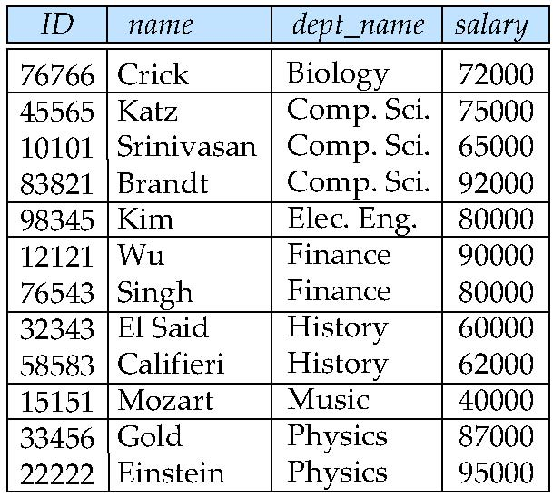
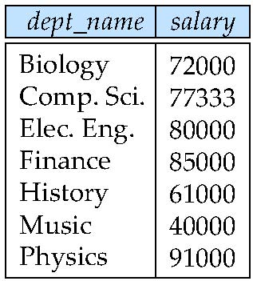
Aggregate Functions – Group By
Find the average salary of instructors in each department
select dept_name, avg (salary) as avg_salary from instructor group by dept_name;
avg_salary

Slide 13
Aggregation (Cont.)
Attributes in select clause outside of aggregate functions must appear in group by list
/* erroneous query */ select dept_name, ID, avg (salary) from instructor group by dept_name;

Slide 14
Aggregate Functions – Having Clause
Find the names and average salaries of all departments whose average salary is greater than 42000
select dept_name, avg (salary)
from instructor
group by dept_name
having avg (salary) > 42000;
Note: predicates in the having clause are applied after the formation of groups whereas predicates in the where clause are applied before forming groups
*** For each course section offered in 2009, find the average total credits (tot cred) of all students enrolled in the section, if the section had at least 2 students.

Slide 15
Null Values and Aggregates
Total all salaries
select sum (salary ) from instructor
Above statement ignores null amounts
Result is null if there is no non-null amount
All aggregate operations except count(*) ignore tuples with null values on the aggregated attributes
What if collection has only null values?
count returns 0
all other aggregates return null

Slide 16
Nested Subqueries
SQL provides a mechanism for the nesting of subqueries. A subquery is a select-from-where expression that is nested within another query.
The nesting can be done in the following SQL query select A₁, A₂, ..., A_{n} from r₁, r₂, ..., r_{m} where P
as follows:
A_{i} can be replaced be a subquery that generates a single value.
r_{i} can be replaced by any valid subquery
P can be replaced with an expression of the form:
B <operation> (subquery)
Where B is an attribute and <operation> to be defined later.

Slide 17
Subqueries in the Where Clause

Slide 18
Subqueries in the Where Clause
A common use of subqueries is to perform tests:
For set membership
For set comparisons
For set cardinality.

Slide 19
Set Membership
Find courses offered in Fall 2009 and in Spring 2010
select distinct course_id
from section
where semester = ’Fall’ and year= 2009 and course_id in (select course_id
from section
where semester = ’Spring’ and year= 2010);
Find courses offered in Fall 2009 but not in Spring 2010
select distinct course_id
from section
where semester = ’Fall’ and year= 2009 and course_id not in (select course_id
from section
where semester = ’Spring’ and year= 2010);

Slide 20
Set Membership (Cont.)
Find the total number of (distinct) students who have taken course sections taught by the instructor with ID 10101
select count (distinct ID)
from takes
where (course_id, sec_id, semester, year) in (select course_id, sec_id, semester, year
from teaches
where teaches.ID= 10101);
Note: Above query can be written in a much simpler manner. The formulation above is simply to illustrate SQL features.
Can you do it in other way?

Slide 21
Set Comparison – “some” Clause
Find names of instructors with salary greater than that of some (at least one) instructor in the Biology department.
select distinct T.name
from instructor as T, instructor as S
where T.salary > S.salary and S.dept name = ’Biology’;
Same query using > some clause
select name
from instructor
where salary > some (select salary
from instructor
where dept name = ’Biology’);

Slide 22
Definition of “some” Clause
F <comp> some r ⇔ ∃ t ∈ r such that (F <comp> t ) Where <comp> can be: <, ≤, >, =, ≠
0
(5 < some
5
) = true
(read: 5 < some tuple in the relation)
6
0
(5 < some
5
) = false
0
(5 = some
) = true
5
0
(5 ≠ some
5
) = true (since 0 ≠ 5)
(= some) ≡ in
However, (≠ some) ≡ not in

Slide 23
Set Comparison – “all” Clause
Find the names of all instructors whose salary is greater than the salary of all instructors in the Biology department.
select name
from instructor
where salary > all (select salary
from instructor
where dept name = ’Biology’);

Slide 24
Definition of “all” Clause
F <comp> all r ⇔ ∀ t ∈ r (F <comp> t)
0
(5 < all
5
) = false
6
6
(5 < all
) = true
10
4
(5 = all
) = false
5
4
(5 ≠ all
) = true (since 5 ≠ 4 and 5 ≠ 6)
6
(≠ all) ≡ not in
However, (= all) ≡ in

Slide 25
Test for Empty Relations
The exists construct returns the value true if the argument subquery is nonempty.
exists r ⇔ r ≠ Ø
not exists r ⇔ r = Ø

Slide 26
Use of “exists” Clause
Yet another way of specifying the query “Find all courses taught in both the Fall 2009 semester and in the Spring 2010 semester”
select course_id from section as S where semester = ’Fall’ and year = 2009 and exists (select * from section as T where semester = ’Spring’ and year= 2010 and S.course_id = T.course_id);
Correlation name – variable S in the outer query
Correlated subquery – the inner query

Slide 27
Use of “not exists” Clause
Find all students who have taken all courses offered in the Biology department.
select distinct S.ID, S.name
from student as S
where not exists ( (select course_id
from course
where dept_name = ’Biology’)
except
(select T.course_id
from takes as T
where S.ID = T.ID));
First nested query lists all courses offered in Biology
Second nested query lists all courses a particular student took
Note that X – Y = Ø ⇔ X ⊆ Y
Note: Cannot write this query using = all and its variants

Slide 28
Test for Absence of Duplicate Tuples
The unique construct tests whether a subquery has any duplicate tuples in its result.
The unique construct evaluates to “true” if a given subquery contains no duplicates .
Find all courses that were offered at most once in 2009
select T.course_id from course as T where unique (select R.course_id from section as R where T.course_id= R.course_id and R.year = 2009);

Slide 29
Subqueries in the Form Clause

Slide 30
Subqueries in the Form Clause
SQL allows a subquery expression to be used in the from clause
Find the average instructors’ salaries of those departments where the average salary is greater than $42,000.”
select dept_name, avg_salary from (select dept_name, avg (salary) as avg_salary from instructor group by dept_name) where avg_salary > 42000;
Note that we do not need to use the having clause
Another way to write above query
select dept_name, avg_salary from (select dept_name, avg (salary) from instructor group by dept_name) as dept_avg (dept_name, avg_salary)
where avg_salary > 42000;

Slide 31
With Clause
The with clause provides a way of defining a temporary relation whose definition is available only to the query in which the with clause occurs.
Find all departments with the maximum budget with max_budget (value) as (select max(budget) from department) select department.name from department, max_budget where department.budget = max_budget.value;

Slide 32
Complex Queries using With Clause
Find all departments where the total salary is greater than the average of the total salary at all departments
with dept _total (dept_name, value) as
(select dept_name, sum(salary)
from instructor
group by dept_name),
dept_total_avg(value) as
(select avg(value)
from dept_total)
select dept_name
from dept_total, dept_total_avg
where dept_total.value > dept_total_avg.value;

Slide 33
Subqueries in the Select Clause

Slide 34
Scalar Subquery
Scalar subquery is one which is used where a single value is expected
List all departments along with the number of instructors in each department
select dept_name, (select count(*) from instructor where department.dept_name = instructor.dept_name) as num_instructors from department;
Runtime error if subquery returns more than one result tuple

Slide 35
Modification of the Database
Deletion of tuples from a given relation.
Insertion of new tuples into a given relation
Updating of values in some tuples in a given relation

Slide 36
Deletion
Delete all instructors
delete from instructor
Delete all instructors from the Finance department delete from instructor where dept_name= ’Finance’;
Delete all tuples in the instructor relation for those instructors associated with a department located in the Watson building.
delete from instructor where dept name in (select dept name from department where building = ’Watson’);

Slide 37
Deletion (Cont.)
Delete all instructors whose salary is less than the average salary of instructors
delete from instructor
where salary < (select avg (salary)
from instructor);
Problem: as we delete tuples from deposit, the average salary changes
Solution used in SQL:
1. First, compute avg (salary) and find all tuples to delete
2. Next, delete all tuples found above (without
recomputing avg or retesting the tuples)

Slide 38
Insertion
Add a new tuple to course
insert into course values (’CS-437’, ’Database Systems’, ’Comp. Sci.’, 4);
or equivalently
insert into course (course_id, title, dept_name, credits) values (’CS-437’, ’Database Systems’, ’Comp. Sci.’, 4);
Add a new tuple to student with tot_creds set to null
insert into student values (’3003’, ’Green’, ’Finance’, null);

Slide 39
Insertion (Cont.)
Add all instructors to the student relation with tot_creds set to 0
insert into student select ID, name, dept_name, 0 from instructor
The select from where statement is evaluated fully before any of its results are inserted into the relation.
Otherwise queries like
insert into table1 select * from table1
would cause problem

Slide 40
Updates
Increase salaries of instructors whose salary is over $100,000 by 3%, and all others by a 5%
Write two update statements:
update instructor set salary = salary * 1.03 where salary > 100000; update instructor set salary = salary * 1.05 where salary <= 100000;
The order is important
Can be done better using the case statement (next slide)

Slide 41
Case Statement for Conditional Updates
Same query as before but with case statement
update instructor set salary = case when salary <= 100000 then salary * 1.05 else salary * 1.03 end

Slide 42
Updates with Scalar Subqueries
Recompute and update tot_creds value for all students
update student S set tot_cred = (select sum(credits) from takes, course where takes.course_id = course.course_id and S.ID= takes.ID.and takes.grade <> ’F’ and takes.grade is not null);
Sets tot_creds to null for students who have not taken any course
Instead of sum(credits), use:
case when sum(credits) is not null then sum(credits) else 0 end

Slide 43
End of Chapter 3 Part 2 Questions???

