Slide 1
Chapter 4: Intermediate SQL

Slide 2
Schema Diagram for University Database

Slide 3
Chapter 4: Intermediate SQL
Join Expressions
Views
Transactions
Integrity Constraints
SQL Data Types and Schemas
Authorization
Notes:
1

Slide 4
Joins
For all instructors who have taught courses, find their names and the course ID of the courses they taught.
select name, course_id from instructor, teaches where instructor.ID = teaches.ID
Find the course ID, semester, year and title of each course offered by the Comp. Sci. department
select section.course_id, semester, year, title from section, course where section.course_id = course.course_id and dept_name = ‘Comp. Sci.'

Slide 5
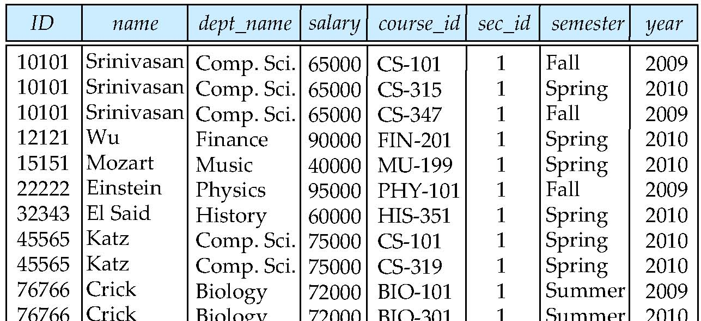
Natural Join
Natural join matches tuples with the same values for all common attributes, and retains only one copy of each common column
select * from instructor natural join teaches;

Slide 6
Natural Join (Cont.)
Danger in natural join: beware of unrelated attributes with same name which get equated incorrectly
List the names of instructors along with the the titles of courses that they teach
Incorrect version (equates course.dept_name with instructor.dept_name)
select name, title from instructor natural join teaches natural join course;
Correct version
select name, title from instructor natural join teaches, course where teaches.course_id= course.course_id;
Another correct version
select name, title from (instructor natural join teaches) join course using(course_id);

Slide 7
Joined Relations
Join operations take two relations and return as a result another relation.
A join operation is a Cartesian product which requires that tuples in the two relations match (under some condition). It also specifies the attributes that are present in the result of the join.
The join operations are typically used as subquery expressions in the from clause.

Slide 8
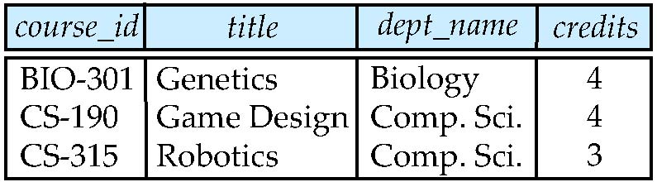
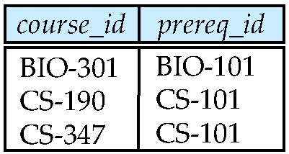
Join operations – Example
Relation course
Relation prereq
Note: prereq information missing for CS-315 and course
information missing for CS-347.

Slide 9
Outer Join
An extension of the join operation that avoids loss of information.
Computes the join and then adds tuples form one relation that does not match tuples in the other relation to the result of the join.
Uses null values.

Slide 10
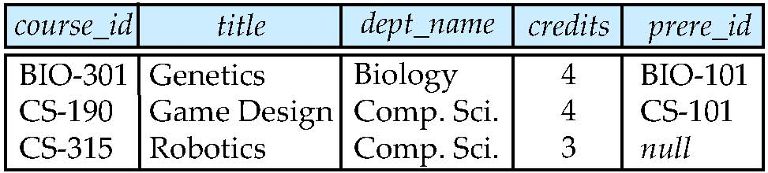
Left Outer Join
course natural left outer join prereq
Note: read prere_id as prereq_id

Slide 11
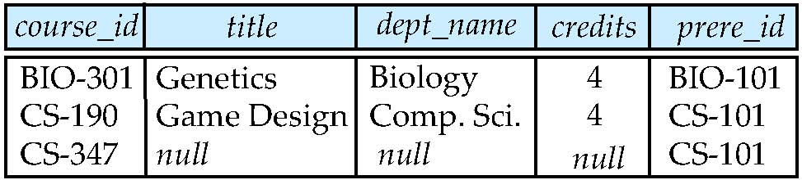
Right Outer Join
course natural right outer join prereq

Slide 12
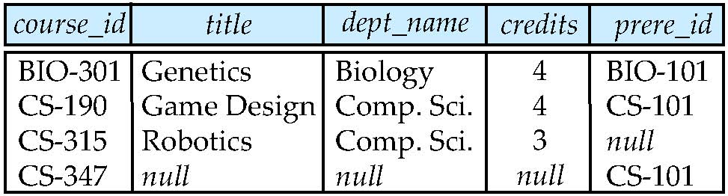
Full Outer Join
course natural full outer join prereq

Slide 13
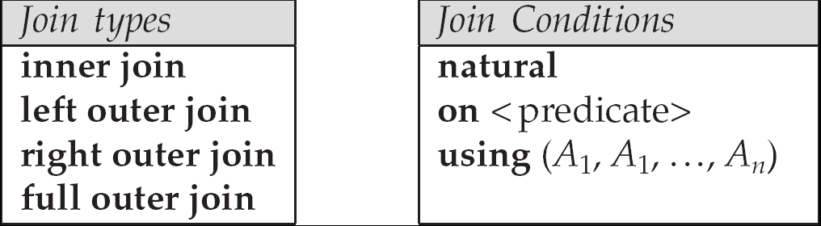
Joined Relations
Join operations take two relations and return as a result another relation.
These additional operations are typically used as subquery expressions in the from clause
Join condition – defines which tuples in the two relations match, and what attributes are present in the result of the join.
Join type – defines how tuples in each relation that do not match any tuple in the other relation (based on the join condition) are treated.

Slide 14
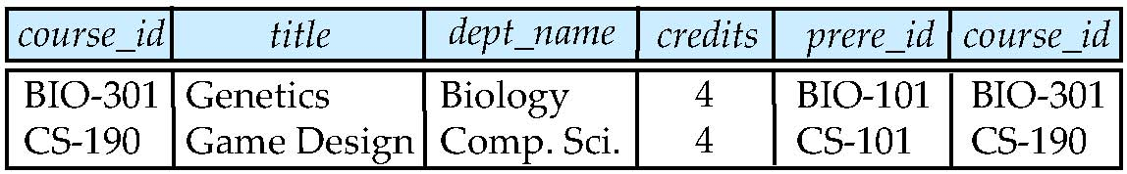
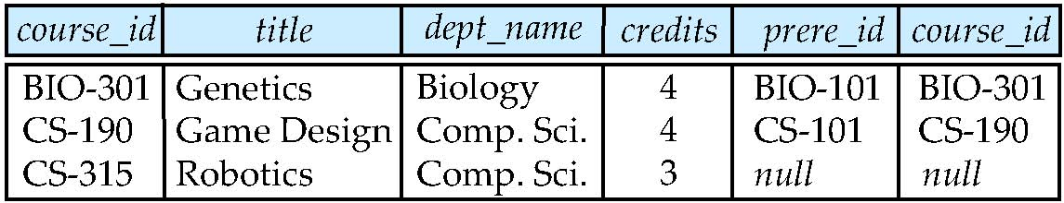
Joined Relations – Examples
course inner join prereq on course.course_id = prereq.course_id
course left outer join prereq on course.course_id = prereq.course_id

Slide 15
Joined Relations – Examples
course natural right outer join prereq
course right outer join prereq using (course_id)

Slide 16
Views
In some cases, it is not desirable for all users to see the entire logical model (that is, all the actual relations stored in the database.)
Consider a person who needs to know an instructors name and department, but not the salary. This person should see a relation described, in SQL, by select ID, name, dept_name from instructor
A view provides a mechanism to hide certain data from the view of certain users.
Any relation that is not of the conceptual model but is made visible to a user as a “virtual relation” is called a view.

Slide 17
View Definition
A view is defined using the create view statement which has the form
create view v as < query expression >
where <query expression> is any legal SQL expression. The view name is represented by v.
Once a view is defined, the view name can be used to refer to the virtual relation that the view generates.
View definition is not the same as creating a new relation by evaluating the query expression
Rather, a view definition causes the saving of an expression; the expression is substituted into queries using the view.

Slide 18
Example Views
A view of instructors without their salary create view faculty as select ID, name, dept_name from instructor
Find all instructors in the Biology department select name from faculty where dept_name = ‘Biology’
Create a view of department salary totals create view departments_total_salary(dept_name, total_salary) as select dept_name, sum (salary) from instructor group by dept_name;

Slide 19
Views Defined Using Other Views
create view physics_fall_2009 as select course.course_id, sec_id, building, room_number from course, section where course.course_id = section.course_id and course.dept_name = ’Physics’ and section.semester = ’Fall’ and section.year = ’2009’;
create view physics_fall_2009_watson as select course_id, room_number from physics_fall_2009 where building= ’Watson’;

Slide 20
Update of a View
Add a new tuple to faculty view which we defined earlier
insert into faculty values (’30765’, ’Green’, ’Music’);
This insertion must be represented by the insertion of the tuple
(’30765’, ’Green’, ’Music’, null)
into the instructor relation.

Slide 21
Some Updates cannot be Translated Uniquely
create view instructor_info as select ID, name, building from instructor, department where instructor.dept_name= department.dept_name;
insert into instructor info values (’69987’, ’White’, ’Taylor’);
which department, if multiple departments in Taylor?
what if no department is in Taylor?
Most SQL implementations allow updates only on simple views
The from clause has only one database relation.
The select clause contains only attribute names of the relation, and does not have any expressions, aggregates, or distinct specification.
Any attribute not listed in the select clause can be set to null
The query does not have a group by or having clause.

Slide 22
Transactions
Unit of work
Atomic transaction
either fully executed or rolled back as if it never occurred
Isolation from concurrent transactions
Transactions begin implicitly
Ended by commit work or rollback work
But default on most databases: each SQL statement commits automatically
Can turn off auto commit for a session (e.g. using API)
In SQL:1999, can use: begin atomic …. end

Slide 23
Integrity Constraints
Integrity constraints guard against accidental damage to the database, by ensuring that authorized changes to the database do not result in a loss of data consistency.
A checking account must have a balance greater than $10,000.00.
A salary of a bank employee must be at least $4.00 an hour.
A customer must have a (non-null) phone number.

Slide 24
Constraints on a Single Relation
not null
primary key
unique
check (P), where P is a predicate

Slide 25
Not Null and Unique Constraints
not null
Declare name and budget to be not null
name varchar(20) not null budget numeric(12,2) not null
unique ( A₁, A₂, …, A_{m})
The unique specification states that the attributes A1, A2, … Am form a candidate key.
Candidate keys are permitted to be null (in contrast to primary keys).

Slide 26
The check clause
check (P)
where P is a predicate
Example: ensure that semester is one of fall, winter, spring or summer:
create table section (
course_id varchar (8),
sec_id varchar (8),
semester varchar (6),
year numeric (4,0),
building varchar (15),
room_number varchar (7),
time slot id varchar (4),
primary key (course_id, sec_id, semester, year),
check (semester in (’Fall’, ’Winter’, ’Spring’, ’Summer’)) );

Slide 27
Referential Integrity
Ensures that a value that appears in one relation for a given set of attributes also appears for a certain set of attributes in another relation.
Example: If “Biology” is a department name appearing in one of the tuples in the instructor relation, then there exists a tuple in the department relation for “Biology”.
Let A be a set of attributes. Let R and S be two relations that contain attributes A and where A is the primary key of S. A is said to be a foreign key of R if for any values of A appearing in R these values also appear in S.

Slide 28
Cascading Actions in Referential Integrity
create table course ( course_id char(5) primary key, title varchar(20), dept_name varchar(20) references department )
create table course ( … dept_name varchar(20), foreign key (dept_name) references department on delete cascade on update cascade, . . . )
alternative actions to cascade: set null, set default

Slide 29
Integrity Constraint Violation During Transactions
E.g.,
create table person ( ID char(10), name char(40), mother char(10), father char(10), primary key ID, foreign key father references person, foreign key mother references person)
How to insert a tuple?
What if mother or father is declared not null?
constraint father_ref foreign key father references person, constraint mother_ref foreign key mother references person)
set constraints father_ref, mother_ref deferred

Slide 30
Complex Check Clauses
check (time_slot_id in (select time_slot_id from time_slot))
why not use a foreign key here?
Every section has at least one instructor teaching the section.
how to write this?
Unfortunately: subquery in check clause not supported by pretty much any database
Alternative: triggers (later)
create assertion <assertion-name> check <predicate>;
Also not supported by anyone

Slide 31
Built-in Data Types in SQL
date: Dates, containing a (4 digit) year, month and date
Example: date ‘2005-7-27’
time: Time of day, in hours, minutes and seconds.
Example: time ‘09:00:30’ time ‘09:00:30.75’
timestamp: date plus time of day
Example: timestamp ‘2005-7-27 09:00:30.75’
interval: period of time
Example: interval ‘1’ day
Subtracting a date/time/timestamp value from another gives an interval value
Interval values can be added to date/time/timestamp values

Slide 32
Other Features
create table student (ID varchar (5), name varchar (20) not null, dept_name varchar (20), tot_cred numeric (3,0) default 0, primary key (ID))
create index studentID index on student(ID)
Large objects
book review clob(10KB)
image blob(10MB)
movie blob(2GB)

Slide 33
User-Defined Types
create type construct in SQL creates user-defined type
create type Dollars as numeric (12,2) final
create table department (dept_name varchar (20), building varchar (15), budget Dollars);

Slide 34
Domains
create domain construct in SQL-92 creates user-defined domain types
create domain person_name char(20) not null
Types and domains are similar. Domains can have constraints, such as not null, specified on them.
create domain degree_level varchar(10) constraint degree_level_test check (value in (’Bachelors’, ’Masters’, ’Doctorate’));

Slide 35
Large-Object Types
Large objects (photos, videos, CAD files, etc.) are stored as a large object:
blob: binary large object -- object is a large collection of uninterpreted binary data (whose interpretation is left to an application outside of the database system)
clob: character large object -- object is a large collection of character data
When a query returns a large object, a pointer is returned rather than the large object itself.

Slide 36
Authorization
Forms of authorization on parts of the database:
Read - allows reading, but not modification of data.
Insert - allows insertion of new data, but not modification of existing data.
Update - allows modification, but not deletion of data.
Delete - allows deletion of data.
Forms of authorization to modify the database schema
Index - allows creation and deletion of indices.
Resources - allows creation of new relations.
Alteration - allows addition or deletion of attributes in a relation.
Drop - allows deletion of relations.

Slide 37
Authorization Specification in SQL
The grant statement is used to confer authorization
grant <privilege list>
on <relation name or view name> to <user list>
<user list> is:
a user-id
public, which allows all valid users the privilege granted
A role (more on this later)
Granting a privilege on a view does not imply granting any privileges on the underlying relations.
The grantor of the privilege must already hold the privilege on the specified item (or be the database administrator).

Slide 38
Privileges in SQL
select: allows read access to relation, or the ability to query using the view
Example: grant users U₁, U₂, and U₃ select authorization on the branch relation:
grant select on instructor to U₁, U₂, U₃
insert: the ability to insert tuples.
update: the ability to update using the SQL update statement.
delete: the ability to delete tuples.
all privileges: used as a short form for all the allowable privileges.

Slide 39
Revoking Authorization in SQL
The revoke statement is used to revoke authorization.
revoke <privilege list>
on <relation name or view name> from <user list>
Example:
revoke select on branch from U₁, U₂, U₃
<privilege-list> may be all to revoke all privileges the revokee may hold.
If <revokee-list> includes public, all users lose the privilege except those granted it explicitly.
If the same privilege was granted twice to the same user by different grantees, the user may retain the privilege after the revocation.
All privileges that depend on the privilege being revoked are also revoked.

Slide 40
Roles
create role instructor;
Privileges can be granted to roles:
grant select on takes to instructor;
Roles can be granted to users, as well as to other roles
create role student
grant instructor to Amit;
create role dean;
grant instructor to dean;
grant dean to Satoshi;

Slide 41
Authorization on Views
create view geo_instructor as (select * from instructor where dept_name = ’Geology’);
grant select on geo_instructor to staff

