Slide 1
Chapter 7: Entity-Relationship Model

Slide 2
Chapter 7: Entity-Relationship Model
Design Process
Modeling
Constraints
E-R Diagram
Design Issues
Weak Entity Sets
Extended E-R Features
Design of the University Database
Reduction to Relation Schemas
Database Design

Slide 3
Design Phases
The initial phase of database design is to characterize fully the data needs of the prospective database users.
Next, the designer chooses a data model and, by applying the concepts of the chosen data model, translates these requirements into a conceptual schema of the database.
A fully developed conceptual schema also indicates the functional requirements of the enterprise. In a “specification of functional requirements”, users describe the kinds of operations (or transactions) that will be performed on the data.
Notes:
3

Slide 4
Design Phases (Cont.)
The process of moving from an abstract data model to the implementation of the database proceeds in two final design phases.
Logical Design – Deciding on the database schema. Database design requires that we find a “good” collection of relation schemas.
Business decision – What attributes should we record in the database?
Computer Science decision – What relation schemas should we have and how should the attributes be distributed among the various relation schemas?
Physical Design – Deciding on the physical layout of the database
Notes:
4

Slide 5
Design Approaches
Entity Relationship Model (covered in this chapter)
Models an enterprise as a collection of entities and relationships
Entity: a “thing” or “object” in the enterprise that is distinguishable from other objects
Described by a set of attributes
Relationship: an association among several entities
Represented diagrammatically by an entity-relationship diagram:
Normalization Theory (Chapter 8)
Formalize what designs are bad, and test for them
Notes:
5

Slide 6
ER model -- Database Modeling
The ER data mode was developed to facilitate database design by allowing specification of an enterprise schema that represents the overall logical structure of a database.
The ER model is very useful in mapping the meanings and interactions of real-world enterprises onto a conceptual schema. Because of this usefulness, many database-design tools draw on concepts from the ER model.
The ER data model employs three basic concepts:
entity sets,
relationship sets,
attributes.
The ER model also has an associated diagrammatic representation, the ER diagram, which can express the overall logical structure of a database graphically.

Slide 7
Modeling
A database can be modeled as:
a collection of entities,
relationship among entities.
An entity is an object that exists and is distinguishable from other objects.
Example: specific person, company, event, plant
Entities have attributes
Example: people have names and addresses
An entity set is a set of entities of the same type that share the same properties.
Example: set of all persons, companies, trees, holidays

Slide 8
Entity Sets instructor and student
instructor_ID instructor_name student-ID student_name

Slide 9
Relationship Sets
A relationship is an association among several entities
Example: 44553 (Peltier) advisor 22222 (Einstein) student entity relationship set instructor entity
A relationship set is a mathematical relation among n ≥ 2 entities, each taken from entity sets
{(e₁, e₂, … e_{n}) | e₁ ∈ E₁, e₂ ∈ E₂, …, e_{n} ∈ E_{n}} where (e₁, e₂, …, e_{n}) is a relationship
Example:
(44553,22222) ∈ advisor

Slide 10
Relationship Set advisor

Slide 11
E-R Diagrams
Rectangles represent entity sets.
Diamonds represent relationship sets.
Attributes listed inside entity rectangle
Underline indicates primary key attributes

Slide 12
Another Example
Entity sets: chocolate_type, person
Some relationship sets:
Likes
Likes best
ate

Slide 13
Relationship Sets (Cont.)
An attribute can also be property of a relationship set.
For instance, the advisor relationship set between entity sets instructor and student may have the attribute date which tracks when the student started being associated with the advisor

Slide 14
Relationship Sets with Attributes

Slide 15
Degree of a Relationship Set
binary relationship
involve two entity sets (or degree two).
most relationship sets in a database system are binary.
Relationships between more than two entity sets are rare. Most relationships are binary. (More on this later.)
Example: students work on research projects under the guidance of an instructor.
relationship proj_guide is a ternary relationship between instructor, student, and project

Slide 16
Attributes
An entity is represented by a set of attributes, that is descriptive properties possessed by all members of an entity set.
Example:
instructor = (ID, name, street, city, salary ) course= (course_id, title, credits)
Domain – the set of permitted values for each attribute
Attribute types:
Simple and composite attributes.
Single-valued and multivalued attributes
Example: multivalued attribute: phone_numbers
Derived attributes
Can be computed from other attributes
Example: age, given date_of_birth

Slide 17
Composite Attributes

Slide 18
Entity With Composite, Multivalued, and Derived Attributes

Slide 19
Mapping Cardinality Constraints
Express the number of entities to which another entity can be associated via a relationship set.
Most useful in describing binary relationship sets.
For a binary relationship set the mapping cardinality must be one of the following types:
One to one
One to many
Many to one
Many to many

Slide 20
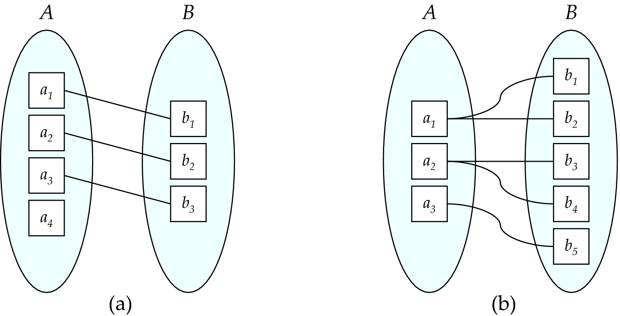
Mapping Cardinalities
One to one
One to many
Note: Some elements in A and B may not be mapped to any
elements in the other set

Slide 21
Cardinality Constraints
We express cardinality constraints by drawing either a directed line (→), signifying “one,” or an undirected line (—), signifying “many,” between the relationship set and the entity set.

Slide 22
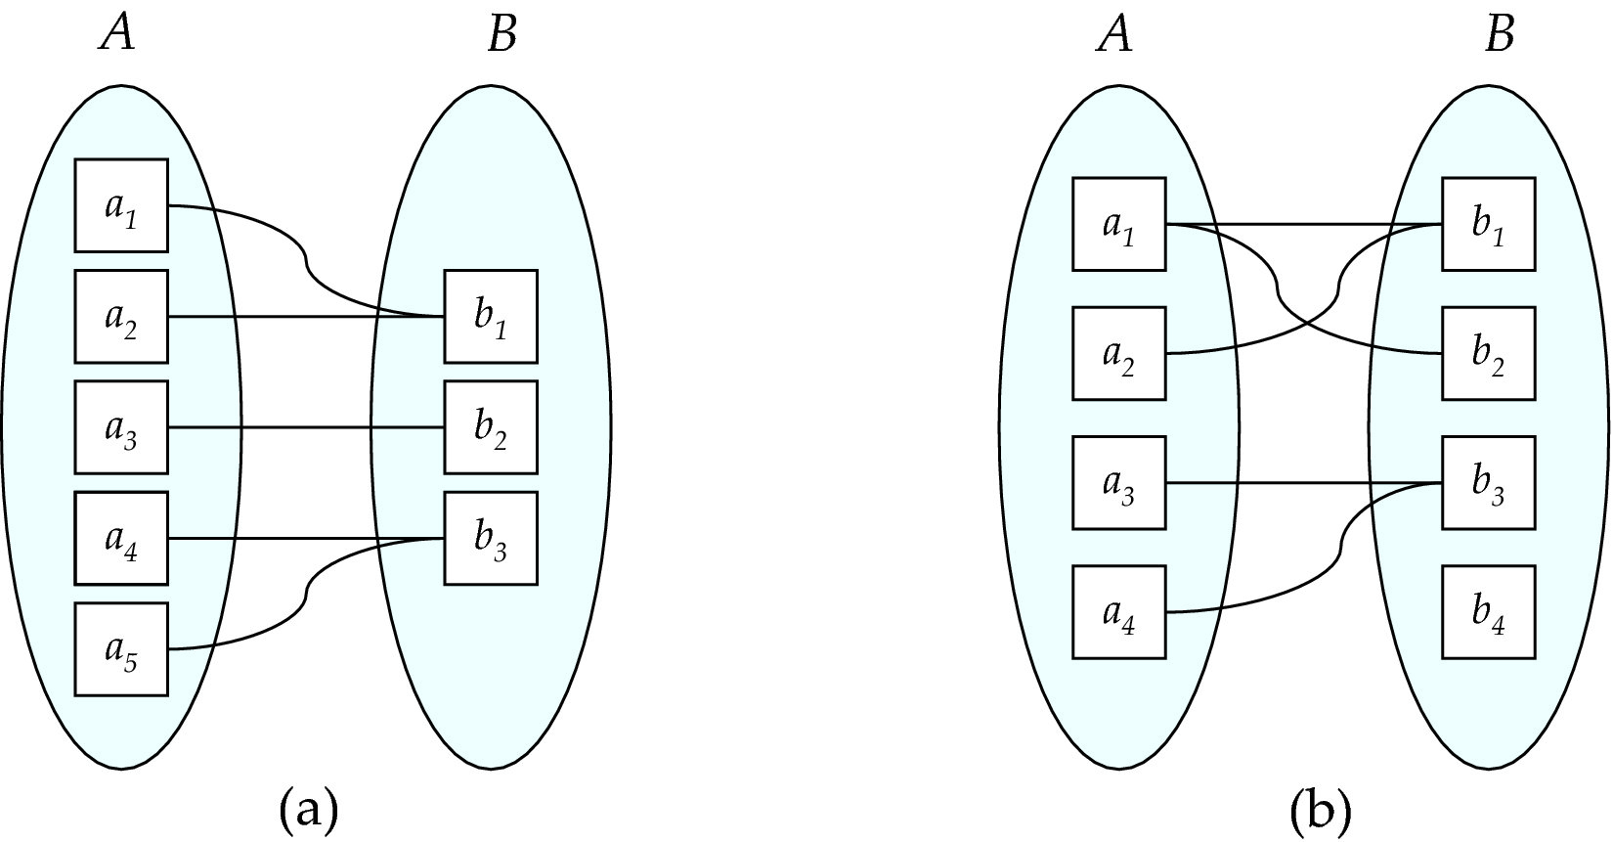
Mapping Cardinalities
Many to one
Many to many
Note: Some elements in A and B may not be mapped to any
elements in the other set

Slide 23
One-to-One Relationship
one-to-one relationship between an instructor and a student
an instructor is associated with at most one student via advisor
and a student is associated with at most one instructor via advisor

Slide 24
One-to-Many Relationship
one-to-many relationship between an instructor and a student
an instructor is associated with several (including 0) students via advisor
a student is associated with at most one instructor via advisor,

Slide 25
Many-to-One Relationships
In a many-to-one relationship between an instructor and a student,
an instructor is associated with at most one student via advisor,
and a student is associated with several (including 0) instructors via advisor

Slide 26
Many-to-Many Relationship
An instructor is associated with several (possibly 0) students via advisor
A student is associated with several (possibly 0) instructors via advisor

Slide 27
Alternative Notation for Cardinality Limits
Cardinality limits can also express participation constraints

Slide 28
Chocolate Example
What are the cardinality constraints on various relationship sets between person and chocolate?
Likes
LikesBest
Ate

Slide 29
Participation of an Entity Set in a Relationship Set
Total participation (indicated by double line): every entity in the entity set participates in at least one relationship in the relationship set
E.g., If every student has (at least one) instructor who is her advisor, the participation of student in advisor is total
Partial participation: some entities may not participate in any relationship in the relationship set
Example: If there could be instructors who don’t advise any students, participation of instructor in advisor is partial

Slide 30
Keys
A super key of an entity set is a set of one or more attributes whose values uniquely determine each entity.
A candidate key of an entity set is a minimal super key
ID is candidate key of instructor
course_id is candidate key of course
Although several candidate keys may exist, one of the candidate keys is selected to be the primary key.
Example: consider Person(first_name, last_name, birthdate, school, favorite_color) where we know that we will NEVER have
two people with the same first name and last name
two people with the same last name and birthdate
What are the candidate keys?

Slide 31
Redundant Attributes
Suppose we have entity sets
instructor, with attributes including dept_name
department
and a relationship
inst_dept relating instructor and department
Attribute dept_name in entity instructor is redundant since there is an explicit relationship inst_dept which relates instructors to departments
The attribute replicates information present in the relationship, and should be removed from instructor
BUT: when converting back to tables, in some cases the attribute gets reintroduced, as we will see.

Slide 32
Roles
Entity sets of a relationship need not be distinct
Each occurrence of an entity set plays a “role” in the relationship
The labels “course_id” and “prereq_id” are called roles.

Slide 33
E-R Diagram with a Ternary Relationship

Slide 34
Cardinality Constraints on Ternary Relationship
We allow at most one arrow out of a ternary (or greater degree) relationship to indicate a cardinality constraint
E.g., an arrow from proj_guide to instructor indicates each student has at most one guide for a project
If there is more than one arrow, there are two ways of defining the meaning.
E.g., a ternary relationship R between A, B and C with arrows to B and C could mean
1. each A entity is associated with a unique entity from B and C or
2. each pair of entities from (A, B) is associated with a unique C entity, and each pair (A, C) is associated with a unique B
Each alternative has been used in different formalisms
To avoid confusion we outlaw more than one arrow

Slide 35
Weak Entity Sets
An entity set that does not have a primary key is referred to as a weak entity set.
The existence of a weak entity set depends on the existence of a identifying entity set
It must relate to the identifying entity set via a total, one-to-many relationship set from the identifying to the weak entity set
Identifying relationship depicted using a double diamond
The discriminator (or partial key) of a weak entity set is the set of attributes that distinguishes among all the entities of a weak entity set.
The primary key of a weak entity set is formed by the primary key of the strong entity set on which the weak entity set is existence dependent, plus the weak entity set’s discriminator.

Slide 36
Weak Entity Sets (Cont.)
We underline the discriminator of a weak entity set with a dashed line.
We put the identifying relationship of a weak entity in a double diamond.
Primary key for section – (course_id, sec_id, semester, year)

Slide 37
More Chocolates
What if chocolate pieces have numbers that are unique within their chocolate type, but not across chocolate types, e.g
Mr Goodbar, 1
Mr Goodbar, 2
Snickers, 1
Modify the ER diagram. Hint: use a weak entity set

Slide 38
E-R Diagram for a University Enterprise

Slide 39
Practice Exercise 1
Design an E-R diagram for keeping track of the exploits of your favorite sports team. You should store the matches played, the scores in each match, the players in each match, and individual player statistics for each match. Summary statistics should be modeled as derived attributes.

Slide 40
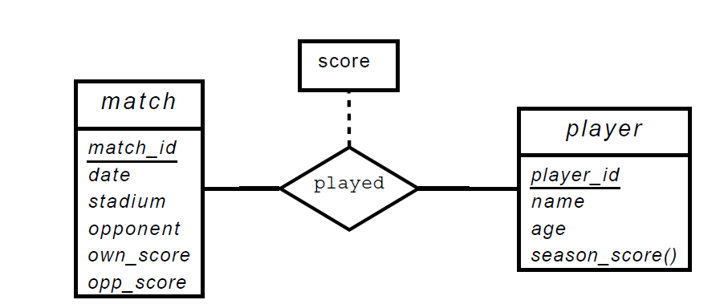
Solution for Practice Exercise

