Slide 1
Chapter 7: Entity-Relationship Model Part 2

Slide 2
Chapter 7: Entity-Relationship Model
Database Design
Extended E-R Features
Reduction to Relation Schemas
Design of the University Database

Slide 3
Design Issues
Use of entity sets vs. attributes
Use of phone as an entity allows extra information about phone numbers (plus multiple phone numbers)
Notes:
3

Slide 4
Design Issues
Use of entity sets vs. relationship sets Possible guideline is to designate a relationship set to describe an action that occurs between entities
Notes:
4

Slide 5
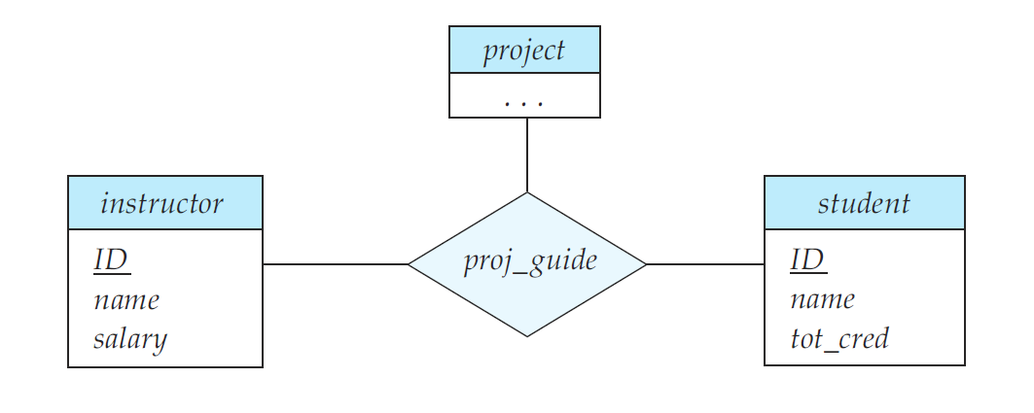
Design Issues
Binary versus n-ary relationship sets Although it is possible to replace any nonbinary (n-ary, for n > 2) relationship set by a number of distinct binary relationship sets, a n-ary relationship set shows more clearly that several entities participate in a single relationship.
Notes:
5

Slide 6
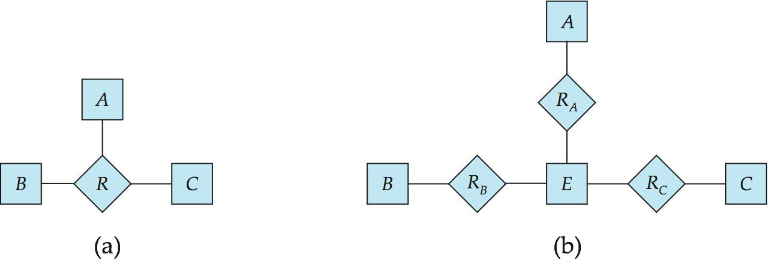
Converting Non-Binary Relationships to Binary Form
In general, any non-binary relationship can be represented using binary relationships by creating an artificial entity set.
Replace R between entity sets A, B and C by an entity set E, and three relationship sets:
1. R_{A}, relating E and A 2. R_{B}, relating E and B 3. R_{C}, relating E and C
Create an identifying attribute for E and add any attributes of R to E
For each relationship (a_{i} , b_{i} , c_{i}) in R, create
1. a new entity e_{i} in the entity set E 2. add (e_{i} , a_{i} ) to R_{A}
3. add (e_{i} , b_{i} ) to R_{B} 4. add (e_{i} , c_{i} ) to R_{C}
Notes:
6

Slide 7
Binary Vs. Non-Binary Relationships
Some relationships that appear to be non-binary may be better represented using binary relationships
E.g., A ternary relationship parents, relating a child to his/her father and mother, is best replaced by two binary relationships, father and mother
Using two binary relationships allows partial information (e.g., only mother being know)
But there are some relationships that are naturally non-binary
Example: proj_guide
Notes:
7

Slide 8
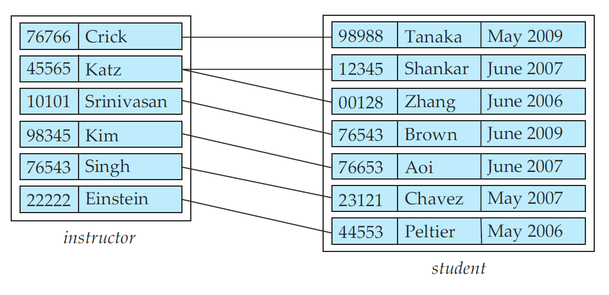
Design Issues
Placement of relationship attributes
e.g., attribute date as attribute of advisor or as attribute of student
Notes:
8

Slide 9
Extended ER Features

Slide 10
Extended E-R Features: Specialization
Top-down design process; we designate subgroupings within an entity set that are distinctive from other entities in the set.
These subgroupings become lower-level entity sets that have attributes or participate in relationships that do not apply to the higher-level entity set.
Depicted by a triangle component labeled ISA (E.g., instructor “is a” person).
Attribute inheritance – a lower-level entity set inherits all the attributes and relationship participation of the higher-level entity set to which it is linked.

Slide 11
Specialization Example

Slide 12
Extended ER Features: Generalization
A bottom-up design process – combine a number of entity sets that share the same features into a higher-level entity set.
Specialization and generalization are simple inversions of each other; they are represented in an E-R diagram in the same way.
The terms specialization and generalization are used interchangeably.

Slide 13
Specialization and Generalization (Cont.)
Can have multiple specializations of an entity set based on different features.
E.g., permanent_employee vs. temporary_employee, in addition to instructor vs. secretary
Each particular employee would be
a member of one of permanent_employee or temporary_employee,
and also a member of one of instructor, secretary
The ISA relationship also referred to as superclass - subclass relationship

Slide 14
Design Constraints on a Specialization/Generalization
Constraint on which entities can be members of a given lower-level entity set.
condition-defined
Example: all customers over 65 years are members of senior-citizen entity set; senior-citizen ISA person.
user-defined
Constraint on whether or not entities may belong to more than one lower-level entity set within a single generalization.
Disjoint
an entity can belong to only one lower-level entity set
Noted in E-R diagram by having multiple lower-level entity sets link to the same triangle
Overlapping
an entity can belong to more than one lower-level entity set

Slide 15
Design Constraints on a Specialization/Generalization (Cont.)
Completeness constraint -- specifies whether or not an entity in the higher-level entity set must belong to at least one of the lower-level entity sets within a generalization.
total: an entity must belong to one of the lower-level entity sets
partial: an entity need not belong to one of the lower-level entity sets

Slide 16
Aggregation
Consider the ternary relationship proj_guide, which we saw earlier
Suppose we want to record evaluations of a student by a guide on a project

Slide 17
Aggregation (Cont.)
Relationship sets eval_for and proj_guide represent overlapping information
Every eval_for relationship corresponds to a proj_guide relationship
However, some proj_guide relationships may not correspond to any eval_for relationships
So we can’t discard the proj_guide relationship
Eliminate this redundancy via aggregation
Treat relationship as an abstract entity
Allows relationships between relationships
Abstraction of relationship into new entity

Slide 18
Aggregation (Cont.)
Without introducing redundancy, the following diagram represents:
A student is guided by a particular instructor on a particular project
A student, instructor, project combination may have an associated evaluation
Notes:
18

Slide 19
E-R Design Decisions
The use of an attribute or entity set to represent an object.
Whether a real-world concept is best expressed by an entity set or a relationship set.
The use of a ternary relationship versus a pair of binary relationships.
The use of a strong or weak entity set.
The use of specialization/generalization – contributes to modularity in the design.
The use of aggregation – can treat the aggregate entity set as a single unit without concern for the details of its internal structure.

Slide 20
Reduction to Relation Schemas
Entity sets and relationship sets can be expressed uniformly as relation schemas that represent the contents of the database.
A database which conforms to an E-R diagram can be represented by a collection of schemas.
For each entity set and relationship set there is a unique schema that is assigned the name of the corresponding entity set or relationship set.
Each schema has a number of columns (generally corresponding to attributes), which have unique names.

Slide 21
Representing Entity Sets With Simple Attributes
A strong entity set reduces to a schema with the same attributes student(ID, name, tot_cred)
A weak entity set becomes a table that includes a column for the primary key of the identifying strong entity set section ( course_id, sec_id, sem, year )

Slide 22
Representing Relationship Sets
A many-to-many relationship set is represented as a schema with attributes for the primary keys of the two participating entity sets, and any descriptive attributes of the relationship set.
Example: schema for relationship set advisor
advisor = (s_id, i_id)

Slide 23
Redundancy of Schemas
Many-to-one and one-to-many relationship sets that are total on the many-side can be represented by adding an extra attribute to the “many” side, containing the primary key of the “one” side
Example: Instead of creating a schema for relationship set inst_dept, add an attribute dept_name to the schema arising from entity set instructor

Slide 24
Redundancy of Schemas (Cont.)
For one-to-one relationship sets, either side can be chosen to act as the “many” side
That is, extra attribute can be added to either of the tables corresponding to the two entity sets
If participation is partial on the “many” side, replacing a schema by an extra attribute in the schema corresponding to the “many” side could result in null values
The schema corresponding to a relationship set linking a weak entity set to its identifying strong entity set is redundant.
Example: The section schema already contains the attributes that would appear in the sec_course schema
Notes:
24

Slide 25
Composite and Multivalued Attributes
Composite attributes are flattened out by creating a separate attribute for each component attribute
Example: given entity set instructor with composite attribute name with component attributes first_name and last_name the schema corresponding to the entity set has two attributes name_first_name and name_last_name
Prefix omitted if there is no ambiguity
Ignoring multivalued attributes, extended instructor schema is
instructor(ID, first_name, middle_initial, last_name, street_number, street_name, apt_number, city, state, zip_code, date_of_birth)
Notes:
25

Slide 26
Composite and Multivalued Attributes
A multivalued attribute M of an entity E is represented by a separate schema EM
Schema EM has attributes corresponding to the primary key of E and an attribute corresponding to multivalued attribute M
Example: Multivalued attribute phone_number of instructor is represented by a schema: inst_phone= ( ID, phone_number)
Each value of the multivalued attribute maps to a separate tuple of the relation on schema EM
For example, an instructor entity with primary key 22222 and phone numbers 456-7890 and 123-4567 maps to two tuples: (22222, 456-7890) and (22222, 123-4567)
Notes:
26

Slide 27
Multivalued Attributes (Cont.)
Special case:entity time_slot has only one attribute other than the primary-key attribute, and that attribute is multivalued
Optimization: Don’t create the relation corresponding to the entity, just create the one corresponding to the multivalued attribute
time_slot(time_slot_id, day, start_time, end_time)
Caveat: time_slot attribute of section (from sec_time_slot) cannot be a foreign key due to this optimization
Notes:
27

Slide 28
Representing Specialization via Schemas
Method 1:
Form a schema for the higher-level entity
Form a schema for each lower-level entity set, include primary key of higher-level entity set and local attributes schema attributes person ID, name, street, city student ID, tot_cred employee ID, salary
Drawback: getting information about, an employee requires accessing two relations, the one corresponding to the low-level schema and the one corresponding to the high-level schema

Slide 29
Representing Specialization as Schemas (Cont.)
Method 2:
Form a schema for each entity set with all local and inherited attributes schema attributes person ID, name, street, city student ID, name, street, city, tot_cred employee ID, name, street, city, salary
If specialization is total, the schema for the generalized entity set (person) not required to store information
Can be defined as a “view” relation containing union of specialization relations
But explicit schema may still be needed for foreign key constraints
Drawback: name, street and city may be stored redundantly for people who are both students and employees

Slide 30
Schemas Corresponding to Aggregation
To represent aggregation, create a schema containing
primary key of the aggregated relationship,
the primary key of the associated entity set
any descriptive attributes

Slide 31
Schemas Corresponding to Aggregation (Cont.)
For example, to represent aggregation manages between relationship works_on and entity set manager, create a schema
eval_for (s_ID, project_id, i_ID, evaluation_id)
Schema proj_guide is redundant provided we are willing to store null values for attribute evaluation_id in relation on schema evaluation

Slide 32
E-R Diagram for a University Enterprise

Slide 33
Figure 7.29 (Online Book Store)

Slide 34
Summary of Symbols Used in E-R Notation

Slide 35
Symbols Used in E-R Notation (Cont.)

