Slide 1
Chapter 8: Relational Database Design
Notes:
In general, the goal of relational database design is to generate a set of relation
schemas that allows us to store information without unnecessary redundancy, yet
also allows us to retrieve information easily. This is accomplished by designing
schemas that are in an appropriate normal form. To determine whether a relation
schema is in one of the desirable normal forms, we need information about
the real-world enterprise that we are modeling with the database. Some of this
information exists in a well-designed E-R diagram, but additional information
about the enterprise may be needed as well.
In this chapter, we introduce a formal approach to relational database design
based on the notion of functional dependencies. We then define normal forms
in terms of functional dependencies and other types of data dependencies.

Slide 2
Chapter 8: Relational Database Design
Features of Good Relational Design
Atomic Domains and First Normal Form
Decomposition Using Functional Dependencies
Functional Dependency Theory [skipping details]
Algorithms for Functional Dependencies [skipping details]
Decomposition Using Multivalued Dependencies [skip]
More Normal Form [skip]
Database-Design Process
Modeling Temporal Data [skip]

Slide 3
First Normal Form
Domain is atomic if its elements are considered to be indivisible units
Examples of non-atomic domains:
Set of names, composite attributes
Identification numbers like CS101 that can be broken up into parts
A relational schema R is in first normal form if the domains of all attributes of R are atomic
Non-atomic values complicate storage and encourage redundant (repeated) storage of data
Example: Set of accounts stored with each customer, and set of owners stored with each account
We assume all relations are in first normal form (and revisit this in Chapter 22: Object Based Databases)

Slide 4
First Normal Form (Cont’d)
Atomicity is actually a property of how the elements of the domain are used.
Example: Strings would normally be considered indivisible
Suppose that students are given roll numbers which are strings of the form CS0012 or EE1127
If the first two characters are extracted to find the department, the domain of roll numbers is not atomic.
Doing so is a bad idea: leads to encoding of information in application program rather than in the database.

Slide 5
Higher Normal forms — Devise a Theory for the Following
Decide whether a particular relation R is in “good” form.
In the case that a relation R is not in “good” form, decompose it into a set of relations {R₁, R₂, ..., R_{n}} such that
each relation is in good form
the decomposition is a lossless-join decomposition
Our theory is based on:
functional dependencies
multivalued dependencies [skipping]

Slide 6
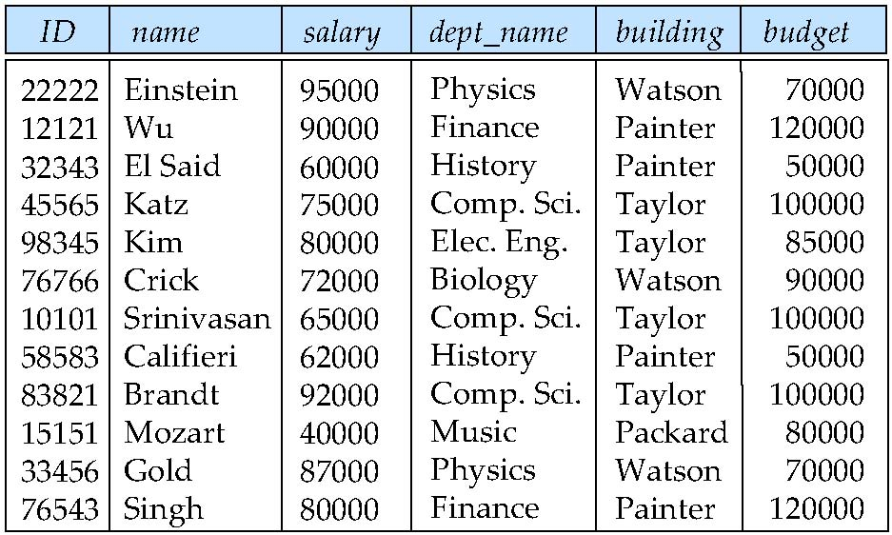
Combine Schemas?
Suppose we combine instructor and department into inst_dept
(No connection to relationship set inst_dept)
Result is possible repetition of information
Notes:
It is important that all these tuples agree as to the budget amount since otherwise
our database would be inconsistent. In our original design using instructor
and department, we stored the amount of each budget exactly once. This suggests
that using inst dept is a bad idea since it stores the budget amounts redundantly
and runs the risk that some user might update the budget amount in one tuple
but not all, and thus create inconsistency.
Even if we decided to live with the redundancy problem, there is still another
problem with the inst dept schema. Suppose we are creating a new department
in the university. In the alternative design above, we cannot represent directly
the information concerning a department (dept name, building, budget) unless that
department has at least one instructor at the university. This is because tuples in
the inst dept table require values for ID, name, andsalary.

Slide 7
A Combined Schema Without Repetition
Consider combining relations
sec_class(sec_id, building, room_number) and
section(course_id, sec_id, semester, year)
into one relation
section(course_id, sec_id, semester, year, building, room_number)
No repetition in this case

Slide 8
What About Smaller Schemas?
Suppose we had started with inst_dept. How would we know to split up (decompose) it into instructor and department?
Write a rule “if there were a schema (dept_name, building, budget), then dept_name would be a candidate key”
Denote as a functional dependency:
dept_name → building, budget
In inst_dept, because dept_name is not a candidate key, the building and budget of a department may have to be repeated.
This indicates the need to decompose inst_dept
Not all decompositions are good. Suppose we decompose employee(ID, name, street, city, salary) into
employee1 (ID, name)
employee2 (name, street, city, salary)
The next slide shows how we lose information -- we cannot reconstruct the original employee relation -- and so, this is a lossy decomposition.

Slide 9
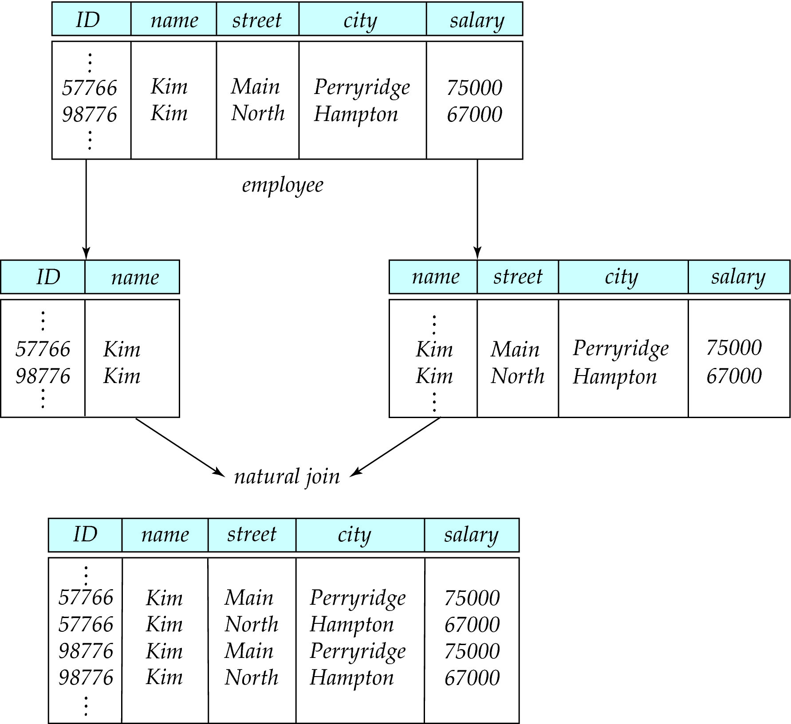
A Lossy Decomposition
Notes:
The flaw in this decomposition arises from the possibility that the enterprise has
two employees with the same name. This is not unlikely in practice, as many
cultures have certain highly popular names. Of course each person would have
a unique employee-id, which is why ID can serve as the primary key. As an
example, let us assume two employees, both named Kim, work at the university
and have the following tuples in the relation on schema employee in the original
design:
Figure 8.3 shows these tuples, the resulting tuples using the schemas resulting
from the decomposition, and the result if we attempted to regenerate the original
tuples using a natural join. As we see in the figure, the two original tuples
appear in the result along with two new tuples that incorrectly mix data values
pertaining to the two employees named Kim. Although we have more tuples,
we actually have less information in the following sense. We can indicate that a
certain street, city, and salary pertain to someone named Kim, but we are unable
to distinguish which of the Kims. Thus, our decomposition is unable to represent
certain important facts about the university employees.

Slide 10
Example of Lossless-Join Decomposition
Lossless join decomposition
Decomposition of R = (A, B, C) R₁ = (A, B) R₂ = (B, C)
A
B
C
A
B
B
C
α
β
1
2
A
B
α
β
1
2
1
2
A
B
r
∏_{A,B}(r)
∏_{B,C}(r)
∏_{A,B} (r) ∏_{B,C} (r)
A
B
C
α
β
1
2
A
B

Slide 11
Functional Dependencies
Constraints on the set of legal relations.
Require that the value for a certain set of attributes determines uniquely the value for another set of attributes.
A functional dependency is a generalization of the notion of a key.

Slide 12
Functional Dependencies (Cont.)
Let R be a relation schema
α ⊆ R and β ⊆ R
The functional dependency
α → β holds on R if and only if for any legal relations r(R), whenever any two tuples t₁ and t₂ of r agree on the attributes α, they also agree on the attributes β. That is,
t₁[α] = t₂ [α] ⇒ t₁[β ] = t₂ [β ]
Example: Consider r(A,B ) with the following instance of r.
On this instance, A → B does NOT hold, but B → A does hold.
4
1 5
3 7

Slide 13
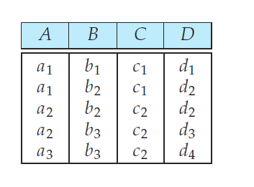
Functional Dependency
A→C???
C→A???
Notes:
Some functional dependencies are said to be trivial because they are satisfied
by all relations. For example, A → A is satisfied by all relations involving
attribute A. Reading the definition of functional dependency literally,we see that,
for all tuples t1 and t2 such that t1[A] = t2[A], it is the case that t1[A] = t2[A].
Similarly, AB → A is satisfied by all relations involving attribute A. In general,
a functional dependency of the form alpha→beta is trivial if beta⊆alpha .

Slide 14
Functional Dependencies (Cont.)
K is a superkey for relation schema R if and only if K → R
K is a candidate key for R if and only if
K → R, and
for no α ⊂ K, α → R
Functional dependencies allow us to express constraints that cannot be expressed using superkeys. Consider the schema:
inst_dept (ID, name, salary, dept_name, building, budget ).
We expect these functional dependencies to hold:
dept_name→ building
and ID → building
but would not expect the following to hold:
dept_name → salary

Slide 15
Use of Functional Dependencies
We use functional dependencies to:
test relations to see if they are legal under a given set of functional dependencies.
If a relation r is legal under a set F of functional dependencies, we say that r satisfies F.
specify constraints on the set of legal relations
We say that F holds on R if all legal relations on R satisfy the set of functional dependencies F.
Note: A specific instance of a relation schema may satisfy a functional dependency even if the functional dependency does not hold on all legal instances.
For example, a specific instance of instructor may, by chance, satisfy name → ID.
Notes:
It is important to realize that an instance of a relation may satisfy some functional
dependencies that are not required to hold on the relation’s schema. In the
instance of the classroom relation of Figure 8.5, we see that room number→capacity
is satisfied. However, we believe that, in the real world, two classrooms in different
buildings can have the same room number but with different room capacity.
Thus, it is possible, at some time, to have an instance of the classroom relation
in which room number→capacity is not satisfied. So, we would not include room
number→capacity in the set of functional dependencies that hold on the schema
for the classroom relation. However, we would expect the functional dependency
building, room number→capacity to hold on the classroom schema.

Slide 16
Functional Dependencies (Cont.)
A functional dependency is trivial if it is satisfied by all instances of a relation
Example:
ID, name → ID
name → name
In general, α → β is trivial if β ⊆ α

Slide 17
Closure of a Set of Functional Dependencies
Given a set F set of functional dependencies, there are certain other functional dependencies that are logically implied by F.
For e.g.: If A → B and B → C, then we can infer that A → C
The set of all func. dependencies logically implied by F is the closure of F.
We denote the closure of F by F⁺.
We can find F^{+,} the closure of F, by repeatedly applying Armstrong’s Axioms:
if β ⊆ α, then α → β (reflexivity)
if α → β, then γ α → γ β (augmentation)
if α → β, and β → γ, then α → γ (transitivity)
These rules are
sound (generate only functional dependencies that actually hold), and
complete (generate all functional dependencies that hold).
Notes:
Armstrong’s axioms are sound, because they do not generate any incorrect
functional dependencies. They are complete, because, for a given set F of functional
dependencies, they allow us to generate all F+.

Slide 18
Example
R = (A, B, C, G, H, I) F = { A → B A → C CG → H CG → I B → H}
some members of F⁺
A → H
by transitivity from A → B and B → H
AG → I
by augmenting A → C with G, to get AG → CG and then transitivity with CG → I
CG → HI
by augmenting CG → I to infer CG → CGI,
and augmenting of CG → H to infer CGI → HI,
and then transitivity

Slide 19
Boyce-Codd Normal Form
A relation schema R is in BCNF with respect to a set F of functional dependencies if for all functional dependencies in F⁺ of the form
α → β
where α ⊆ R and β ⊆ R, at least one of the following holds:
α → β is trivial (i.e., β ⊆ α)
α is a superkey for R
Example schema not in BCNF:
instr_dept (ID, name, salary, dept_name, building, budget )
because dept_name→ building, budget
holds on instr_dept, but dept_name is not a superkey

Slide 20
Decomposing a Schema into BCNF
Suppose we have a schema R and a non-trivial dependency α→β causes a violation of BCNF.
We decompose R into:
(αU β )
( R - ( β - α ) )
In our example,
α = dept_name
β = building, budget
and inst_dept is replaced by
(α U β ) = ( dept_name, building, budget )
( R - ( β - α ) ) = ( ID, name, salary, dept_name )

Slide 21
Example of BCNF Decomposition
class (course_id, title, dept_name, credits, sec_id, semester, year, building, room_number, capacity, time_slot_id)
Functional dependencies:
course_id→ title, dept_name, credits
building, room_number→capacity
course_id, sec_id, semester, year→building, room_number, time_slot_id
A candidate key {course_id, sec_id, semester, year}.
BCNF Decomposition:
course_id→ title, dept_name, credits holds
but course_id is not a superkey.
We replace class by:
course(course_id, title, dept_name, credits)
class-1 (course_id, sec_id, semester, year, building, room_number, capacity, time_slot_id)

Slide 22
BCNF Decomposition (Cont.)
course is in BCNF
How do we know this?
building, room_number→capacity holds on class-1
but {building, room_number} is not a superkey for class-1.
We replace class-1 by:
classroom (building, room_number, capacity)
section (course_id, sec_id, semester, year, building, room_number, time_slot_id)
classroom and section are in BCNF.

Slide 23
Another example
Orders(cust_id, sandwich_name, size, price, quantity, status)
primary key (cust_id, sandwich_name, size)
Assume the sandwich name and size determines the price.
Example of a non-trivial Functional dependency where LHS is not superkey?
Decomposition into BCNF

Slide 24
BCNF and Dependency Preservation
Constraints, including functional dependencies, are costly to check in practice unless they pertain to only one relation
If it is sufficient to test only those dependencies on each individual relation of a decomposition in order to ensure that all functional dependencies hold, then that decomposition is dependency preserving.
Because it is not always possible to achieve both BCNF and dependency preservation, we consider a weaker normal form, known as third normal form.

Slide 25
Third Normal Form
A relation schema R is in 3rd normal form (3NF) if for all:
α → β in F⁺ at least one of the following holds:
α → β is trivial (i.e., β is a subset of α)
α is a superkey for R
Each attribute A in β – α is contained in a candidate key for R.
(NOTE: each attribute may be in a different cand. key)
If a relation is in BCNF it is in 3NF (since in BCNF one of the first two conditions above must hold).
Third condition is a minimal relaxation of BCNF to ensure dependency preservation (will see why later).

Slide 26
Design Goals
Goal for a relational database design is:
BCNF.
Lossless join.
(Dependency preservation -- we’re skipping this topic)
If we cannot achieve this, we accept one of
Lack of dependency preservation
Redundancy due to use of 3NF
Interestingly, SQL does not provide a direct way of specifying functional dependencies other than superkeys.
Can specify FDs using assertions, but they are expensive to test, (and currently not supported by any of the widely used databases!)
Even if we had a dependency preserving decomposition, using SQL we would not be able to efficiently test a functional dependency whose left hand side is not a key.

Slide 27
How good is BCNF?
There are database schemas in BCNF that do not seem to be sufficiently normalized
Consider a relation
inst_info (ID, child_name, phone)
where an instructor may have more than one phone and can have multiple children
ID
child_name
phone
99999
99999
99999
99999
David
David
William
Willian
512-555-1234
512-555-4321
512-555-1234
512-555-4321
inst_info

Slide 28
How good is BCNF? (Cont.)
There are no non-trivial functional dependencies and therefore the relation is in BCNF
Insertion anomalies – i.e., if we add a phone 981-992-3443 to 99999, we need to add two tuples
(99999, David, 981-992-3443) (99999, William, 981-992-3443)

Slide 29
How good is BCNF? (Cont.)
Therefore, it is better to decompose inst_info into:
ID
child_name
inst_child
99999
99999
99999
99999
David
David
William
Willian
ID
phone
inst_phone
99999
99999
99999
99999
512-555-1234
512-555-4321
512-555-1234
512-555-4321
This suggests the need for higher normal forms, such as Fourth Normal Form (4NF).

Slide 30
Overall Database Design Process
We have assumed schema R is given
R could have been generated when converting E-R diagram to a set of tables.
R could have been a single relation containing all attributes that are of interest (called universal relation).
Normalization breaks R into smaller relations.
R could have been the result of some ad hoc design of relations, which we then test/convert to normal form.

Slide 31
ER Model and Normalization
When an E-R diagram is carefully designed, identifying all entities correctly, the tables generated from the E-R diagram should not need further normalization.
However, in a real (imperfect) design, there can be functional dependencies from non-key attributes of an entity to other attributes of the entity
Example: an employee entity with attributes department_name and building, and a functional dependency department_name→ building
Good design would have made department an entity
Functional dependencies from non-key attributes of a relationship set possible, but rare --- most relationships are binary

Slide 32
Denormalization for Performance
May want to use non-normalized schema for performance
For example, displaying prereqs along with course_id, and title requires join of course with prereq
Alternative 1: Use denormalized relation containing attributes of course as well as prereq with all above attributes
faster lookup
extra space and extra execution time for updates
extra coding work for programmer and possibility of error in extra code
Alternative 2: use a materialized view defined as course prereq
Benefits and drawbacks same as above, except no extra coding work for programmer and avoids possible errors

Slide 33
Other Design Issues
Some aspects of database design are not caught by normalization
Examples of bad database design, to be avoided:
Instead of earnings (company_id, year, amount ), use
earnings_2004, earnings_2005, earnings_2006, etc., all on the schema (company_id, earnings).
Above are in BCNF, but make querying across years difficult and needs new table each year
company_year (company_id, earnings_2004, earnings_2005, earnings_2006)
Also in BCNF, but also makes querying across years difficult and requires new attribute each year.
Is an example of a crosstab, where values for one attribute become column names
Used in spreadsheets, and in data analysis tools

