Slide 1
Chapter 9: Application Design and Development

Slide 2
Chapter 9: Application Design and Development
Today we’ll focus on
Application Programs and User Interfaces
Web Fundamentals
Servlets and JSP
We’ll skip following topics, we may cover them later.
Application Architectures
Rapid Application Development
Application Performance
Application Security
Encryption and Its Applications

Slide 3
Application Programs and User Interfaces
Most database users do not use a query language like SQL
An application program acts as the intermediary between users and the database
Applications split into
front-end
middle layer
backend
Front-end: user interface
Forms
Graphical user interfaces
Many interfaces are Web-based

Slide 4
Application Architecture Evolution
Three distinct era’s of application architecture
mainframe (1960’s and 70’s)
personal computer era (1980’s)
We era (1990’s onwards)

Slide 5
Web Interface
Web browsers have become the de-facto standard user interface to databases
Enable large numbers of users to access databases from anywhere
Avoid the need for downloading/installing specialized code, while providing a good graphical user interface
Javascript, Flash and other scripting languages run in browser, but are downloaded transparently
Examples: banks, airline and rental car reservations, university course registration and grading, an so on.

Slide 6
The World Wide Web
The Web is a distributed information system based on hypertext.
Most Web documents are hypertext documents formatted via the HyperText Markup Language (HTML)
HTML documents contain
text along with font specifications, and other formatting instructions
hypertext links to other documents, which can be associated with regions of the text.
forms, enabling users to enter data which can then be sent back to the Web server

Slide 7
Uniform Resources Locators
In the Web, functionality of pointers is provided by Uniform Resource Locators (URLs).
URL example:
http://www.acm.org/sigmod
The first part indicates how the document is to be accessed
“http” indicates that the document is to be accessed using the Hyper Text Transfer Protocol.
The second part gives the unique name of a machine on the Internet.
The rest of the URL identifies the document within the machine.
The local identification can be:
The path name of a file on the machine, or
An identifier (path name) of a program, plus arguments to be passed to the program
E.g., http://www.google.com/search?q=silberschatz

Slide 8
HTML and HTTP
HTML provides formatting, hypertext link, and image display features
including tables, stylesheets (to alter default formatting), etc.
HTML also provides input features
Select from a set of options
Pop-up menus, radio buttons, check lists
Enter values
Text boxes
Filled in input sent back to the server, to be acted upon by an executable at the server
HyperText Transfer Protocol (HTTP) used for communication with the Web server

Slide 9
Sample HTML Source Text
<html>
<body>
<table border> <tr> <th>ID</th> <th>Name</th> <th>Department</th> </tr> <tr> <td>00128</td> <td>Zhang</td> <td>Comp. Sci.</td> </tr> ….
</table>
<form action="PersonQuery" method=get> Search for: <select name="persontype"> <option value="student" selected>Student </option> <option value="instructor"> Instructor </option> </select> <br> Name: <input type=text size=20 name="name"> <input type=submit value="submit">
</form>
</body> </html>

Slide 10
Display of Sample HTML Source

Slide 11
Web Servers
A Web server can easily serve as a front end to a variety of information services.
The document name in a URL may identify an executable program, that, when run, generates a HTML document.
When an HTTP server receives a request for such a document, it executes the program, and sends back the HTML document that is generated.
The Web client can pass extra arguments with the name of the document.
To install a new service on the Web, one simply needs to create and install an executable that provides that service.
The Web browser provides a graphical user interface to the information service.
Common Gateway Interface (CGI): a standard interface between web server and application server

Slide 12
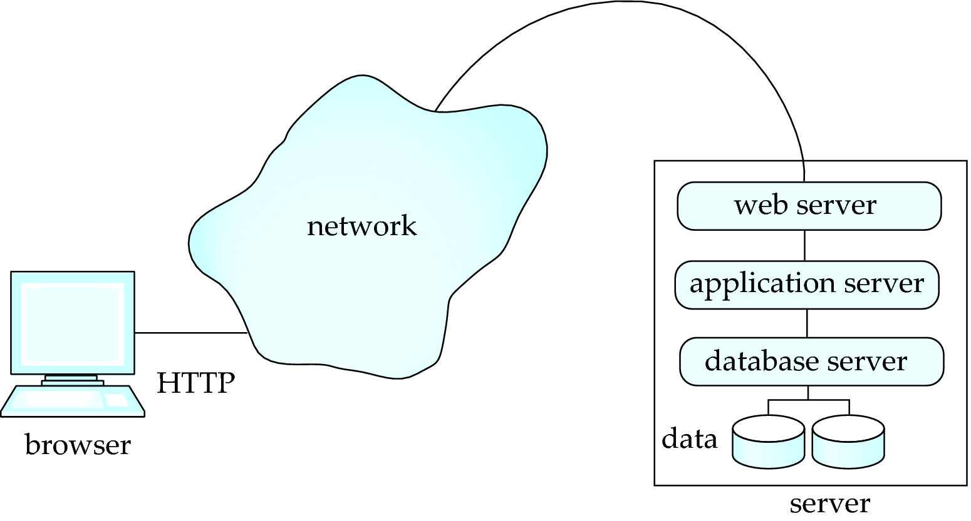
Three-Layer Web Architecture

Slide 13
Two-Layer Web Architecture
Multiple levels of indirection have overheads
Alternative: two-layer architecture

Slide 14
HTTP and Sessions
The HTTP protocol is connectionless
That is, once the server replies to a request, the server closes the connection with the client, and forgets all about the request
In contrast, Unix logins, and JDBC/ODBC connections stay connected until the client disconnects
retaining user authentication and other information
Motivation: reduces load on server
operating systems have tight limits on number of open connections on a machine
Information services need session information
E.g., user authentication should be done only once per session
Solution: use a cookie

Slide 15
Sessions and Cookies
A cookie is a small piece of text containing identifying information
Sent by server to browser
Sent on first interaction, to identify session
Sent by browser to the server that created the cookie on further interactions
part of the HTTP protocol
Server saves information about cookies it issued, and can use it when serving a request
E.g., authentication information, and user preferences
Cookies can be stored permanently or for a limited time

Slide 16
Servlets
Java Servlet specification defines an API for communication between the Web/application server and application program running in the server
E.g., methods to get parameter values from Web forms, and to send HTML text back to client
Application program (also called a servlet) is loaded into the server
Each request spawns a new thread in the server
thread is closed once the request is serviced

Slide 17
Example Servlet Code
import java.io.*;
import javax.servlet.*;
import javax.servlet.http.*;
public class PersonQueryServlet extends HttpServlet {
public void doGet (HttpServletRequest request, HttpServletResponse response)
throws ServletException, IOException
{
response.setContentType("text/html");
PrintWriter out = response.getWriter();
out.println("<HEAD><TITLE> Query Result</TITLE></HEAD>");
out.println("<BODY>");
….. BODY OF SERVLET (next slide) …
out.println("</BODY>");
out.close();
}
}

Slide 18
Example Servlet Code
String persontype = request.getParameter("persontype");
String number = request.getParameter("name");
if(persontype.equals("student")) {
... code to find students with the specified name ...
... using JDBC to communicate with the database ..
out.println("<table BORDER COLS=3>");
out.println(" <tr> <td>ID</td> <td>Name: </td>" + " <td>Department</td> </tr>");
for(... each result ...){
... retrieve ID, name and dept name
... into variables ID, name and deptname
out.println("<tr> <td>" + ID + "</td>" + "<td>" + name + "</td>" + "<td>" + deptname + "</td></tr>");
};
out.println("</table>");
}
else {
... as above, but for instructors ...
}

Slide 19
Servlet Support
Servlets run inside application servers such as
Apache Tomcat, Glassfish, JBoss
BEA Weblogic, IBM WebSphere and Oracle Application Servers
Application servers support
deployment and monitoring of servlets
Java 2 Enterprise Edition (J2EE) platform supporting objects, parallel processing across multiple application servers, etc

Slide 20
Servlet Sessions
Servlet API supports handling of sessions
Sets a cookie on first interaction with browser, and uses it to identify session on further interactions
To check if session is already active:
if (request.getSession(false) == true)
.. then existing session
else .. redirect to authentication page
authentication page
check login/password
request.getSession(true): creates new session
Store/retrieve attribute value pairs for a particular session
session.setAttribute(“userid”, userid)
session.getAttribute(“userid”)

Slide 21
Server-Side Scripting
Server-side scripting simplifies the task of connecting a database to the Web
Define an HTML document with embedded executable code/SQL queries.
Input values from HTML forms can be used directly in the embedded code/SQL queries.
When the document is requested, the Web server executes the embedded code/SQL queries to generate the actual HTML document.
Numerous server-side scripting languages
JSP, PHP
General purpose scripting languages: VBScript, Perl, Python

Slide 22
Java Server Pages (JSP)
A JSP page with embedded Java code
<html>
<head> <title> Hello </title> </head>
<body>
<% if (request.getParameter(“name”) == null)
{ out.println(“Hello World”); }
else { out.println(“Hello, ” + request.getParameter(“name”)); }
%>
</body>
</html>
JSP is compiled into Java + Servlets
JSP allows new tags to be defined, in tag libraries
such tags are like library functions, can are used for example to build rich user interfaces such as paginated display of large datasets

Slide 23
PHP
PHP is widely used for Web server scripting
Extensive libaries including for database access using ODBC
<html>
<head> <title> Hello </title> </head>
<body>
<?php if (!isset($_REQUEST[‘name’]))
{ echo “Hello World”; }
else { echo “Hello, ” + $_REQUEST[‘name’]; }
?>
</body>
</html>

Slide 24
Client Side Scripting
Browsers can fetch certain scripts (client-side scripts) or programs along with documents, and execute them in “safe mode” at the client site
Javascript
Macromedia Flash and Shockwave for animation/games
VRML
Applets
Client-side scripts/programs allow documents to be active
E.g., animation by executing programs at the local site
E.g., ensure that values entered by users satisfy some correctness checks
Permit flexible interaction with the user.
Executing programs at the client site speeds up interaction by avoiding many round trips to server
Notes:
24

Slide 25
Client Side Scripting and Security
Security mechanisms needed to ensure that malicious scripts do not cause damage to the client machine
Easy for limited capability scripting languages, harder for general purpose programming languages like Java
E.g., Java’s security system ensures that the Java applet code does not make any system calls directly
Disallows dangerous actions such as file writes
Notifies the user about potentially dangerous actions, and allows the option to abort the program or to continue execution.
Notes:
25

Slide 26
Javascript
Javascript very widely used
forms basis of new generation of Web applications (called Web 2.0 applications) offering rich user interfaces
Javascript functions can
check input for validity
modify the displayed Web page, by altering the underling document object model (DOM) tree representation of the displayed HTML text
communicate with a Web server to fetch data and modify the current page using fetched data, without needing to reload/refresh the page
forms basis of AJAX technology used widely in Web 2.0 applications
E.g. on selecting a country in a drop-down menu, the list of states in that country is automatically populated in a linked drop-down menu

Slide 27
Javascript
Example of Javascript used to validate form input
<html> <head> <script type="text/javascript"> function validate() { var credits=document.getElementById("credits").value; if (isNaN(credits)|| credits<=0 || credits>=16) { alert("Credits must be a number greater than 0 and less than 16"); return false } } </script>
</head> <body> <form action="createCourse" onsubmit="return validate()"> Title: <input type="text" id="title" size="20"><br /> Credits: <input type="text" id="credits" size="2"><br /> <Input type="submit" value="Submit"> </form>
</body> </html>

