Slide 1
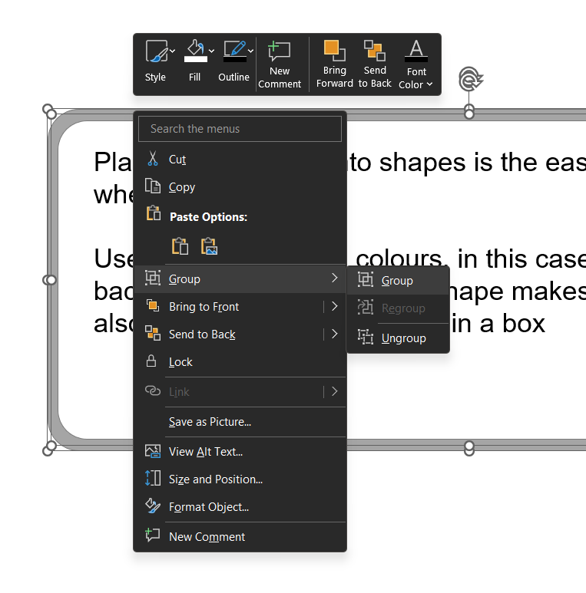
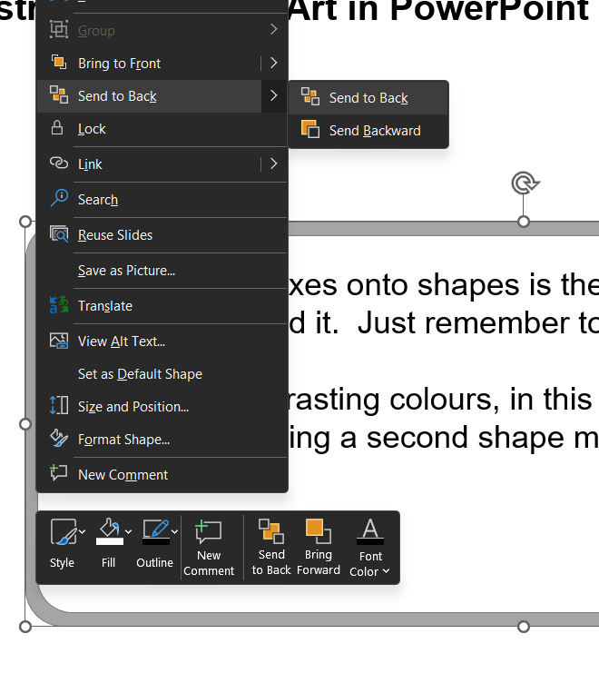







Digital Champions
Look for the Digital Champions in the Writing Café (group study area),
they can help you with software questions or concerns
Speak to Writing Mentors about your posters
Book a one to ones with your Learning Development Advisor
This is a smart object called SmartArt
Type ‘smart art’ in PowerPoint search
Then pick one that suites your needs
You can also change the type of SmartArt
Really handy to show processes
Thr
Use PowerPoint objects in clever ways…
This is simply a text box, with white text on top of an object
This is Arial 36 a good for subheading
You can go smaller for sub-sub-headings, but be careful
This is Arial 28 font size for normal text, which is generally acceptable for A1 posters
Tip: Use the zoom control to view ‘full size’ A1 on-screen: important when organising and pasting images to ensure quality. This is located on the bottom right of PowerPoint:
Figure 1: Demonstration of SmartArt in PowerPoint
Placing text boxes onto shapes is the easiest way create professional looking objects.
Use good contrasting colours!
Here the white background is created using a second shape on top of a larger grey shape. PLUS, a ‘text box’ on top. It looks like it is in this box, but comprises of 3 objects: rounded grey rectangle, rounded white rectangle and text box
Grouping objects
If you select all objects > right mouse, click > group. ‘group them’ and then they become like one object! Selecting Ctrl + left mouse allows you to select specific objects in grouped objects.
Try expanding this box – and rotating (choose the highest/top rotate option to move all objects) N.B. When resizing, you may need to modify the text size manually. Occasionally when stretching/resizing, it will require some adjustment of the object corners. Overall, it is much easier to have them grouped, as you can arrange them easily.
Placing objects ‘in front’, ‘behind’ each other. Right clicking objects gives you options to place them - Practise doing this on basic objects first, then you can be more adventurous, and apply it to complex ones.
Thr
Also use Ctrl + mouse wheel to Zoom in and out of a large poster, it helps with object alignment!
This logo has a clear background, so it can be mounted on coloured objects. However, keep a good contrast with any background colours, do not use very dark colours. Light colours are preferred for UoP logo use.

Slide 2
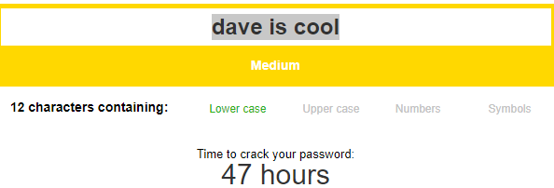


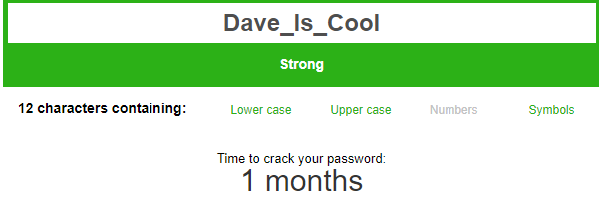
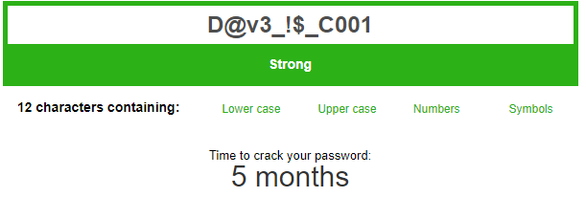
Project White Spectra
Comp 1004
The Issues:
Vulnerability of people Online
Not aware of dangers
Unable to protect themselves
Doubts of internet security/integrity
Forgetfulness
The Fix:
Assist User online safety
Web Page -> “Take their Hand”
Password System -> Ensures Secure password of user
Web Page
Password System
Memorable Information Creator and Retriever (MIC/MIR)
One Place for everything
User Can access website via icons like:
Basic:
Manipulates User string to implement Snake_Case
Forgetful?
Need to take Notes?
Keep Password Hints in one Place
Safe redirect ensuring user is not transferred to a fake website stealing credentials
Extreme:
Data scrambled using Cipher Text encryption.
A-> @
i->!
Hints are sent to a Database and only accessible via

