Slide 1
EEG & fNIRS Based Alzheimer's Disease Detection
Primarily references the literature: Event-specific EEG-FNIRS feature fusion FOR Alzheimer’s disease classification^{[1]}
Gangfeng Hu, Sangdae Nam, Niko Hams,
Uli Prantz, Eric Ji, Matthew Zhou
[1] S.-H. Kim, T.-M. Choi, S.-K. Lee, M. Kim, J. G. Kim, and J.-H. Kim, ‘Event-specific EEG-FNIRS feature fusion FOR Alzheimer’s disease classification’, in 2024 IEEE International Conference on Image Processing (ICIP), Abu Dhabi, United Arab Emirates, 2024, pp. 3137–3143.

Slide 2
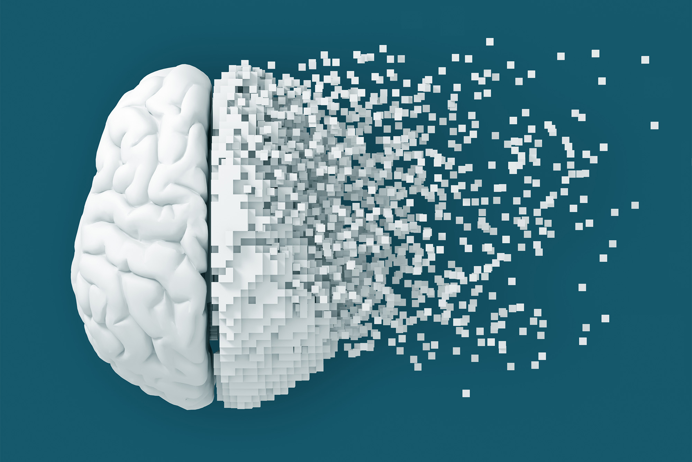
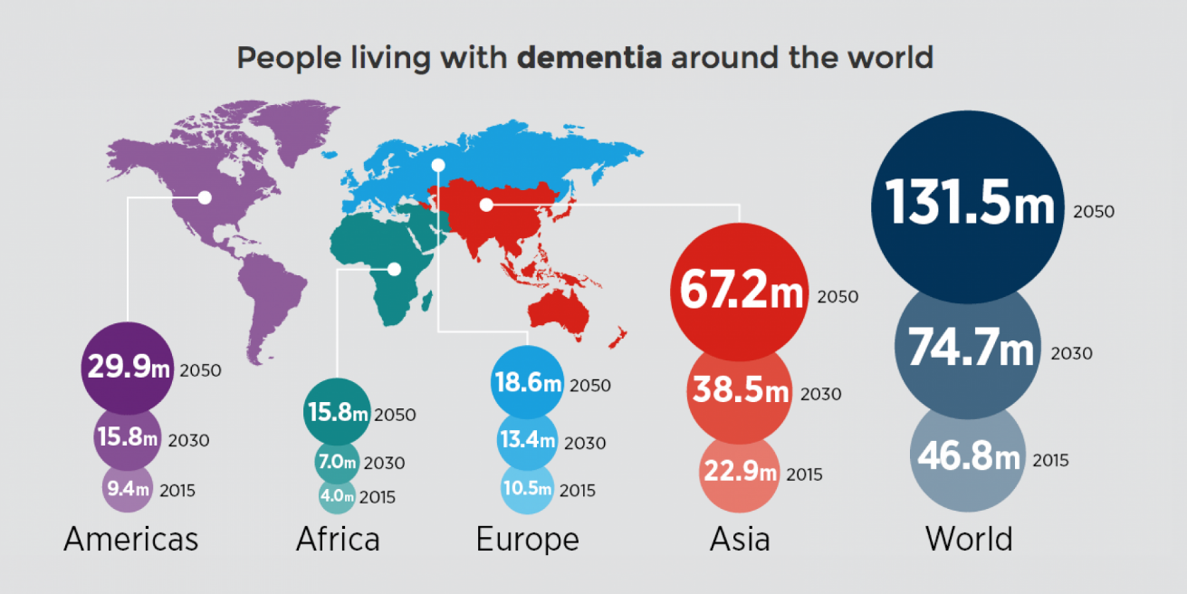
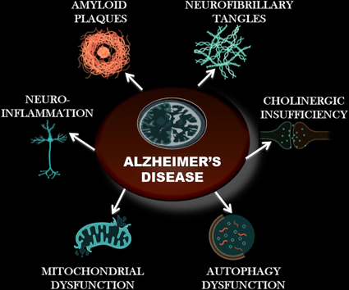
Introduction: Alzheimer’s Disease
An irreversible neurodegenerative disease
Starts slowly and progressively worsens
60–70% of cases of all dementia cases^{[1]}
Exact cause is not fully understood:
Some key factors believed to be involved^{[2]}:
Genetics
Abnormal protein deposition: amyloid-β and tau
Vascular factors
...
[1] "Dementia Fact sheet". World Health Organization. 15 March 2023. Retrieved 10 July 2023.
[2] https://en.wikipedia.org/wiki/Alzheimer%27s_disease#cite_note-WHO2023-2

Slide 3
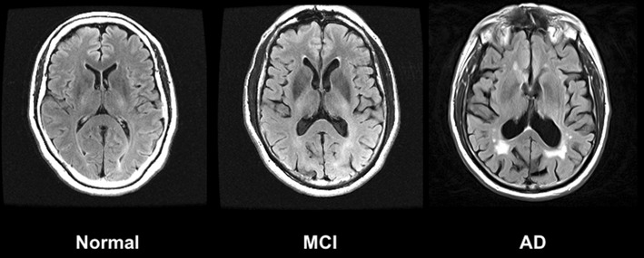
Introduction: Alzheimer’s Disease
AD (Alzheimer’s Disease): Severe memory and cognitive decline
MCI (Mild Cognitive Impairment): Noticeable but mild cognitive changes
HC (Healthy Controls): Healthy brain function, no impairments
Focus of Study: Classify participants into these three categories
A dataset of 63 HC, 46 MCI, and 35 AD patients
Notes:
Here are three basic types that we would like to classify:
The first one is AD. These patients have been already diagnosed as Alzheimer’s Disease, and are somewhat severe
MCI is the type that patients are losing their memory in a certain extent. This is the main type that is needed to detect clinically
HC is the normal patients for comparison
In our project, we utilize a dataset of EEG and fNIRS signals from 144 participants with 63 HC, 46 MCI and 35 AD patients

Slide 4
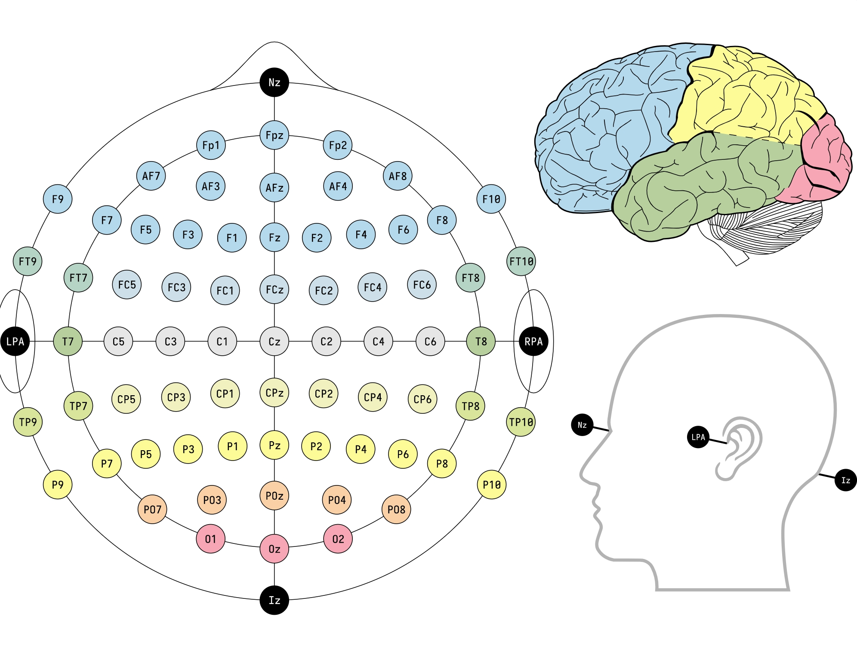
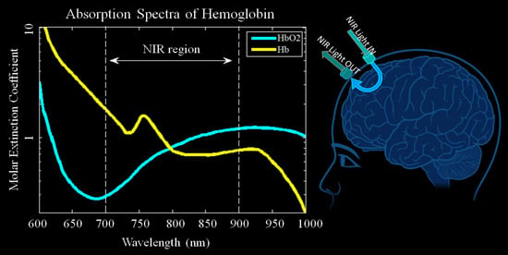
Introduction: EEG & fNIRS
EEG (electroencephalography):
Non-invasive brain activity recording
Captures electrical signals in real-time
High temporal resolution (milliseconds)
Measures brainwaves: Delta, Theta, Alpha, Beta, Gamma
fNIRS (Functional Near-Infrared Spectroscopy):
Measures brain blood oxygenation
Monitors oxygenated (HbO) and deoxygenated hemoglobin (HbR)
High spatial resolution
Less sensitive to motion artifacts than EEG
Notes:
"EEG, or electroencephalography, is a non-invasive method that records brain activity through electrodes placed on the scalp. It provides high temporal resolution, capturing rapid electrical signals in real-time. EEG is widely used in cognitive studies and measures different types of brainwaves such as Delta, Theta, and Gamma.
"fNIRS stands for Functional Near-Infrared Spectroscopy. It measures brain activity indirectly by tracking blood oxygenation levels using near-infrared light. This non-invasive and portable technology provides high spatial resolution and is less affected by motion compared to EEG."

Slide 5
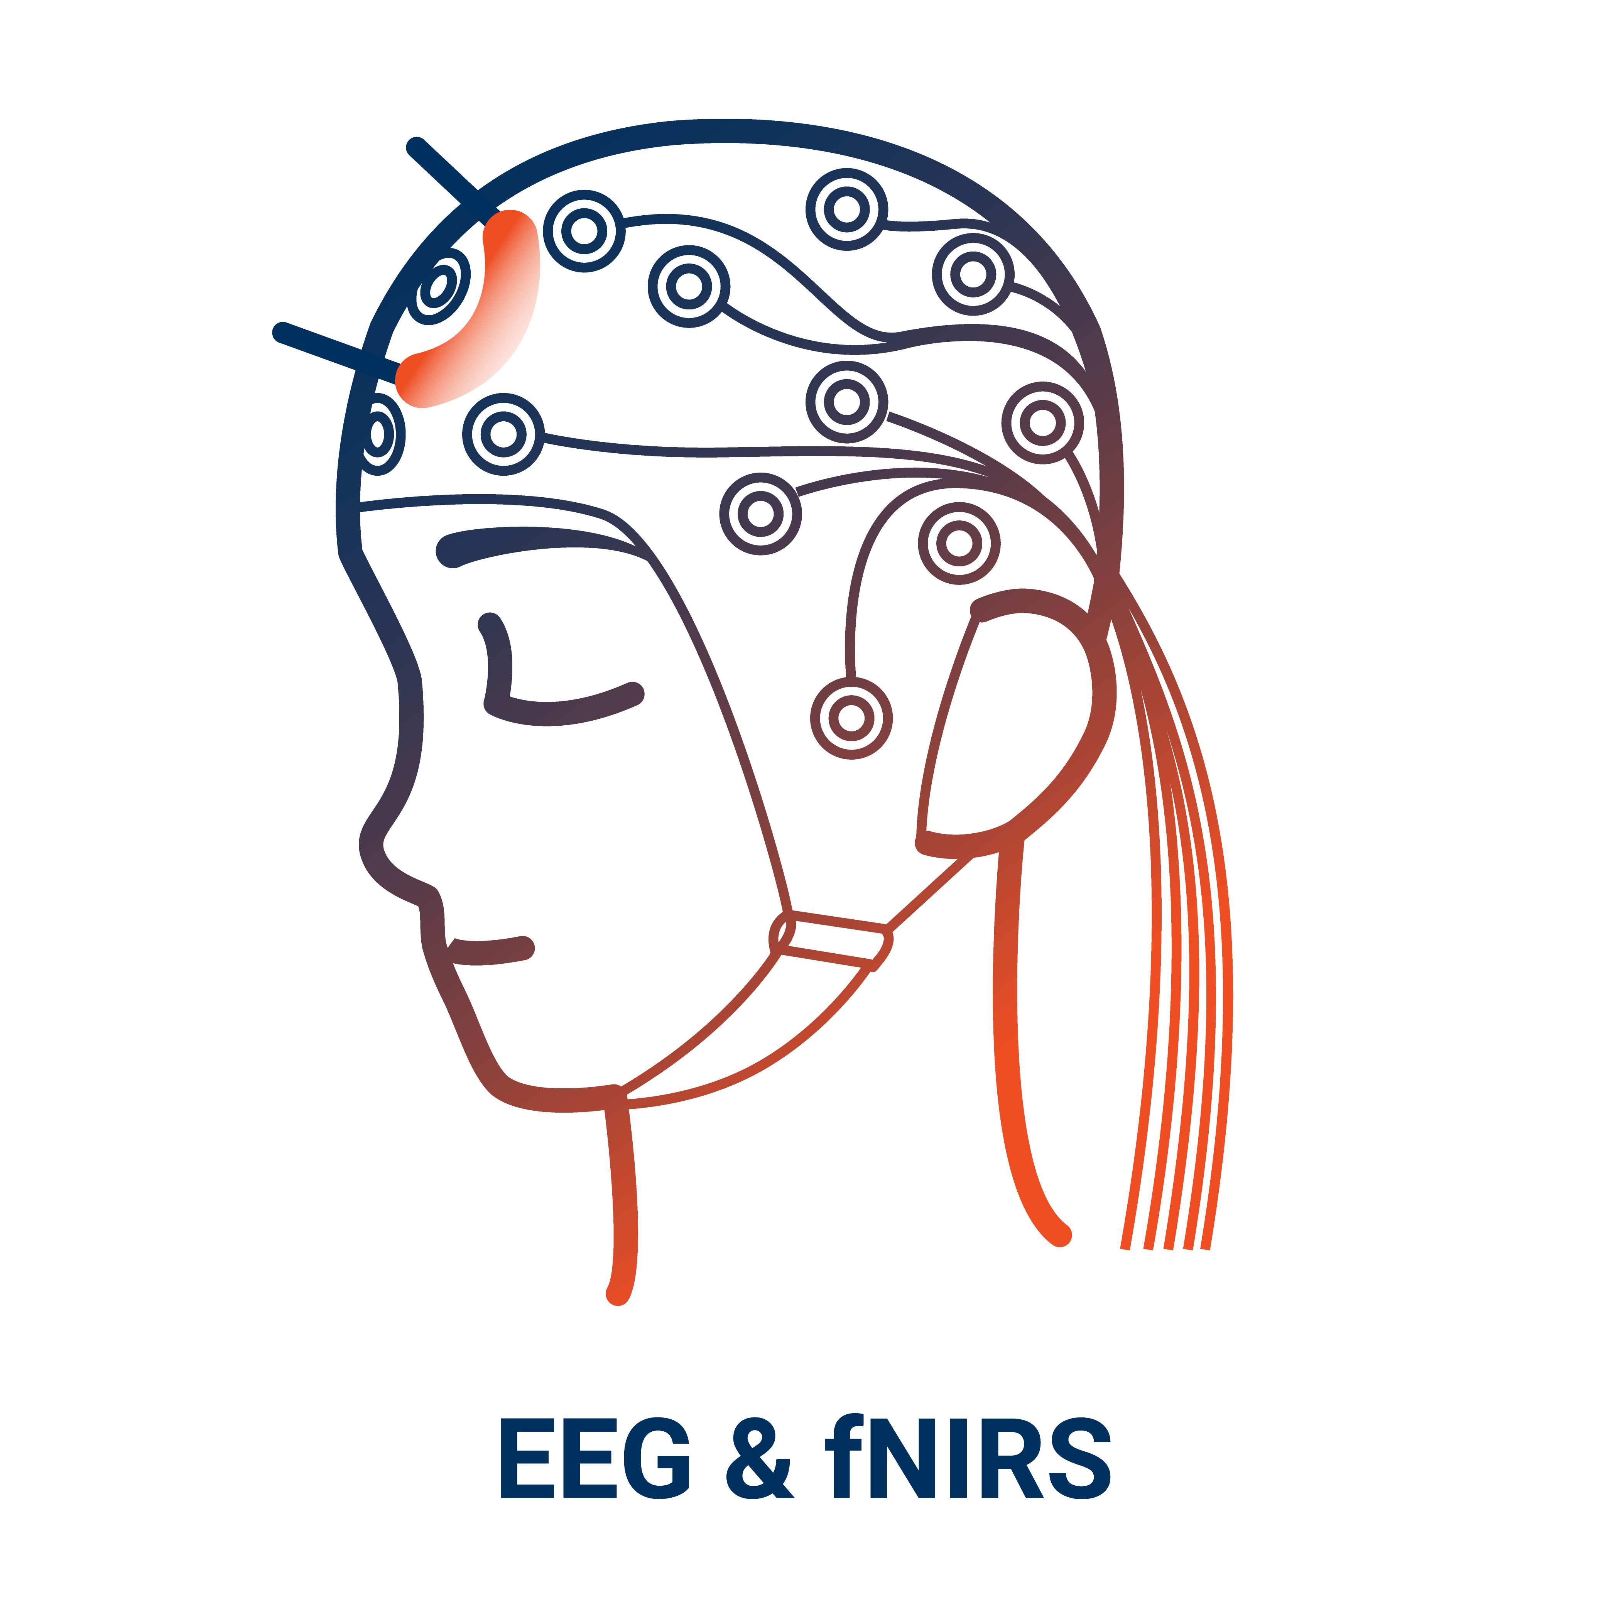
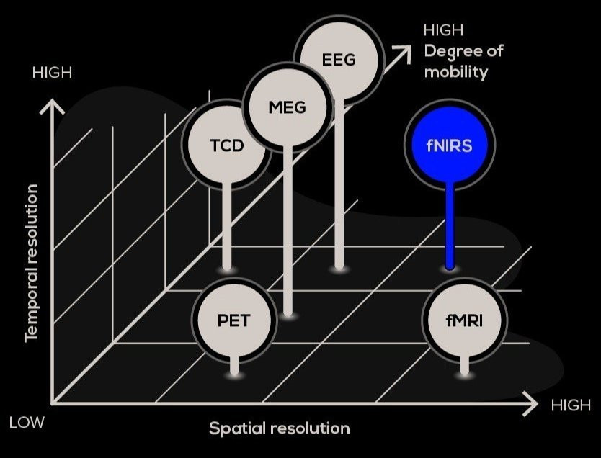
Introduction: EEG & fNIRS
Why Combine EEG and fNIRS?
Exploit complementary strengths
EEG | fNIRS
Real-time | Slight delay in response
High temporal | Less motion-sensitive
Less spatial resolution | High spatial resolution

Slide 6
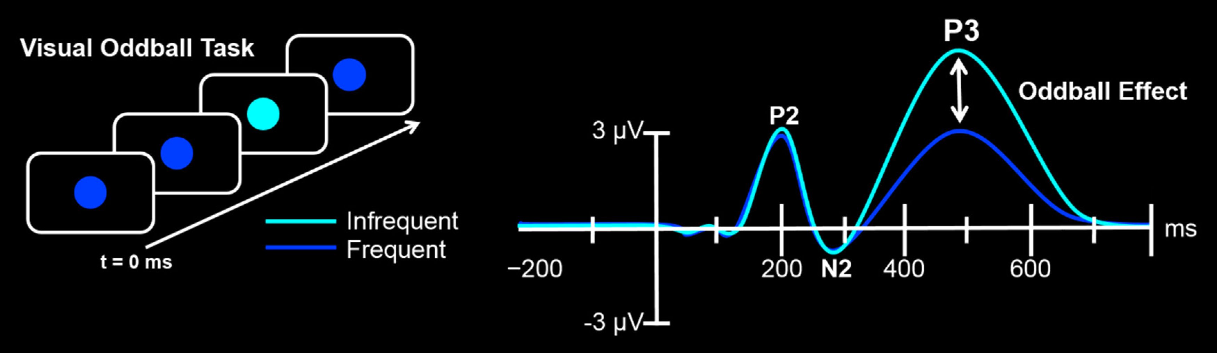
Methods: the Four Tasks
EEG and fNIRS signals are detected during the process of the four tasks below:
1. Resting Task:
Focus on a white cross on a screen
Duration: 60 seconds
Baseline brain activity measurement
2. Oddball Task:
Identify yellow (target) and blue (non-target) circles
Respond to yellow by pressing a button
Tests attention and response inhibition
3. 1-back Task:
A number in {1,2,3} shows on a screen every time
Press a button when the current number matches the previous one
Evaluates working memory and cognitive flexibility
4. Verbal Fluency Task:
Phonemic Fluency: Generate words starting with a given letter
Semantic Fluency: Generate words within a specific category (e.g., animals)
1
2
Time
2
Press Button
...
3

Slide 7
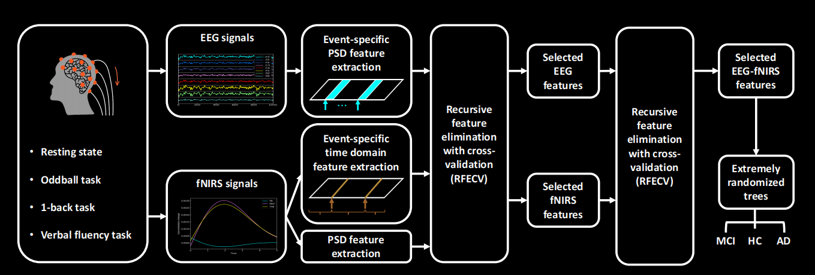
Methods: Pipeline
Notes:
Here is the pipeline of our classification:
We begin by collecting EEG and fNIRS signals while participants perform four cognitive tasks.
For EEG signals, we perform event-specific Power Spectral Density (PSD) feature extraction.
For fNIRS signals, we apply event-specific time-domain feature extraction as well as PSD analysis. These steps capture the unique characteristics of both modalities during the tasks.
Using Recursive Feature Elimination with Cross-Validation (RFECV), we refine the extracted features to identify the most relevant ones for classification.
This is done separately for EEG and fNIRS signals to ensure each modality contributes effectively.
After selecting task-specific features for each modality, we combine them into hybrid EEG-fNIRS features.
RFECV is applied again to select the most discriminative features from the combined set.
Finally, we use an Extremely Randomized Trees classifier to categorize participants into three groups

Slide 8
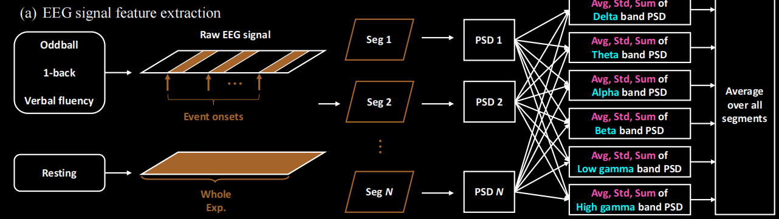
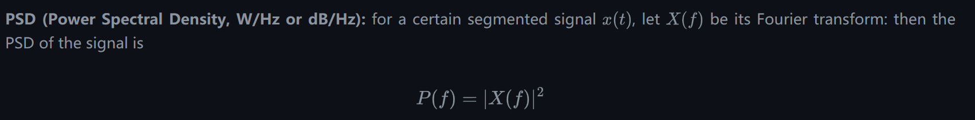
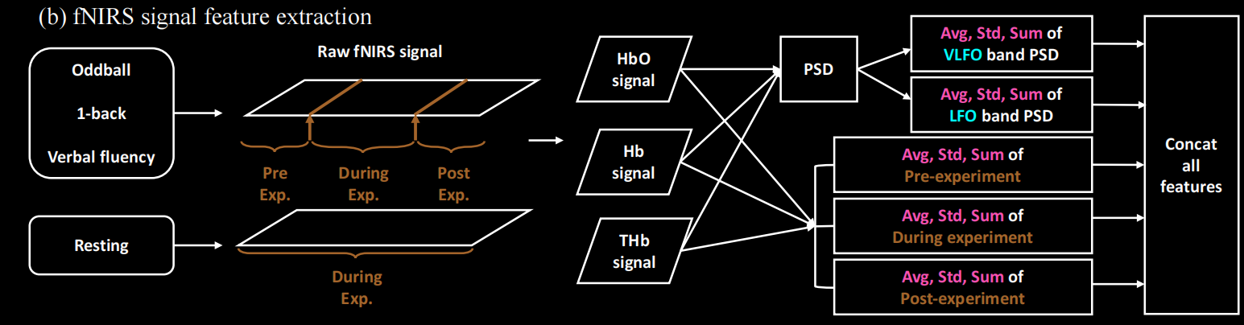
Methods: Feature Extraction
Notes:
For the details of feature extraction, actually it is simple because of the small amount number of patients and features.
For the three tasks with information, we only utilize the duration that the patients have actions, while for resting task, we calculate the average value of the whole 60 seconds.
After segmentation, in the EEG part, we calculate the power spectral density of each band, and in the fNIRS part, we caculate some specific feature of the signal shown in the literate.

Slide 9
Experiment Results
Performance Metrics:
Metric | ExtraTree | MLP
Accuracy | 0.79 | 0.83
Macro Avg F1 | 0.80 | 0.83
Weighted Avg F1 | 0.79 | 0.83
Key Observations
MLP performs slightly better in overall accuracy and F1 scores.
ExtraTree excels in precision for Class 0 but has lower recall for Class 2.
MLP balances recall better across classes, leading to higher overall performance.

