Slide 1
EEG & fNIRS Based Alzheimer's Disease Detection
Primarily references the literature: Event-specific EEG-FNIRS feature fusion FOR Alzheimer’s disease classification^{[1]}
Gangfeng Hu, Sangdae Nam, Niko Hams,
Uli Prantz, Eric Ji, Matthew Zhou
[1] S.-H. Kim, T.-M. Choi, S.-K. Lee, M. Kim, J. G. Kim, and J.-H. Kim, ‘Event-specific EEG-FNIRS feature fusion FOR Alzheimer’s disease classification’, in 2024 IEEE International Conference on Image Processing (ICIP), Abu Dhabi, United Arab Emirates, 2024, pp. 3137–3143.

Slide 2
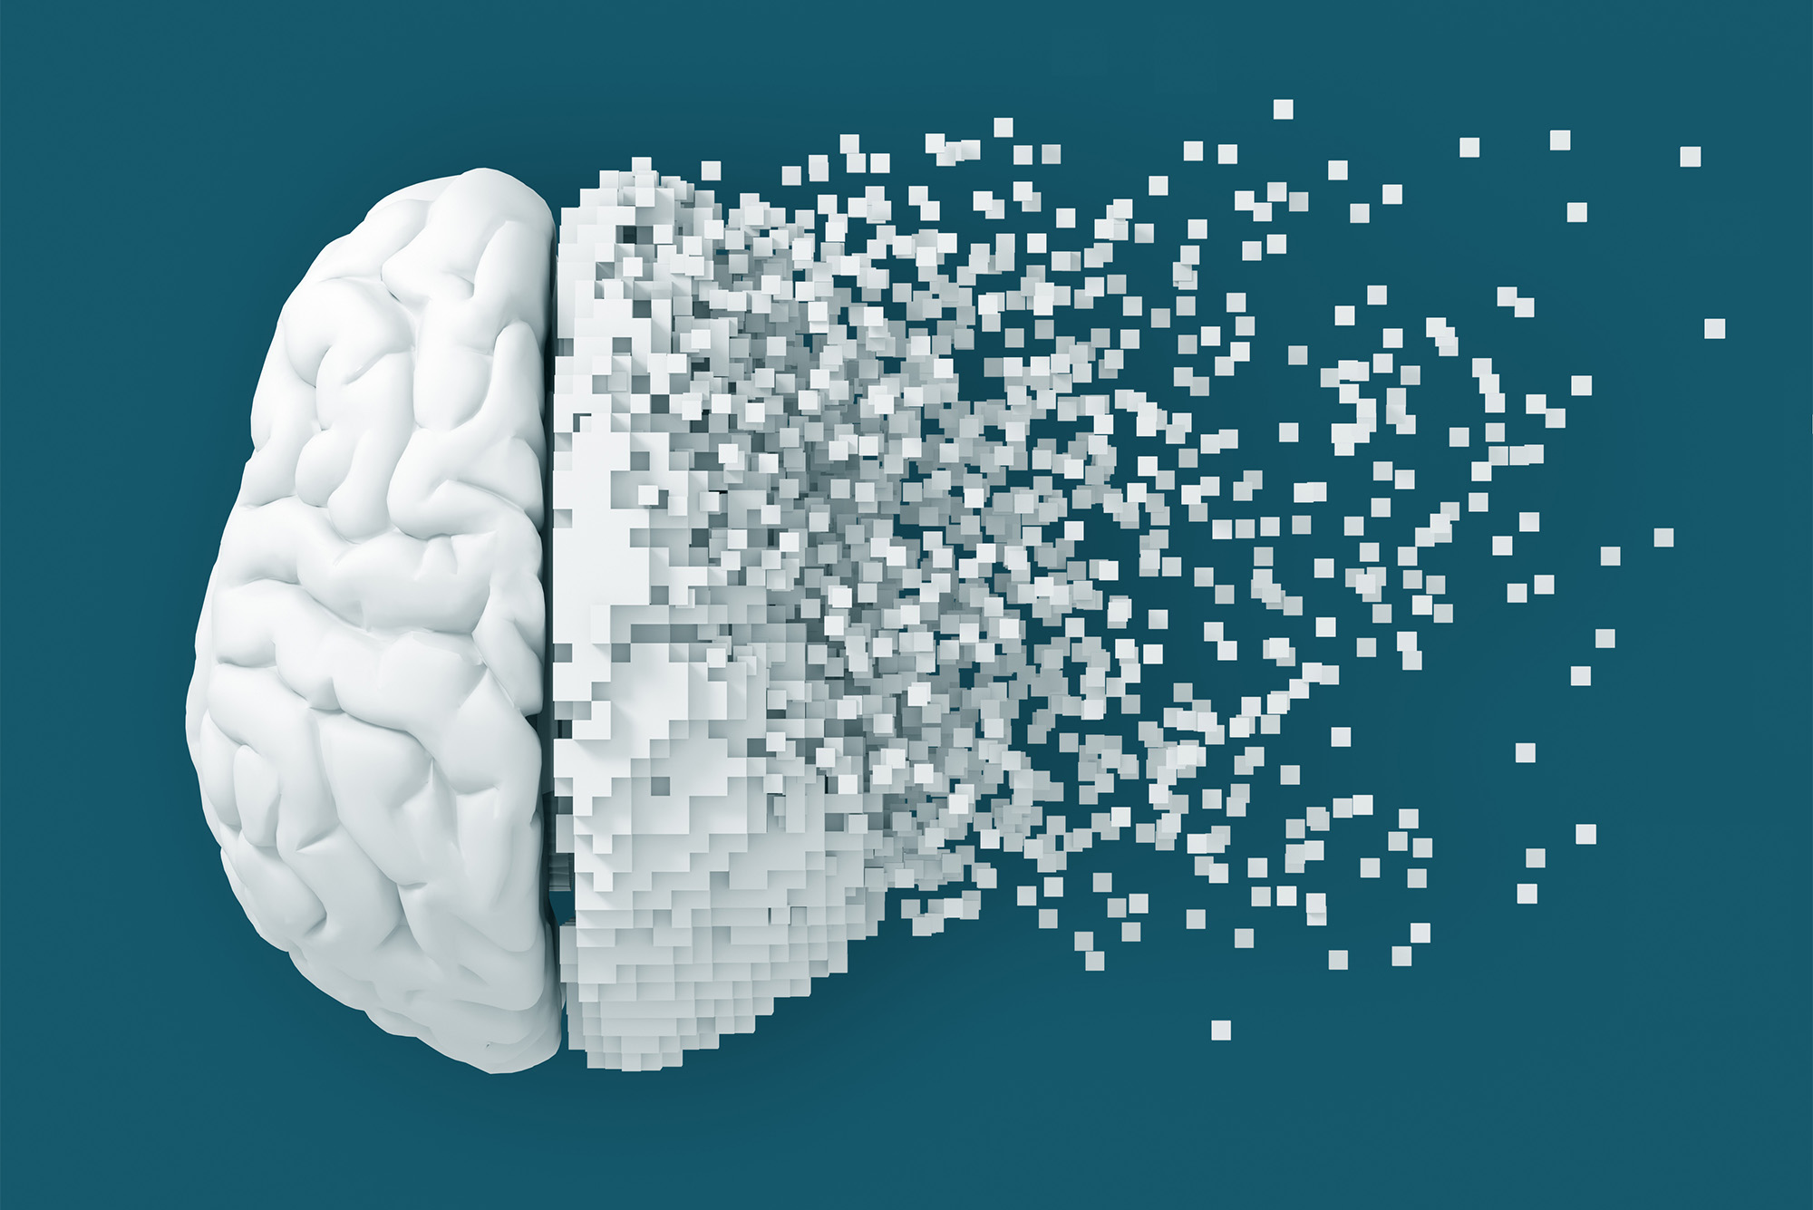
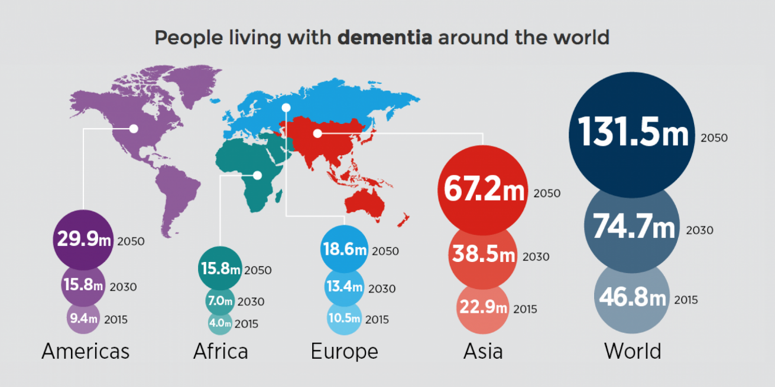
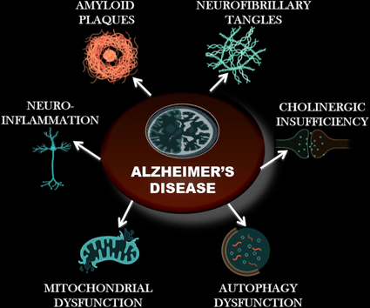
Introduction: Alzheimer’s Disease
An irreversible neurodegenerative disease
Starts slowly and progressively worsens
60–70% of cases of all dementia cases.
Exact cause is not fully understood:
Some key factors believed to be involved:
Genetics
Abnormal protein deposition: amyloid-β and tau
Vascular factors
...
Notes:
[1] "Dementia Fact sheet". World Health Organization. 15 March 2023. Retrieved 10 July 2023.
[2] https://en.wikipedia.org/wiki/Alzheimer%27s_disease#cite_note-WHO2023-2

Slide 3
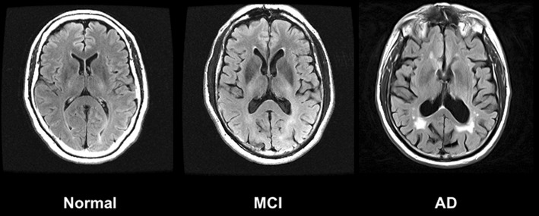
Introduction: Alzheimer’s Disease
AD (Alzheimer’s Disease): Severe memory and cognitive decline
MCI (Mild Cognitive Impairment): Noticeable but mild cognitive changes
NC (Normal Cognition): Healthy brain function, no impairments
Focus of Study: Classify participants into these three categories

Slide 4
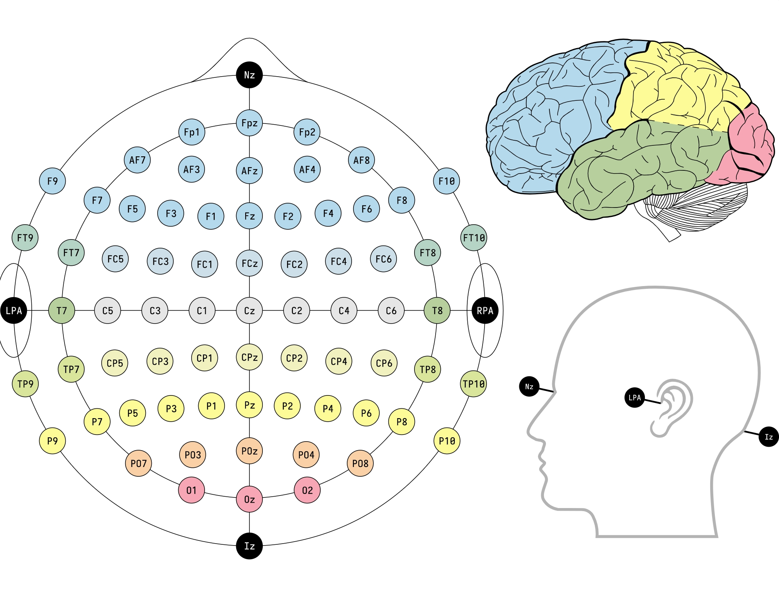
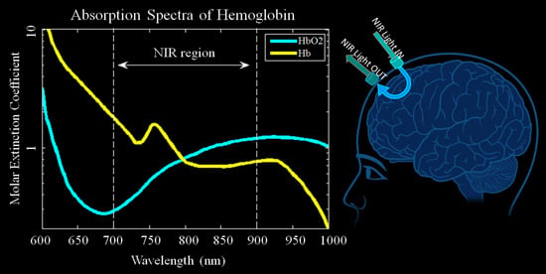
Introduction: EEG & fNIRS
EEG (electroencephalography):
Non-invasive brain activity recording
Captures electrical signals in real-time
High temporal resolution (milliseconds)
Measures brainwaves: Delta, Theta, Alpha, Beta, Gamma
fNIRS (Functional Near-Infrared Spectroscopy):
Measures brain blood oxygenation
Monitors oxygenated (HbO) and deoxygenated hemoglobin (HbR)
High spatial resolution
Less sensitive to motion artifacts than EEG
Notes:
"EEG, or electroencephalography, is a non-invasive method that records brain activity through electrodes placed on the scalp. It provides high temporal resolution, capturing rapid electrical signals in real-time. EEG is widely used in cognitive studies and measures different types of brainwaves such as Delta, Theta, and Gamma.
"fNIRS stands for Functional Near-Infrared Spectroscopy. It measures brain activity indirectly by tracking blood oxygenation levels using near-infrared light. This non-invasive and portable technology provides high spatial resolution and is less affected by motion compared to EEG."

Slide 5
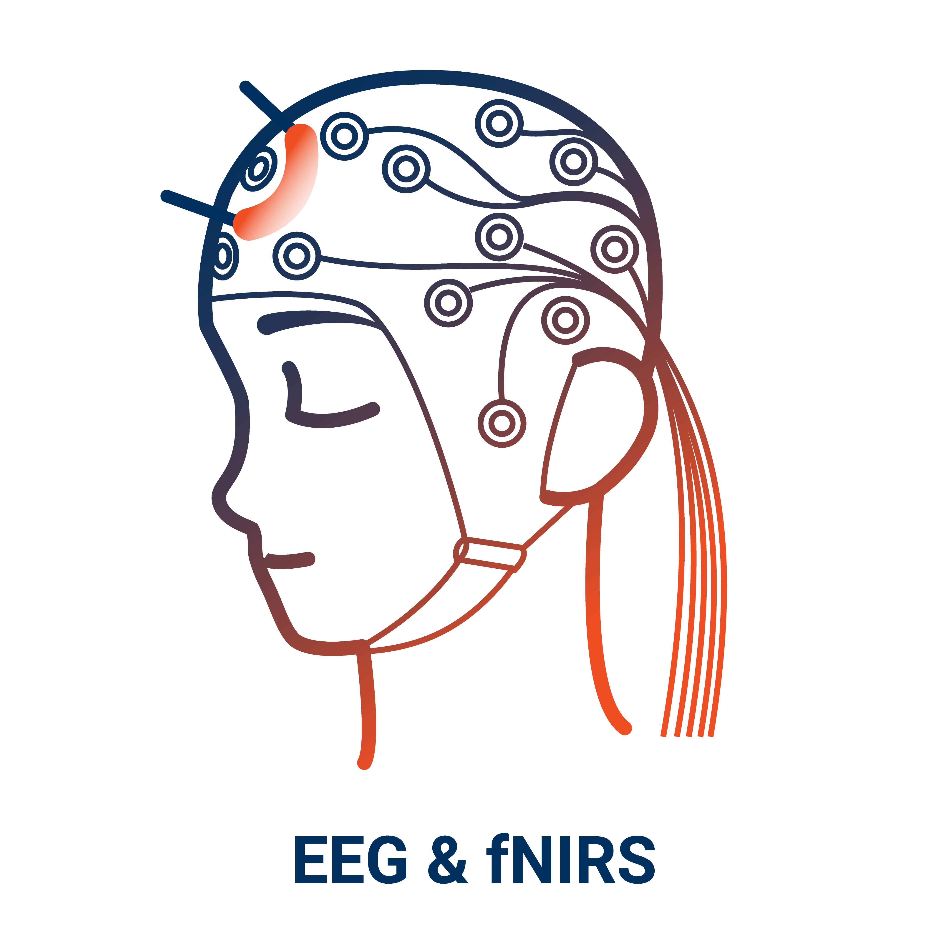
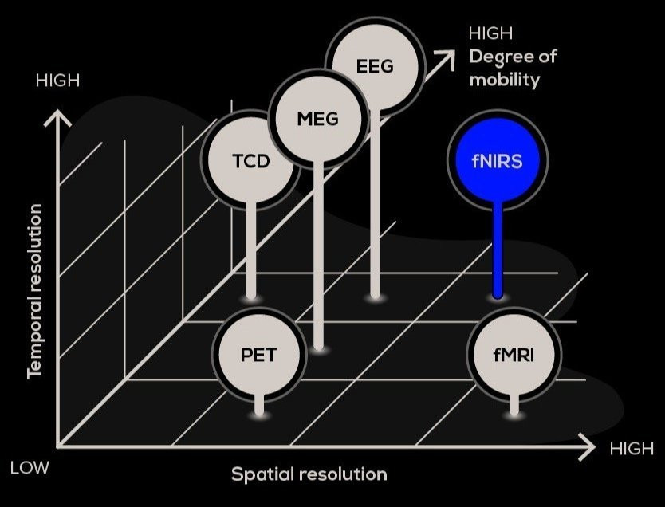
Introduction: EEG & fNIRS
Why Combine EEG and fNIRS?
- Exploit complementary strengths
EEG | fNIRS
Real-time | Slight delay in response
High temporal | Less motion-sensitive
Less spatial resolution | High spatial resolution

Slide 6
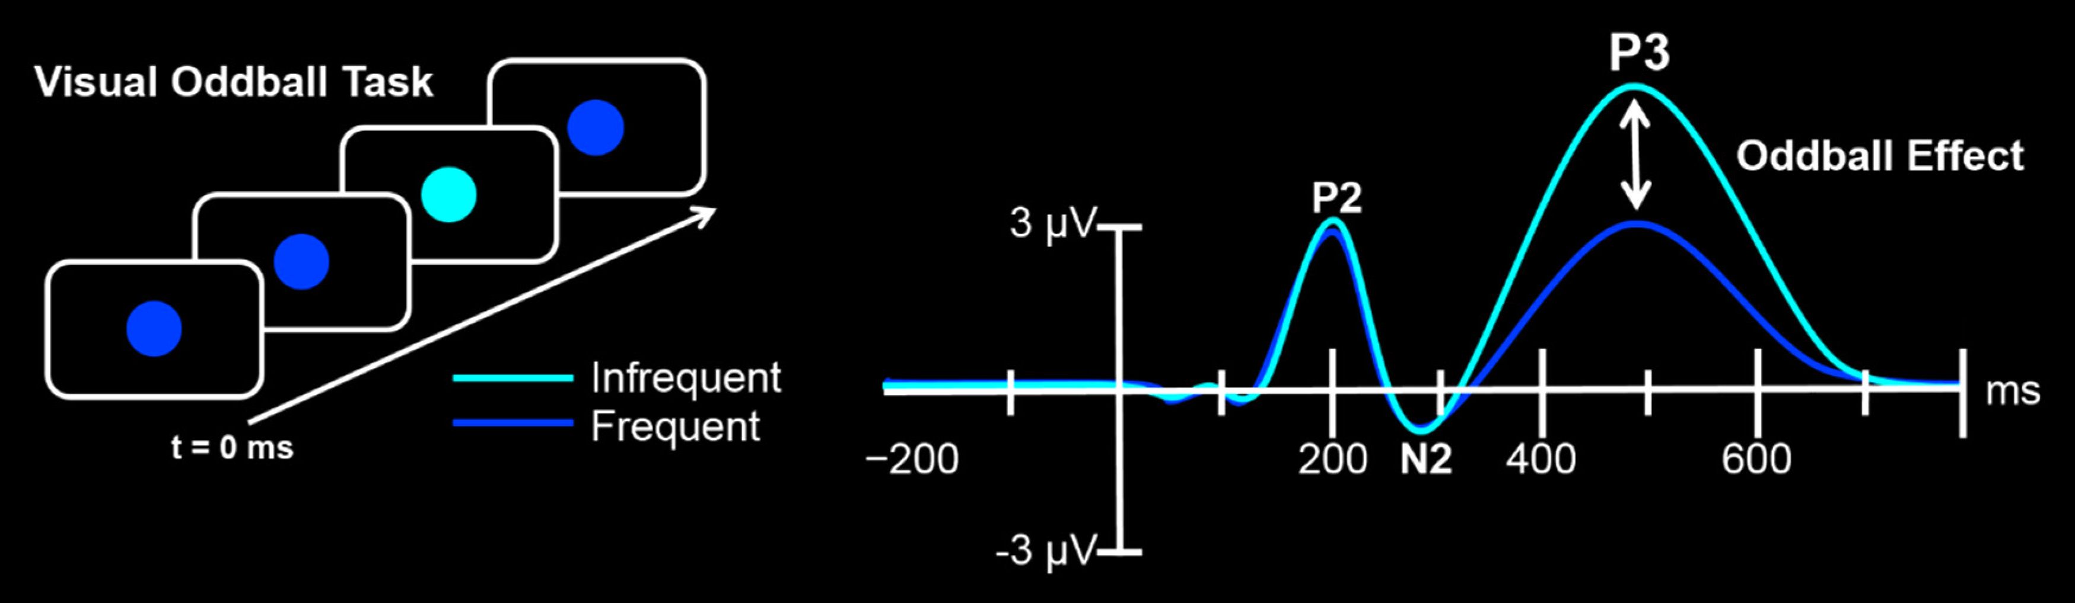
Methods: the Four Tasks
EEG and fNIRS signals are detected during the process of the four tasks below:
1. Resting Task:
Focus on a white cross on a screen
Duration: 60 seconds
Baseline brain activity measurement
2. Oddball Task:
Identify yellow (target) and blue (non-target) circles
Respond to yellow by pressing a button
Tests attention and response inhibition
3. 1-back Task:
A number in {1,2,3} shows on a screen every time
Press a button when the current number matches the previous one
Evaluates working memory and cognitive flexibility
4. Verbal Fluency Task:
Phonemic Fluency: Generate words starting with a given letter
Semantic Fluency: Generate words within a specific category (e.g., animals)
1
2
Time
2
Press Button
...
3

Slide 7
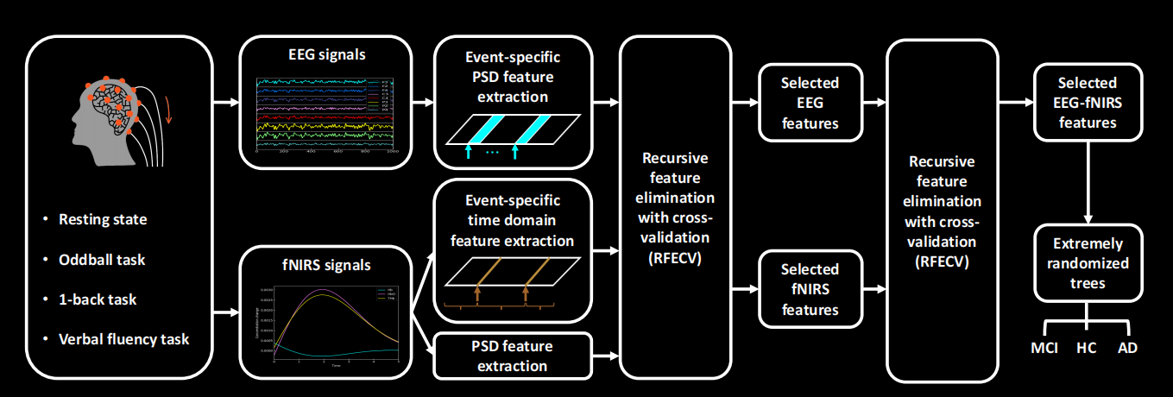
Methods: Pipeline

Slide 8
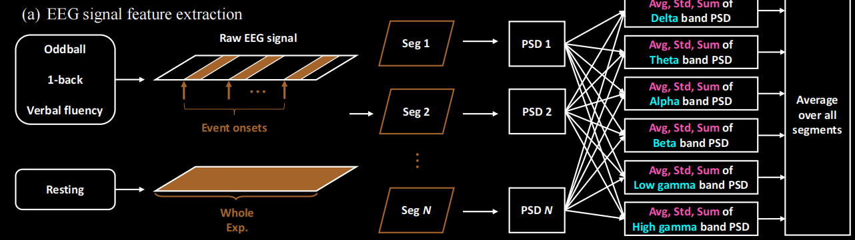
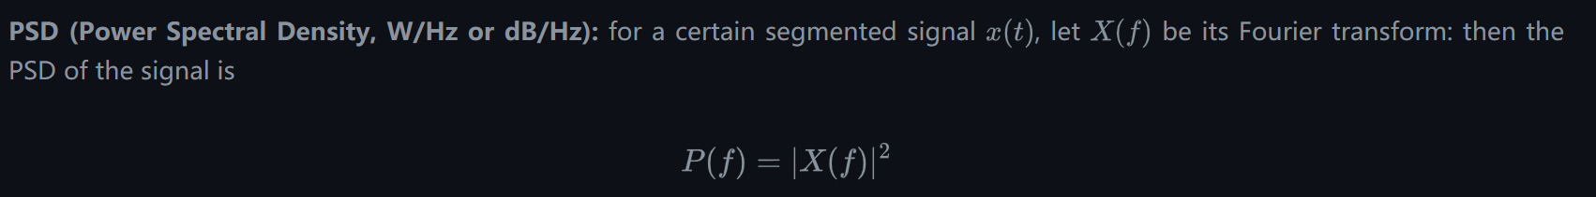
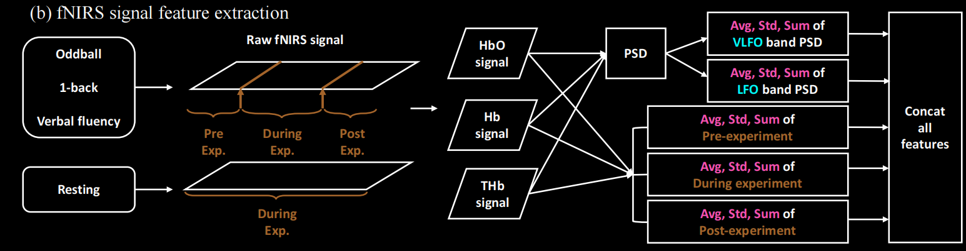
Methods: Feature Extracion

Slide 9
Experiment Results
Performance Metrics:
Metric | ExtraTree | MLP
Accuracy | 0.79 | 0.83
Macro Avg F1 | 0.80 | 0.83
Weighted Avg F1 | 0.79 | 0.83
Key Observations
MLP performs slightly better in overall accuracy and F1 scores.
ExtraTree excels in precision for Class 0 but has lower recall for Class 2.
MLP balances recall better across classes, leading to higher overall performance.

