Slide 1
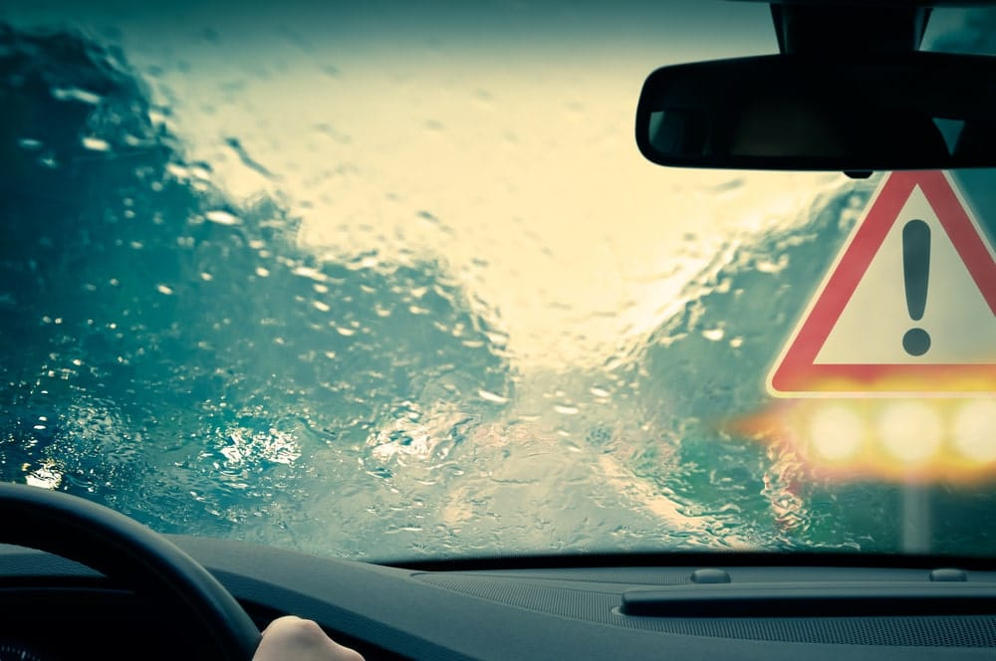
Co-Optimizing Diffractive Optics and Object Detection for Robust Perception in Adverse Weather
CSED520 – Computational Imaging
Nikolo Rohrmoser, Wilmer Zetterqvist, Michelle Reimann

Slide 2
Co-Optimizing Diffractive Optics and Object Detection for Robust Perception in Adverse Weather
CSED520 – Computational Imaging
Nikolo Rohrmoser, Wilmer Zetterqvist, Michelle Reimann

Slide 3
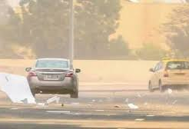
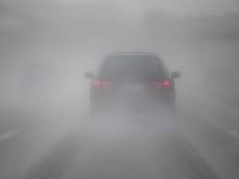
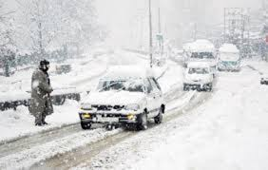
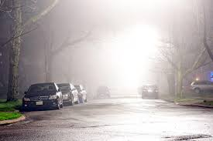
Motivation
Autonomous driving requires reliable object detection
Fog, rain, and snow cause scattering, glare & attenuation → reduced image quality
Even state-of-the-art deep detectors struggle under adverse conditions

Slide 4
Motivation
Autonomous driving requires reliable object detection
Fog, rain, and snow cause scattering, glare & attenuation → reduced image quality
Even state-of-the-art deep detectors struggle under adverse conditions

Slide 5
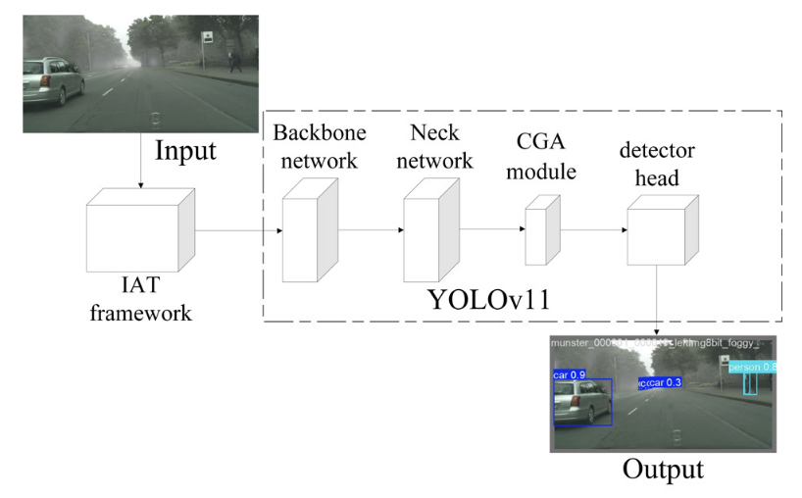
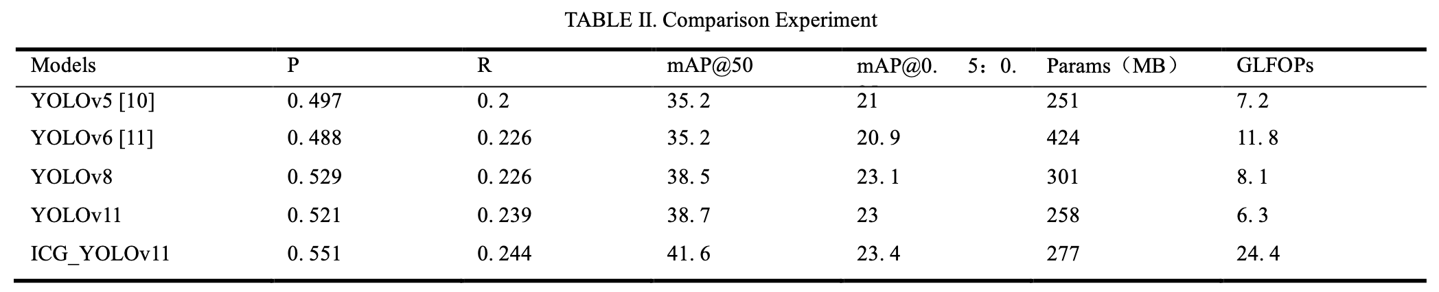
Previous Work
Weather-diverse datasets (Cityscapes, DAWN, ACDC, RTTS) containing synthesized/real foggy images
Digital-domain solutions (R-YOLO [1], IA-YOLO [2]) mainly focussing on improvements on software-side:
network adaption
preprocessing of images
image enhancement
Visibility issues from scattering/attenuation remain unresolved
=> joint optimization of physical optical system (DOE) + object detection model using pado
Chen et al., 2025 [3]
Illumination Adaptive Transformer
emulates image signal processor to resolve image quality issues
=> accuracy improvement of 2.9%
[1] P. B. S. Varma, P. Adimoolam, Y. L. Marna, A. Vengala, V. S. D. Sundar, and M. V. T. R. P. Kumar, ‘Enhancing robust object detection in weather-impacted environments using deep learning techniques’, 2024 2nd International Conference on Self Sustainable Artificial Intelligence Systems (ICSSAS), pp. 599–604, 2024.
[2] W. Liu, G. Ren, R. Yu, S. Guo, J. Zhu, and L. Zhang, “Image-Adaptive YOLO for Object Detection in Adverse Weather Conditions”, AAAI, vol. 36, no. 2, pp. 1792-1800, Jun. 2022.
[3] L. Chen, X. Yuan and B. Yang, "Object detection and recognition in foggy environment based on improved YOLOv11," 2025 6th International Conference on Electronic Communication and Artificial Intelligence (ICECAI), Chengdu, China, 2025, pp. 368-372, doi: 10.1109/ICECAI66283.2025.11170606.

Slide 6
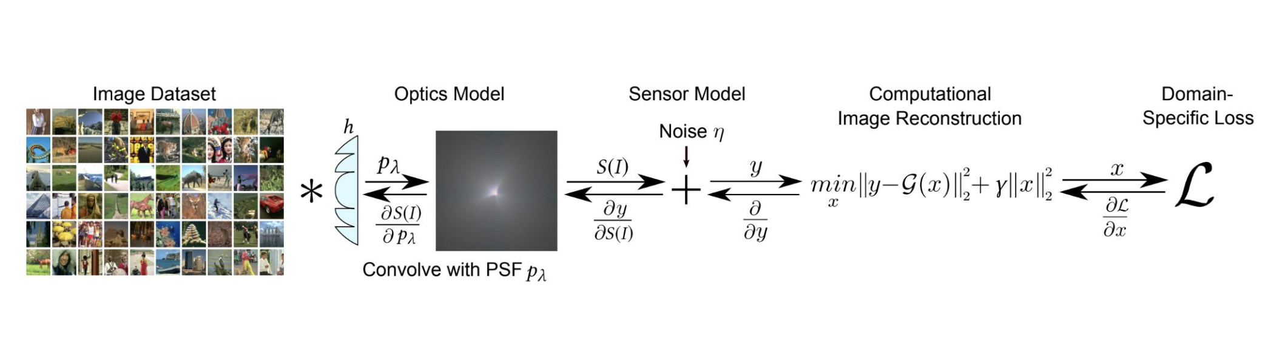
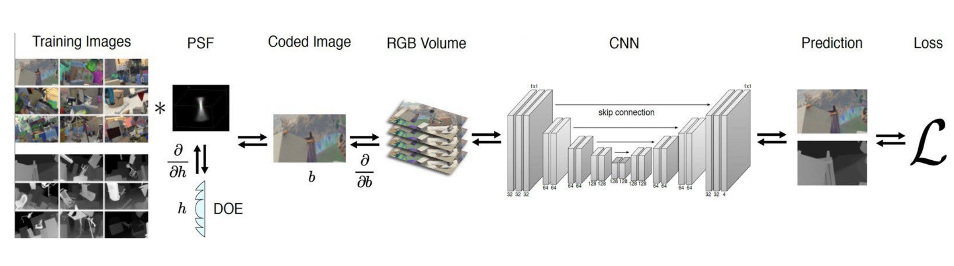
Methods

Slide 7
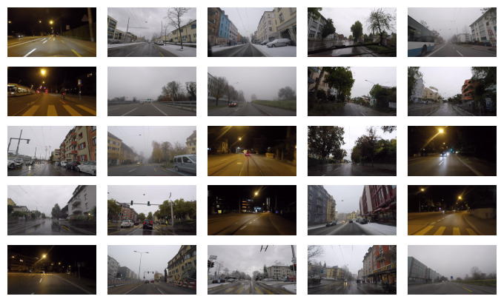
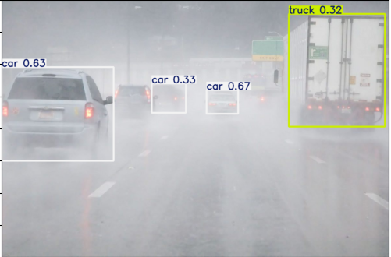



Methods
Baseline:
Detection
Loss
YOLOv11
(Ultralytics)
$$ℒ$$
ACDC Images [1] (1375 + 399 + 199 images)
DOE using PADO:
Detection
Loss
$$∗$$
YOLOv11
(Ultralytics)
$$ℒ$$
DOE
ACDC Images [1] (1375 + 399 + 199 images)
Notes:
Use pado framework to simulate diffractive optical elements (DOE).
Model assumes depth-independent point spread function (PSF).
Optical simulation processes RGB images before detection.
Enables gradient-based optimization of both DOE pattern and network parameters. YOLO11n adopted as baseline detector (accuracy–efficiency tradeoff).
Optical simulation output fed directly into YOLO pipeline.
End-to-end training optimizes:
DOE phase profile
Detector weights
Uses Ultralytics standard training pipeline for stability and reproducibility.

Slide 8
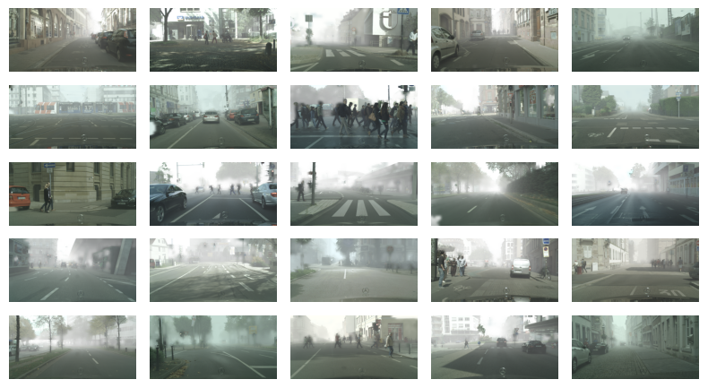
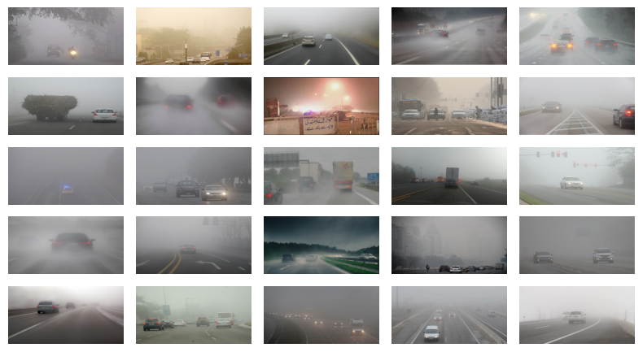
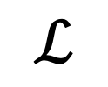

Methods
Baseline:
Detection
Loss
Foggy Cityscape Images [1] (2976 + 501 images)
YOLOv11
(Ultralytics)
$$ℒ$$
DAWN Images [2] (301 + 167 images)
DOE using PADO:
Detection
Loss
$$∗$$
YOLOv11
(Ultralytics)
$$ℒ$$
DOE
[1] https://www.kaggle.com/datasets/khitdon/foggy-cityscapes-yolo [2] https://www.kaggle.com/datasets/orvile/dawn-detection-in-adverse-weather-nature
Notes:
Use pado framework to simulate diffractive optical elements (DOE).
Model assumes depth-independent point spread function (PSF).
Optical simulation processes RGB images before detection.
Enables gradient-based optimization of both DOE pattern and network parameters. YOLO11n adopted as baseline detector (accuracy–efficiency tradeoff).
Optical simulation output fed directly into YOLO pipeline.
End-to-end training optimizes:
DOE phase profile
Detector weights
Uses Ultralytics standard training pipeline for stability and reproducibility.

Slide 9
Results

Slide 10
Conclusion

Slide 11



Cityscapes dataset
https://people.ee.ethz.ch/~csakarid/SFSU_synthetic/ ETH Zürich, Foggy driving, 101 real world images
https://www.cityscapes-dataset.com/foggydownload/ ETH Zürich, 25000 images with simulated fog
https://www.kaggle.com/datasets/yessicatuteja/foggy-cityscapes-image-dataset 1500 simulated images (500 per no fog, medium fog, dense fog)
https://www.kaggle.com/datasets/khitdon/foggy-cityscapes-yolo 3475 images, no source mentioned
DAWN: 303 foggy images with bounding boxes

