Slide 1
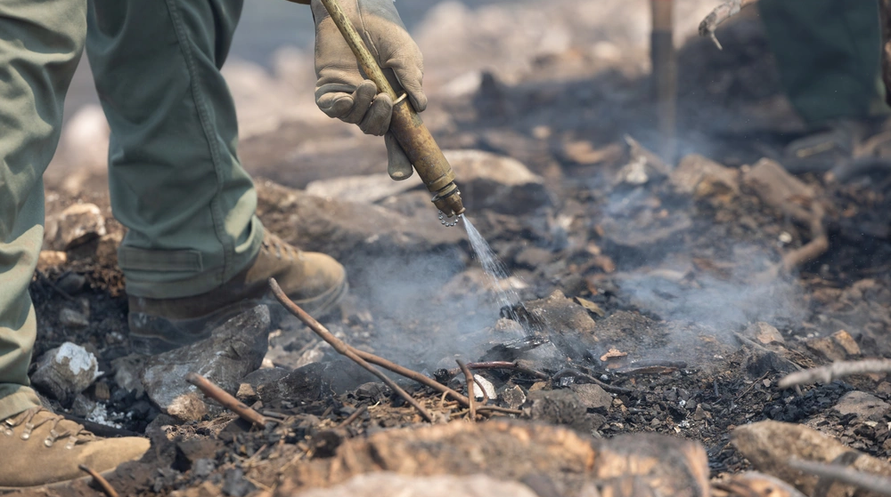
A heavy pump.
A steep hill.
A forest fire.
SEDAC
A support add-on in development
Forest Service photo via DVIDS · Public domain
01
Notes:
A heavy pump. A steep hill. A forest fire.
P2.04 is the current CAD pre-design. No physical test, fit check, ergonomic result, or safety result is claimed. Generated firefighter image is illustrative and is not the actual pump. The user photograph is the real pump reference. DVIDS image 9870773 is an independent Forest Service field photo and is used only as context. All source and compatibility notes are in Fuentes_y_limites.md.
Photo: U.S. Forest Service / Andrew Avitt, DVIDS 9870773.

Slide 2
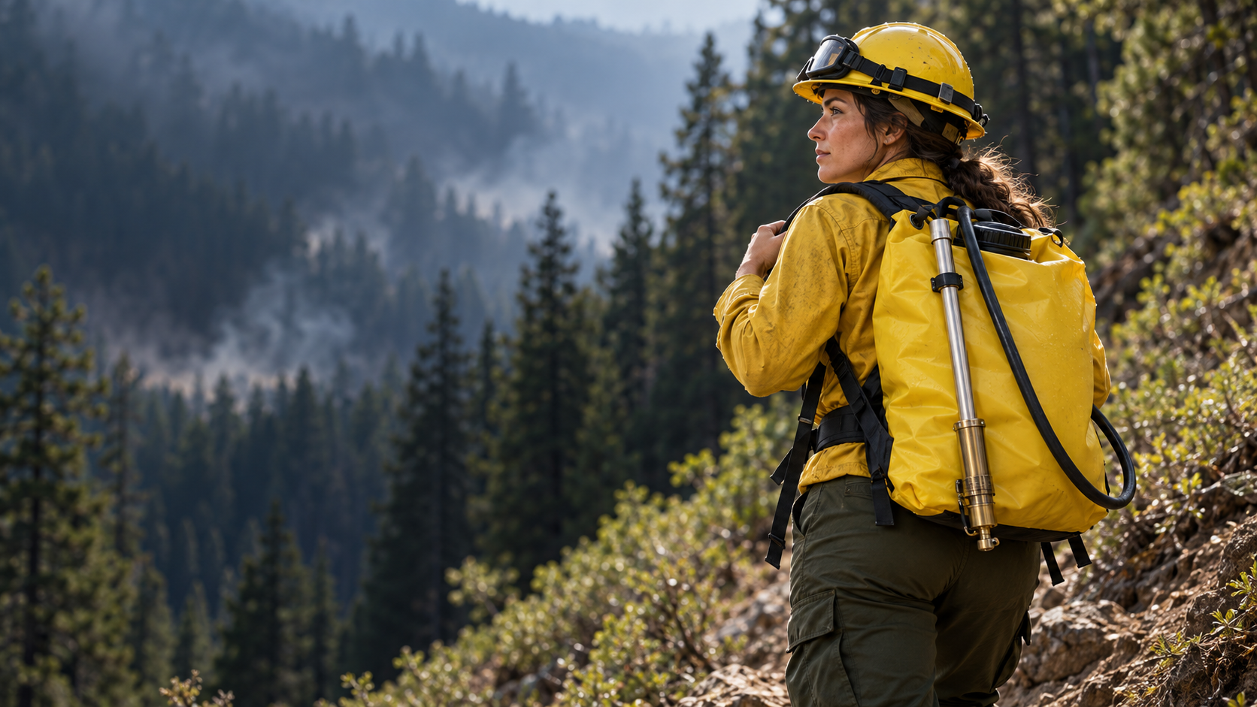
Can the carry
system do more?
DESIGN QUESTIONS
SHOULDER LOAD?
BELT SUPPORT?
FIT TO PUMP?
Illustrative image · not the project pump
02
Notes:
A firefighter carries a pump in the field. Can the support do more?
P2.04 is the current CAD pre-design. No physical test, fit check, ergonomic result, or safety result is claimed. Generated firefighter image is illustrative and is not the actual pump. The user photograph is the real pump reference. DVIDS image 9870773 is an independent Forest Service field photo and is used only as context. All source and compatibility notes are in Fuentes_y_limites.md.

Slide 3
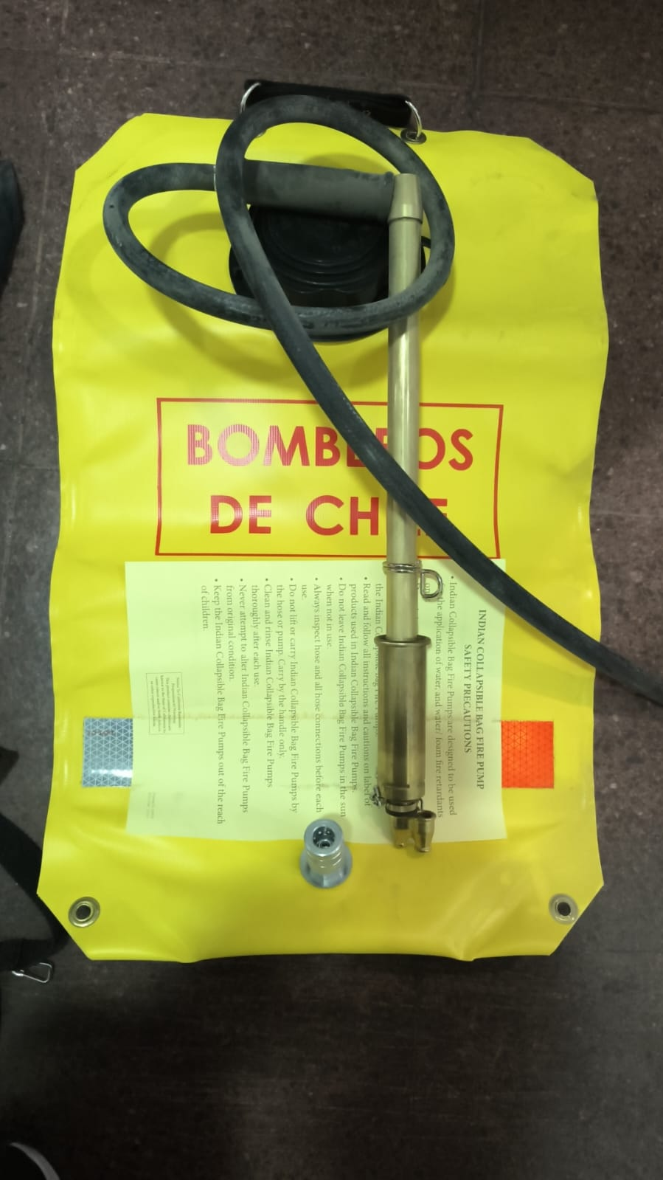
Our real
pump.
Project reference
This photo shows the front of the pump.
03
Notes:
This is the real pump from our project. Its fit and dimensions still need to be measured.
P2.04 is the current CAD pre-design. No physical test, fit check, ergonomic result, or safety result is claimed. Generated firefighter image is illustrative and is not the actual pump. The user photograph is the real pump reference. DVIDS image 9870773 is an independent Forest Service field photo and is used only as context. All source and compatibility notes are in Fuentes_y_limites.md.

Slide 4
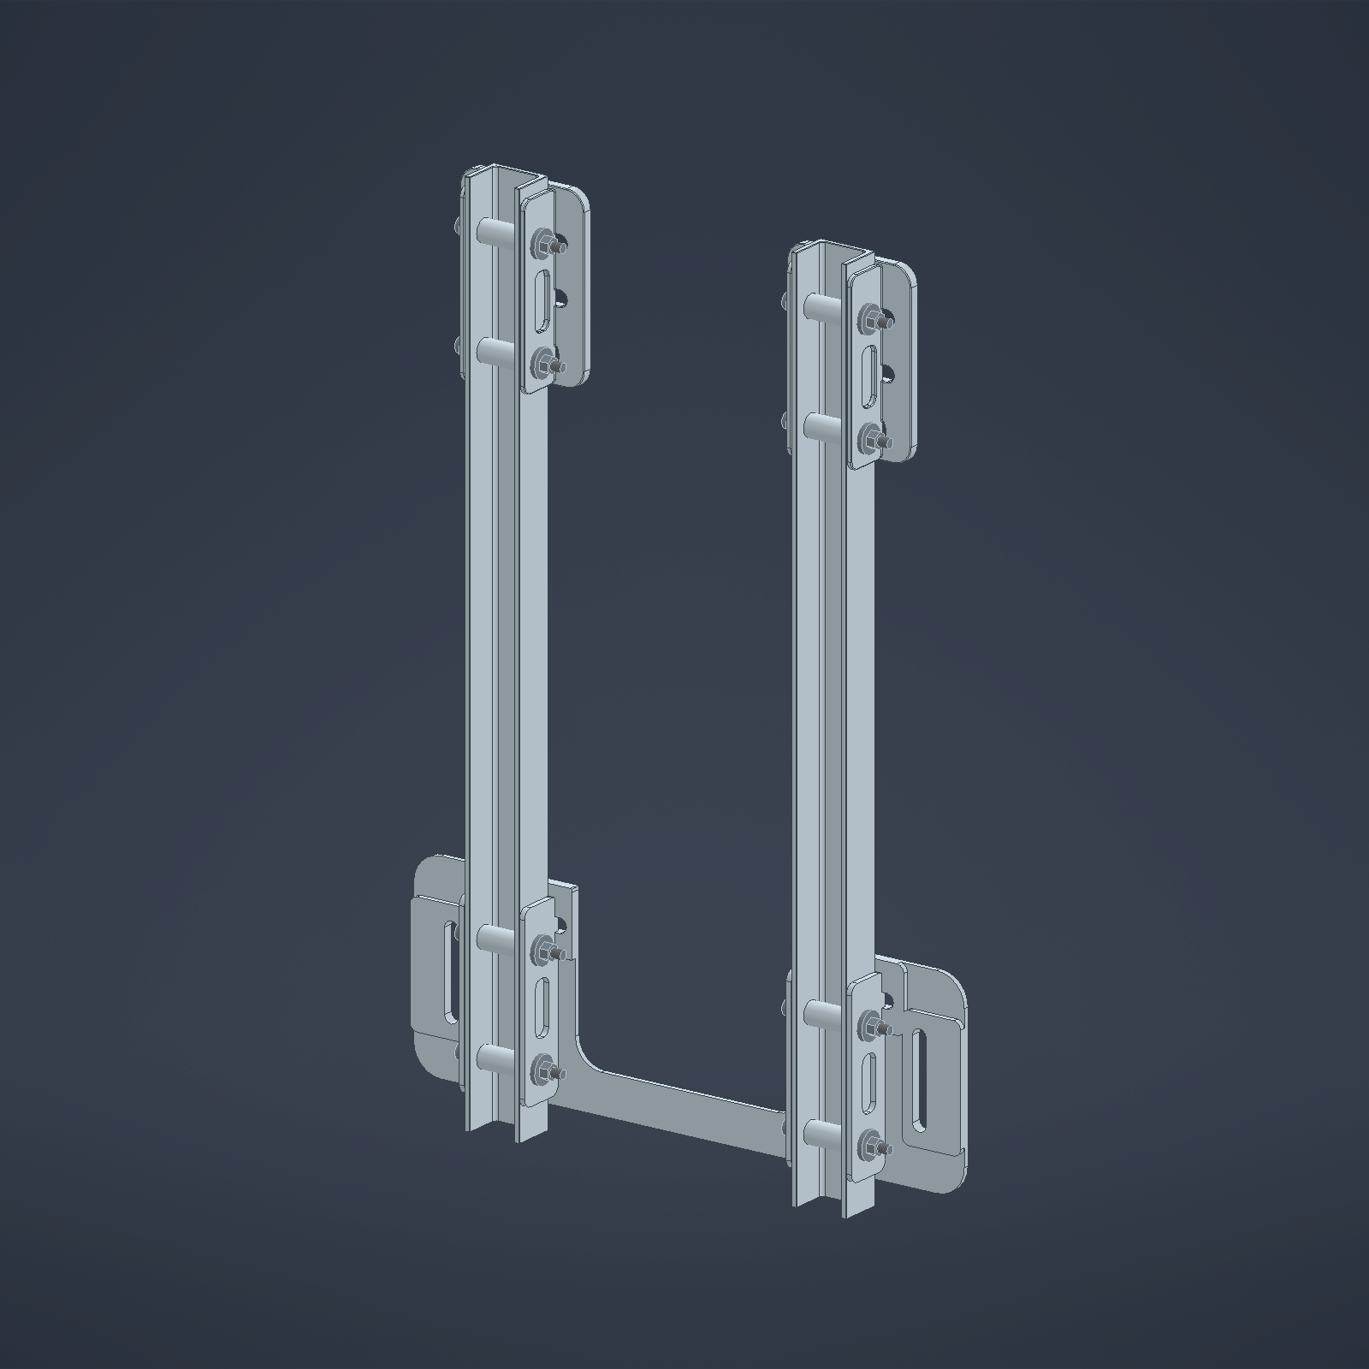
The support
add-on.
P2.04 · CAD pre-design
FRAME
BELT SUPPORT
Concept geometry · not built or tested
04
Notes:
P2.04 is our current CAD pre-design. It includes a frame and belt support.
P2.04 is the current CAD pre-design. No physical test, fit check, ergonomic result, or safety result is claimed. Generated firefighter image is illustrative and is not the actual pump. The user photograph is the real pump reference. DVIDS image 9870773 is an independent Forest Service field photo and is used only as context. All source and compatibility notes are in Fuentes_y_limites.md.
Image: original P2.04 VISTA_ESTRUCTURA export. No water bag is shown in this CAD view.

Slide 5
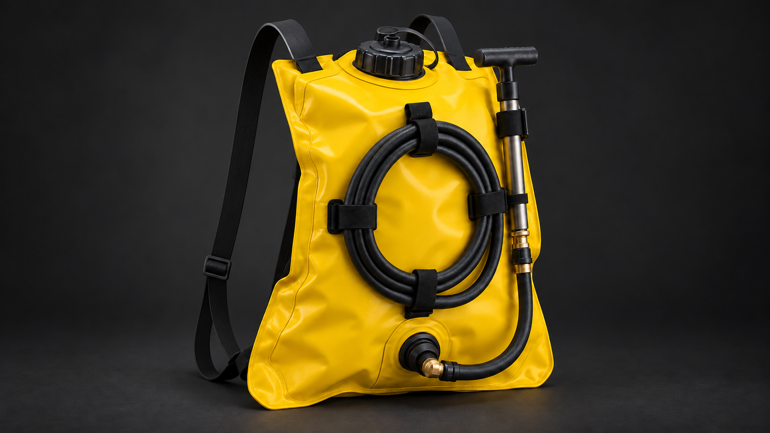
WITHOUT SEDAC
RUBBER SHOULDER STRAPS
No support frame or hip belt
Notes:
This reference shows the backpack pump with narrow rubber shoulder straps. It has no auxiliary frame or hip belt.

Slide 6
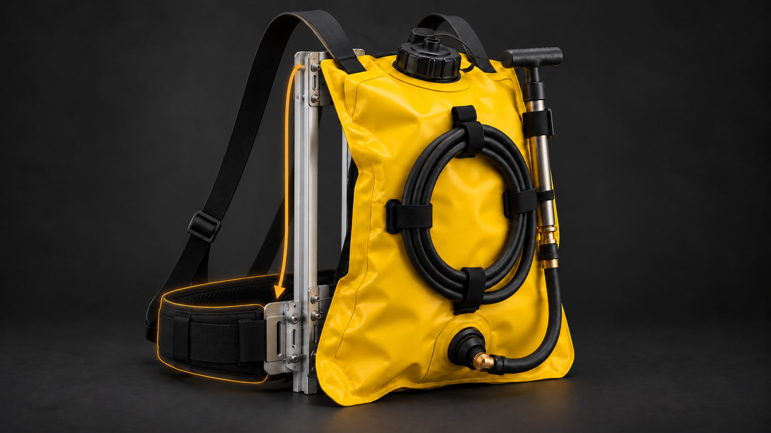
WITH SEDAC
SUPPORT CONCEPT
SUPPORT FRAME
HIP BELT SUPPORT
INTENDED LOAD PATH · TO BE TESTED
Notes:
This is a conceptual view of the pump connected to the support frame and hip belt. The amber arrow shows the intended load path. Fit and any change in shoulder loading have not been physically tested.

Slide 7
CURRENT STATUS
P2.04 is a
CAD pre-design.
Not physically tested yet.
Recent work: carabiner design iterations
06
Notes:
P2.04 has not been physically tested. Our latest design work includes carabiner options.
P2.04 is the current CAD pre-design. No physical test, fit check, ergonomic result, or safety result is claimed. Generated firefighter image is illustrative and is not the actual pump. The user photograph is the real pump reference. DVIDS image 9870773 is an independent Forest Service field photo and is used only as context. All source and compatibility notes are in Fuentes_y_limites.md.

Slide 8
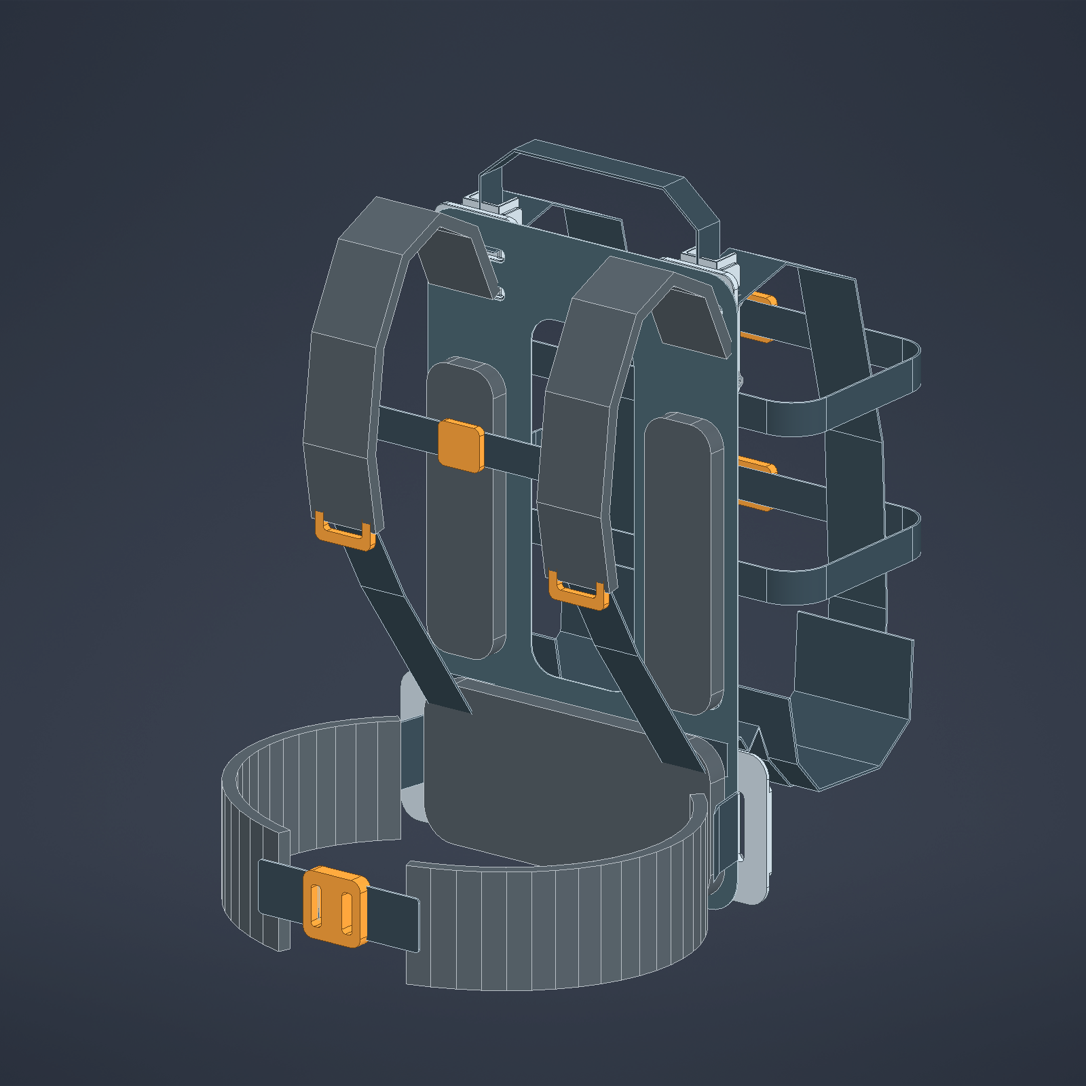
SEDAC · IMU TEST PLAN
COMPARE THE
MOVEMENT.
PLANNED LAB SESSION · THIS WEEK
Pump only vs. pump + SEDAC
Same pump · load · task · conditions
IMU MEASUREMENTS
Movement · orientation · sway
IMUs do not measure force · results pending
Future risk alerts need design and testing.
P2.04 CAD PRE-DESIGN · SENSORS NOT INSTALLED
Notes:
This week, a professor is lending us the lab for a planned IMU session. We plan to compare the pump alone with the same pump plus SEDAC, keeping the pump, load, task, and conditions the same. The sensor mounting, attachment, calibration, and protocol must be agreed with the professor before measuring. IMUs record movement, orientation, and oscillation (sway); they do not measure force or pressure. Results are pending, and this planned session is not a completed validation. Sensor alerts for possible risk conditions are a future product goal. Alert rules and any effect on risk still need to be designed and tested. The P2.04 image is CAD pre-design and has no sensors installed.

Slide 9
NEXT STEP
01
02
03
04
›
›
›
MEASURE
IMPROVE
BUILD
TEST
A staged plan for the next validation work.
No test results are available yet.
07
Notes:
Next: measure, improve, build and test.
P2.04 is the current CAD pre-design. No physical test, fit check, ergonomic result, or safety result is claimed. Generated firefighter image is illustrative and is not the actual pump. The user photograph is the real pump reference. DVIDS image 9870773 is an independent Forest Service field photo and is used only as context. All source and compatibility notes are in Fuentes_y_limites.md.

Slide 10
Same pump.
New way to
carry it.
Feedback and support for the next validation stage.
SEDAC · P2.04 concept
08
Notes:
Same pump. New way to carry it. We need feedback and support for validation.
P2.04 is the current CAD pre-design. No physical test, fit check, ergonomic result, or safety result is claimed. Generated firefighter image is illustrative and is not the actual pump. The user photograph is the real pump reference. DVIDS image 9870773 is an independent Forest Service field photo and is used only as context. All source and compatibility notes are in Fuentes_y_limites.md.

