Slide 1
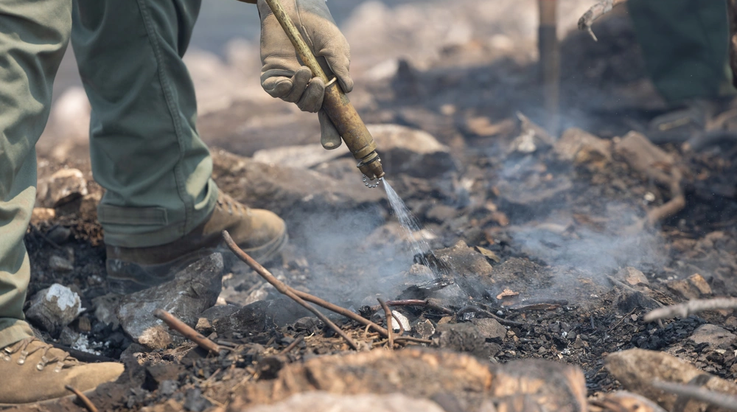
A heavy pump.
A steep hill.
A forest fire.
SEDAC
A support add-on in development
Forest Service photo via DVIDS · Public domain
01
Notes:
A heavy pump. A steep hill. A forest fire.
P2.04 is the current CAD pre-design. No physical test, fit check, ergonomic result, or safety result is claimed. Generated firefighter image is illustrative and is not the actual pump. The user photograph is the real pump reference. DVIDS image 9870773 is an independent Forest Service field photo and is used only as context. All source and compatibility notes are in Fuentes_y_limites.md.
Photo: U.S. Forest Service / Andrew Avitt, DVIDS 9870773.

Slide 2
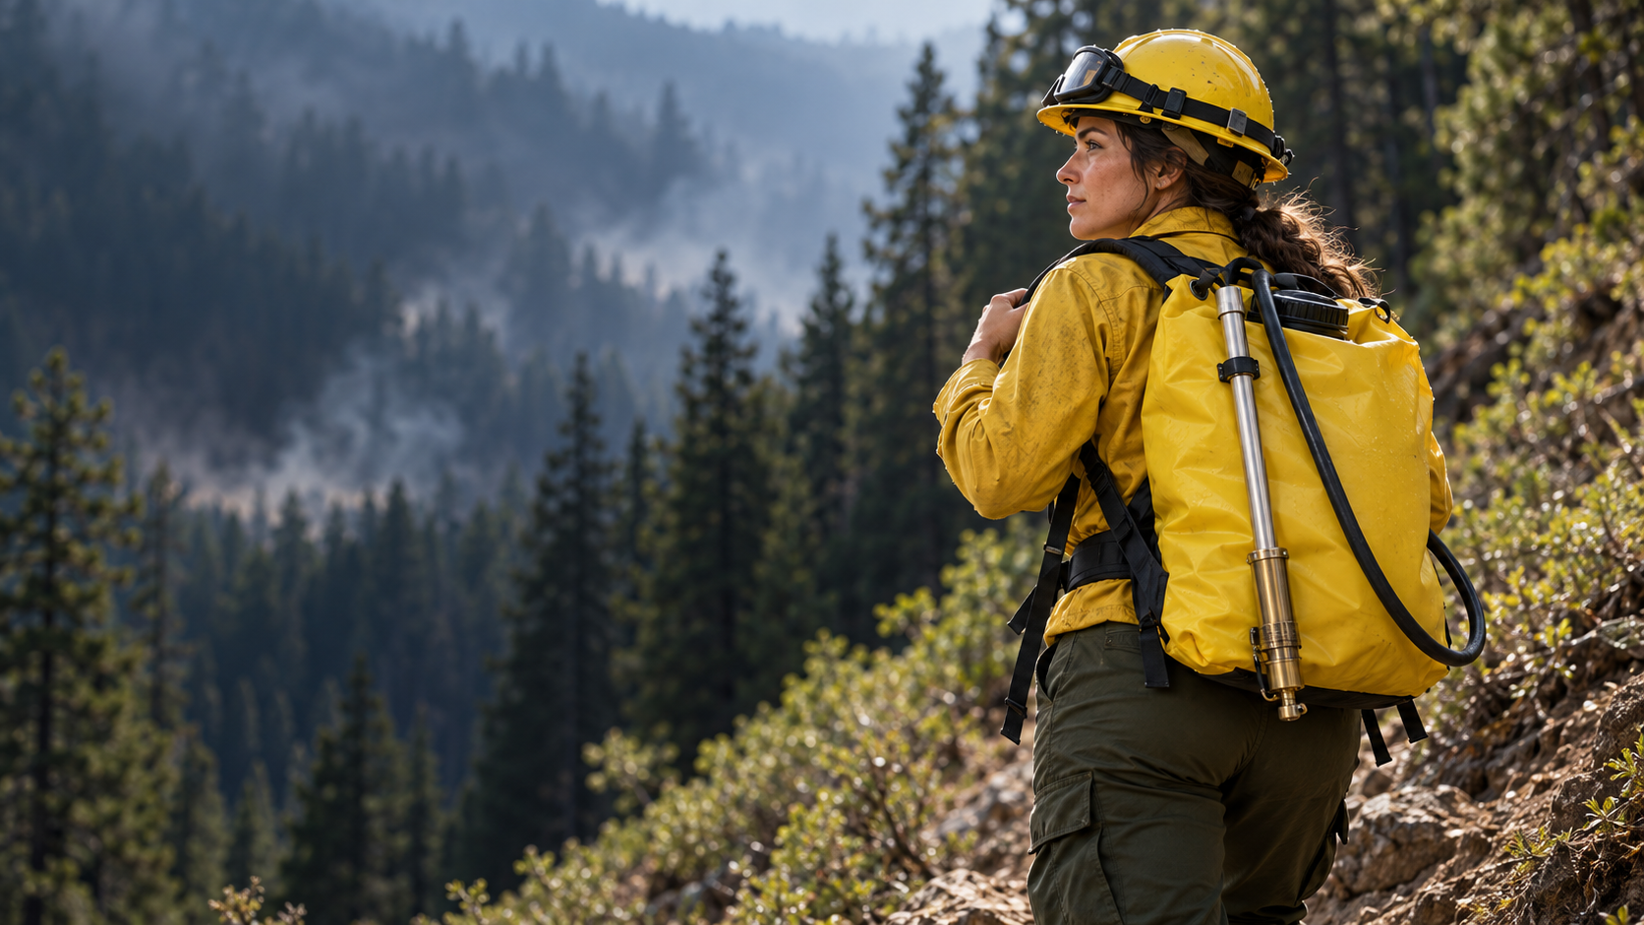
Can the carry
system do more?
DESIGN QUESTIONS
SHOULDER LOAD?
BELT SUPPORT?
FIT TO PUMP?
Illustrative image · not the project pump
02
Notes:
A firefighter carries a pump in the field. Can the support do more?
P2.04 is the current CAD pre-design. No physical test, fit check, ergonomic result, or safety result is claimed. Generated firefighter image is illustrative and is not the actual pump. The user photograph is the real pump reference. DVIDS image 9870773 is an independent Forest Service field photo and is used only as context. All source and compatibility notes are in Fuentes_y_limites.md.

Slide 3
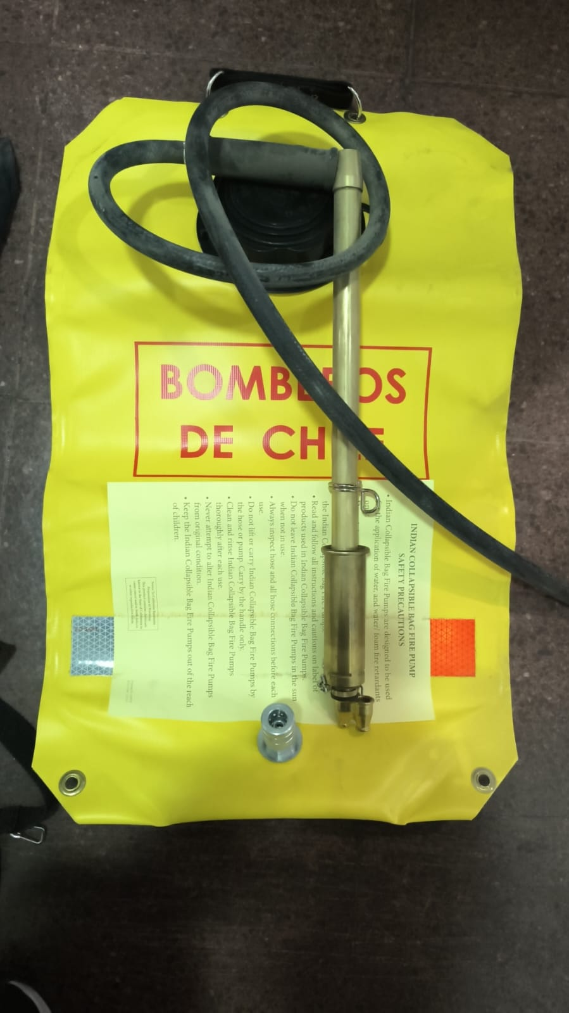
Our real
pump.
Project reference
This photo shows the front of the pump.
03
Notes:
This is the real pump from our project. Its fit and dimensions still need to be measured.
P2.04 is the current CAD pre-design. No physical test, fit check, ergonomic result, or safety result is claimed. Generated firefighter image is illustrative and is not the actual pump. The user photograph is the real pump reference. DVIDS image 9870773 is an independent Forest Service field photo and is used only as context. All source and compatibility notes are in Fuentes_y_limites.md.

Slide 4
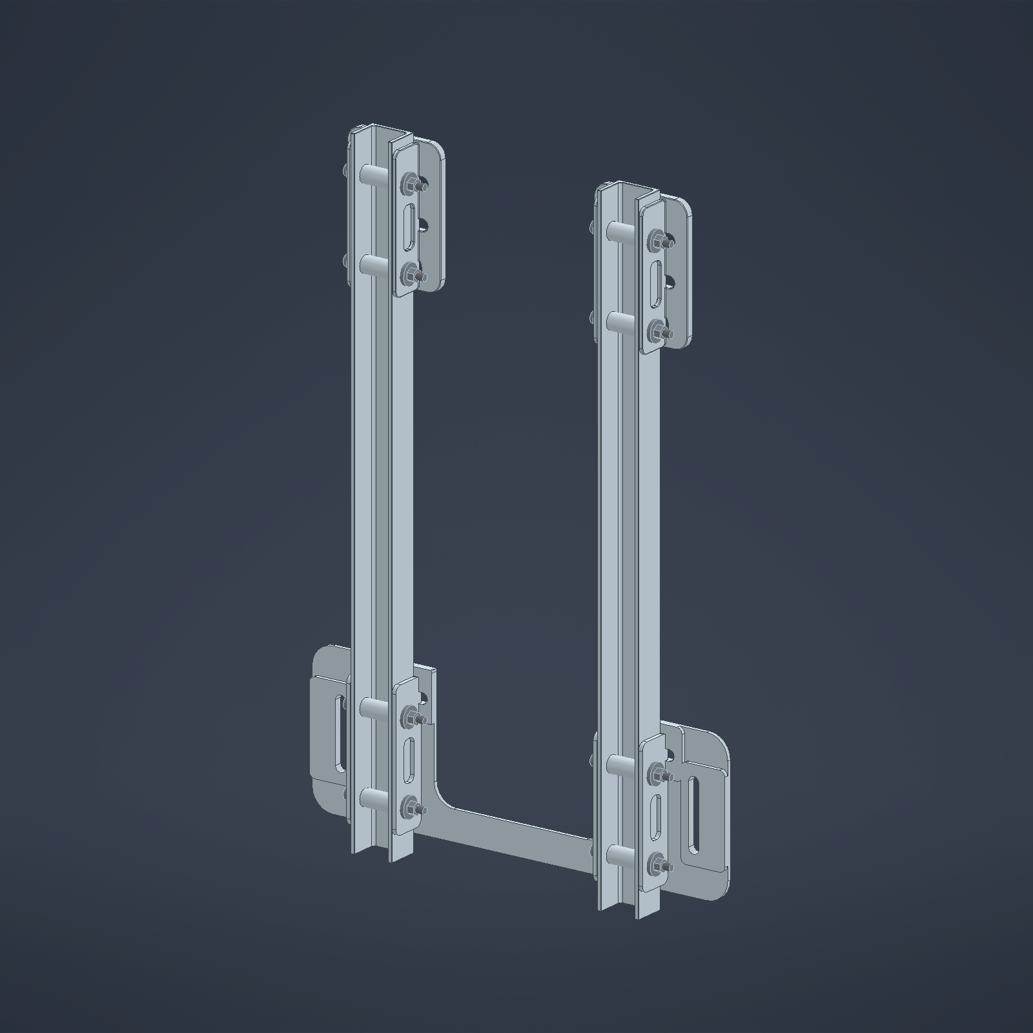
The support
add-on.
P2.04 · CAD pre-design
FRAME
BELT SUPPORT
Concept geometry · not built or tested
04
Notes:
P2.04 is our current CAD pre-design. It includes a frame and belt support.
P2.04 is the current CAD pre-design. No physical test, fit check, ergonomic result, or safety result is claimed. Generated firefighter image is illustrative and is not the actual pump. The user photograph is the real pump reference. DVIDS image 9870773 is an independent Forest Service field photo and is used only as context. All source and compatibility notes are in Fuentes_y_limites.md.
Image: original P2.04 VISTA_ESTRUCTURA export. No water bag is shown in this CAD view.

Slide 5
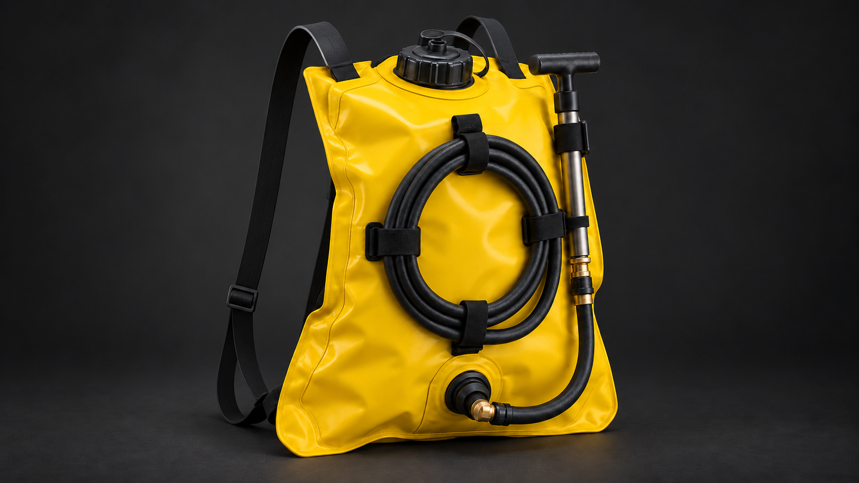
WITHOUT SEDAC
RUBBER SHOULDER STRAPS
No support frame or hip belt
Notes:
This reference shows the backpack pump with narrow rubber shoulder straps. It has no auxiliary frame or hip belt.

Slide 6
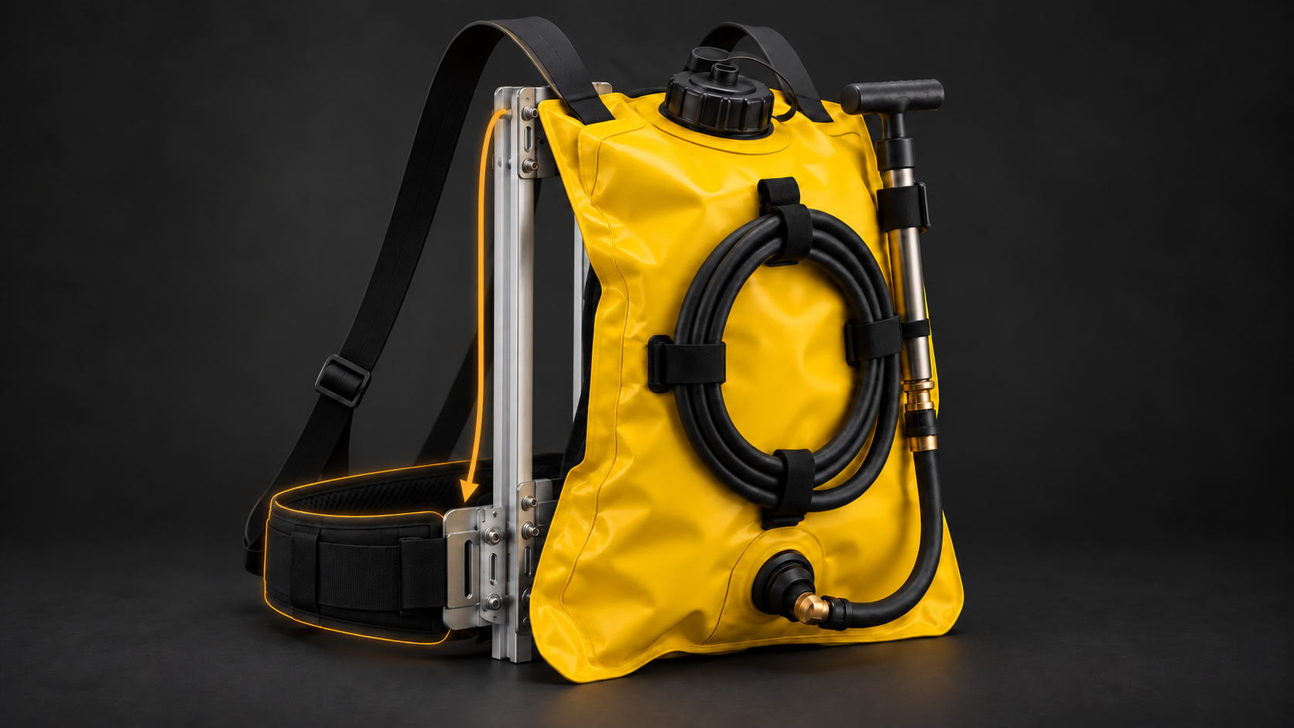
WITH SEDAC
SUPPORT CONCEPT
SUPPORT FRAME
HIP BELT SUPPORT
INTENDED LOAD PATH · TO BE TESTED
Notes:
This is a conceptual view of the pump connected to the support frame and hip belt. The amber arrow shows the intended load path. Fit and any change in shoulder loading have not been physically tested.

Slide 7
CURRENT STATUS
P2.04 is a
CAD pre-design.
Not physically tested yet.
Recent work: carabiner design iterations
06
Notes:
P2.04 has not been physically tested. Our latest design work includes carabiner options.
P2.04 is the current CAD pre-design. No physical test, fit check, ergonomic result, or safety result is claimed. Generated firefighter image is illustrative and is not the actual pump. The user photograph is the real pump reference. DVIDS image 9870773 is an independent Forest Service field photo and is used only as context. All source and compatibility notes are in Fuentes_y_limites.md.

Slide 8
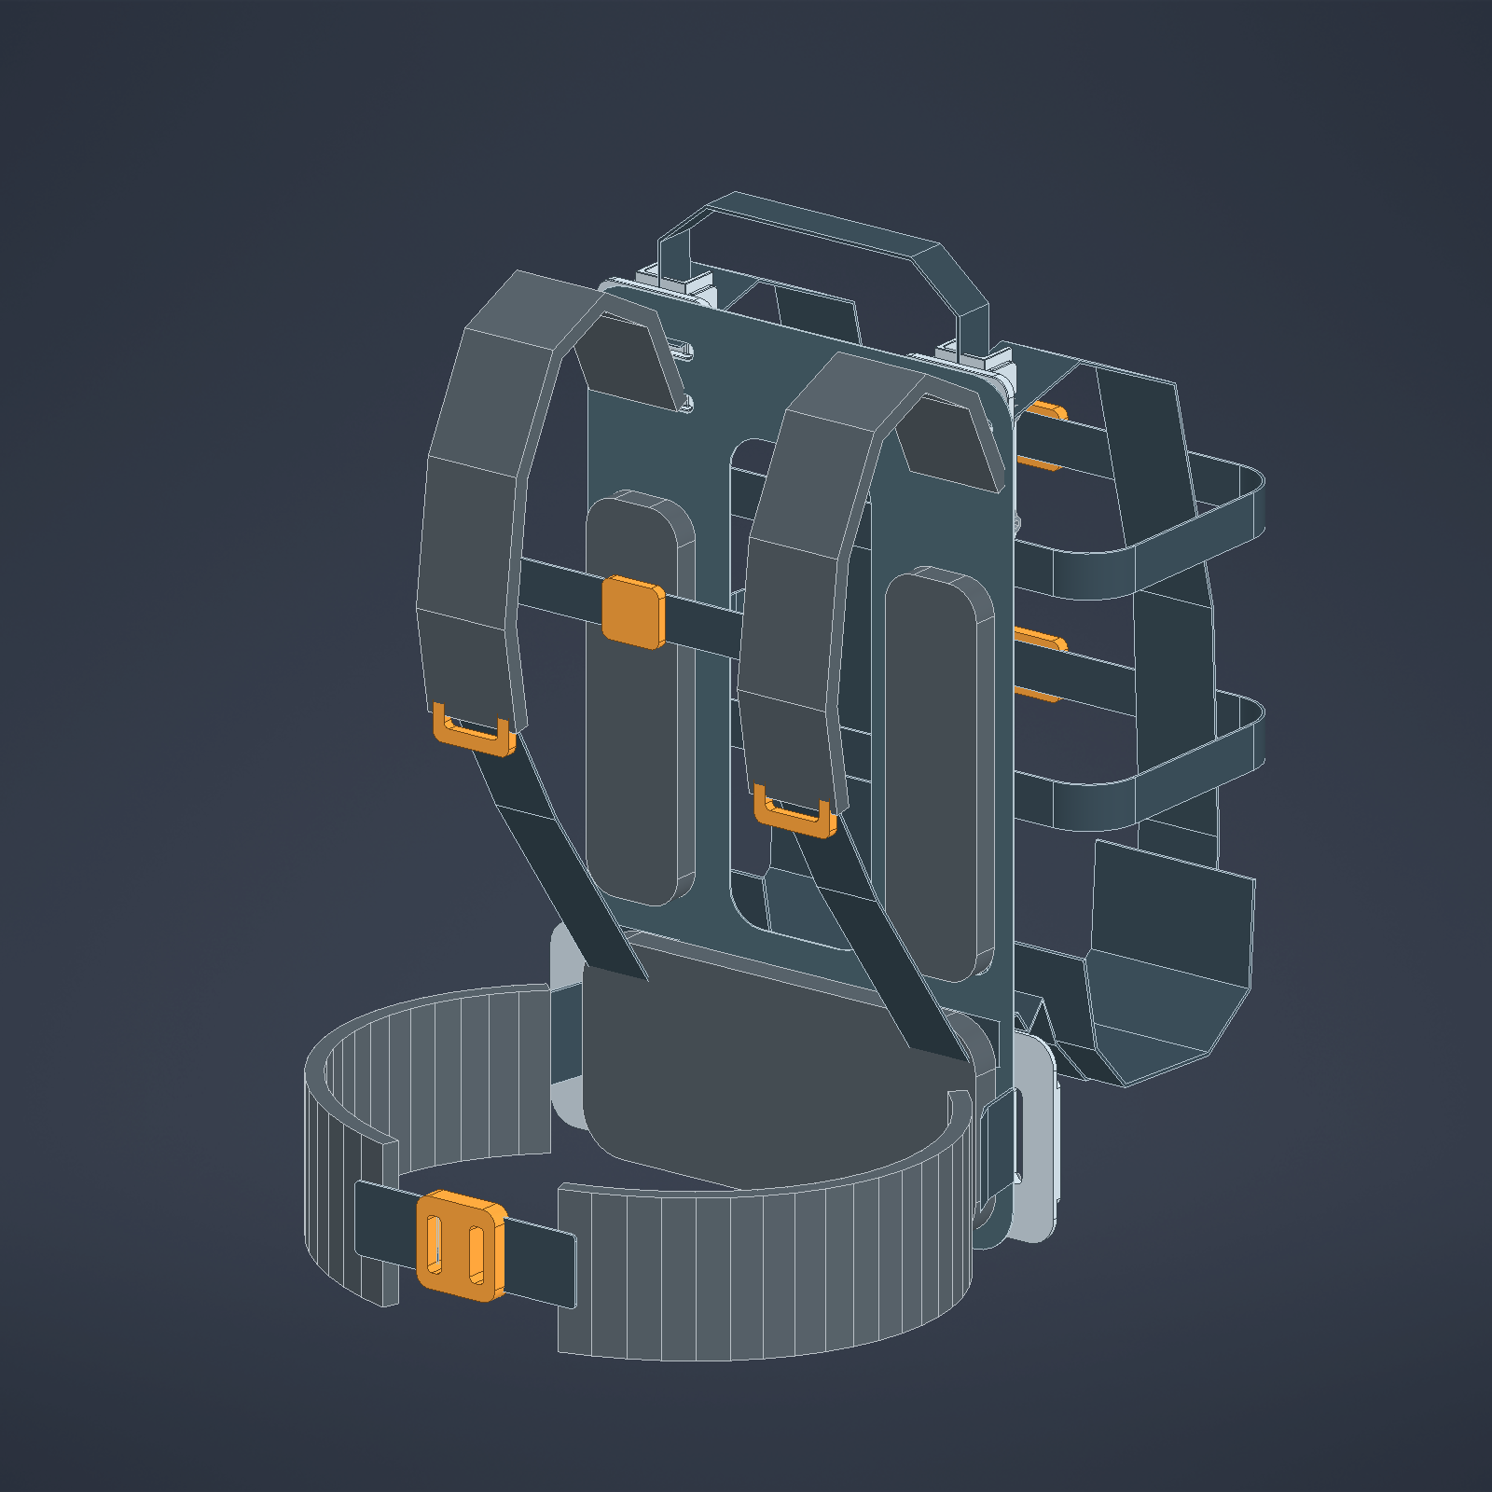
SEDAC · FUTURE SENSING
MEASURE NOW.
ALERT NEXT.
THIS WEEK · PLANNED LAB SESSION
IMU measurements
Movement and orientation
FUTURE PRODUCT GOAL
Sensor alerts for
defined risk conditions
IMUs track movement, not force.
Alert rules and risk reduction still need testing.
P2.04 CAD PRE-DESIGN · SENSORS NOT INSTALLED
Notes:
A professor is lending us the lab this week, and we plan to take IMU measurements. An IMU tracks movement and orientation; it does not measure force. Our future product goal is to add sensors and alerts for defined risk conditions. The alert rules and any risk reduction still need to be designed and tested. P2.04 remains a CAD pre-design, and the planned session is not a completed validation.

Slide 9
NEXT STEP
01
02
03
04
›
›
›
MEASURE
IMPROVE
BUILD
TEST
A staged plan for the next validation work.
No test results are available yet.
07
Notes:
Next: measure, improve, build and test.
P2.04 is the current CAD pre-design. No physical test, fit check, ergonomic result, or safety result is claimed. Generated firefighter image is illustrative and is not the actual pump. The user photograph is the real pump reference. DVIDS image 9870773 is an independent Forest Service field photo and is used only as context. All source and compatibility notes are in Fuentes_y_limites.md.

Slide 10
Same pump.
New way to
carry it.
Feedback and support for the next validation stage.
SEDAC · P2.04 concept
08
Notes:
Same pump. New way to carry it. We need feedback and support for validation.
P2.04 is the current CAD pre-design. No physical test, fit check, ergonomic result, or safety result is claimed. Generated firefighter image is illustrative and is not the actual pump. The user photograph is the real pump reference. DVIDS image 9870773 is an independent Forest Service field photo and is used only as context. All source and compatibility notes are in Fuentes_y_limites.md.

