Slide 1
Summaries and critical reviews Introduction to the project work
Lecture 5

Slide 2
Writing summaries
Summary = a brief account of the most relevant points (main messages)
Why?
Understand the main points without reading the entire paper
How?
Read carefully and extract the main message
When writing
Do not put in your opinion in the summary text
Use your own wording

Slide 3
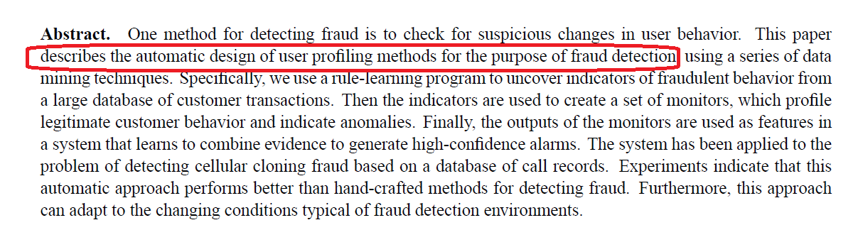
Writing summaries
Main message: What makes this paper valuable? Why would one want to read it?
Example: A paper on fraud.
Summary is not a short description of everything in the paper

Slide 4
Writing summaries
Bad structure of a summary :
Background information – 90%
Description of the main contribution– 10%
Good structure (step-by-step, approx equal text proportions):
Context
Explanation of the main contribution
Comparison of the author’s approach and the alternative approaches – what does the author write about this?
Conclusions, limitations

Slide 5


Typical mistakes
Do not use a (not widely known) concept before you explain it or give a reference to it!
Use references if it is really needed, otherwise avoid

Slide 6

Typical mistakes
When mention a paper, cite it
…in paper[1]

Slide 7
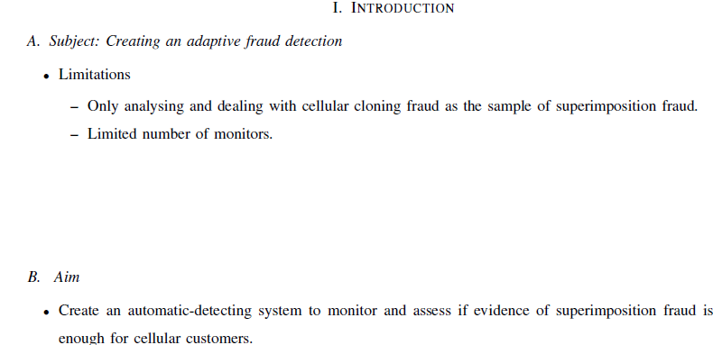
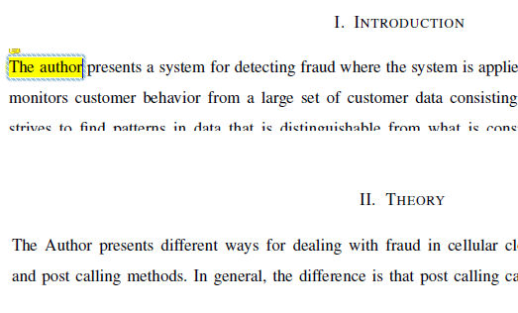
Typical mistakes
Introduction is not so long→splitting in sections or any kind of formating is not reasonable

Slide 8
Typical mistakes
Missunderstaning of ”now” and ”then”
Think if the paper is from 1990s…

Slide 9
Other mistakes
Paraphrazing is a kind of plagiarism
Urkund IS smart.. Create sentences yourself!

Slide 10
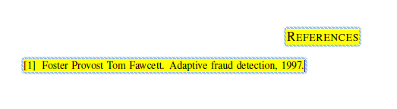
Other mistakes
Specify the complete reference (page, journal, year…)

Slide 11
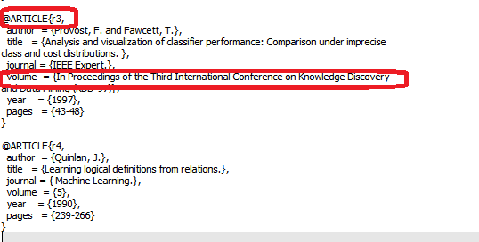
Other mistakes
There are different types of references in BibTex, not only article→use the appropriate one!
Book
Inproceedings
PhD Thesis

Slide 12
Critical reviews
The critical review involves analysing and evaluating someone’s work and presenting a point of view that you can support
Main questons:
What to write about?
How to write? (style, wording,..)

Slide 13
Critical reviews
Types of reviews
Review of a manuscript (opposition of master thesis)
Text, formatting and structure issues
Methodological issues
Review a paper as a part of the own paper
Methodological issues

Slide 14
Preliminary analysis
Author’s central purpose?
Methods to accomplish purpose?
Results
How was each method used?
Are results significant? Or empirical?
How do the results contribute to central purpose?
How were results interpreted?
Is research question answered?
Novelty of the research?
Does result support other researcher’s findings?

Slide 15
What to write about?
Significance and contribution to the field
How relevant is research question?
To what extent is the aim achieved?
Does the text bring much new knowledge?
How does it match to other works/results in the field?
What was missing/not stated?

Slide 16
What to write about?
Methodology or approach
Is methodology clearly explained?
Are other studies considered?
How objective/biased is the approach?
From previous author’s papers?
Bayesian/Frequentist, Quantitative/Qualitative
Are the results valid and reliable?
Qualitative? Statistical tests?
May there be better/alternative approaches?
Limitations discussed?

Slide 17
What to write about?
Argument and use of evidence
Is there a clear problem, statement or hypothesis?
Are the arguments consistent? Do author contradicts to him/herself?
Are conclusions too strong? Too weak?
How valid and reliable is the evidence?
Data valid?
Simulation results sufficient?
How effective is the evidence in supporting the argument?
Do these simulation actually support the claim?
Are conclusions justified? Do they rely on results?

Slide 18
What to write about?
Formatting
Title matches subject?
Purpose in abstract matches introduction?
Does the information come into right sections?
Are tables, graph well presented?
Connection of text and tables graphs
Do they complement or repeat each other?
Methods well explained?

Slide 19
How to write?
Main guideline: constructive criticism
Cautious language, positive features first
Ex: Saying what the author should have done but did not
“This was a well-written survey of current information but the connection between nutrient stress, secondary compounds, and herbivory rates in wetland plats could have received greater coverage.”
“The discussion would have been somewhat more relevant if the author had used more recent literature to support his views.”

Slide 20
How to write?
past unreal conditionals, format:
... should/could/would/might have been (better,stronger, etc.) ... if ...
... as opposed to present unreal conditionals:
“Your paper would be stronger if you included some additional information.”

Slide 21
Point of view
Your statements needs to be supported
Providing explanations
Citing other papers

Slide 22
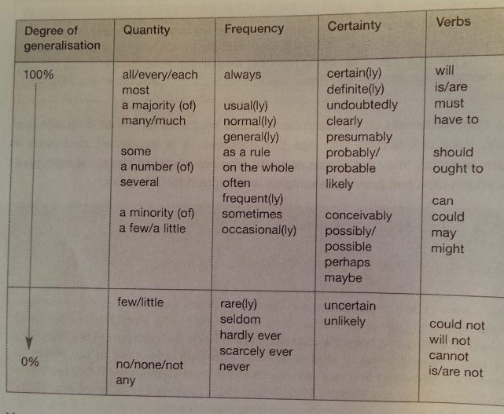
Generalizations
Your statements will probably relate not only to a particular situations but more generally

Slide 23
Recommendations
Is needed
Must be done
Should be done
Is recommended
Is advisable
Could/might/may be considered

Slide 24
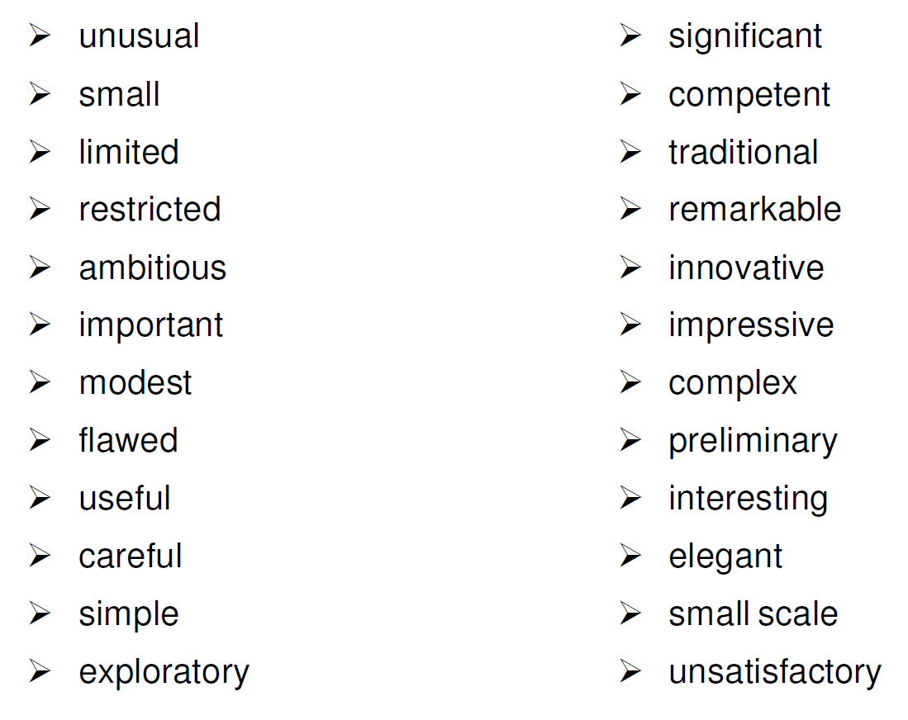
Evaluative language

Slide 25
Evaluative language
All disciplines:
Good: useful, important, interesting
Poor: difficult
Humanities:
Good: clear, accessible, insightful, original, perceptive, rigorous, complex (sociology)
Average: sound
Poor: inconsistent, restricted, misleading, thin, anecdotal, simple (sociology)
Technology:
Good: detailed, up-to-date, comprehensive, practical, elegant, economical, simple, efficient
Average: accurate
Poor: sloppy, complex

Slide 26
References
“TGTU39 Academic Writing” by J, Takkinen (2010)
Kuyper, B.J. (1991). Bringing up scientists in the art of critiquing research. Bioscience 41(4), 248-250.
https://student.unsw.edu.au/writing-critical-review

Slide 27
Project work
A short paper (3-4 pages) on one of the following topics:
Academic writing
Writing reviews on scientific papers
Constructive criticism in the context of higher education
Ethical rules in the context of higher education
Academic culture
Equal opportunities the context of higher education
Litterature search, search engines
Plagiarism in the context of higher education

Slide 28
Project work
Required ingridients
Usual paper elements (title, abstract, introduction, conclusion and discussion, references)
Introduction
Make a statement in the paper about why this topic is important, mention which problems there might exist in the context of this topic
Check the existing literature (scientific papers) on the topic, summarize and present important facts/theories/methods/approaches

Slide 29
Project work
Required ingridients
In some section
Make a critical analysis of the topic by performing some of the following actions:
Comparing the problems/methods/approaches you described to the situation/traditions in your own country
Providing your own critical judgement about the theories/methods/approaches/guidelines that are present in the literature
Interviewing some people about the topic of your paper, summarizing their answers in the paper and making conclusions (construct the interview questions yourself)
Attach survey and answers as appendix!

Slide 30
Project work
The paper should be written in RMarkdown The first draft of the paper should be submitted to LISAM at latest on 19th of September, 23:59.
Go to “Collaborative Workspace”
Create a folder with your name, for ex. “Anders Andersson”
Put your RMD, BIB and PDF files inside.
The final draft of the paper should be submitted to LISAM in the same way at latest on 30th of September, 23:59.

Slide 31
Workshops
Schedule for groups and opposition is published:
Group 1: 28th of September at LISAM, Course Documents
Group 2,3,4: 5th of October at LISAM, Course Documents
You participate at only one seminar of the scheduled three (see opposition schedule)
Read all papers of the participants at your workhop
Read one paper that you are opponent for very carefully and prepare at least 5 questions/comments to the author of this paper.
These questions/comments should not relate to the grammar or formatting but should rather be such questions that may raise discussions in the class.
Try to make your questions interesting for other participants
You must be able to have enough questions to support discussions regarding this paper for at least 15 minutes.

Slide 32
Criteria for ’pass’
Attendance of lectures
Active participation at the workshop – not only during the session that you are responsible for
The paper has a sufficient quality.
What is sufficient?

Slide 33
Criteria for ’pass’
Sufficient quality of the written report:
The paper is devoted to one of the specified topics. The paper has necessary elements of a paper (title, abstract, introduction etc). The problem is clearly presented and its importance is well explained. The introductory section summarizes in a clear fashion a reasonable amount of research papers containing theories/methods/facts/approaches related to the topic. Alternatively, at least one research paper is summarized but the student also presents a conducted interview and a connection between the interview results and the conclusions in the selected research paper(s). The main section of the student paper, which constitutes approximately half of the text, contains own critical judgements related to the topic, to the conducted interview and/or to the papers related to the topic. Grammar and the structure of the sentences in the paper are of a good quality.

Slide 34
Criteria for ’pass’
Scientific papers need to be primarily analyzed!
Blogs, webpages etc only as support
Own critical judgements should be clearly seen
Alternative 1: Put all of them in separate section
Alternative 2: Use “I think”, “I conclude”, “From my point of view”, “I disagree with..” etc.

