Slide 1
732A54 / TDDE31
Big Data Analytics
6hp
http://www.ida.liu.se/~732A54
http://www.ida.liu.se/~TDDE31

Slide 2
Teachers
Examiner: Patrick Lambrix (B:2B:474)
Lectures: Patrick Lambrix,
Christoph Kessler,
Jose Pena,
Olaf Hartig
Labs: Huanyu Li, Jose Pena
Director of studies: Patrick Lambrix
Notes:
2001-10-01
<number>(2)

Slide 3
Course literature
Articles (on web/handout)
Lab descriptions (on web)
Notes:
2001-10-01
<number>(2)

Slide 4
Data and Data Storage
Notes:
2001-10-01
<number>(2)

Slide 5
Data and Data Storage
Database / Data source
One (of several) ways to store data in electronic format
Used in everyday life: bank, hotel reservations, library search, shopping
Notes:
2001-10-01
<number>(2)

Slide 6
Databases / Data sourcces
Database management system (DBMS): a collection of programs to create and maintain a database
Database system = database + DBMS
Notes:
2001-10-01
<number>(2)

Slide 7
Databases / Data sources
Information
Queries
Answer
Model
Database
system
Processing of
queries/updates
Database
management
system
Access to stored data
Physical
database
Notes:
2001-10-01
<number>(2)

Slide 8
What information is stored?
Model the information
- Entity-Relationship model (ER)
- Unified Modeling Language (UML)
Notes:
2001-10-01
<number>(2)

Slide 9
What information is stored? - ER
entities and attributes
entity types
key attributes
relationships
cardinality constraints
EER: sub-types
Notes:
2001-10-01
<number>(2)

Slide 10
DEFINITION Homo sapiens adrenergic, beta-1-, receptor
ACCESSION NM_000684
SOURCE ORGANISM human
REFERENCE 1
AUTHORS Frielle, Collins, Daniel, Caron, Lefkowitz,
Kobilka
TITLE Cloning of the cDNA for the human
beta 1-adrenergic receptor
REFERENCE 2
AUTHORS Frielle, Kobilka, Lefkowitz, Caron
TITLE Human beta 1- and beta 2-adrenergic
receptors: structurally and functionally
related receptors derived from distinct
genes
Notes:
2001-10-01
<number>(2)
PUT THIS SLIDE ALSO ON OH
We wil model this data using the different approaches to give a feel for the issues in the different approaches, we focus on data model + querying.
OBS: the formatted file resources have their own tags
(first step in a chain of biochemical reactions that put cell in stressed state)
SOURCE of data:Genbank
This membrane-bound protein is responsible for detecting adrenalin (ephineprine).
- adrenalin binds to the beta-receptor and induces a conformation change, which lets an associated membrane-bound G-protein lose a alpha sub-unit.
- alpha-unit changes a GDP toa GTP and acivates a neighboring membrane-bound adenylatcylase.
- the adenylatcylase synthesizes (converts ATP to) a lot of cAMP and then shuts down.
- the cAMP level in the cell activates a cAMP-dependent proteinkinase (cAPK) that mediates the signal to cellresponse through phosphorylation. (This phosphorylation puts the cell in a ’stressed state’.)

Slide 11
Entity-relationship
protein-id
source
PROTEIN
accession
definition
m
Reference
n
title
article-id
ARTICLE
author
Notes:
2001-10-01
<number>(2)

Slide 12
Databases / Data sources
Information
Queries
Answer
Model
Database
system
Processing of
queries/updates
Database
management
system
Access to stored data
Physical
database
Notes:
2001-10-01
<number>(2)

Slide 13
How is the information stored?
(high level)
How is the information accessed?
(user level)
structure
precision
Text (IR)
Semi-structured data
Data models (DB)
Rules + Facts (KB)
Notes:
2001-10-01
<number>(2)

Slide 14
IR - formal characterization
Information retrieval model: (D,Q,F,R)
D is a set of document representations
Q is a set of queries
F is a framework for modeling document representations, queries and their relationships
R associates a real number to document-query-pairs (ranking)
Notes:
2001-10-01
<number>(2)

Slide 15
IR - Boolean model
adrenergic
cloning
receptor
Doc1
Doc2
yes
no
yes
yes
no
no
-->
-->
(1 1 0)
(0 1 0)
Q1: cloning and (adrenergic or receptor)
--> (1 1 0) or (1 1 1) or (0 1 1) Result: Doc1
Q2: cloning and not adrenergic
--> (0 1 0) or (0 1 1) Result: Doc2
Notes:
2001-10-01
<number>(2)
CONCEPTUAL MODEL
boolean model:
OBS: DISJUNCTIVE NORMAL FORM
disjunction of conjunction of literals
Q1: cloning and (adrenergic or receptor)
(cloning and adrenergic) or (cloning and receptor)
(cloning and adrenergic and receptor) or (cloning and adrenergic and not receptor) or (cloning and receptor and not adrenergic)
(1 1 1) or (1 1 0) or (0 1 1)
Q2: cloning and not adrenergic
(cloning and not adrenergic and receptor) or (cloning and not adrenergic and not receptor)
(0 1 1) or (0 1 0)

Slide 16
IR - Vector model (simplified)
Doc1 (1,1,0)
cloning
Doc2 (0,1,0)
Q (1,1,1)
adrenergic
sim(d,q) = d . q
|d| x |q|
receptor
Notes:
2001-10-01
<number>(2)

Slide 17
Semi-structured data
human
”Homo sapiens adrenergic,
beta-1-, receptor”
NM_000684
ACCESSION
SOURCE
DEFINITION
Protein
DB
PROTEIN
REFERENCE
REFERENCE
AUTHOR
TITLE
TITLE
AUTHOR
Frielle
AUTHOR
AUTHOR
Collins
AUTHOR
”Human beta-1 …”
”Cloning of …”
AUTHOR
AUTHOR
Daniel
AUTHOR
AUTHOR
Caron
AUTHOR
Lefkowitz
Kobilka
Notes:
2001-10-01
<number>(2)

Slide 18
Semi-structured data - Queries
select source
from PROTEINDB.protein P
where P.accession = ”NM_000684”;
Notes:
2001-10-01
<number>(2)

Slide 19
Relational databases
PROTEIN
REFERENCE
PROTEIN-ID
ACCESSION
DEFINITION
SOURCE
PROTEIN-ID
ARTICLE-ID
1
NM_000684
Homo sapiens adrenergic,
beta-1-, receptor
human
1
1
1
2
ARTICLE-AUTHOR
ARTICLE-TITLE
ARTICLE-ID
AUTHOR
ARTICLE-ID
TITLE
1
1
1
1
1
1
2
2
2
2
Frielle
Collins
Daniel
Caron
Lefkowitz
Kobilka
Frielle
Kobilka
Lefkowitz
Caron
1
Cloning of the cDNA for the human
beta 1-adrenergic receptor
2
Human beta 1- and beta 2-adrenergic receptors: structurally and functionally related receptors derived from distinct
genes
Notes:
2001-10-01
<number>(2)

Slide 20
Relational databases - SQL
select source
from protein
where accession = NM_000684;
PROTEIN
PROTEIN-ID
ACCESSION
DEFINITION
SOURCE
1
NM_000684
Homo sapiens adrenergic,
beta-1-, receptor
human
Notes:
2001-10-01
<number>(2)

Slide 21
Evolution of Database Technology
1960s:
  Data collection, database creation, IMS and network DBMS
1970s:
  Relational data model, relational DBMS implementation
1980s:
  Advanced data models (extended-relational, OO, deductive, etc.)
  Application-oriented DBMS (spatial, temporal, multimedia, etc.)
1990s:
  Data mining, data warehousing, multimedia databases, and Web databases
2000s
  Stream data management and mining
  Data mining and its applications
  Web technology (XML, data integration) and global information systems
  NoSQL databases

Slide 22
Knowledge bases
(F) source(NM_000684, Human)
(R) source(P?,Human) => source(P?,Mammal)
(R) source(P?,Mammal) => source(P?,Vertebrate)
Q: ?- source(NM_000684, Vertebrate)
A: yes
Q: ?- source(x?, Mammal)
A: x? = NM_000684
Notes:
2001-10-01
<number>(2)

Slide 23
Interested in more?
732A57/TDDD12/TDDD37/TDDD46/ TDDD74/TDDD81 Database Technology
(relational databases)
TDDD43 Advanced data models and databases
(IR, semi-structured data, DB, KB)
Notes:
2001-10-01
<number>(2)

Slide 24
Analytics

Slide 25
Analytics
Discovery, interpretation and communication of meaningful patterns in data
Notes:
2001-10-01
<number>(2)

Slide 26
Analytics - IBM
What is happening? Descriptive
Discovery and explanation
Why did it happen? Diagnostic
Reporting, analysis, content analytics
What could happen? Predictive
Predictive analytics and modeling
What action should I take? Prescriptive
Decision management
What did I learn, what is best?
Cognitive

Slide 27
Analytics - Oracle
Classification
Regression
Clustering
Attribute importance
Anomaly detection
Feature extraction and creation
Market basket analysis

Slide 28
Why Analytics?
The Explosive Growth of Data
  Data collection and data availability
    Automated data collection tools, database systems, Web, computerized society
  Major sources of abundant data
    Business: Web, e-commerce, transactions, stocks, …
    Science: Remote sensing, bioinformatics, scientific simulation, …
    Society and everyone: news, digital cameras, YouTube
We are drowning in data, but starving for knowledge!

Slide 29
Ex.: Market Analysis and Management
Where does the data come from?—Credit card transactions, loyalty cards, discount coupons, customer complaint calls, plus (public) lifestyle studies
Target marketing
  Find clusters of “model” customers who share the same characteristics: interest, income level, spending habits, etc.
  Determine customer purchasing patterns over time
Cross-market analysis—Find associations/co-relations between product sales, & predict based on such association
Customer profiling—What types of customers buy what products (clustering or classification)
Customer requirement analysis
  Identify the best products for different groups of customers
  Predict what factors will attract new customers
Provision of summary information
  Multidimensional summary reports
  Statistical summary information (data central tendency and variation)
Notes:
Market baket analysis: computer and printer sell well together

Slide 30
Ex.: Fraud Detection & Mining Unusual Patterns
Approaches: Clustering & model construction for frauds, outlier analysis
Applications: Health care, retail, credit card service, telecomm.
  Auto insurance: ring of collisions
  Money laundering: suspicious monetary transactions
  Medical insurance
    Professional patients, ring of doctors, and ring of references
    Unnecessary or correlated screening tests
  Telecommunications: phone-call fraud
    Phone call model: destination of the call, duration, time of day or week. Analyze patterns that deviate from an expected norm
  Anti-terrorism

Slide 31
Knowledge Discovery (KDD) Process
Knowledge
Pattern evaluation and presentation
Data Mining
Task-relevant Data
Data Warehouse
Selection and transformation
Data Cleaning
Data Integration
Databases

Slide 32
Data Mining – what kinds of patterns?
Concept/class description:
  Characterization: summarizing the data of the class under study in general terms
    E.g. Characteristics of customers spending more than 10000 sek per year
  Discrimination: comparing target class with other (contrasting) classes
    E.g. Compare the characteristics of products that had a sales increase to products that had a sales decrease last year

Slide 33
Data Mining – what kinds of patterns?
Frequent patterns, association, correlations
  Frequent itemset
  Frequent sequential pattern
  Frequent structured pattern
  E.g. buy(X, “Diaper”) → buy(X, “Beer”) [support=0.5%, confidence=75%]
  confidence: if X buys a diaper, then there is 75% chance that X buys beer
  support: of all transactions under consideration 0.5% showed that diaper and
  beer were bought together
  E.g. Age(X, ”20..29”) and income(X, ”20k..29k”) → buys(X, ”cd-player”) [support=2%, confidence=60%]

Slide 34
Data Mining – what kinds of patterns?
Classification and prediction
  Construct models (functions) that describe and distinguish classes or concepts for future prediction.
  The derived model is based on analyzing training data – data whose class labels are known.
    E.g., classify countries based on (climate), or classify cars based on (gas mileage)
  Predict some unknown or missing numerical values

Slide 35
Data Mining – what kinds of patterns?
Cluster analysis
  Class label is unknown: Group data to form new classes, e.g., cluster customers to find target groups for marketing
  Maximizing intra-class similarity & minimizing interclass similarity
Outlier analysis
  Outlier: Data object that does not comply with the general behavior of the data
  Noise or exception? Useful in fraud detection, rare events analysis
Trend and evolution analysis
  Trend and deviation

Slide 36
Interested in more?
732A95/TDDE01 Introduction to machine learning
732A75/TDDD41 Advanced data mining / Data mining – clustering and association analysis
Notes:
2001-10-01
<number>(2)

Slide 37
Big Data
Notes:
2001-10-01
<number>(2)

Slide 38
Big Data
So large data that it becomes difficult to process it using a ’traditional’ system
Notes:
2001-10-01
<number>(2)

Slide 39
Big Data – 3Vs
Volume
  size of the data
Notes:
2001-10-01
<number>(2)

Slide 40
Volume - examples
Facebook processes 500 TB per day
Walmart handles 1 million customer transactions per hour
Airbus generates 640 TB in one fligth (10 TB per 30 minutes)
72 hours of video uploaded to youtube every minute
SMS, e-mail, internet, social media

Slide 41
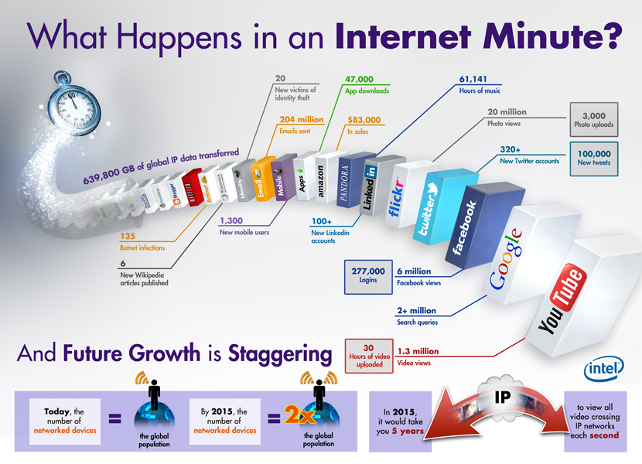
https://y2socialcomputing.files.wordpress.com/2012/06/
social-media-visual-last-blog-post-what-happens-in-an-internet-minute-infographic.jpg

Slide 42
Big Data – 3Vs
Volume
  size of the data
Variety
  type and nature of the data
    text, semi-structured data, databases, knowledge bases
Notes:
2001-10-01
<number>(2)

Slide 43
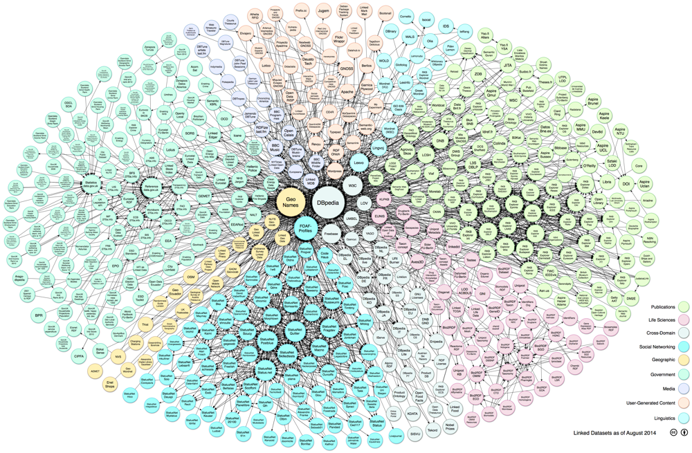
Linking Open Data cloud diagram 2014, by Max Schmachtenberg, Christian Bizer, Anja Jentzsch and Richard Cyganiak.
http://lod-cloud.net/

Slide 44
Linked open data of US government
Format (# Datasets) http://catalog.data.gov/
HTML (27005)
XML (24077)
PDF (19628)
CSV (10058)
JSON (8948)
RDF (6153)
JPG (5419)
WMS (5019)
Excel (3389)
WFS (2781)

Slide 45
Big Data – 3Vs
Volume
  size of the data
Variety
  type and nature of the data
Velocity
  speed of generation and processing of data
Notes:
2001-10-01
<number>(2)

Slide 46
Velocity - examples
Traffic data
Financial market
Social networks

Slide 47
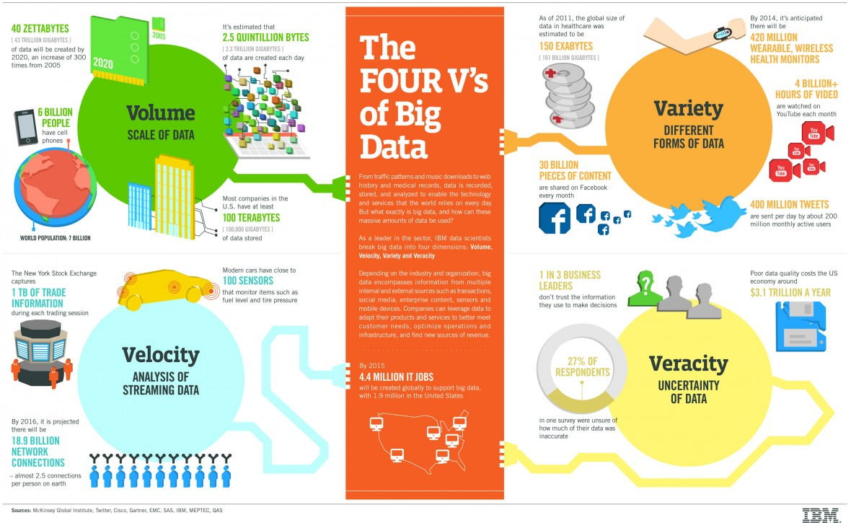
http://www.ibmbigdatahub.com/infographic/four-vs-big-data

Slide 48
Big Data – other Vs
Variability
  inconsistency of the data
Veracity
  quality of the data
Value
  useful analysis results
…
Notes:
2001-10-01
<number>(2)

Slide 49
BDA system architecture
Specialized services
for domain A
Specialized services
for domain B
Big Data Services Layer
Knowledge Management Layer
Data Storage and Management Layer

Slide 50
BDA system architecture
  Large amounts of data, distributed environment
  Unstructured and semi-structured data
  Not necessarily a schema
  Heterogeneous
  Streams
  Varying quality
Data Storage and Management Layer

Slide 51
Data Storage and management – this course
Data storage:
  NoSQL databases
  OLTP vs OLAP
  Horizontal scalability
  Consistency, availability, partition tolerance
Data management
  Hadoop
  Data management systems

Slide 52
BDA system architecture
  Semantic technologies
  Integration
  Knowledge acquisition
Knowledge Management Layer

Slide 53
Knowledge management – this course
Not a focus topic in this course
For semantic and integration approaches see TDDD43

Slide 54
BDA system architecture
  Analytics services for Big Data
Big Data Services Layer

Slide 55
Big Data Services – this course
Big data versions of analytics/data mining algorithms

Slide 56
Databases
Parallel
programming
Machine
learning

Slide 57
Course overview
Review : ONLY 732A54
  Databases (lectures + labs)
  Databases for Big Data (lectures + lab)
  Parallel algorithms for processing Big Data (lectures + lab + exercise session)
  Machine Learning for Big Data (lectures + lab)
Visit to National Supercomputer Centre
Notes:
2001-10-01
<number>(2)

Slide 58
Info
Results reported in connection to exams
Info about handing in labs on web; strong recommendation to hand in as soon as possible
Sign up for labs via web (in pairs)
Notes:
2001-10-01
<number>(2)

Slide 59
Info
ONLY 732A54: Relational database labs require special database account
→ make sure you are registered for the course
BDA labs require special access to NSC resources
→ fill out forms
Notes:
2001-10-01
<number>(2)

Slide 60
Info
Lab deadlines:
  Final deadlines in connection to the exams; no reporting between exams
  HARD DEADLINE: May exam
  (No guarantee NSC resources available after April.)
Notes:
2001-10-01
<number>(2)

Slide 61
Examination
Written exam
Labs
Notes:
2001-10-01
<number>(2)

Slide 62
What if I already took …?
What if I also take…?
ONLY 732A54:
TDDD37/732A57 Database technology
  RDB labs 1-2 in one of the courses, results registered for both

Slide 63
Changes w.r.t. last year

Slide 64
My own interest and research
Modeling of data
  Ontologies
Ontology engineering
  Ontology alignment
  (Winner Anatomy track OAEI 2008 /
  Organizer OAEI tracks since 2013)
  Ontology debugging and completion
  (Founder and organizer WoDOOM/CoDeS 2012-2016)
Ontologies and databases for Big Data
  Swedish Veterinary Agency, animal health surveillance
  Swedish e-Science Centre, materials design
  Swedish Food Agency, toxics
  EU VALCRI, crime scene analysis
Notes:
2001-10-01
<number>(2)

Slide 65
My own interest and research
  Sports Analytics
    Player, team performance
    Injuries
Former work: knowledge representation, data integration, knowledge-based information retrieval, object-centered databases
http://www.ida.liu.se/~patla00/research.shtml
Notes:
2001-10-01
<number>(2)

Slide 66
https://www.youtube.com/watch?v=LrNlZ7-SMPk
Notes:
2001-10-01
<number>(2)

