Slide 1
Linear classification methods
Lecture 2a

Slide 2
Overview
Elements of decision theory
Logistic regression
Discriminant Analysis models

Slide 3

Classification
Given data $D=\left(\left(X_{i},Y_{i}\right), i=1…N\right)$
${Y_{i}=Y(X_{i})=C}_{j}∈C$
Class set ${C=(C}_{1}, …, C_{K})$
Classification problem:
Decide $\hat{Y}\left(x\right)$that maps any $x$ into some class $C_{K}$
Decision boundary

Slide 4
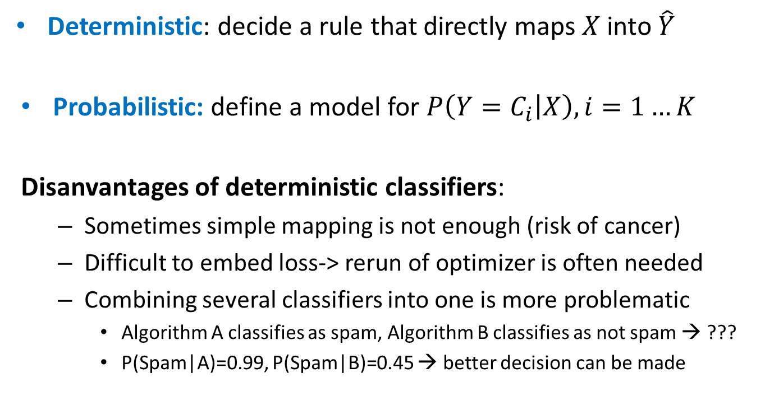
Classifiers
Deterministic: decide a rule that directly maps $X$into $\hat{Y}$
Probabilistic: define a model for $P\left(Y=C_{i} | X\right), i=1…K$
Disanvantages of deterministic classifiers:
Sometimes simple mapping is not enough (risk of cancer)
Difficult to embed loss-> rerun of optimizer is often needed
Combining several classifiers into one is more problematic
Algorithm A classifies as spam, Algorithm B classifies as not spam → ???
P(Spam|A)=0.99, P(Spam|B)=0.45 → better decision can be made

Slide 5
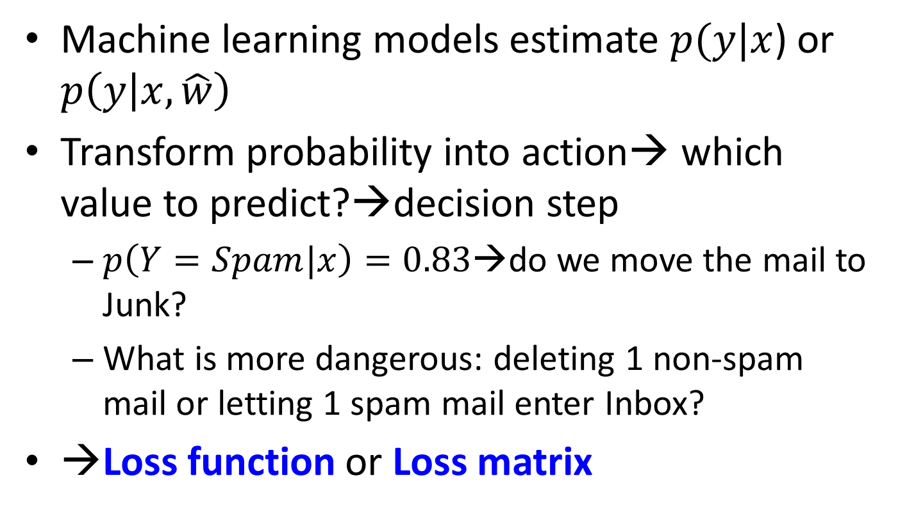
Bayesian decision theory
Machine learning models estimate $p(y|x$) or $p\left(y | x,\hat{w}\right)$
Transform probability into action→ which value to predict?→decision step
$p\left(Y=Spam|x\right)=0.83$→do we move the mail to Junk?
What is more dangerous: deleting 1 non-spam mail or letting 1 spam mail enter Inbox?
→Loss function or Loss matrix

Slide 6
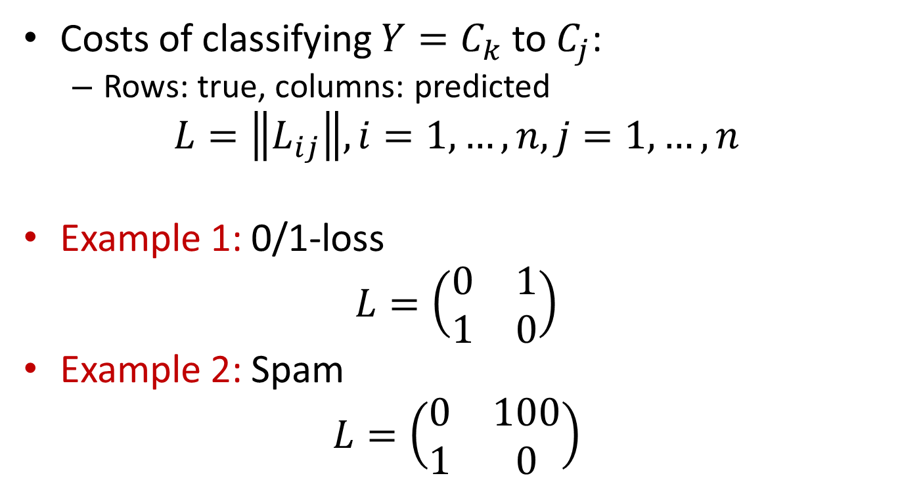
Loss matrix
Costs of classifying $Y=C_{k}$ to $C_{j}$:
Rows: true, columns: predicted
$$L=\left\|L_{ij}\right\|, i=1, …, n, j=1, …,n$$
Example 1: 0/1-loss
$$L=\left(\begin{matrix}0 & 1 \\ 1 & 0\end{matrix}\right)$$
Example 2: Spam
$$L=\left(\begin{matrix}0 & 100 \\ 1 & 0\end{matrix}\right)$$

Slide 7
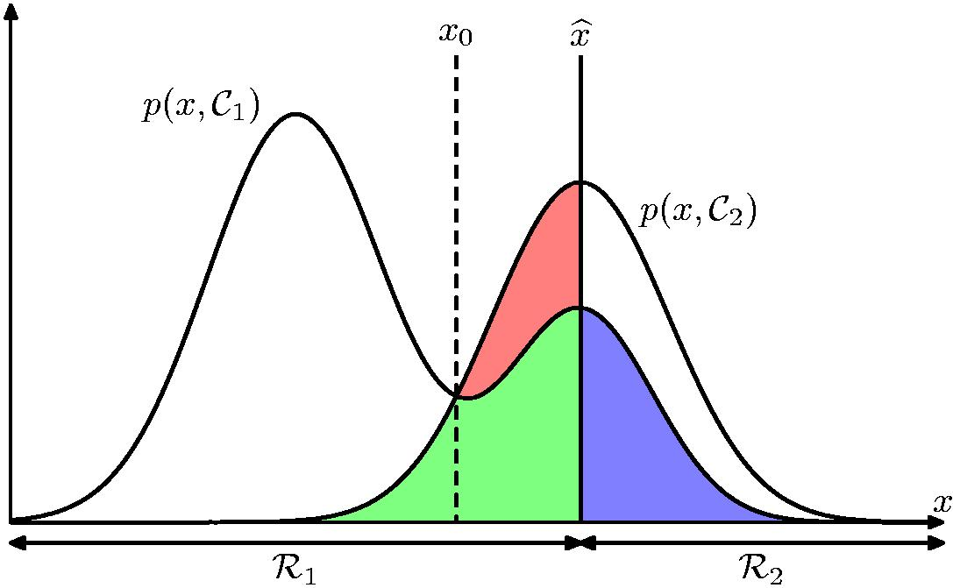
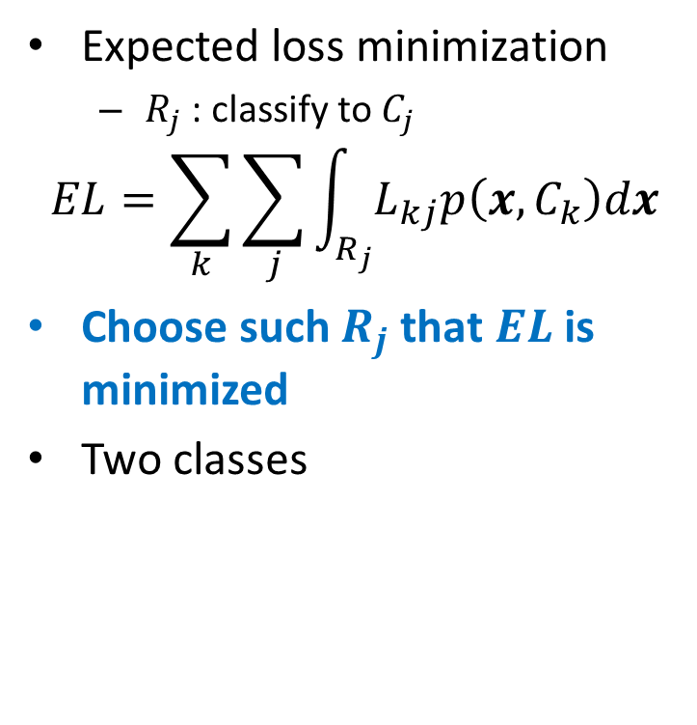
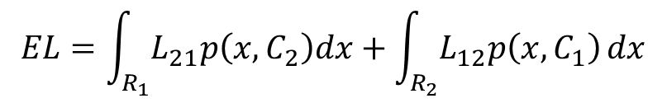
Loss and decision
Expected loss minimization
$R_{j}$ : classify to $C_{j}$
$$EL=\sum_{k}{\sum_{j}{\int_{R_{j}}{L_{kj}p\left(x, C_{k}\right)dx}}}$$
Choose such $R_{j}$ that $EL$ is minimized
Two classes
$$EL=\int_{R_{1}}{L_{21}p\left(x,C_{2}\right)dx}+\int_{R_{2}}{L_{12}p\left(x,C_{1}\right)}dx$$

Slide 8



Loss and decision
Loss minimization
$$\min_{\hat{f}}{EL(y,\hat{f})}=\min_{\hat{f}}{∫L\left(y,\hat{f}\right)p\left(y,x | w\right)dxdy}$$
When loss is $\left\{\begin{matrix}1, wrongly classified \\ 0, correctly classified\end{matrix}\right.$
Classify $Y$ as
$$\hat{Y}=\arg{\max_{c}{p(Y=c|X)}}$$

Slide 9
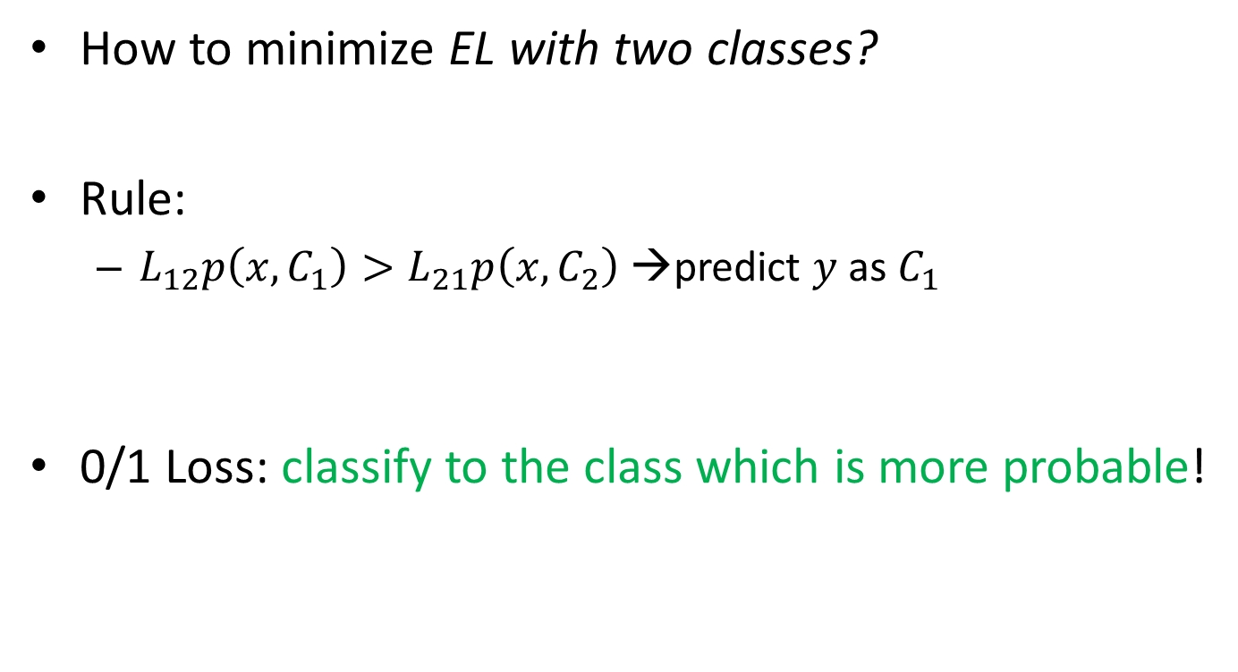
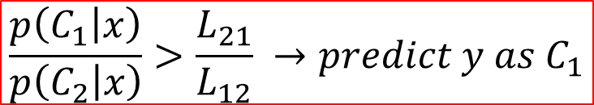
Loss and decision
How to minimize EL with two classes?
Rule:
$L_{12}p\left(x,C_{1}\right)>L_{21}p\left(x,C_{2}\right)$ →predict $y$ as $C_{1}$
0/1 Loss: classify to the class which is more probable!
$$\frac{p\left(C_{1} | x\right)}{p\left(C_{2} | x\right)}>\frac{L_{21}}{L_{12}} →predict y as C_{1}$$

Slide 10
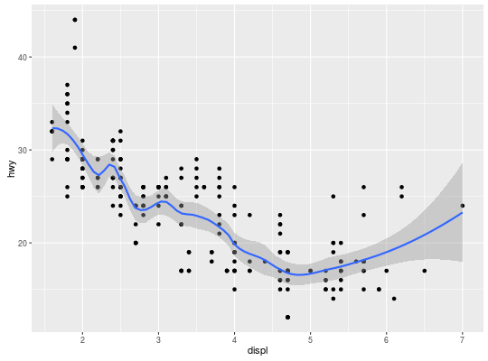
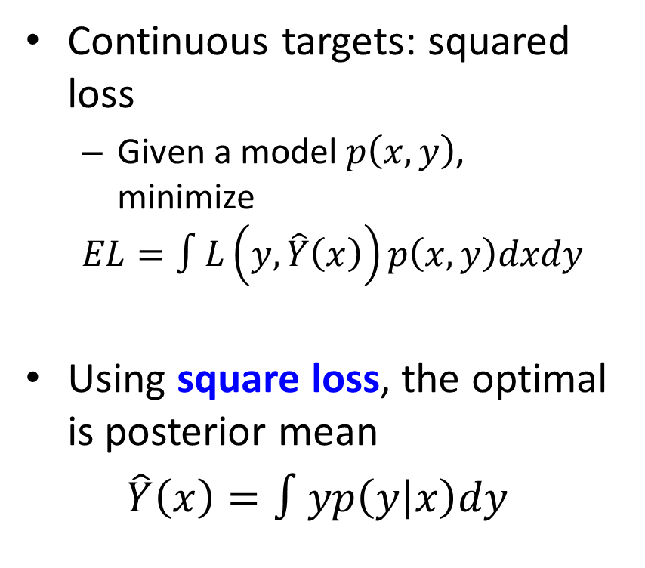
Loss and decision
Continuous targets: squared loss
Given a model $p\left(x,y\right)$, minimize
$$EL=∫L\left(y,\hat{Y}\left(x\right)\right)p\left(x,y\right)dxdy$$
Using square loss, the optimal is posterior mean
$\hat{Y}\left(x\right)=∫yp\left(y | x\right)dy$

Slide 11

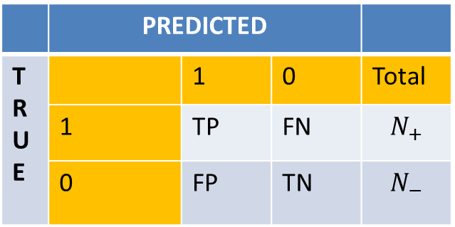
ROC curves
Binary classification
The choice of the thershold $\hat{x}=\frac{L_{21}}{L_{12}}$ affects prediction→ what if we don’t know the loss? Which classifier is better?
Confusion matrix
 | PREDICTED
T R U E |  | 1 | 0 | Total
 | 1 | TP | FN | $$N_{+}$$
 | 0 | FP | TN | $$N_{−}$$

Slide 12
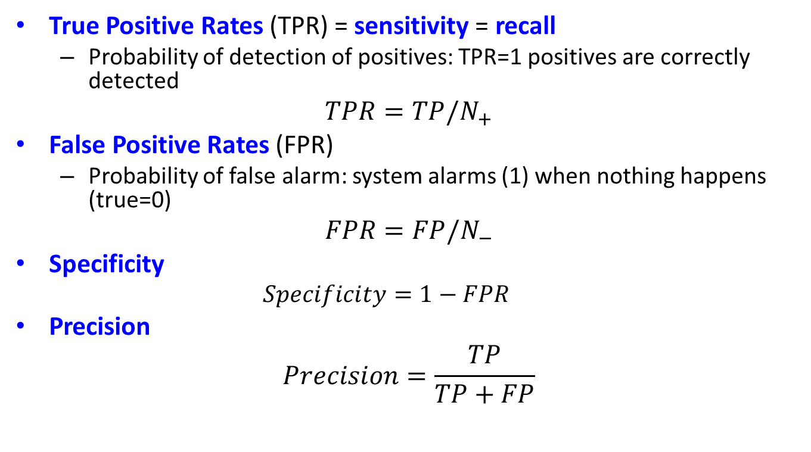
ROC curves
True Positive Rates (TPR) = sensitivity = recall
Probability of detection of positives: TPR=1 positives are correctly detected
$$TPR=TP/N_{+}$$
False Positive Rates (FPR)
Probability of false alarm: system alarms (1) when nothing happens (true=0)
$$FPR=FP/N_{−}$$
Specificity
$$Specificity=1−FPR$$
Precision
$$Precision=\frac{TP}{TP+FP}$$

Slide 13
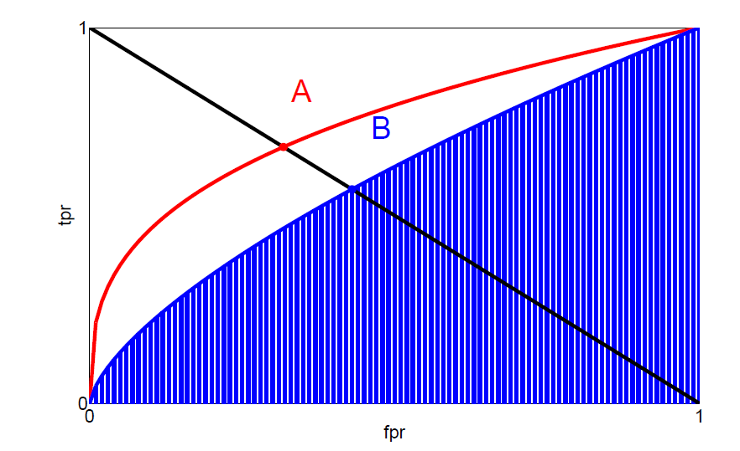
ROC curves
ROC=Receiver operating characteristics
Use various thresholds, measure TPR and FPR
Same FPR, higher TPR→ better classifier
Best classifier = greatest Area Under Curve (AUC)

Slide 14
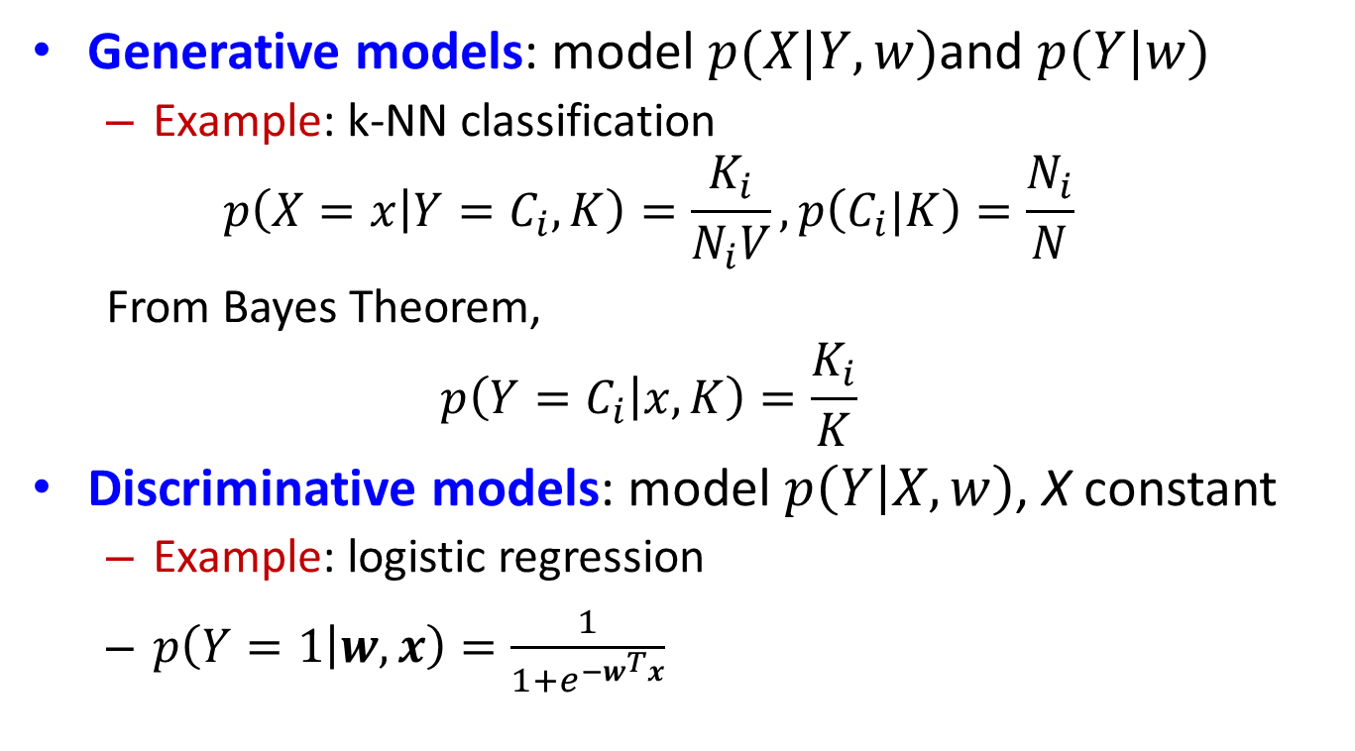
Types of supervised models
Generative models: model $p(X|Y,w)$and $p(Y|w)$
Example: k-NN classification
$$p\left(X=x | Y=C_{i},K\right)=\frac{K_{i}}{N_{i}V}, p\left(C_{i}|K\right)=\frac{N_{i}}{N}$$
From Bayes Theorem,
$$p\left({Y=C}_{i} | x,K\right)=\frac{K_{i}}{K}$$
Discriminative models: model $p\left(Y | X,w\right)$, X constant
Example: logistic regression
$p\left(Y=1 | w,x\right)=\frac{1}{1+e^{−w^{T}x}}$

Slide 15
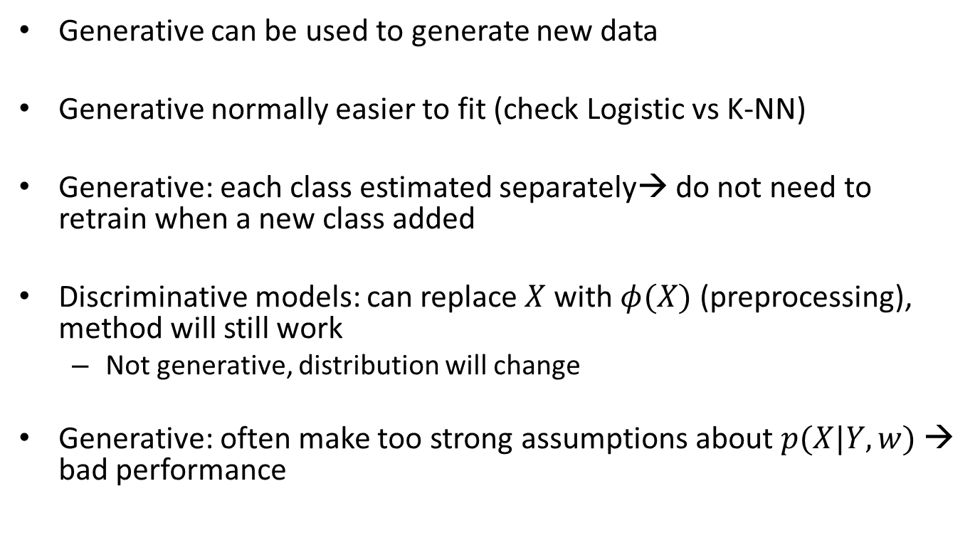
Generative vs Discriminative
Generative can be used to generate new data
Generative normally easier to fit (check Logistic vs K-NN)
Generative: each class estimated separately→ do not need to retrain when a new class added
Discriminative models: can replace $X$ with $φ(X)$ (preprocessing), method will still work
Not generative, distribution will change
Generative: often make too strong assumptions about $p(X|Y,w)$ → bad performance

Slide 16
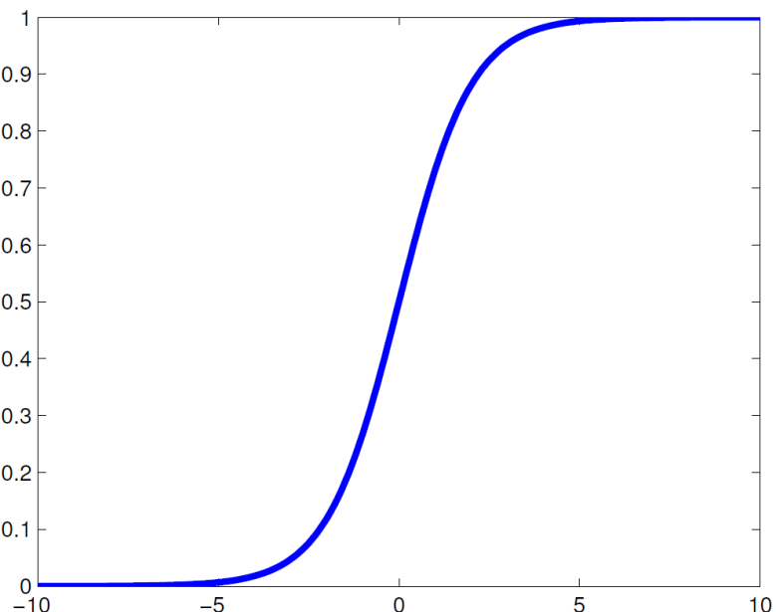
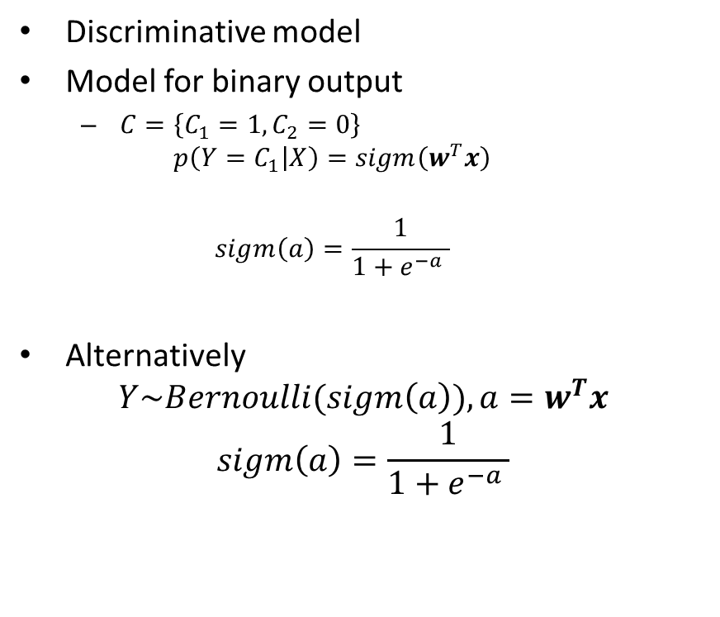

Logistic regression
Discriminative model
Model for binary output
$C=\left\{C_{1}=1,C_{2}=0\right\}$
$$p\left(Y=C_{1} | X\right)=sigm\left(w^{T}x\right)$$
$$sigm\left(a\right)=\frac{1}{1+e^{−a} }$$
Alternatively
$$Y\sim Bernoulli(sigm\left(a\right)), a=w^{T}x$$
$$sigm\left(a\right)=\frac{1}{1+e^{−a} }$$
What is $P({Y=C}_{2}|X)$?

Slide 17

Logistic regression
Logistic model- yet another form
$$ln\frac{p(Y=1|X=x)}{P(Y=0|X=x)}=ln\frac{p(Y=1|X=x)}{1−P(Y=1|X=x)}=logit(p\left(Y=1 | X=x\right))=w^{T}x$$
Here $logit\left(t\right)=\ln\left(\frac{t}{1−t}\right)$
Note $p(Y|X)$ is connected to $w^{T}x$ via logit link
The log of the odds is linear in x
Example: Probability to buy more than once as function of First Amount Spend

Slide 18

Logistic regression
When Y is categorical,
$$p(Y=C_{i}|x)=\frac{e^{w_{i}^{T}x}}{\sum_{j=1}^{K}{e^{w_{j}^{T}x}}}=softmax(w_{i}^{T}x)$$
Alternatively
$$Y\sim Multinoulli\left(softmax\left(w_{1}^{T}x\right), …softmax\left(w_{K}^{T}x\right)\right)$$

Slide 19
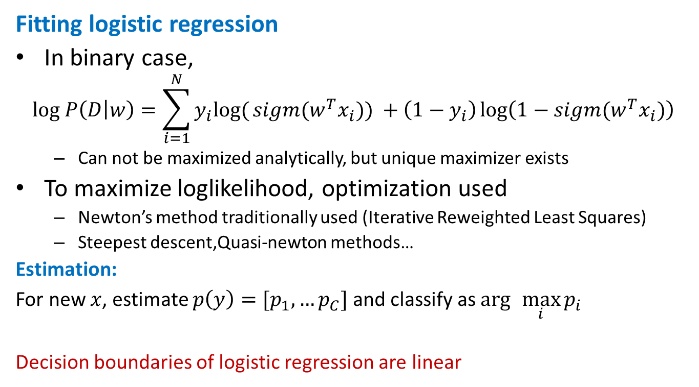
Logistic regression
Fitting logistic regression
In binary case,
$$log P\left(D | w\right)=\sum_{i=1}^{N}{y_{i}log⁡(}sigm(w^{T}x_{i})) +\left(1−y_{i}\right)\log\left(1−sigm(w^{T}x_{i})\right)$$
Can not be maximized analytically, but unique maximizer exists
To maximize loglikelihood, optimization used
Newton’s method traditionally used (Iterative Reweighted Least Squares)
Steepest descent,Quasi-newton methods…
Estimation:
For new $x$, estimate $p\left(y\right)=[p_{1},…p_{C}]$ and classify as $\arg{{\max_{i}{p_{i}}}}$
Decision boundaries of logistic regression are linear

Slide 20
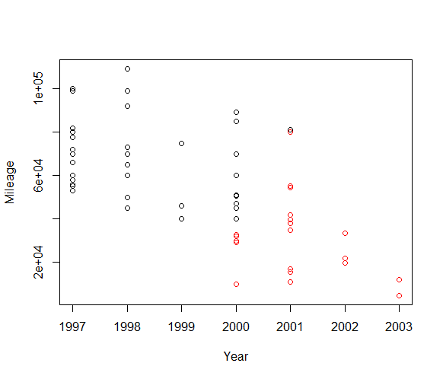
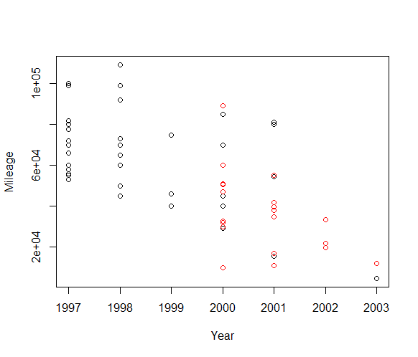
Logistic regression
In R, use glm() with family=”binomial”
Predicted probabilities: predict(fit,newdata, type=”response”)
Example Equipment=f(Year, mileage)
Original data
Classified data

Slide 21
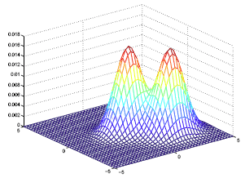
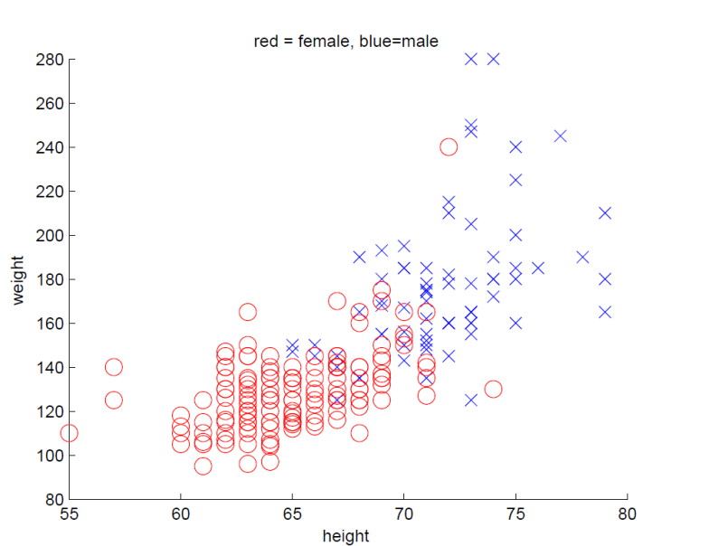
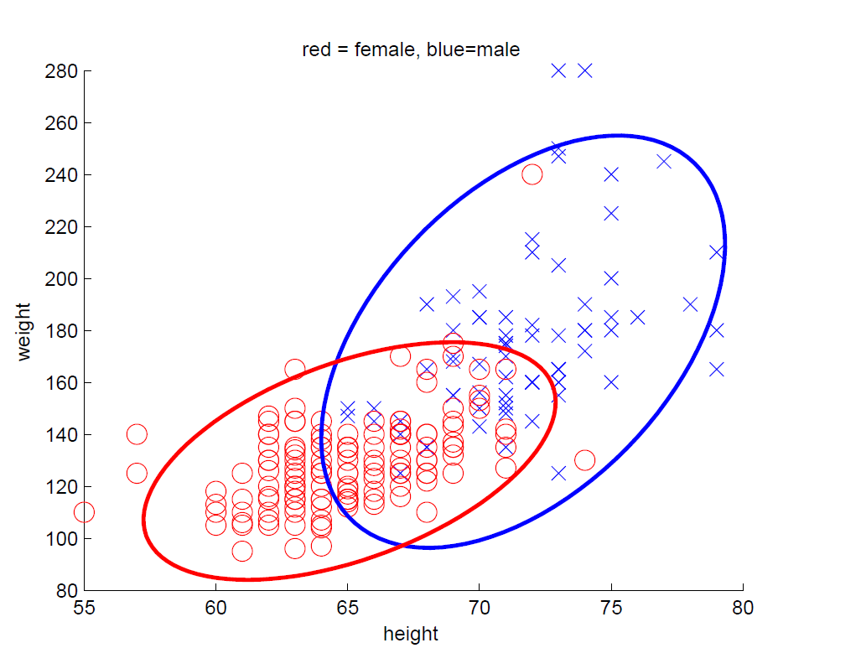


Quadratic discriminant analysis
Generative classifier
Main assumptions:
$x$ is now random as well as $y$
$$p\left(x | y=C_{i}, θ\right)=N(x|μ_{i}, Σ_{i})$$
Unknown parameters $θ=\{μ_{i}, Σ_{i}\}$
Source: Probabilistic Machine Learning by Murphy
Source: Probabilistic Machine Learning by Murphy

Slide 22
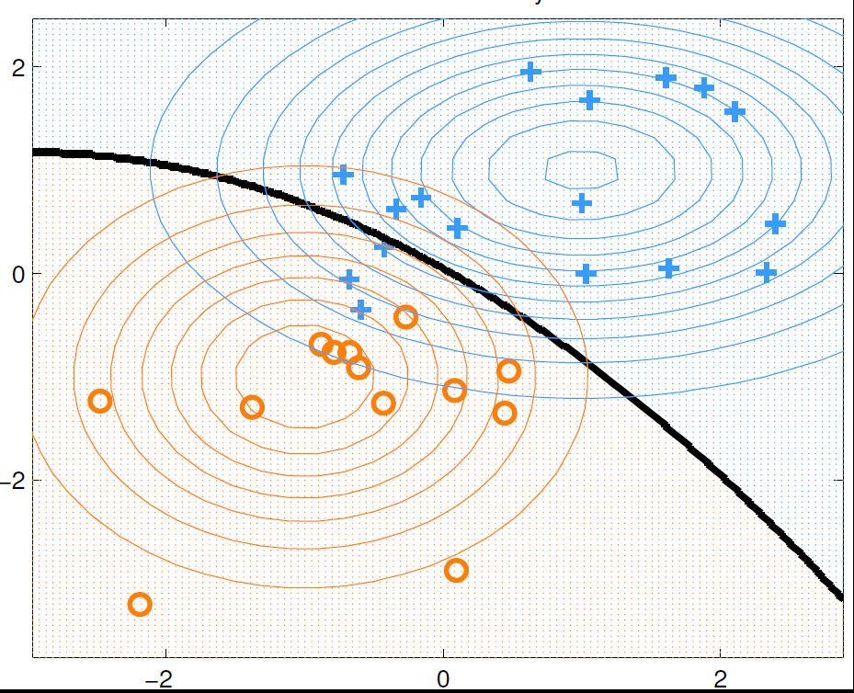

Quadratic discriminant analysis
If parameters are estimated, classify:
$$\hat{y}\left(x\right)=\arg{\max_{c}{p(y=c|x, θ)}}$$
Source: Probabilistic Machine Learning by Murphy

Slide 23
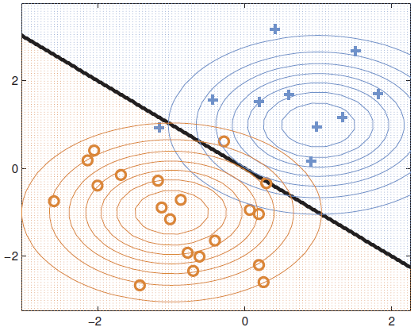

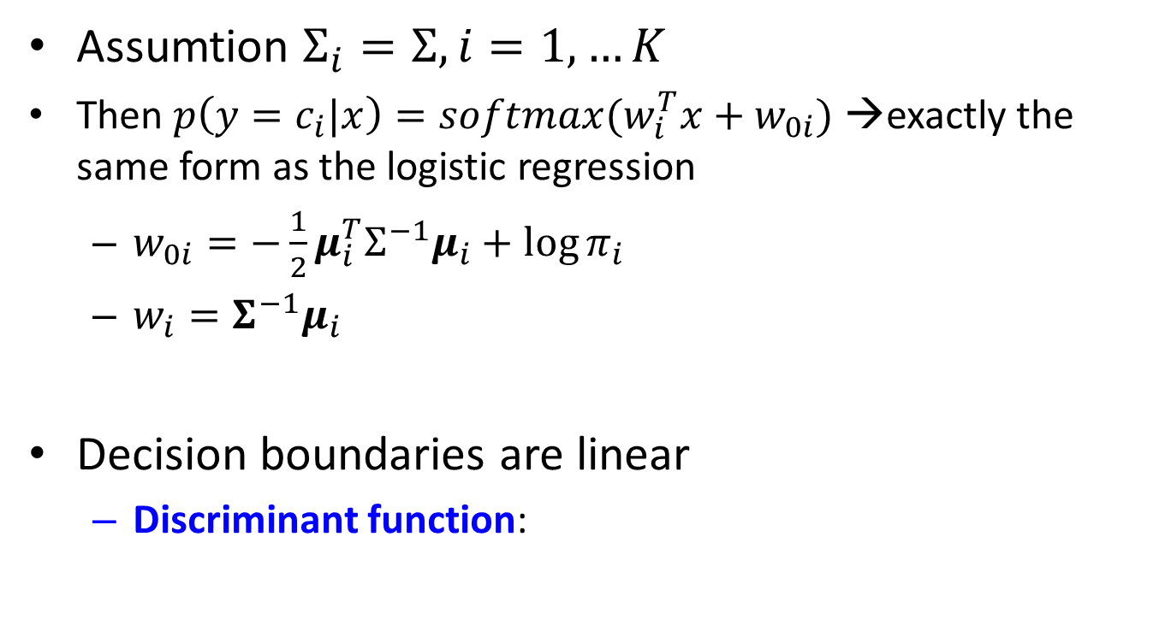
Linear discriminant analysis (LDA)
Assumtion $Σ_{i}=Σ, i=1,…K$
Then $p\left(y=c_{i}|x\right)=softmax(w_{i}^{T}x+w_{0i})$ →exactly the same form as the logistic regression
$w_{0i}=−\frac{1}{2}μ_{i}^{T}Σ^{−1}μ_{i}+\log{π_{i}}$
$w_{i}=Σ^{−1}μ_{i}$
Decision boundaries are linear
Discriminant function:
Source: Probabilistic Machine Learning by Murphy

Slide 24
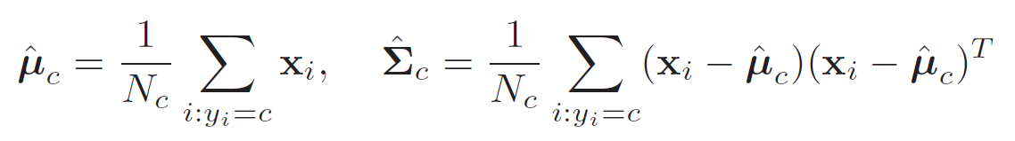
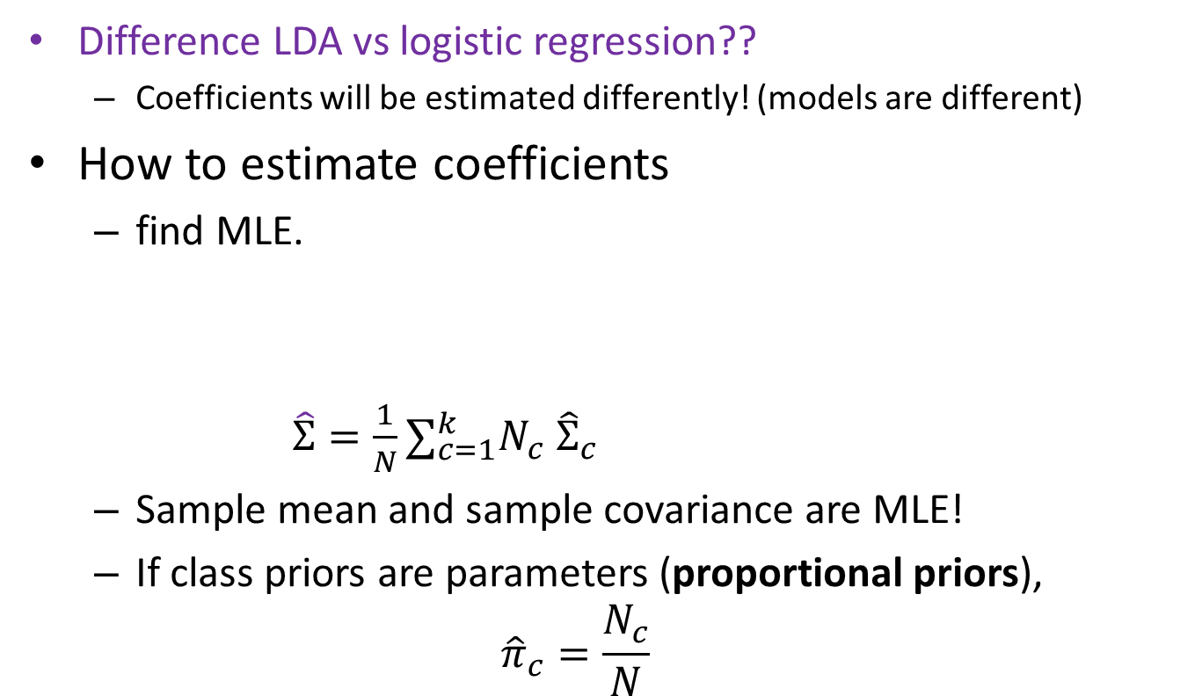
Linear discriminant analysis (LDA)
Difference LDA vs logistic regression??
Coefficients will be estimated differently! (models are different)
How to estimate coefficients
find MLE.
$\hat{Σ}={\frac{1}{N}∑}_{c=1}^{k}N_{c} {\hat{Σ}}_{c}$
Sample mean and sample covariance are MLE!
If class priors are parameters (proportional priors),
$${\hat{π}}_{c}=\frac{N_{c}}{N}$$

Slide 25
LDA and QDA: code
Syntax in R, library MASS
lda(formula, data, ..., subset, na.action)
Prior – class probabiliies
Subset – indices, if training data should be used
qda(formula, data, ..., subset, na.action)
predict(..)

Slide 26
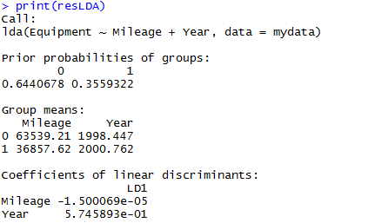
LDA: output
resLDA=lda(Equipment~Mileage+Year, data=mydata)
print(resLDA)

Slide 27

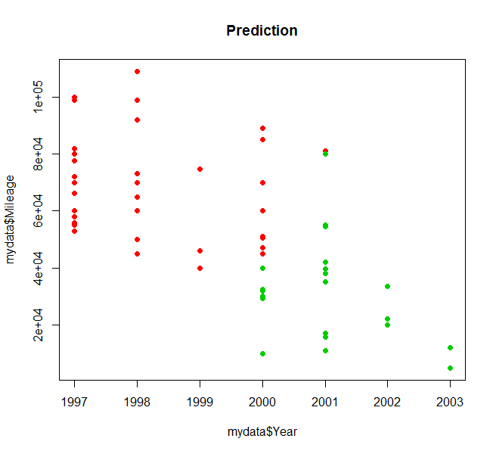
LDA: output
Misclassified items
plot(mydata$Year, mydata$Mileage, col=as.numeric(Pred$class)+1, pch=21, bg=as.numeric(Pred$class)+1, main="Prediction")

Slide 28
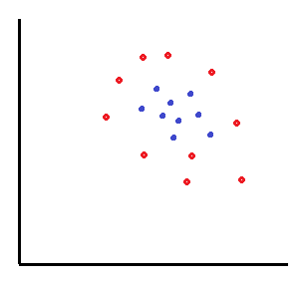
LDA versus Logistic regression
Generative classifiers are easier to fit, discriminative involve numeric optimization
LDA and Logistic have same model form but are fit differently
LDA has stronger assumptions than Logistic, some other generative classifiers lead also to logistic expression
New class in the data?
Logistic: fit model again
LDA: estimate new parameters from the new data
Logistic and LDA: complex data fits badly unless interactions are included

Slide 29
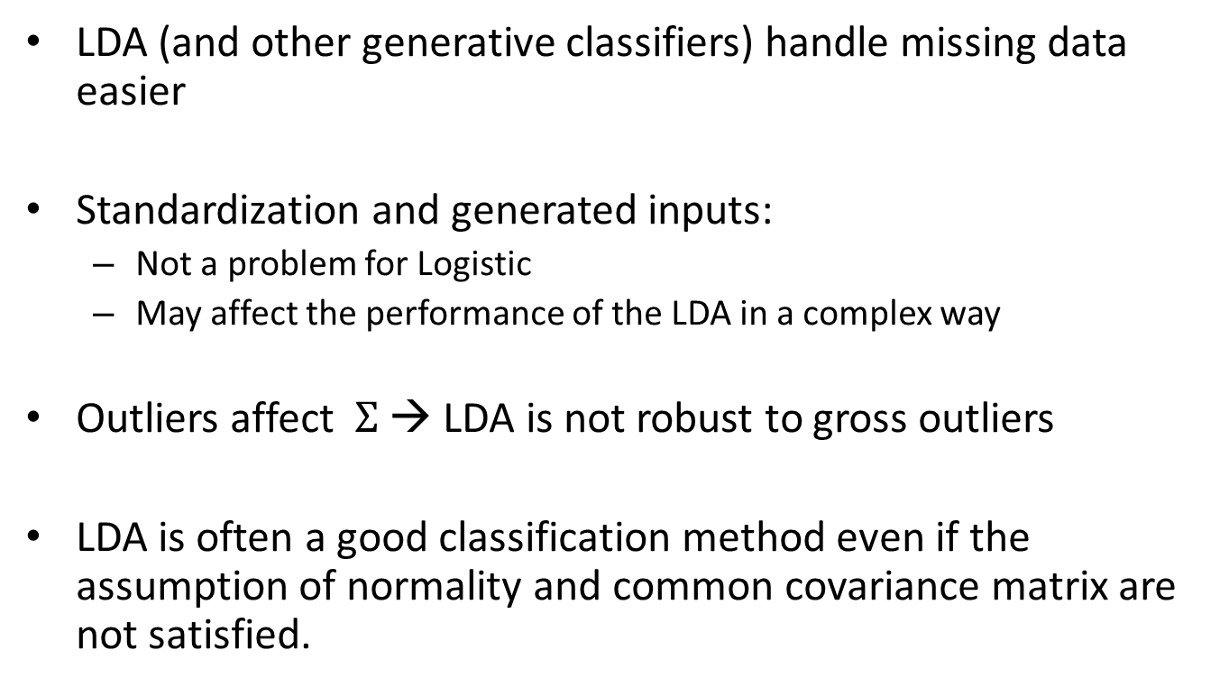
LDA versus Logistic regression
LDA (and other generative classifiers) handle missing data easier
Standardization and generated inputs:
Not a problem for Logistic
May affect the performance of the LDA in a complex way
Outliers affect $Σ$ → LDA is not robust to gross outliers
LDA is often a good classification method even if the assumption of normality and common covariance matrix are not satisfied.

