Slide 1
Generalized Linear Models. Uncertainty estimation
Lecture 2c

Slide 2
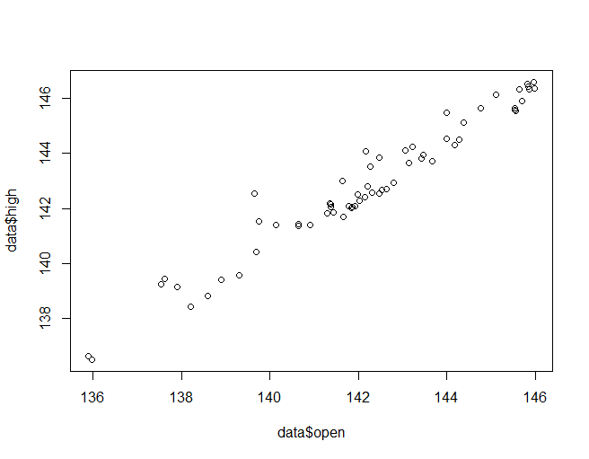
Moving beyond typical distributions
We know how to model
Normally distributed targets -> linear regression
Bernoulli and Multinomial targets→logistic regression
What if target distribution is more complex?
Example 1: Daily Stock prices NASDAQ
Open
High (within day)
Does it seem that the error is normal here?
Example 2: Number of calls to bank
Y=Number of calls
X= time
Endless amount of classes → multinomial does not work… (Poisson)

Slide 3
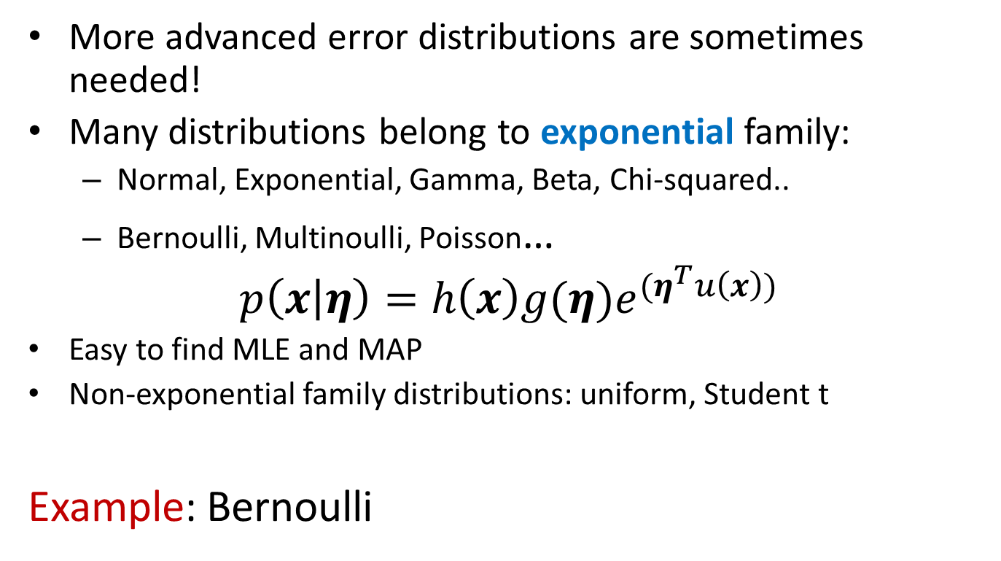
Exponential family
More advanced error distributions are sometimes needed!
Many distributions belong to exponential family:
Normal, Exponential, Gamma, Beta, Chi-squared..
Bernoulli, Multinoulli, Poisson…
$$p\left(x | η\right)=h\left(x\right){g(η)e}^{{(η}^{T}u\left(x\right))}$$
Easy to find MLE and MAP
Non-exponential family distributions: uniform, Student t
Example: Bernoulli

Slide 4
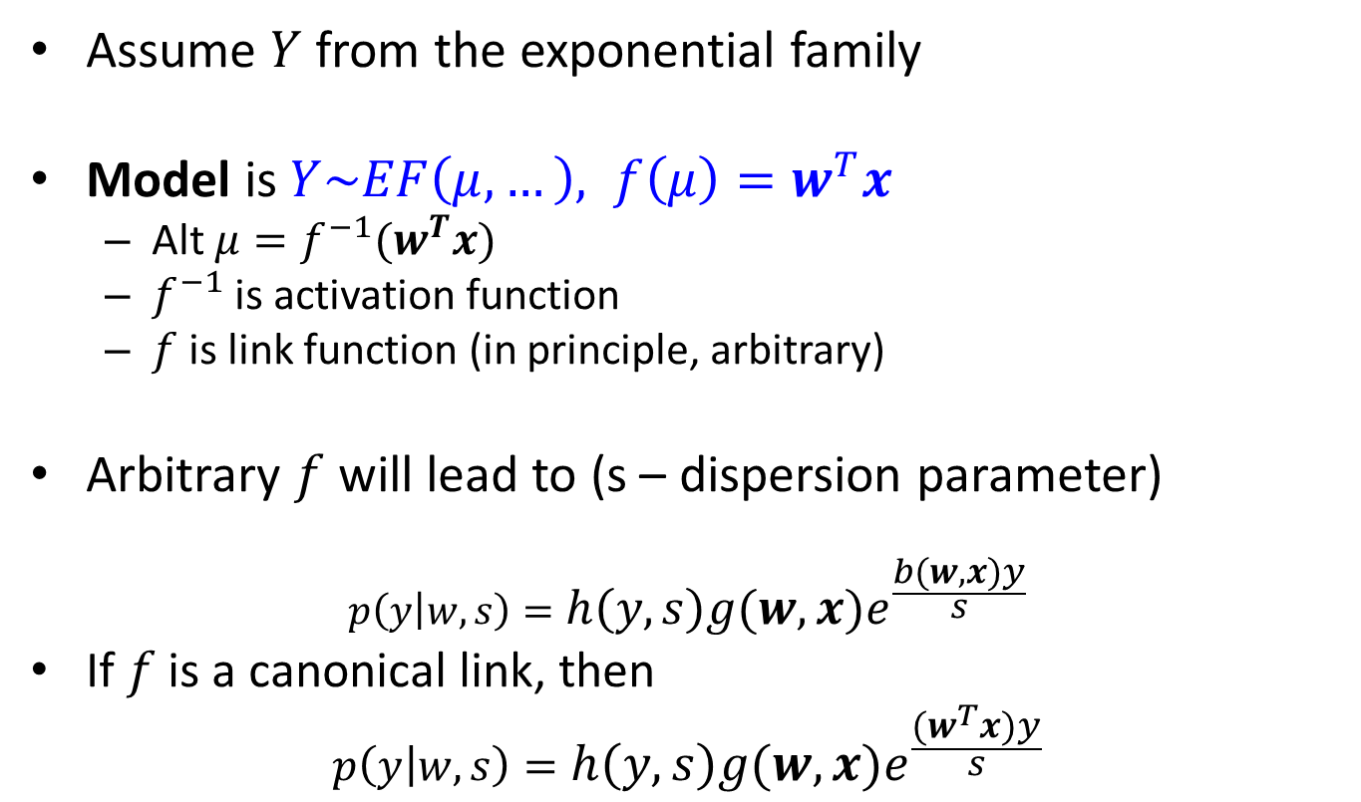
Generalized linear models
Assume $Y$ from the exponential family
Model is $Y\sim EF\left(μ,…\right), f\left(μ\right)=w^{T}x$
Alt $μ=f^{−1}(w^{T}x)$
$f^{−1}$ is activation function
$f$ is link function (in principle, arbitrary)
Arbitrary $f$ will lead to (s – dispersion parameter)
$$p\left(y | w,s\right)=h\left(y,s\right){g(w,x)e}^{\frac{b(w,x)y}{s}}$$
If $f$ is a canonical link, then
$$p\left(y | w,s\right)=h\left(y,s\right){g(w,x)e}^{\frac{{(w}^{T}x)y}{s}}$$

Slide 5
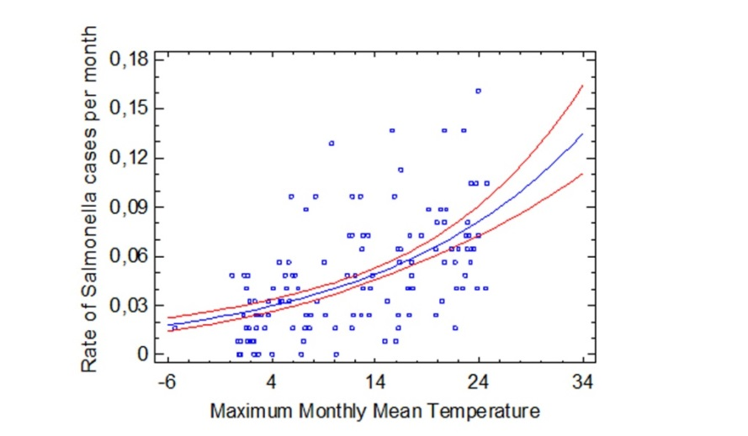
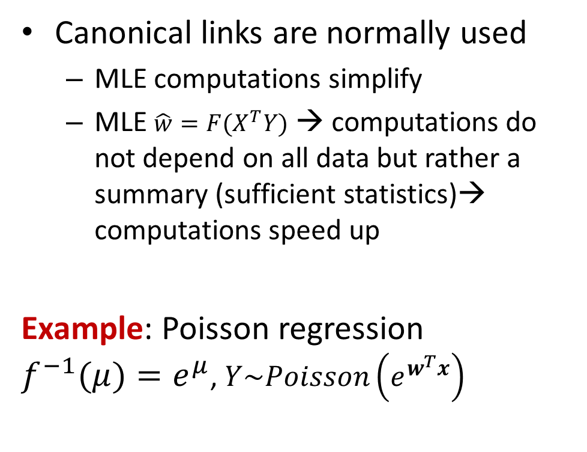
Generalized linear models
Canonical links are normally used
MLE computations simplify
MLE $\hat{w}=F(X^{T}Y)$ → computations do not depend on all data but rather a summary (sufficient statistics)→ computations speed up
Example: Poisson regression $f^{−1}(μ)=e^{μ}$, $Y\sim Poisson\left(e^{w^{T}x}\right)$

Slide 6
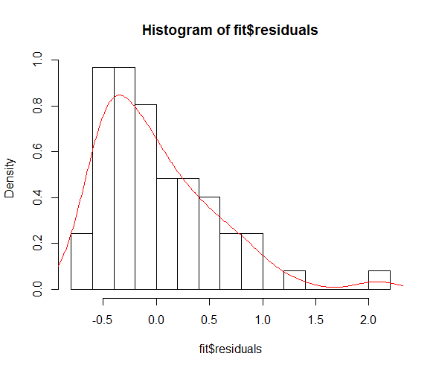
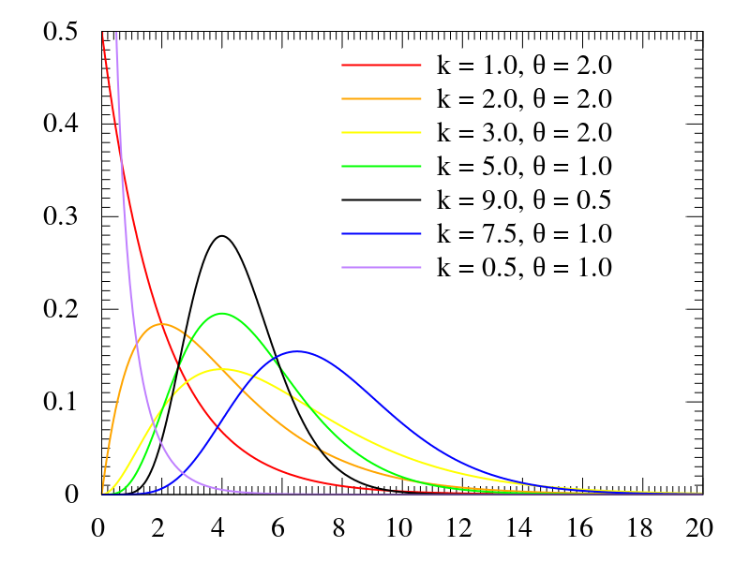
Generalized linear model: software
Use glm(formula, family, data) in R
Example: Daily Stock prices NASDAQ
Open
High (within day)
Try to fit usual linear regression, study histogram of residuals
Gamma distribution: Wikipedia

Slide 7
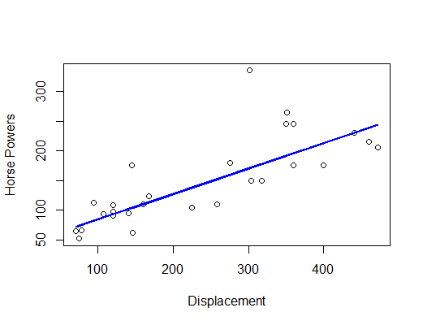
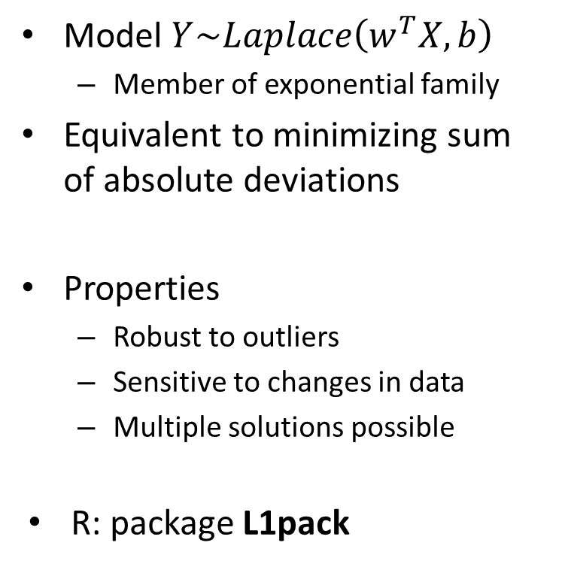
Least absolute deviation regression
Model $Y\sim Laplace\left(w^{T}X,b\right)$
Member of exponential family
Equivalent to minimizing sum of absolute deviations
Properties
Robust to outliers
Sensitive to changes in data
Multiple solutions possible
R: package L1pack

Slide 8
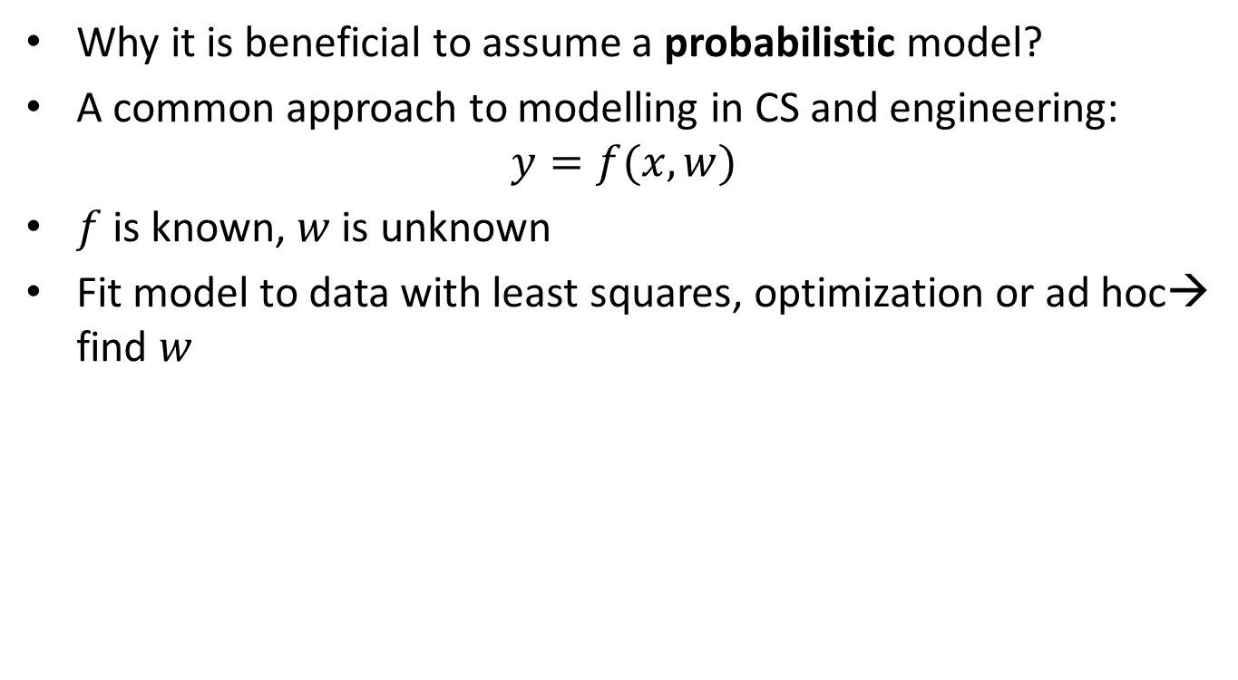
Probabilistic models
Why it is beneficial to assume a probabilistic model?
A common approach to modelling in CS and engineering:
$$y=f(x,w)$$
$f$ is known, $w$ is unknown
Fit model to data with least squares, optimization or ad hoc→ find $w$

Slide 9

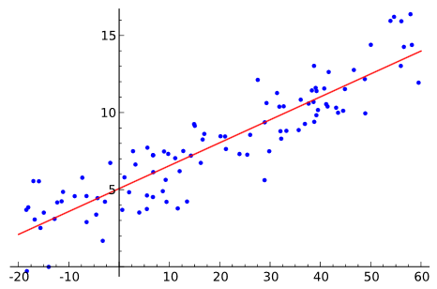

Probabilistic models
Arguments against deterministic models:
The model does not really describe actual data (error is not explained)
No difference between modelling data A (Poisson) and B (Normal)
Estimation strategy for A is not good for B
The model typically gives a deterministic answer, no information about uncertainty
”…The exchange rate tomorrow will be 8.22 …”
A
B

Slide 10
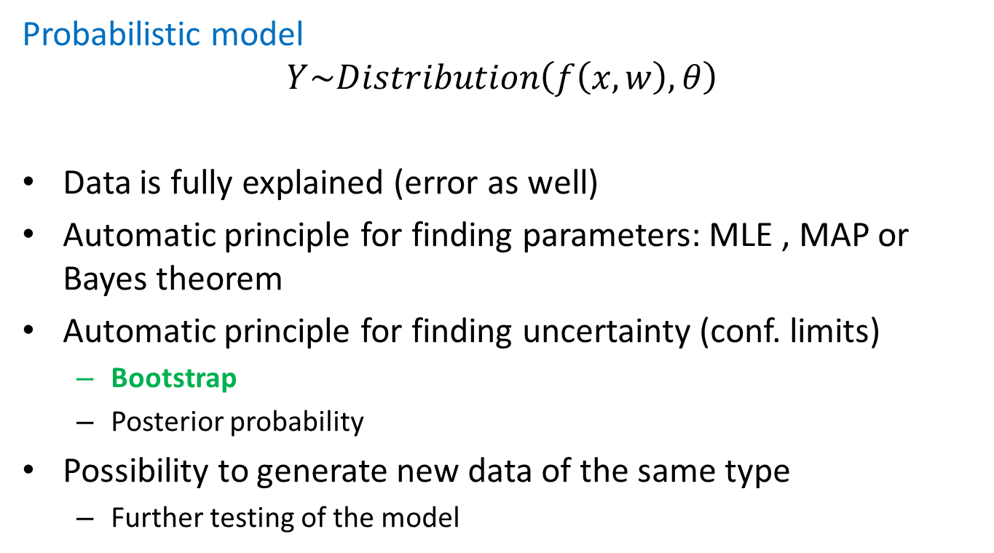
Probabilistic models
Probabilistic model
$$Y\sim Distribution\left(f\left(x,w\right), θ\right)$$
Data is fully explained (error as well)
Automatic principle for finding parameters: MLE , MAP or Bayes theorem
Automatic principle for finding uncertainty (conf. limits)
Bootstrap
Posterior probability
Possibility to generate new data of the same type
Further testing of the model

Slide 11
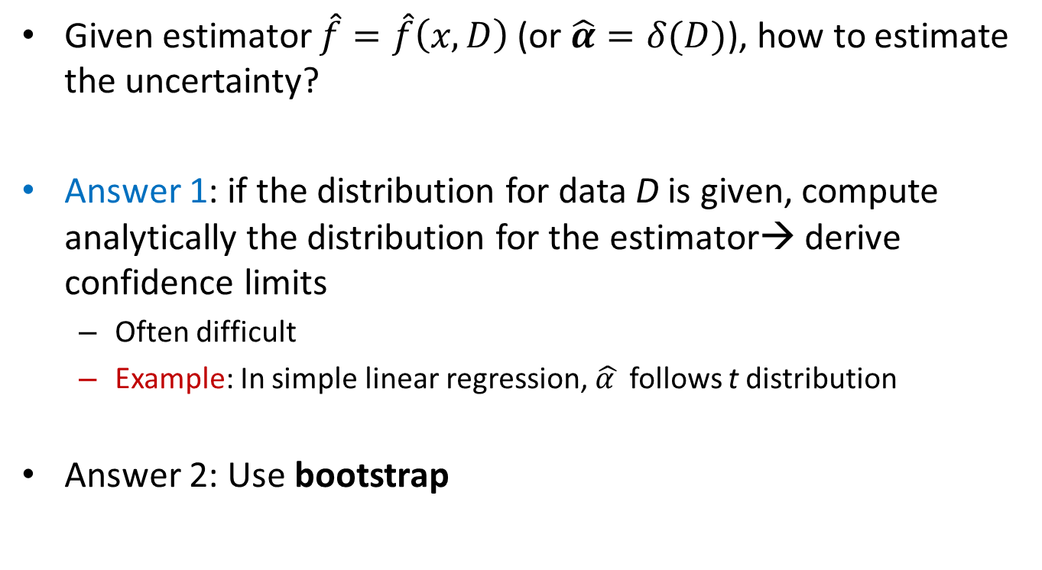
Uncertainty estimation
Given estimator $\hat{f}=\hat{f}\left(x,D\right)$ (or $\hat{α}=δ(D)$), how to estimate the uncertainty?
Answer 1: if the distribution for data D is given, compute analytically the distribution for the estimator→ derive confidence limits
Often difficult
Example: In simple linear regression, $\hat{α }$ follows t distribution
Answer 2: Use bootstrap

Slide 12
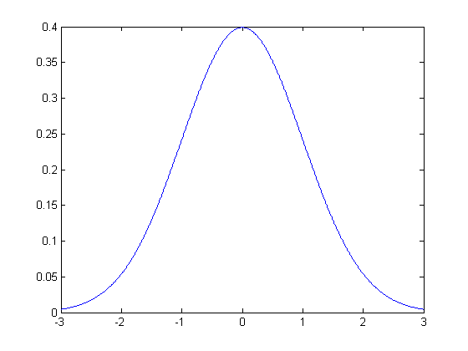
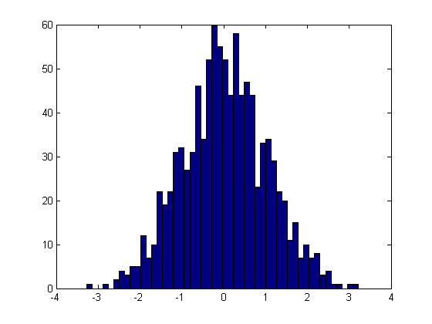

The bootstrap: general principle
We want to determine uncertainty of $\hat{f}(D,X)$
Generate many different $D_{i}$ from their distribution
Use histogram of $\hat{f}(D_{i},X)$ to determine confidence limits→ unfortunately can not be done (distr of D is often unknown)
Instead: Generate many different $D_{i}^{∗}$ from the empirical distribution (histogram)

Slide 13
Nonparametric bootstrap
Observed data
Resampled data
22
60
41
Sampling with replacement
88
34
58
67
88
79
90
88
79
62
39
41
73
41
90
58
44
22
34
44
70
60
70
60
85
85

Slide 14
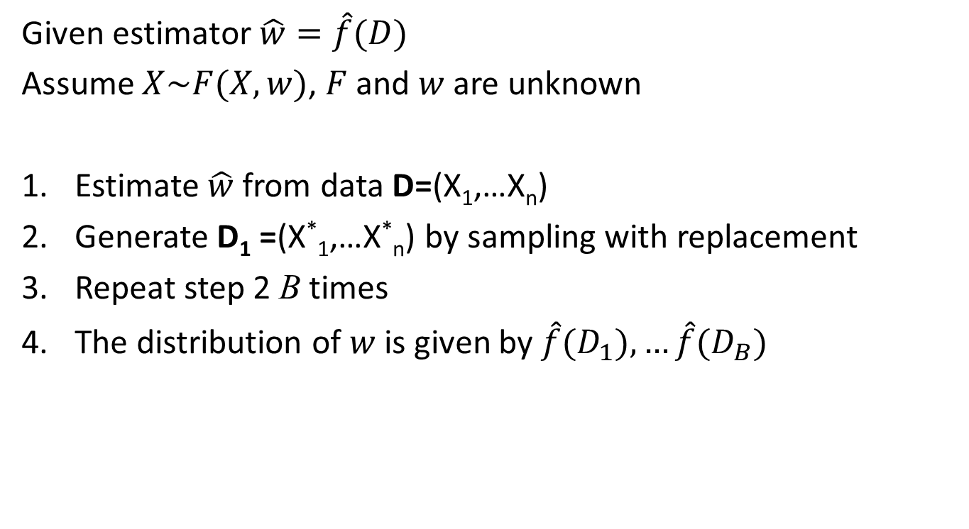
Nonparametric bootstrap
Given estimator$\hat{w}=\hat{f}(D)$
Assume $X\sim F(X, w)$, $F$ and $w$ are unknown
Estimate $\hat{w}$ from data D=(X₁,…X_{n})
Generate D₁ =(X*₁,…X*_{n}) by sampling with replacement
Repeat step 2 B times
The distribution of $w$is given by $\hat{f}(D_{1}),…\hat{f}(D_{B})$
Nonparametric bootstrap can be applied to any deterministic estimator, distribution-free

Slide 15
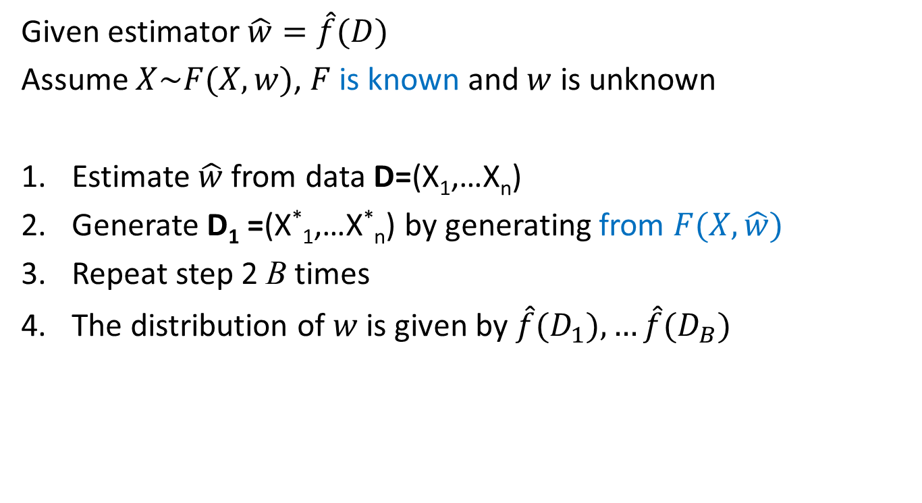
Parametric bootstrap
Given estimator$\hat{w}=\hat{f}(D)$
Assume $X\sim F(X, w)$, $F$ is known and $w$ is unknown
Estimate $\hat{w}$ from data D=(X₁,…X_{n})
Generate D₁ =(X*₁,…X*_{n}) by generating from $F(X, \hat{w})$
Repeat step 2 B times
The distribution of $w$ is given by $\hat{f}(D_{1}),…\hat{f}(D_{B})$
Parametric bootstrap is more precise if the distribution form is correct

Slide 16
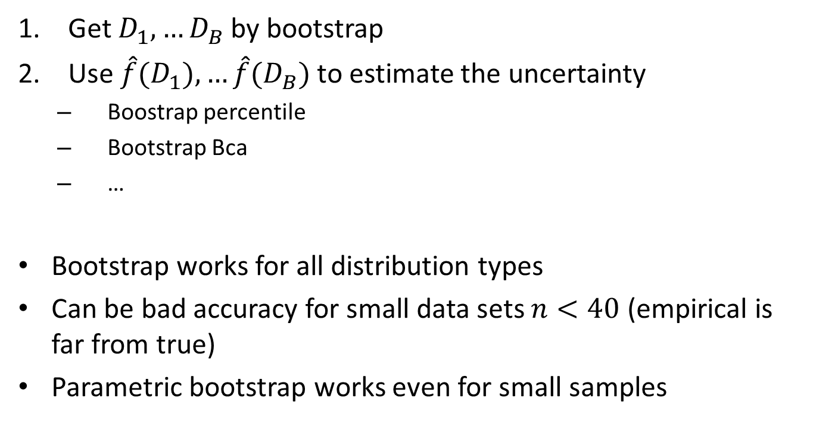
Uncertainty estimation
Get $D_{1}^{}, …D_{B}^{}$ by bootstrap
Use ${\hat{f}(D}_{1}^{}), …{\hat{f}(D}_{B}^{})$ to estimate the uncertainty
Boostrap percentile
Bootstrap Bca
…
Bootstrap works for all distribution types
Can be bad accuracy for small data sets $n<40$ (empirical is far from true)
Parametric bootstrap works even for small samples

Slide 17
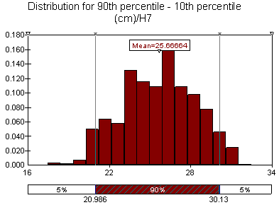
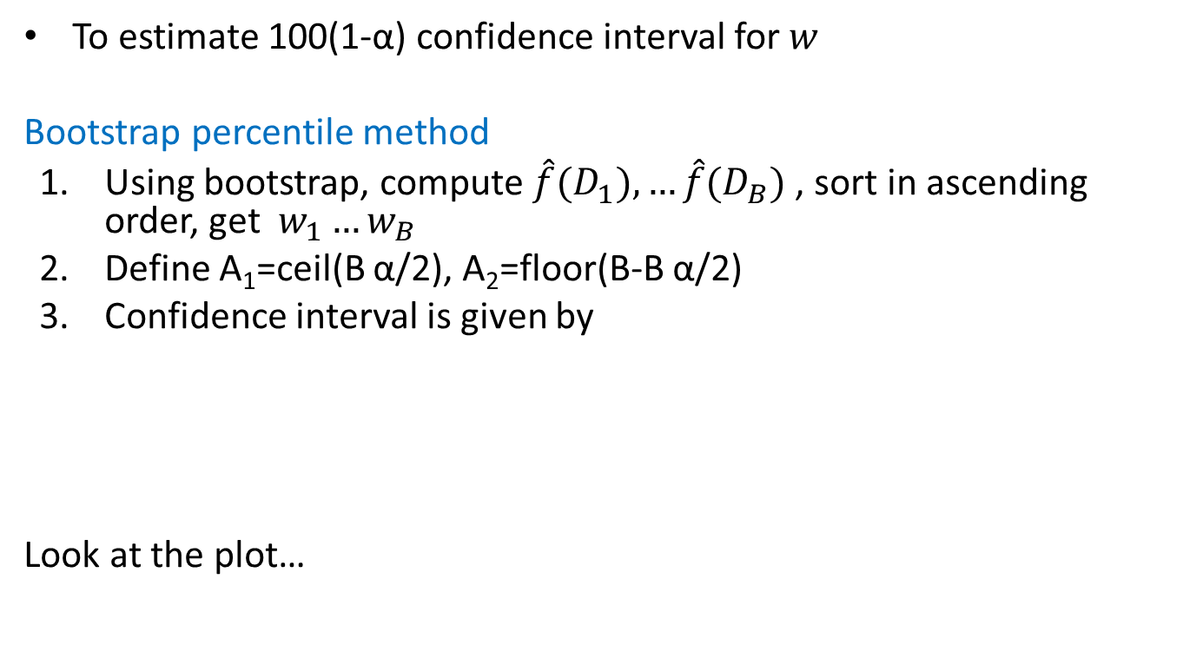
Bootstrap confidence intervals
To estimate 100(1-α) confidence interval for $w$
Bootstrap percentile method
Using bootstrap, compute ${\hat{f}(D}_{1}^{}), …{\hat{f}(D}_{B}^{})$ , sort in ascending order, get $w_{1}…w_{B}$
Define A₁=ceil(B α/2), A₂=floor(B-B α/2)
Confidence interval is given by
Look at the plot…

Slide 18
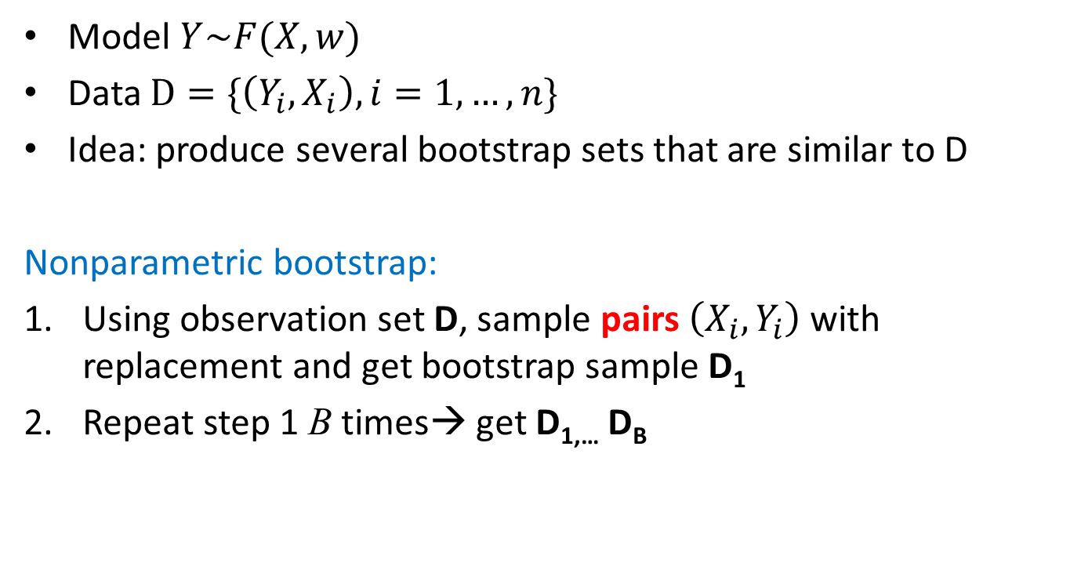
Bootstrap: regression context
Model $Y\sim F(X,w)$
Data $D=\{\left(Y_{i},X_{i}\right), i=1,…, n\}$
Idea: produce several bootstrap sets that are similar to D
Nonparametric bootstrap:
Using observation set D, sample pairs $\left(X_{i},Y_{i}\right)$ with replacement and get bootstrap sample D₁
Repeat step 1 B times→ get D_{1,…} D_{B}

Slide 19
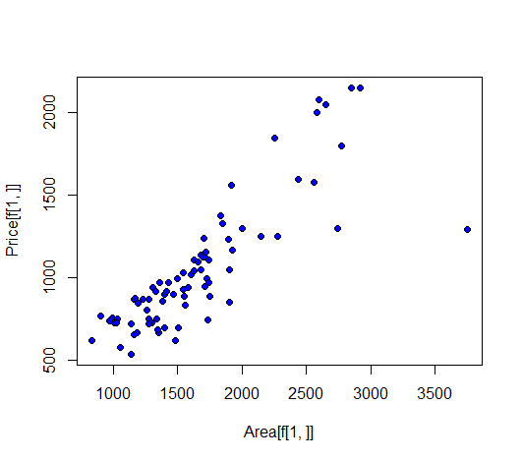
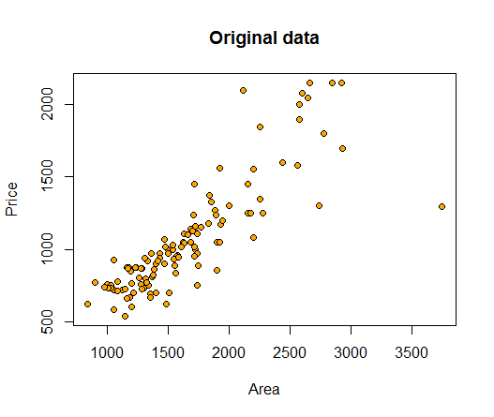
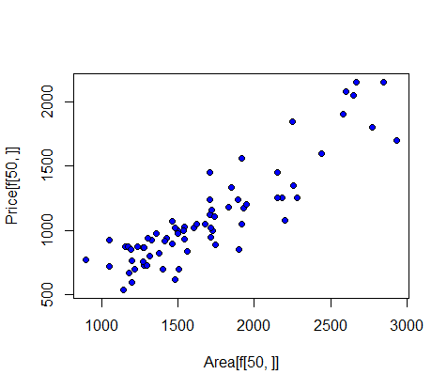


Uncertainty estimation
Example: Albuquerque dataset:
Y=Price of House
X=Area (sqft)
$$D_{1}^{}$$
We sample data index, from {1…N}
$$D_{50}^{}$$

Slide 20

Bootstrap: regression context
Parametric bootstrap
Fit a model to D → get $\hat{w}\left(D\right)$.
Set $X_{i}^{∗}=X_{i}$, generate $Y_{i}^{∗}\sim F(X_{i}, \hat{w})$.
$D_{i}=\{\left(X_{i}^{∗},Y_{i}^{∗}\right), i=1, …, n\}$
Repeat step 2 B times

Slide 21
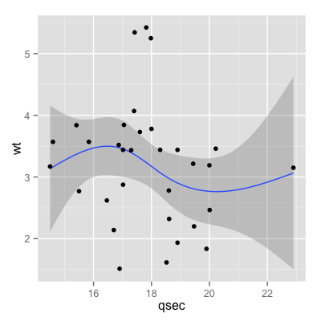
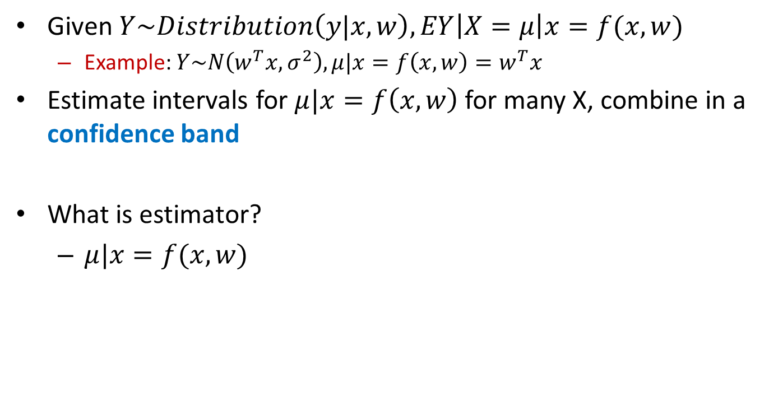
Confindence intervals in regression
Given $Y\sim Distribution\left(y|x, w\right), EY\left|X=μ\right|x=f(x,w)$
Example: $Y\sim N\left(w^{T}x, σ^{2}\right), μ|x=f\left(x,w\right)=w^{T}x$
Estimate intervals for $μ|x=f\left(x,w\right)$ for many X, combine in a confidence band
What is estimator?
$μ|x=f(x,w)$
Source: ggplot2.org

Slide 22
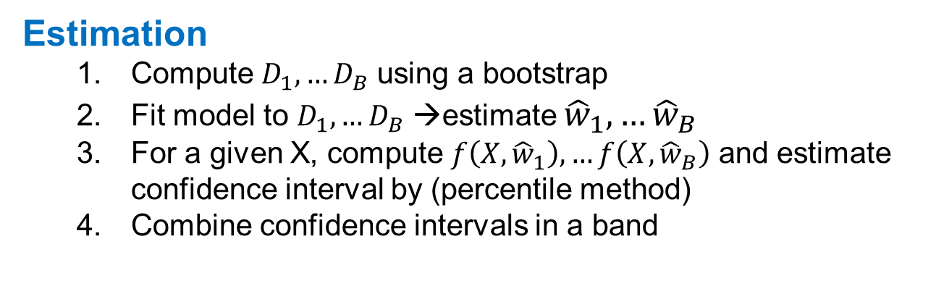
Confindence intervals in regression
Estimation
Compute $D_{1},…D_{B}$ using a bootstrap
Fit model to $D_{1},…D_{B}$ →estimate ${\hat{w}}_{1},…{\hat{w}}_{B}$
For a given X, compute $f\left(X,{\hat{w}}_{1}\right),…f\left(X,{\hat{w}}_{B}\right)$ and estimate confidence interval by (percentile method)
Combine confidence intervals in a band

Slide 23
Bootstrap: R
Package boot
Functions:
boot()
boot.ci() – 1 parameter
envelope() – many parameters
Random random generation for parametic bootstrap:
Rnorm()
Runif()
…
boot(data, statistic, R, sim = "ordinary", ran.gen = function(d, p) d, mle = NULL,…)

Slide 24
Bootstrap: R
Nonparametric bootstrap:
Write a function statistic that depends on dataframe and index and returns the estimator
library(boot)
data2=data[order(data$Area),]#reordering data according to Area
# computing bootstrap samples
f=function(data, ind){
data1=data[ind,]# extract bootstrap sample
res=lm(Price~Area, data=data1) #fit linear model
#predict values for all Area values from the original data
priceP=predict(res,newdata=data2)
return(priceP)
}
res=boot(data2, f, R=1000) #make bootstrap

Slide 25
Bootstrap: R
Parametric bootstrap:
Compute value mle that estimates model parameters from the data
Write function ran.gen that depends on data and mle and which generates new data
Write function statistic that depend on data which will be generated by ran.gen and should return the estimator

Slide 26
Bootstrap
mle=lm(Price~Area, data=data2)
rng=function(data, mle) {
data1=data.frame(Price=data$Price, Area=data$Area)
n=length(data$Price)
#generate new Price
data1$Price=rnorm(n,predict(mle, newdata=data1),sd(mle$residuals))
return(data1)
}
f1=function(data1){
res=lm(Price~Area, data=data1) #fit linear model
#predict values for all Area values from the original data
priceP=predict(res,newdata=data2)
return(priceP)
}
res=boot(data2, statistic=f1, R=1000, mle=mle,ran.gen=rng, sim="parametric")

Slide 27
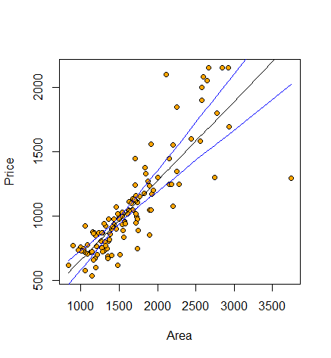
Uncertainty estimation: R
Bootstrap cofidence bands for linear model
e=envelope(res) #compute confidence bands
fit=lm(Price~Area, data=data2)
priceP=predict(fit)
plot(Area, Price, pch=21, bg="orange")
points(data2$Area,priceP,type="l") #plot fitted line
#plot cofidence bands
points(data2$Area,e$point[2,], type="l", col="blue")
points(data2$Area,e$point[1,], type="l", col="blue")

Slide 28
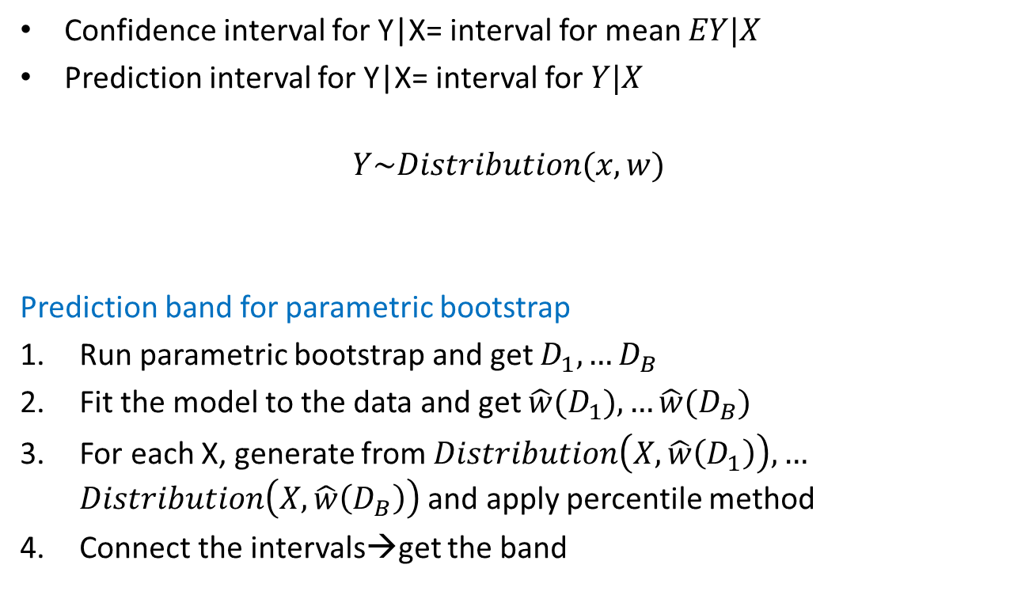
Prediction bands
Confidence interval for Y|X= interval for mean $EY|X$
Prediction interval for Y|X= interval for $Y|X$
$$Y\sim Distribution(x,w)$$
Prediction band for parametric bootstrap
Run parametric bootstrap and get $D_{1},…D_{B}$
Fit the model to the data and get $\hat{w}(D_{1}),…\hat{w}(D_{B})$
For each X, generate from $Distribution\left(X,\hat{w}\left(D_{1}\right)\right),…$ $Distribution\left(X,\hat{w}\left(D_{B}\right)\right)$ and apply percentile method
Connect the intervals→get the band

Slide 29
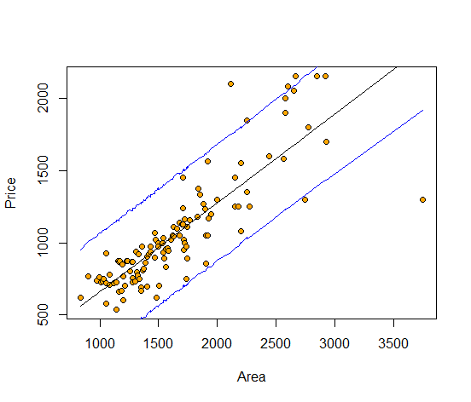
Estimation of the model quality
Example: parametric bootstrap
mle=lm(Price~Area, data=data2)
f1=function(data1){
res=lm(Price~Area, data=data1) #fit linear model
#predict values for all Area values from the original data
priceP=predict(res,newdata=data2)
n=length(data2$Price)
predictedP=rnorm(n,priceP, sd(mle$residuals))
return(predictedP)
}
res=boot(data2, statistic=f1, R=10000, mle=mle,ran.gen=rng, sim="parametric")
Why wider band?

