Slide 1
Naïve Bayes classifiers Decision trees
Lecture 2b

Slide 2

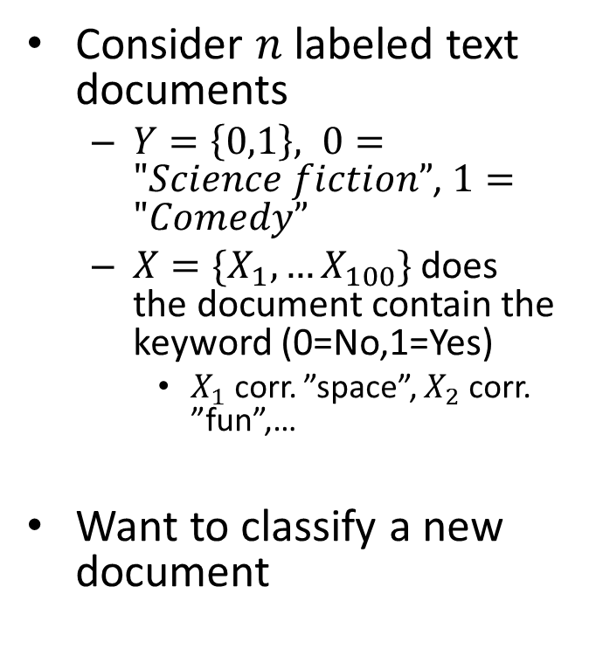
Naive Bayes classifiers: motivation
Consider $n$ labeled text documents
$Y=\left\{0,1\right\}, 0="Science fiction”$, $1="Comedy”$
${X=\{X}_{1},…X_{100}\}$ does the document contain the keyword (0=No,1=Yes)
$X_{1}$ corr. ”space”, $X_{2}$ corr. ”fun”,…
Want to classify a new document
Källa: kdnuggets.com

Slide 3

Naive Bayes classifiers: motivation
Idea: use Bayes classifier
$$p\left(Y=y | X\right)=\frac{P\left(X | Y=y\right)P(Y=y)}{\sum_{j}{P\left(X | Y=y_{j}\right)P(Y=y_{j})}}$$
Chance of observing a given combination of words in science fiction
Proportion of science fiction documents

Slide 4

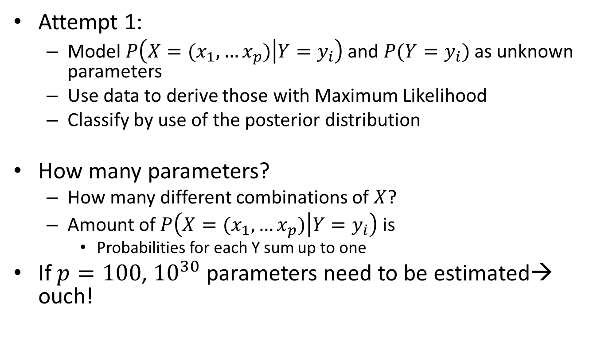

Naive Bayes classifiers: motivation
Attempt 1:
Model $P\left(X=(x_{1},…x_{p}) | Y=y_{i}\right)$ and $P(Y=y_{i})$ as unknown parameters
Use data to derive those with Maximum Likelihood
Classify by use of the posterior distribution
How many parameters?
How many different combinations of $X$?
Amount of $P\left(X=(x_{1},…x_{p}) | Y=y_{i}\right)$ is
Probabilities for each Y sum up to one
If $p=100$, ${10}^{30}$ parameters need to be estimated→ ouch!
$$2^{p}$$
$${2∗2}^{p}−2$$

Slide 5
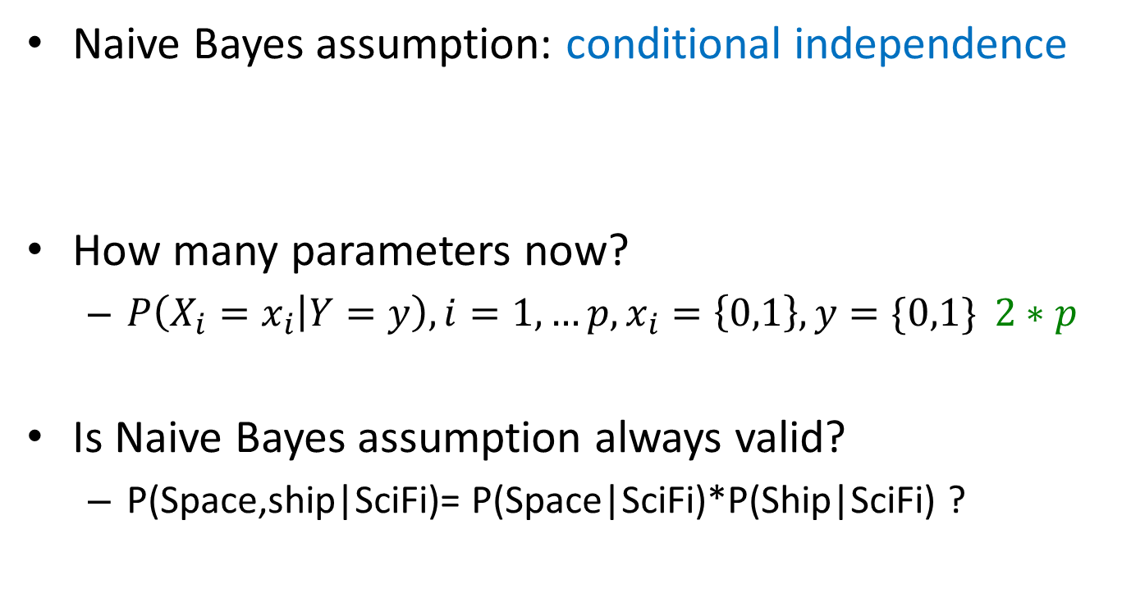
Naive Bayes classifiers
Naive Bayes assumption: conditional independence
How many parameters now?
$P\left(X_{i}=x_{i} | Y=y\right), i=1,…p, x_{i}=\left\{0,1\right\}, y=\{0,1\}$ $2∗p$
Is Naive Bayes assumption always valid?
P(Space,ship|SciFi)= P(Space|SciFi)*P(Ship|SciFi) ?
$P\left(X=(x_{1},…x_{p}) | Y=y\right)=\prod_{i=1}^{p}{P(X_{i}=x_{i}|Y=y)}$

Slide 6

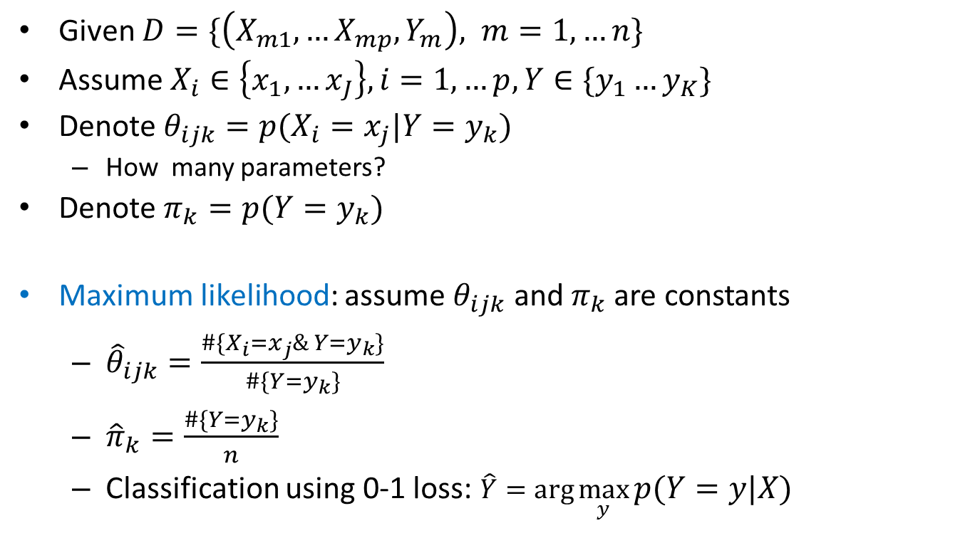
Naive Bayes classifiers - discrete inputs
Given $D=\{\left(X_{m1},…X_{mp},Y_{m}\right), m=1,…n\}$
Assume $X_{i}∈\left\{x_{1},…x_{J}\right\}, i=1,…p, Y∈\{y_{1}…y_{K}\}$
Denote $θ_{ijk}=p(X_{i}=x_{j}|Y=y_{k})$
How many parameters?
Denote $π_{k}=p(Y=y_{k})$
Maximum likelihood: assume $θ_{ijk}$ and $π_{k}$ are constants
${\hat{θ}}_{ijk}=\frac{\#\{X_{i}=x_{j}\& Y=y_{k}\}}{\#\{Y=y_{k}\}}$
${\hat{π}}_{k}=\frac{\#\{Y=y_{k}\}}{n}$
Classification using 0-1 loss: $\hat{Y}=\arg{\max_{y}{p\left(Y=y | X\right)}}$
$(J−1)Kp$

Slide 7
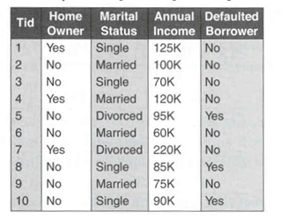
Naive Bayes classifiers - discrete inputs
Example Loan decision
Classify a person: Home Owner=No, Single=Yes

Slide 8
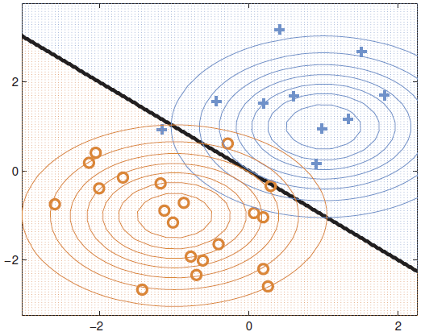
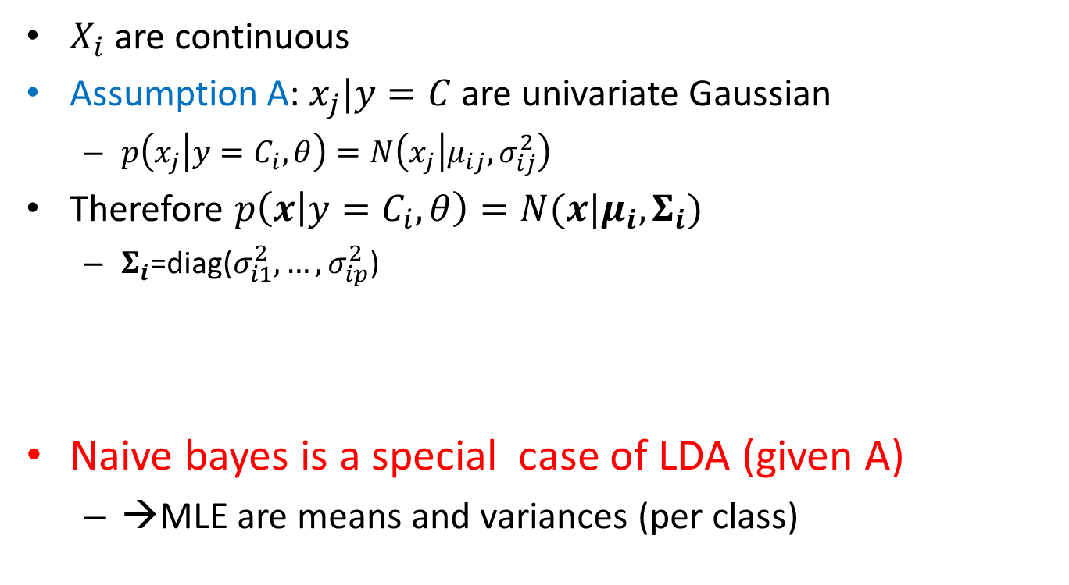
Naive Bayes – continuous inputs
$X_{i}$ are continuous
Assumption A: $x_{j}|y=C$ are univariate Gaussian
$p\left(x_{j} | y=C_{i}, θ\right)=N\left(x_{j} | μ_{ij}, σ_{ij}^{2}\right)$
Therefore $p\left(x | y=C_{i}, θ\right)=N(x|μ_{i}, Σ_{i})$
$Σ_{i}$=diag($σ_{i1}^{2}, …,σ_{ip}^{2}$)
Naive bayes is a special case of LDA (given A)
→MLE are means and variances (per class)

Slide 9
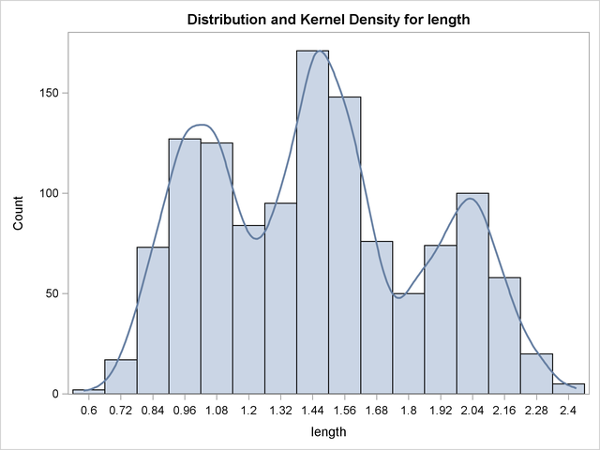
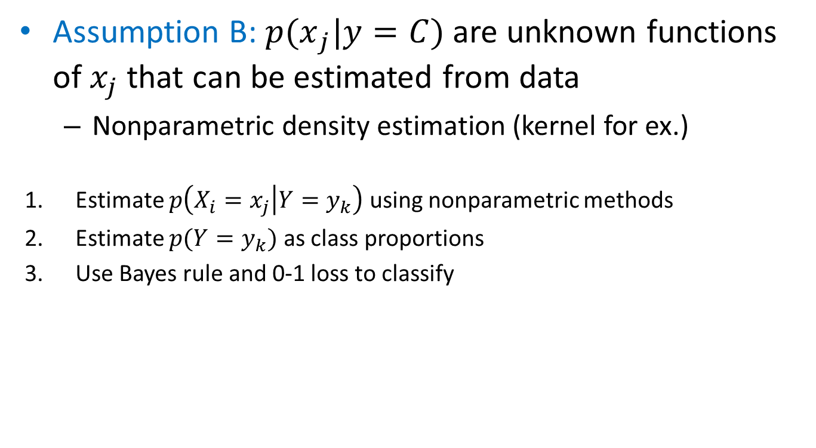
Naive Bayes – continuous inputs
Assumption B: ${p(x}_{j}|y=C)$ are unknown functions of $x_{j}$ that can be estimated from data
Nonparametric density estimation (kernel for ex.)
Estimate $p\left(X_{i}=x_{j} | Y=y_{k}\right)$ using nonparametric methods
Estimate $p(Y=y_{k})$ as class proportions
Use Bayes rule and 0-1 loss to classify
Source: SAS

Slide 10
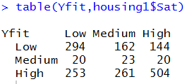
Naive Bayes in R
naiveBayes in package e1071
Example: Satisfaction of householders with their present housing circumstances
library(MASS)
library(e1071)
n=dim(housing)[1]
ind=rep(1:n, housing[,5])
housing1=housing[ind,-5]
fit=naiveBayes(Sat~., data=housing1)
fit
Yfit=predict(fit, newdata=housing1)
table(Yfit,housing1$Sat)

Slide 11
Decision trees
Idea
Split the domain of feature set into the set of hypercubes (rectangles, cubes) and define the target value to be constant within each hypercube
Regression trees:
Target is a continuous variable
Classification trees
Target is a class (qualitative) variable

Slide 12
Classification tree toy example
20
X1
<9
>=9
X2
X2
<16
>=16
<7
>=7
10
0
1
1
X1
<15
>=15
1
0
0
10
20

Slide 13
Definitions
Root node
Nodes
Leaves (terminal nodes)
Parent node, child node
Decision rules
A value is assigned to the leaves
Cond.1
Cond.2
Cond.3
Cond.4
Cond.5
Cond.6
N4
N5
N6
N7

Slide 14
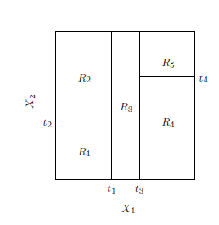
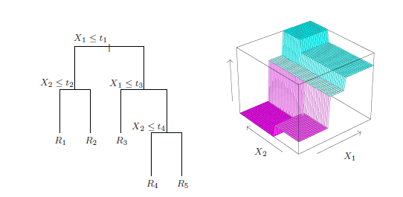
Regression tree toy example

Slide 15
A classification problem
Create a classification tree that would describe the following patterns

Slide 16
Several solutions
Creature = Non-mammal
Tree 1
Tree 3
Body temperature
Large misclassification rate!
Cold
Warm
Creature
= Non-mammal
Skin cover
Tree 2
Body temperature
Not feathers
Cold
Warm
Creature
= Mammal
Creature
= Non-mammal
Creature
= Non-mammal
Creature
= Mammal
Zero misclassification
A lower misclassification rate
Green boxes represent pure nodes =nodes where observed values are the same

Slide 17
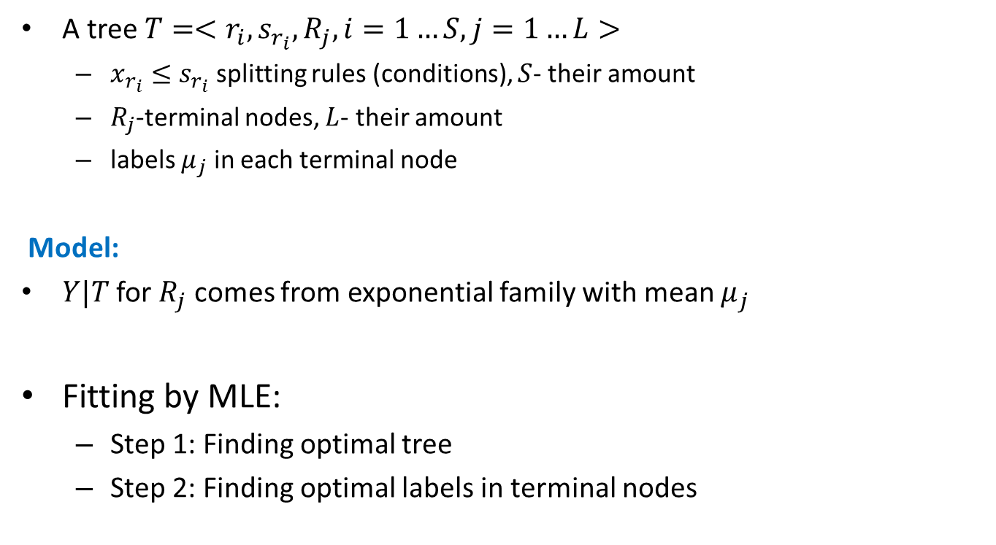
Decision trees
A tree $T=<r_{i},s_{r_{i}},R_{j}, i=1…S, j=1…L>$
$x_{r_{i}}≤s_{r_{i}}$ splitting rules (conditions), $S$- their amount
$R_{j}$-terminal nodes, $L$- their amount
labels $μ_{j}$ in each terminal node
Model:
$Y|T$for $R_{j}$ comes from exponential family with mean $μ_{j}$
Fitting by MLE:
Step 1: Finding optimal tree
Step 2: Finding optimal labels in terminal nodes

Slide 18
Decision trees
Example:
Normal model leads to regression trees
Objective: MSE
Multinoulli model leads to classification trees
Objective: cross-entropy (deviance)

Slide 19
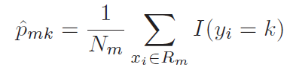

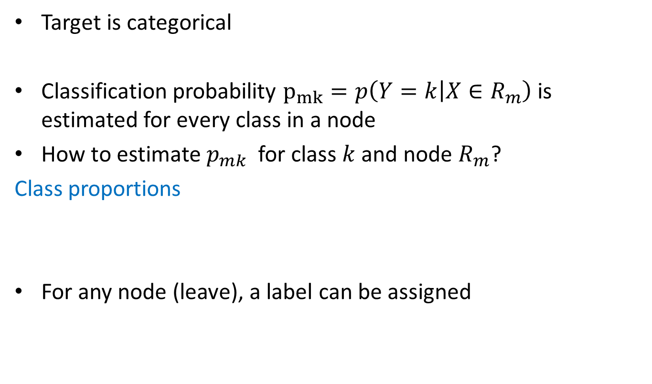
Classification trees
Target is categorical
Classification probability $p_{mk}=p\left(Y=k | X∈R_{m}\right)$ is estimated for every class in a node
How to estimate $p_{mk}$ for class $k$ and node $R_{m}$?
Class proportions
For any node (leave), a label can be assigned

Slide 20
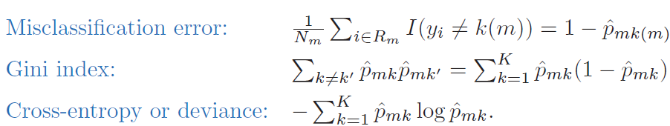
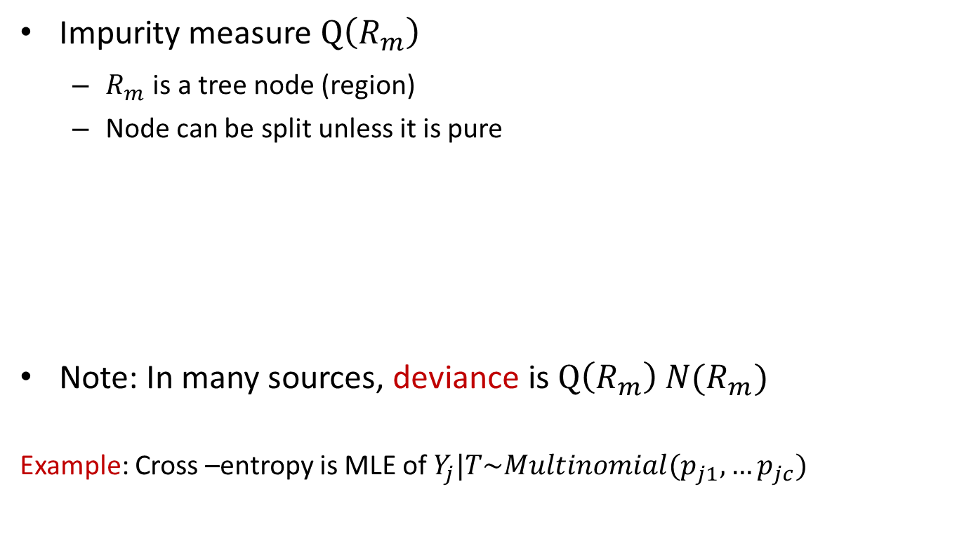
Classification trees
Impurity measure $Q\left(R_{m}\right)$
$R_{m}$ is a tree node (region)
Node can be split unless it is pure
Note: In many sources, deviance is $Q\left(R_{m}\right) N(R_{m})$
Example: Cross –entropy is MLE of $Y_{j}|T\sim Multinomial(p_{j1},…p_{jc})$

Slide 21
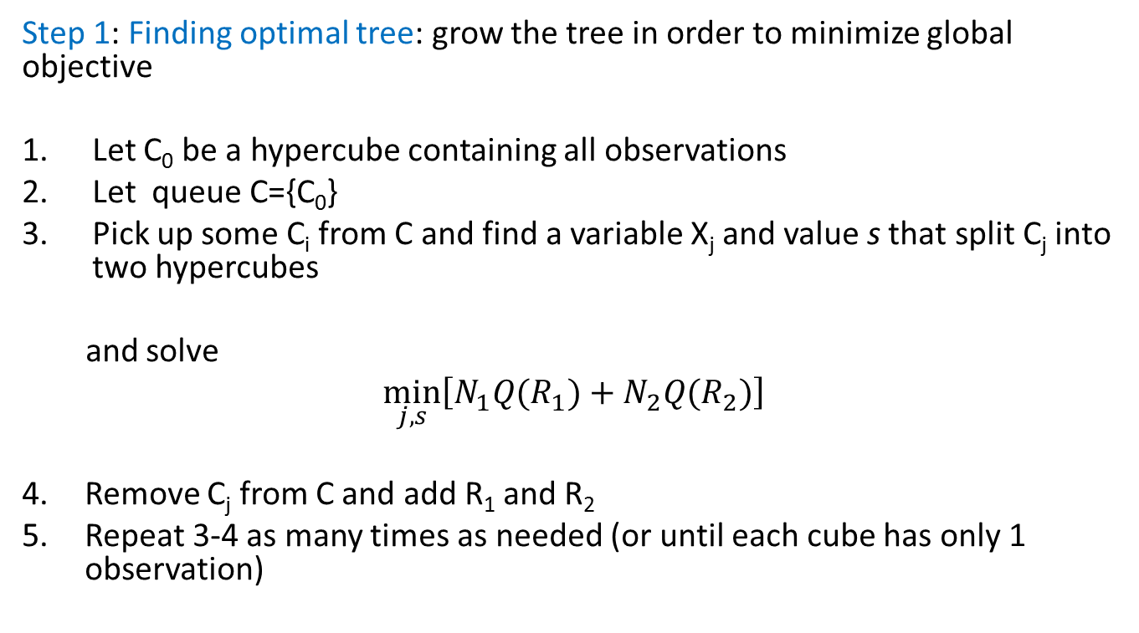
Fitting regression trees: CART
Step 1: Finding optimal tree: grow the tree in order to minimize global objective
Let C₀ be a hypercube containing all observations
Let queue C={C₀}
Pick up some C_{i} from C and find a variable X_{j} and value s that split C_{j} into two hypercubes
and solve
$$\min_{j,s}\left[N_{1}Q(R_{1})+N_{2}Q(R_{2})\right]$$
Remove C_{j} from C and add R₁ and R₂
Repeat 3-4 as many times as needed (or until each cube has only 1 observation)

Slide 22
CART: comments
Greedy algorithm (optimal tree is not found)
The largest tree will interpolate the data → large trees = overfitting the data
Too small trees=underfitting (important structure may not be captured)
Optimal tree length?

Slide 23
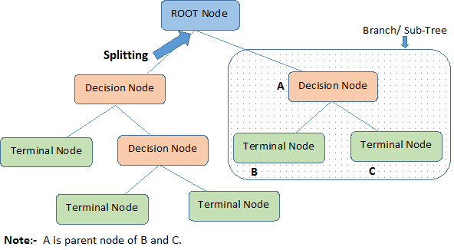
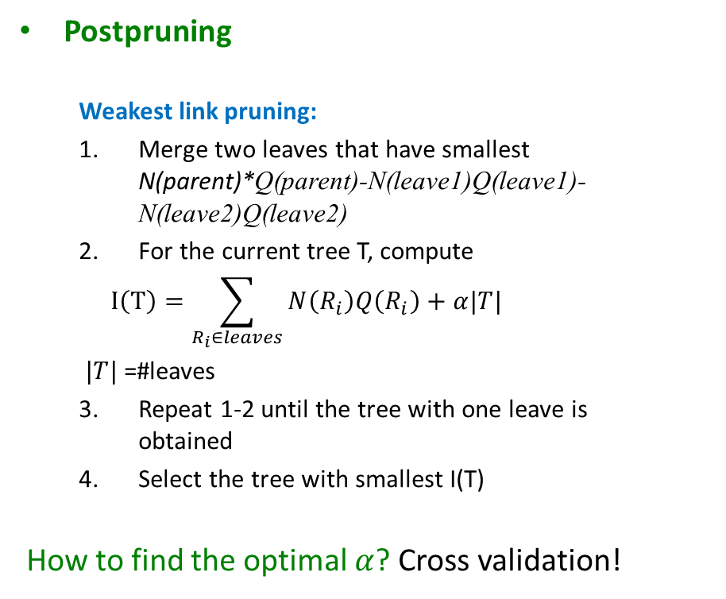
Optimal trees
Postpruning
Weakest link pruning:
Merge two leaves that have smallest N(parent)*Q(parent)-N(leave1)Q(leave1)-N(leave2)Q(leave2)
For the current tree T, compute
$$I\left(T\right)=\sum_{R_{i}∈leaves}{N\left(R_{i}\right)Q\left(R_{i}\right)+α|T|}$$
$|T|$ =#leaves
Repeat 1-2 until the tree with one leave is obtained
Select the tree with smallest I(T)
How to find the optimal $α$? Cross validation!
Source: http://www.analyticsvidhya.com

Slide 24
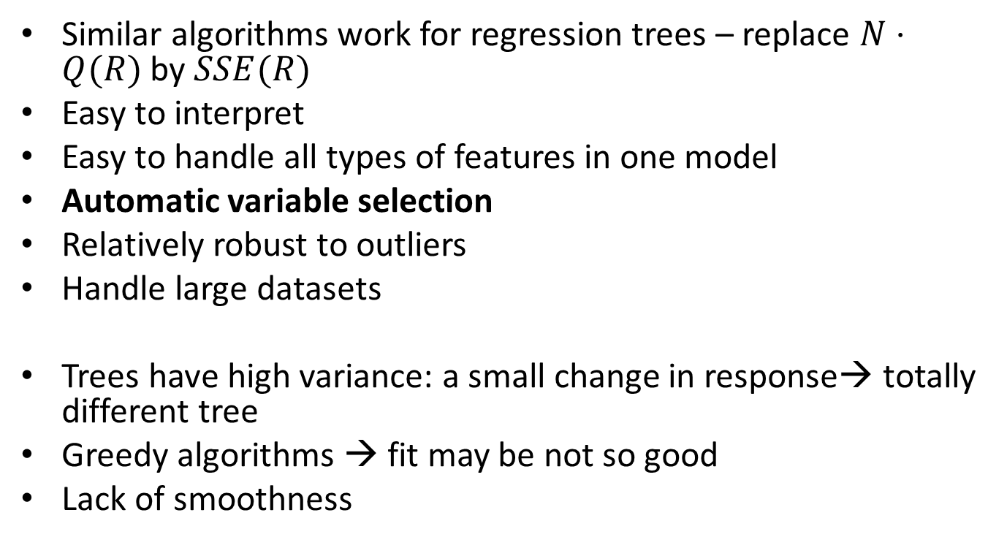
Decision trees: comments
Similar algorithms work for regression trees – replace $N⋅Q(R)$ by $SSE(R)$
Easy to interpret
Easy to handle all types of features in one model
Automatic variable selection
Relatively robust to outliers
Handle large datasets
Trees have high variance: a small change in response→ totally different tree
Greedy algorithms → fit may be not so good
Lack of smoothness

Slide 25
Decision trees: issues
Large trees may be needed to model an easy system:

Slide 26
Decision trees in R
tree package
Alternative: rpart
tree(formula, data, weights, control, split = c("deviance", "gini"), …)
print(), summary(), plot(), text()
Example: breast cancer as a function av biological measurements
library(tree)
n=dim(biopsy)[1]
fit=tree(class~., data=biopsy)
plot(fit)
text(fit, pretty=0)
fit
summary(fit)

Slide 27
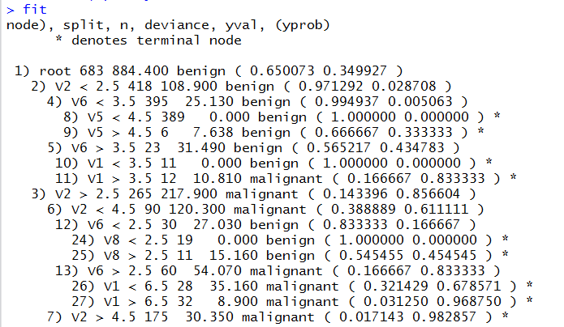
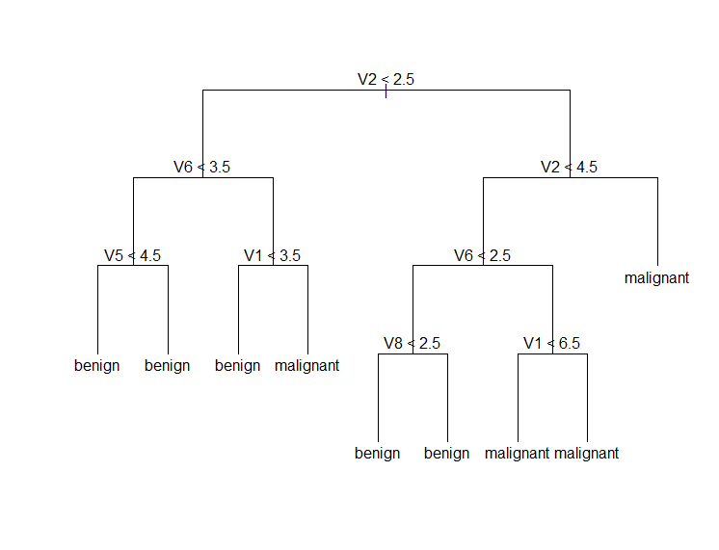
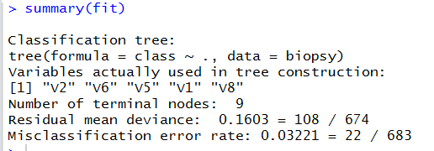
Decision trees in R
Adjust the splitting in the tree with control parameter (leaf size for ex)

Slide 28
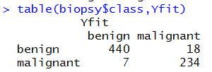
Decision trees in R
Misclassification results
Yfit=predict(fit, newdata=biopsy, type="class")
table(biopsy$class,Yfit)

Slide 29
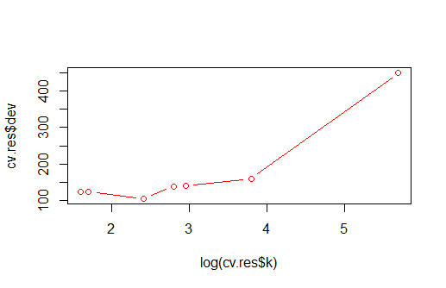
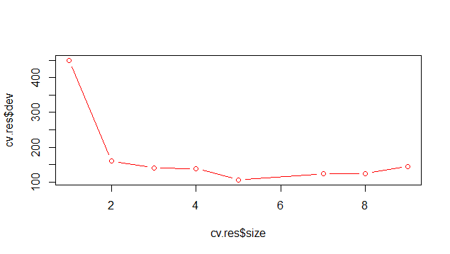
Decision trees in R
Selecting optimal tree by penalizing
Cv.tree()
set.seed(12345)
ind=sample(1:n, floor(0.5*n))
train=biopsy[ind,]
valid=biopsy[-ind,]
fit=tree(class~., data=train)
set.seed(12345)
cv.res=cv.tree(fit)
plot(cv.res$size, cv.res$dev, type="b", col="red")
plot(log(cv.res$k), cv.res$dev, type="b", col="red")
What is optimal number of leaves?

Slide 30
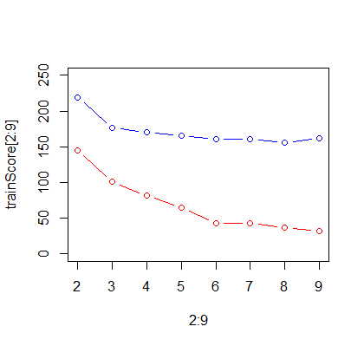
Decision trees in R
Selecting optimal tree by train/validation
fit=tree(class~., data=train)
trainScore=rep(0,9)
testScore=rep(0,9)
for(i in 2:9) {
prunedTree=prune.tree(fit,best=i)
pred=predict(prunedTree, newdata=valid, type="tree")
trainScore[i]=deviance(prunedTree)
testScore[i]=deviance(pred)
}
plot(2:9, trainScore[2:9], type="b", col="red", ylim=c(0,250))
points(2:9, testScore[2:9], type="b", col="blue")
What is optimal number of leaves?

Slide 31
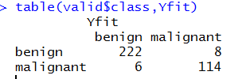
Decision trees in R
Final tree: 5 leaves
finalTree=prune.tree(fit, best=5)
Yfit=predict(finalTree, newdata=valid, type="class")
table(valid$class,Yfit)

