Slide 1
Lecture 2a block 2
Splines
Generalized additive models

Slide 2
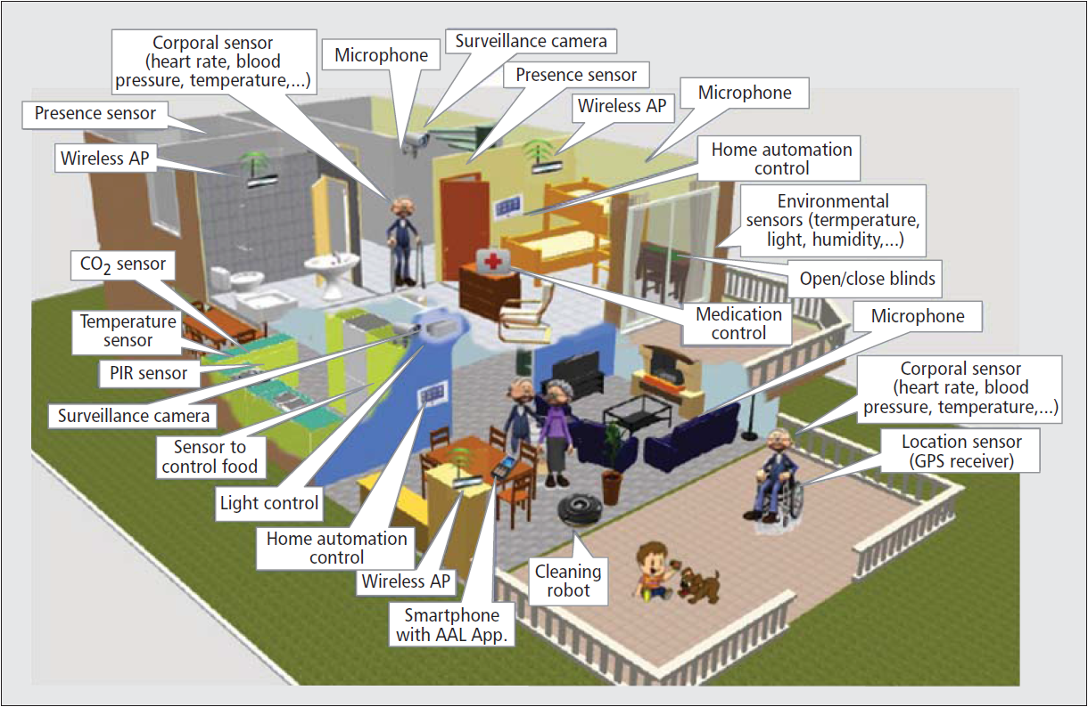
Moving beyond simple models
Sometimes using simple models (linear regression) is not enough
Too simple →more flexible models are needed
Example: Ambient Assisted Living
digitally connected and controlled devices for support of people with special needs
emergency buttons, pressure emergency services with connection to a broader smart home
https://bstassen.files.wordpress.com/2015/01/aal.png

Slide 3
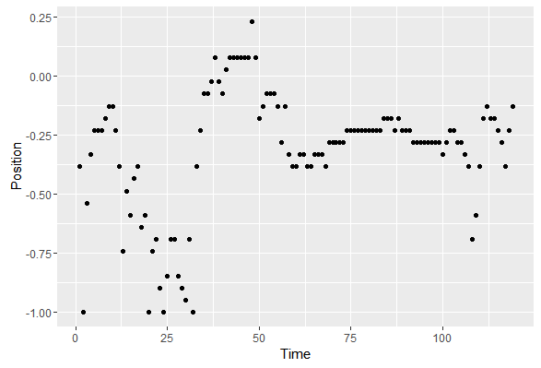
Moving beyond simple models
Ambient Assisted Living
Person’s movement is detected by Radio Signal Strength (RSS) measurements→how to remove noise?

Slide 4
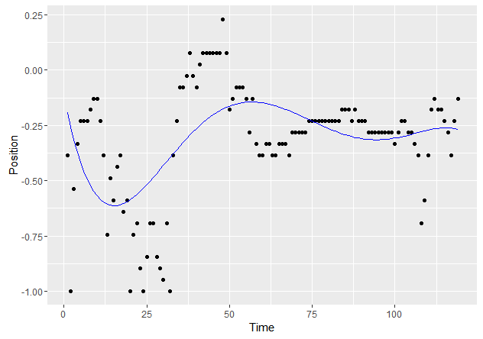
Moving beyond simple models
Attempt 1: 5th degree polynomial
Model underfits data→need more flexible models

Slide 5
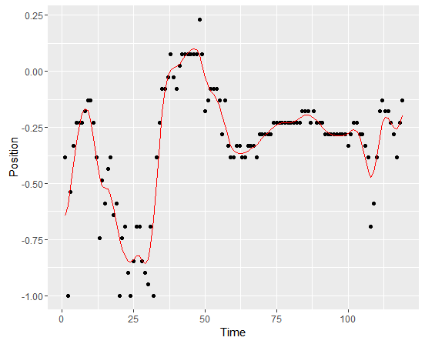
Moving beyond simple models
Using smoothing splines

Slide 6
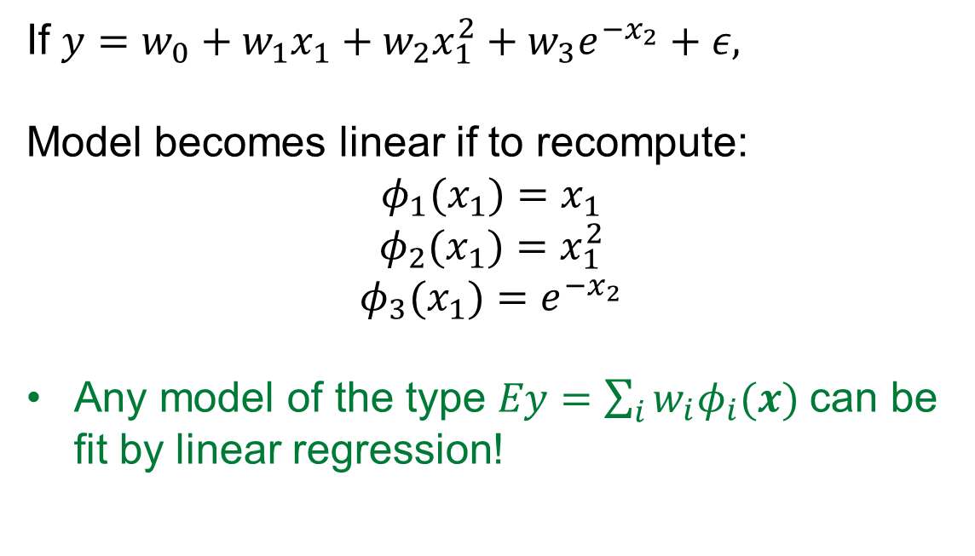
Basis function expansion
If $y=w_{0}+w_{1}x_{1}+w_{2}x_{1}^{2}+w_{3}e^{−x_{2}}+ε,$
Model becomes linear if to recompute:
$$φ_{1}(x_{1})=x_{1}$$
$$φ_{2}(x_{1})=x_{1}^{2}$$
$$φ_{3}(x_{1})=e^{−x_{2}}$$
Any model of the type $Ey=\sum_{i}{w_{i}φ_{i}(x) }$can be fit by linear regression!

Slide 7
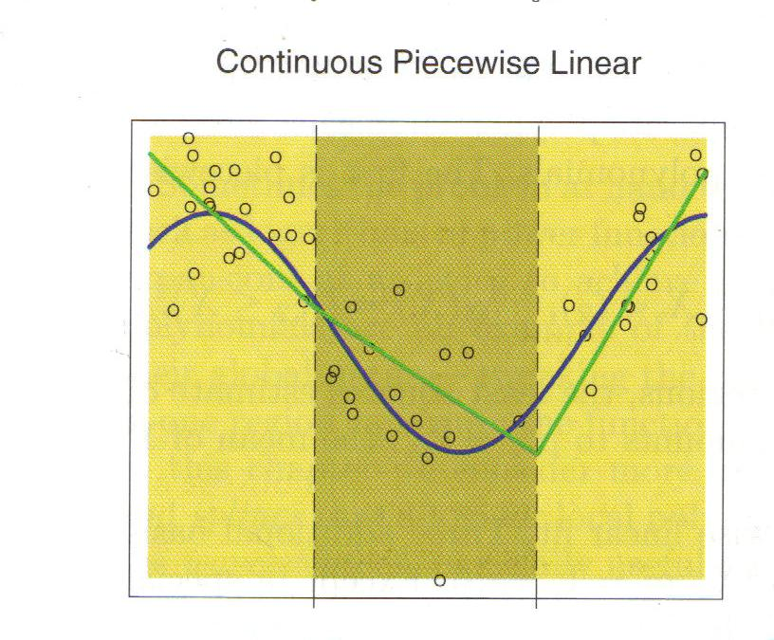
Constructing a piecewise linear function
Method A. Introduce linear functions on each interval and a set of constraints
(4 free parameters) lower left
Method B. Use a basis expansion (4 free parameters)
Theorem. The two methods are equivalent.

Slide 8
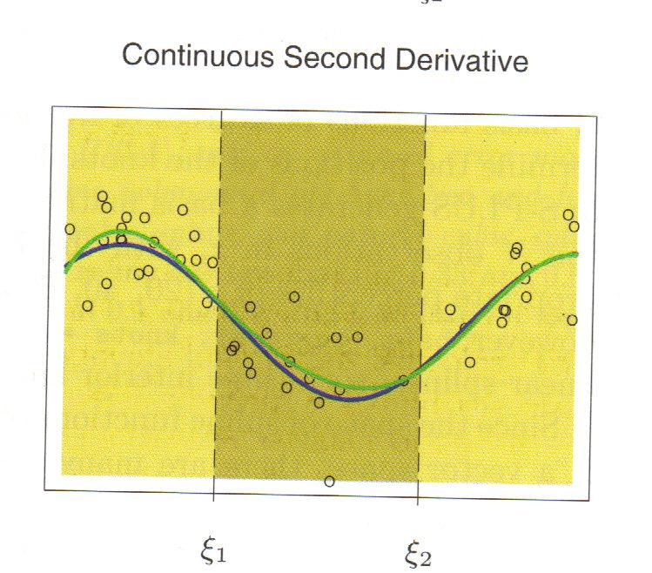
Splines
A piecewise polynomial is called an order-M (or degree M-1) spline if it is continuous and has continuous derivatives up to order M-2 at the knots.
Equivalent: An order-M spline with K knots:
An order-4 (degree-3) spline is called a cubic spline
In cubic splines, knot discontinuity is not visible

Slide 9
Natural cubic spline
A cubic spline f is called natural cubic spline if its 2nd and 3rd derivatives are zero at a and b
Note that f is linear on extreme intervals
Basis functions of natural cubic splines

Slide 10
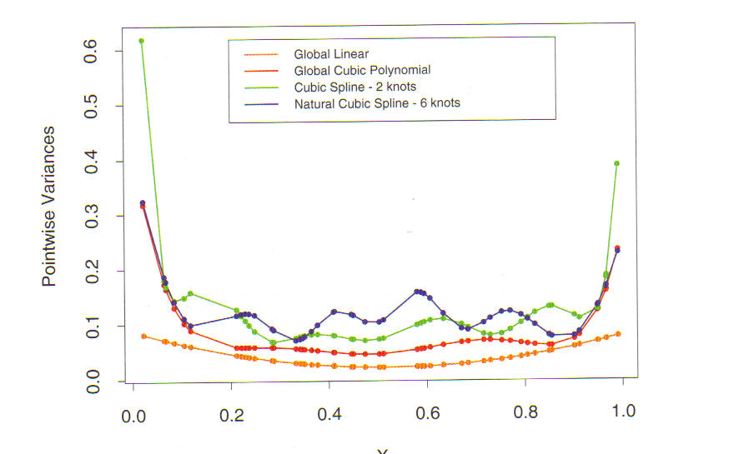
Variance of spline estimators – boundary effects
INSERT FIG 5.3

Slide 11
Fitting smooth functions to data
Minimize
where λ is smoothing parameter.
λ=0 : any function interpolating data
λ=+∞ : least squares line fit

Slide 12
Optimality of smoothing splines
The function f minimizing RSS for a given λ is a natural cubic spline with knots at all unique values of x_{i} (NOTE: N knots!)
Minimizing sum of squares:

Slide 13
A smoothing spline is a linear smoother
Smoothing spline
is a linear smoother.
Compare with other smoothers, such as linear regression.

Slide 14
Degrees of freedom
It can be shown that
where K is penalty matrix
Eigenvalue decomposition of K :
d_{k} and u_{k} are eigenvalues and eigenvectors

Slide 15
Smoothing splines and shrinkage
Smoothing spline decomposes vector y with respect to basis of eigenvectors and shrinks respective contributions
The eigenvectors ordered by ρ increase in complexity. The higher the complexity, the more the contribution is shrunk.

Slide 16
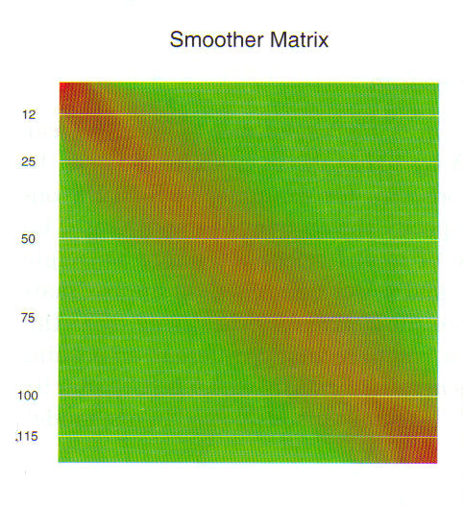
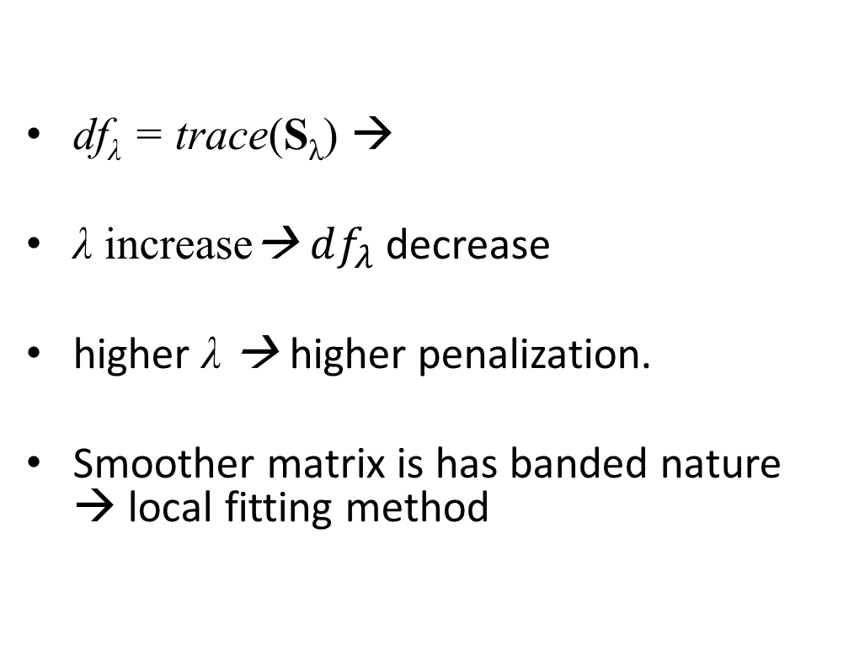
Penalty and degrees of freedom
df_{λ} = trace(S_{λ}) →
λ increase→ $df_{λ}$ decrease
higher λ → higher penalization.
Smoother matrix is has banded nature → local fitting method

Slide 17
Automated selection of smoothing parameters
What can be selected:
Regression splines
Degree of spline
Placement of knots
Smoothing spline
Penalization parameter

Slide 18
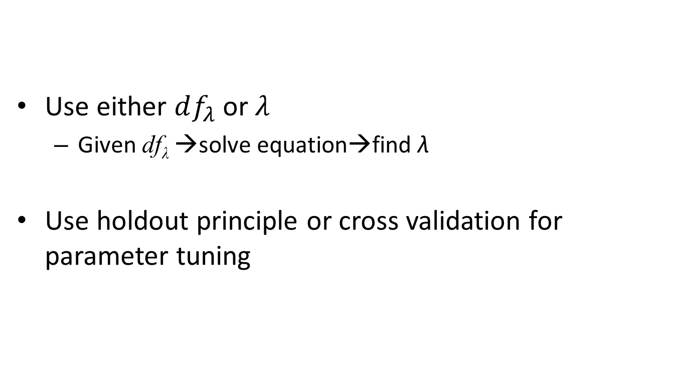
Automated selection of smoothing parameters
Use either $df_{λ}$ or $λ$
Given df_{λ} →solve equation→find λ
Use holdout principle or cross validation for parameter tuning

Slide 19
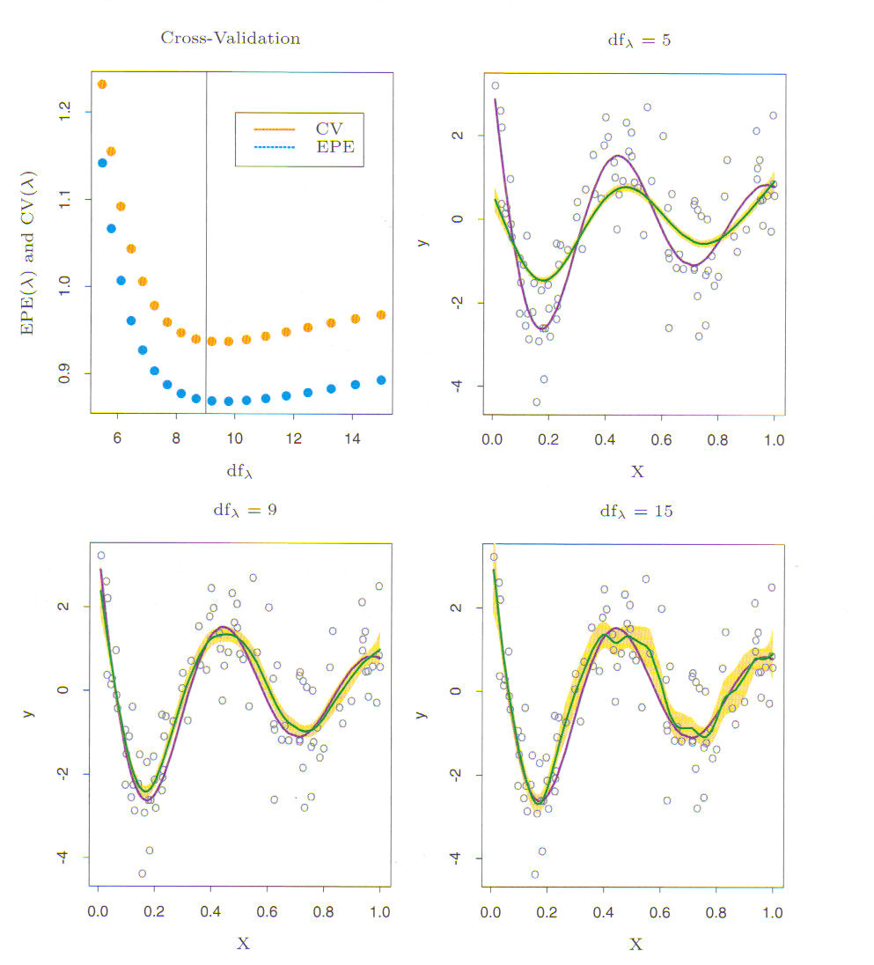
Automated selection of smoothing parameters
INSERT FIG. 5.9
Bias-variance tradeoff

Slide 20
Multidimensional splines
How to fit data smoothly in higher dimensions?
Formulate a new problem
The solution is thin-plate splines
The solution in 2 dimensions is essentially sum of radial basis functions

Slide 21
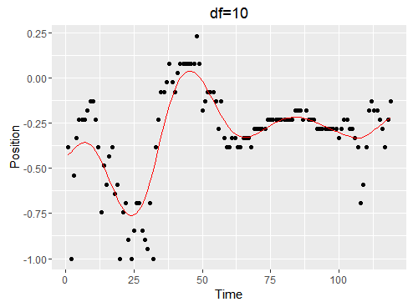
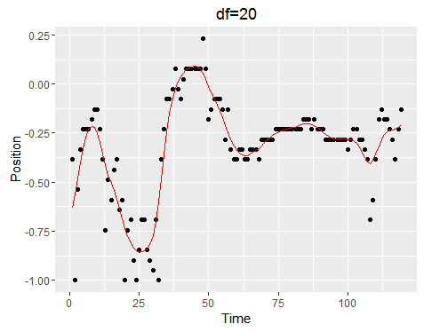
Splines: R code
Smoothing splines : smooth.spline()
Natural clubic splines: ns() in splines
Thin plate splines: Tps() in fields
res1=smooth.spline(data$Time,data$RSS_anchor2,df=10)
predict(res1,x=data$Time)$y

Slide 22
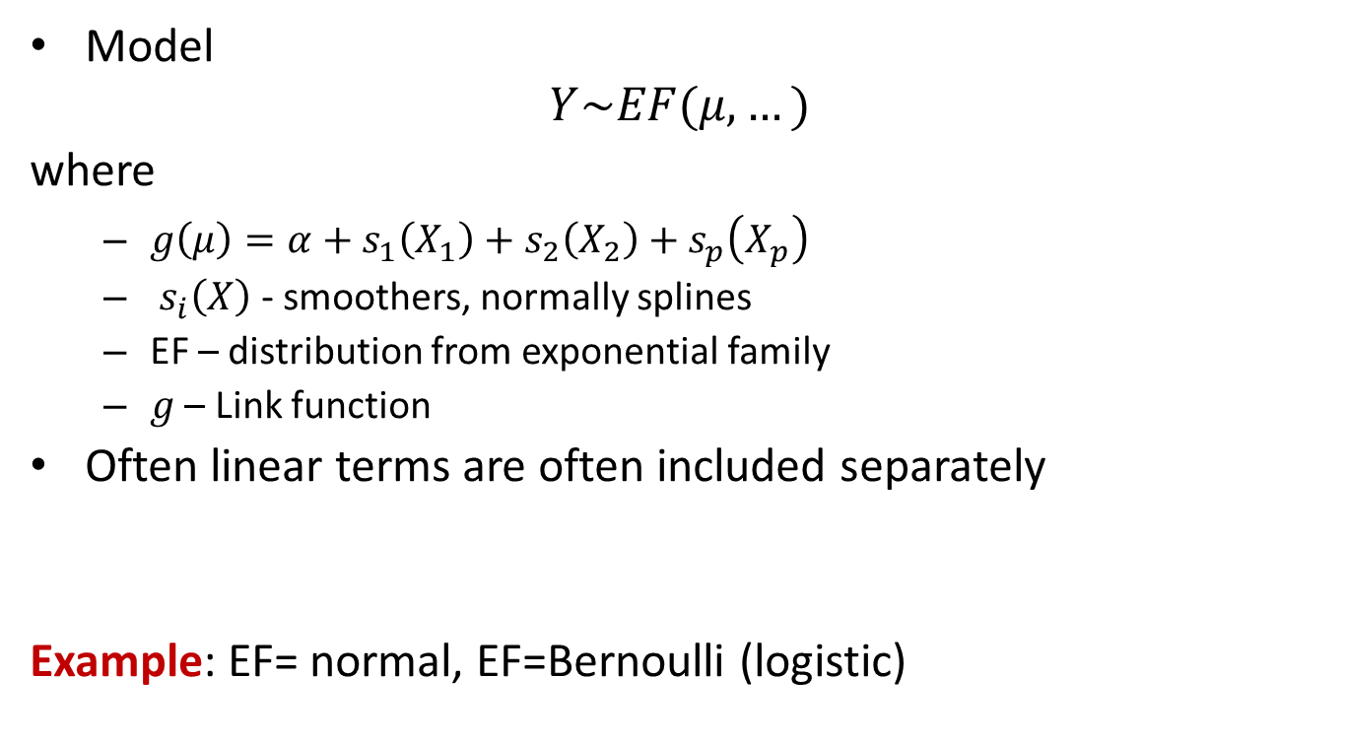
Generalized additive models
Model
$$Y\sim EF(μ,…)$$
where
$g\left(μ\right)=α+s_{1}\left(X_{1}\right)+s_{2}\left(X_{2}\right)+s_{p}\left(X_{p}\right)$
$s_{i}\left(X\right)$ - smoothers, normally splines
EF – distribution from exponential family
$g$ – Link function
Often linear terms are often included separately
Example: EF= normal, EF=Bernoulli (logistic)

Slide 23
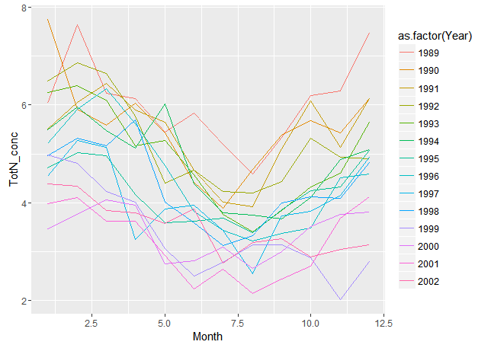
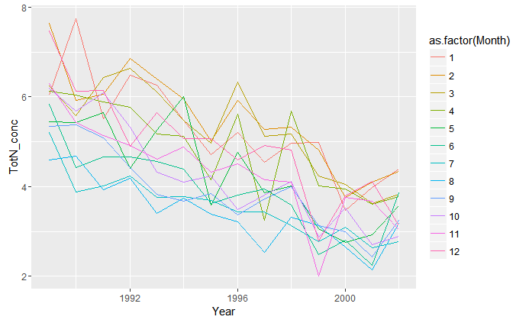
Generalized additive models
Sometimes even higher orders are included (thin-plate splines)
Method is reasonable to apply when additivity is observed or admissble
Example: Total Nitrogen level in Rhine river

Slide 24
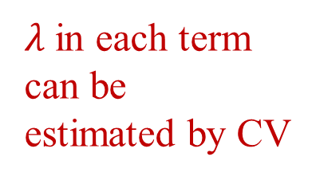
Estimation of additive models
Estimation by MLE
The backfitting algorithm for Normal model
$λ$in each term can be estimated by CV

Slide 25
Generalized additive models
Example: Modelling the concentration of total nitrogen at Lobith on the Rhine
There are seasonal trends (GAM reasonable)
Variables
Nitrogen level
Year
Month
R: package mgcv (also package gam)
gam(formula, family,data,select, method)
Select allows for term (variable) selection
predict(), plot(), summary()…
s(k, sp)
k should be the same as the amount of unique values of this variable in smoothing splines
sp - smoothing penalty.

Slide 26
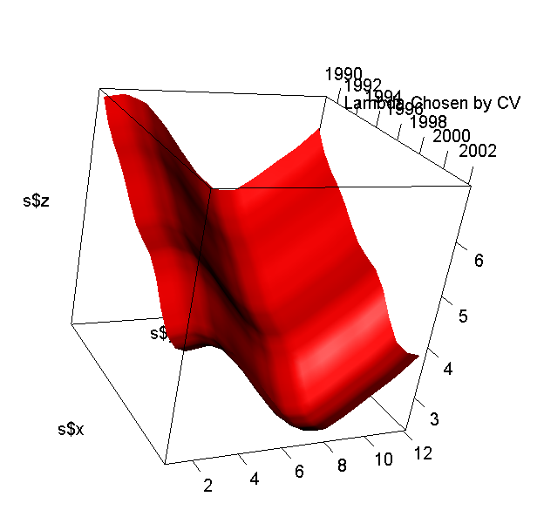
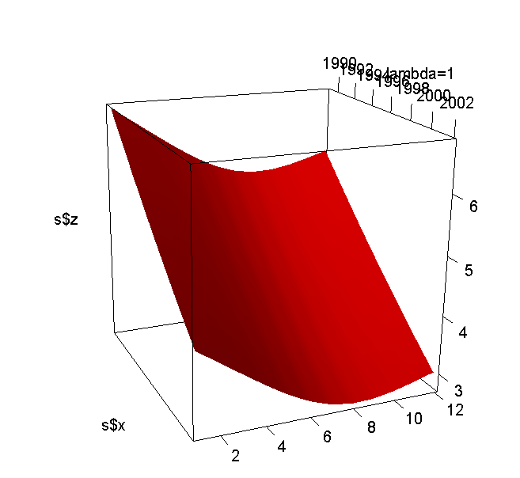
Generalized additive models
R code
river=read.csv2("Rhine.csv")
res=gam(TotN_conc~Year+Month+s(Year)
+s(Month), data=river)
library(rgl)
library(akima)
s=interp(river$Year,river$Month, fitted(res))
persp3d(s$x, s$y, s$z, col="red")

Slide 27
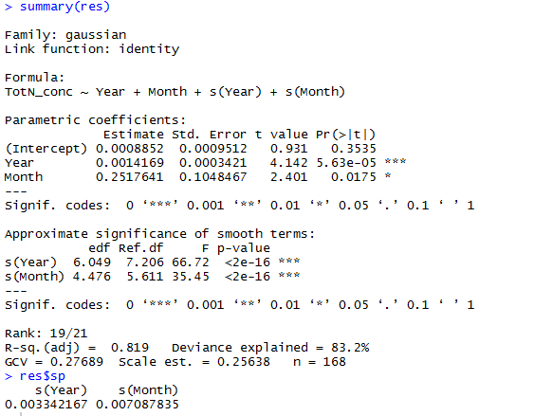
Generalized additive models

Slide 28
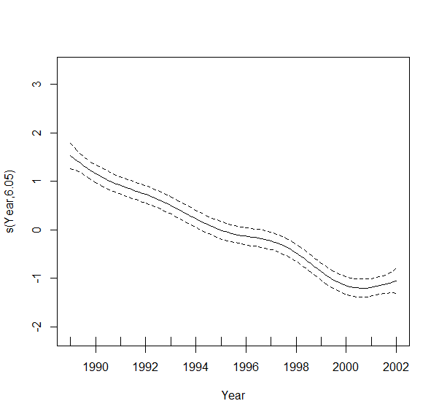
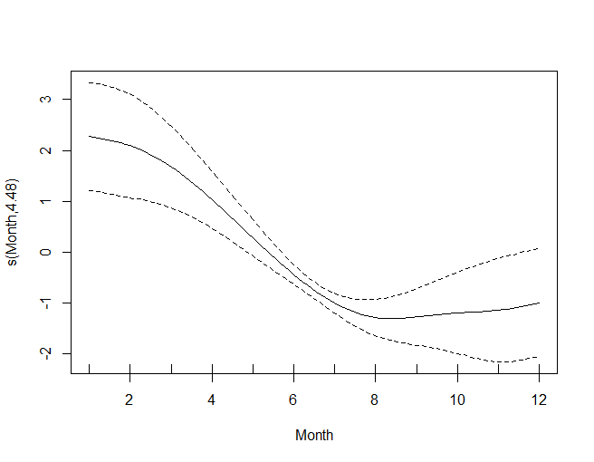
Generalized additive models
Seeing trend and seasonal pattern
plot(res)

