Slide 1
Model selection
Lecture 1e

Slide 2
Overview
Model fitting
Model selection

Slide 3
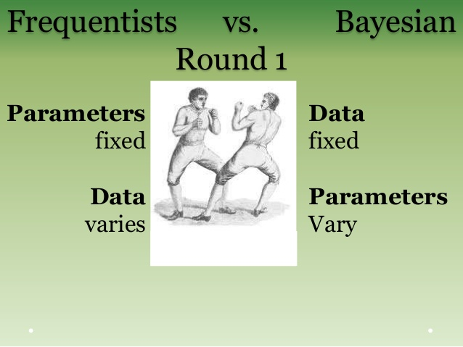
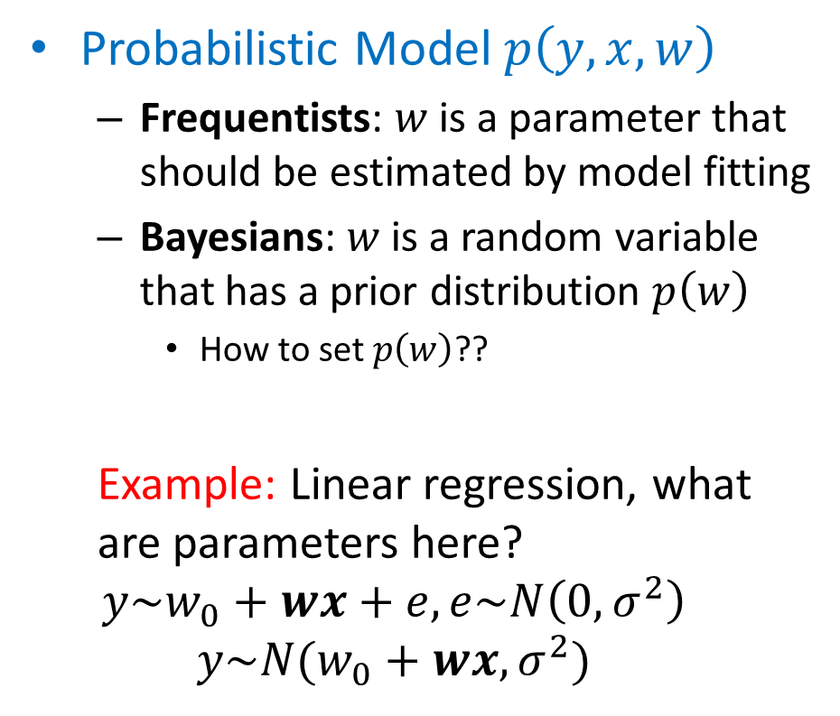
Frequentist vs Bayesian
Probabilistic Model $p\left(y,x,w\right)$
Frequentists: $w$ is a parameter that should be estimated by model fitting
Bayesians: $w$ is a random variable that has a prior distribution $p\left(w\right)$
How to set $p\left(w\right)$??
Example: Linear regression, what are parameters here?
$$y\sim w_{0}+wx+e, e\sim N\left(0,σ^{2}\right)$$
$$y\sim N(w_{0}+wx,σ^{2})$$
https://image.slidesharecdn.com

Slide 4
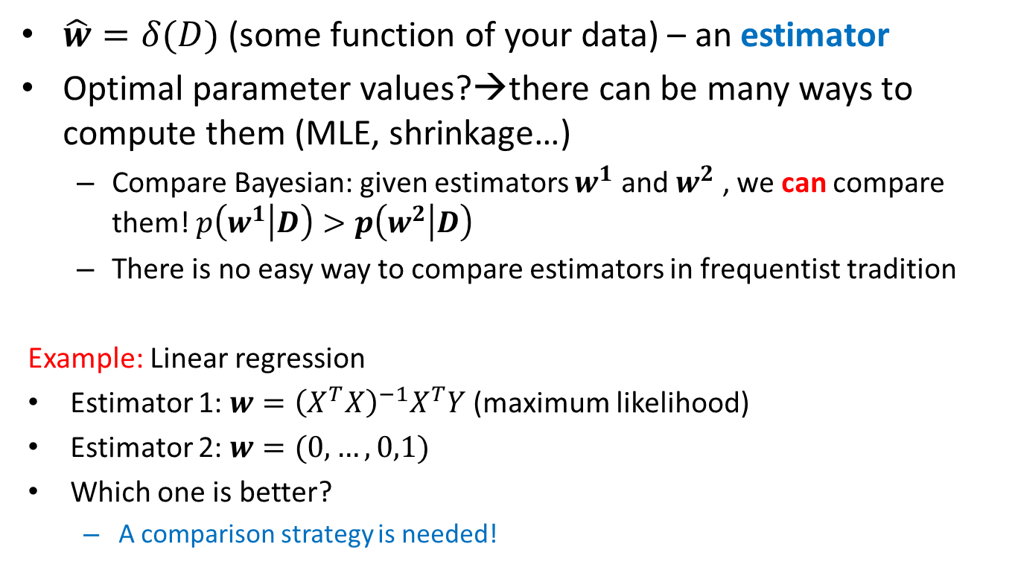
An estimator
$\hat{w}=δ(D)$ (some function of your data) – an estimator
Optimal parameter values?→there can be many ways to compute them (MLE, shrinkage…)
Compare Bayesian: given estimators $w^{1}$ and $w^{2}$ , we can compare them! $p\left(w^{1} | D\right)>p\left(w^{2} | D\right)$
There is no easy way to compare estimators in frequentist tradition
Example: Linear regression
Estimator 1: $w={\left(X^{T}X\right)}^{−1}X^{T}Y$ (maximum likelihood)
Estimator 2: $w=(0,…,0,1)$
Which one is better?
A comparison strategy is needed!

Slide 5
Overfitting
Complex model can overfit your data
Too easy model, a few parameters
Proper one?
Complex model,
many parameters

Slide 6
Overfitting: solutions
Observed: Maximum likelihood can lead to overfitting.
Solutions
Selecting proper parameter values
Regularized risk minimization
Selecting proper model type, for ex. number of parameters
Houldout method
Cross-validation

Slide 7
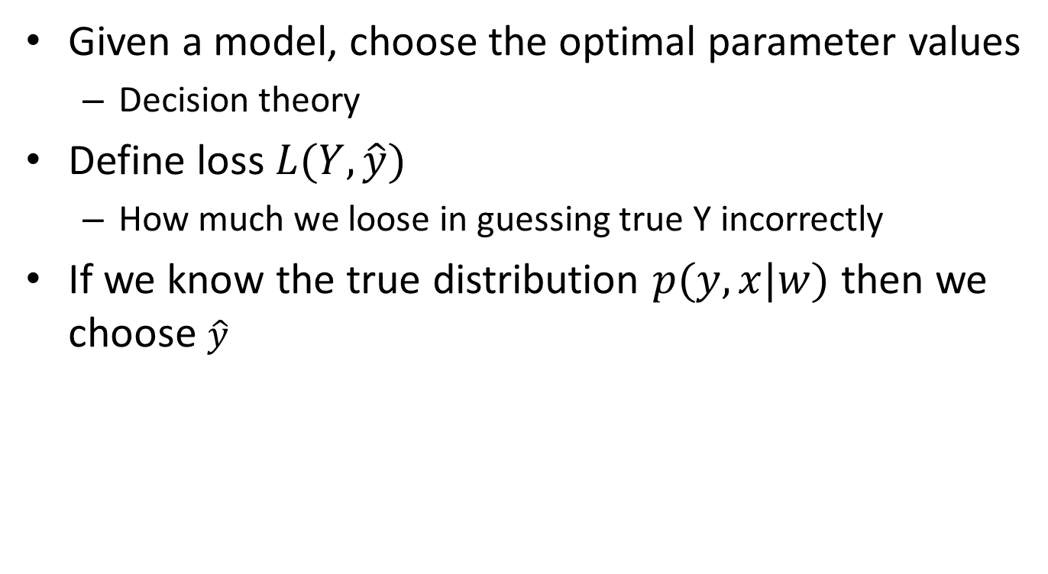

Model selection
Given a model, choose the optimal parameter values
Decision theory
Define loss $L(Y,\hat{y})$
How much we loose in guessing true Y incorrectly
If we know the true distribution $p(y,x|w)$ then we choose $\hat{y}$
$$\min_{\hat{f}}{EL(y,\hat{y})}=\min_{\hat{y}}{∫L\left(y,\hat{y}\right)p\left(y,x | w\right)dxdy}$$

Slide 8
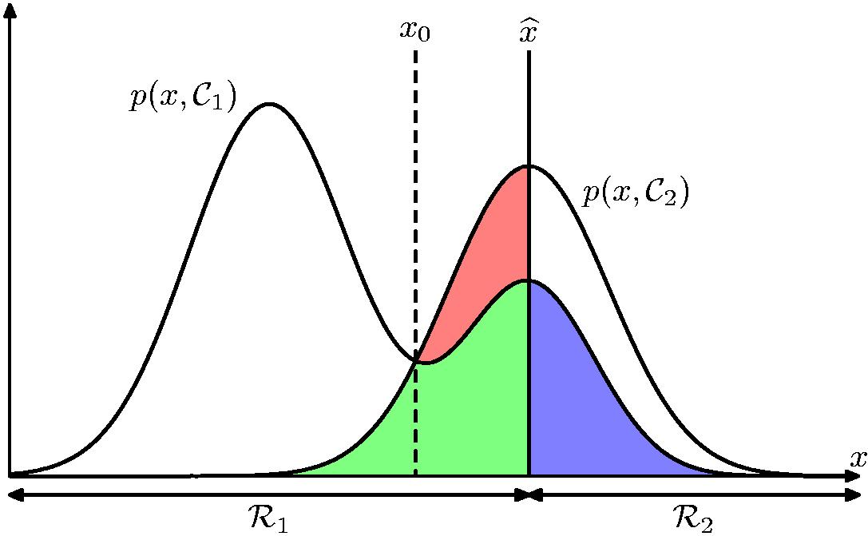

Model selection
Example: Spam classification
Loss for incorrect classifying mails and spams
$L_{12}=100$, $L_{21}=1$

Slide 9
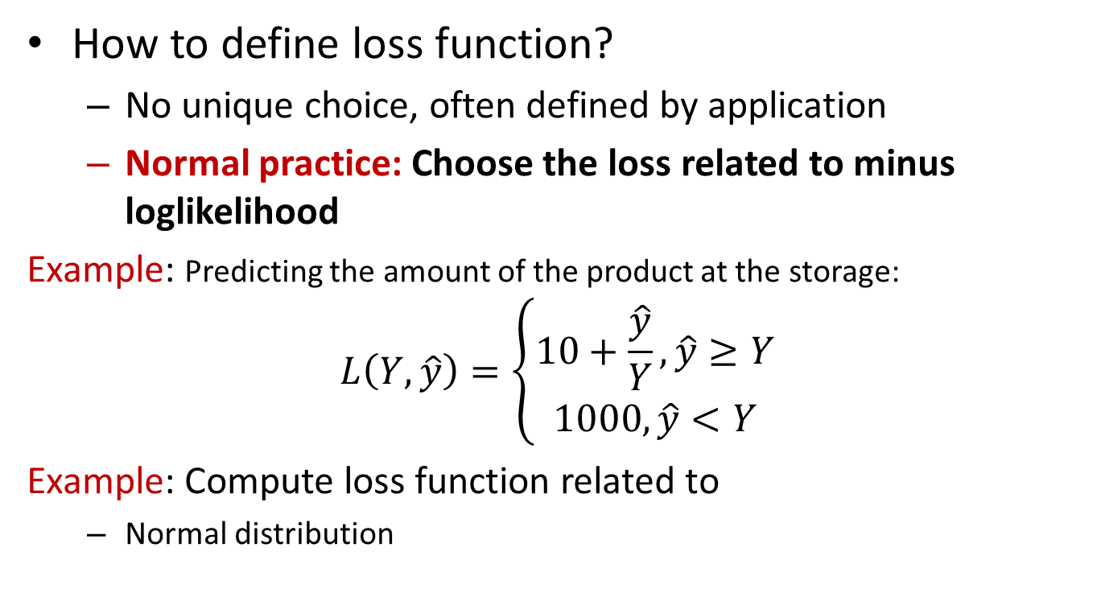
Loss functions
How to define loss function?
No unique choice, often defined by application
Normal practice: Choose the loss related to minus loglikelihood
Example: Predicting the amount of the product at the storage:
$$L\left(Y,\hat{y}\right)=\left\{\begin{matrix}10+\frac{\hat{y}}{Y}, \hat{y}≥Y \\ 1000,\hat{y}<Y\end{matrix}\right.$$
Example: Compute loss function related to
Normal distribution
Guess why such loss function was chosen

Slide 10
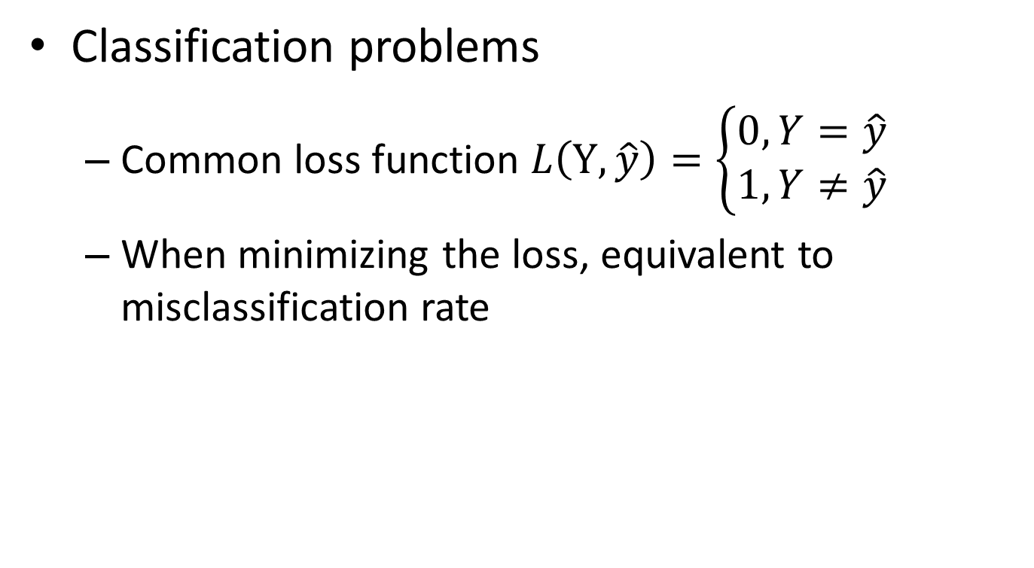
Loss functions
Classification problems
Common loss function $L\left(Y,\hat{y}\right)=\left\{\begin{matrix}0, Y=\hat{y} \\ 1,Y≠\hat{y}\end{matrix}\right.$
When minimizing the loss, equivalent to misclassification rate

Slide 11
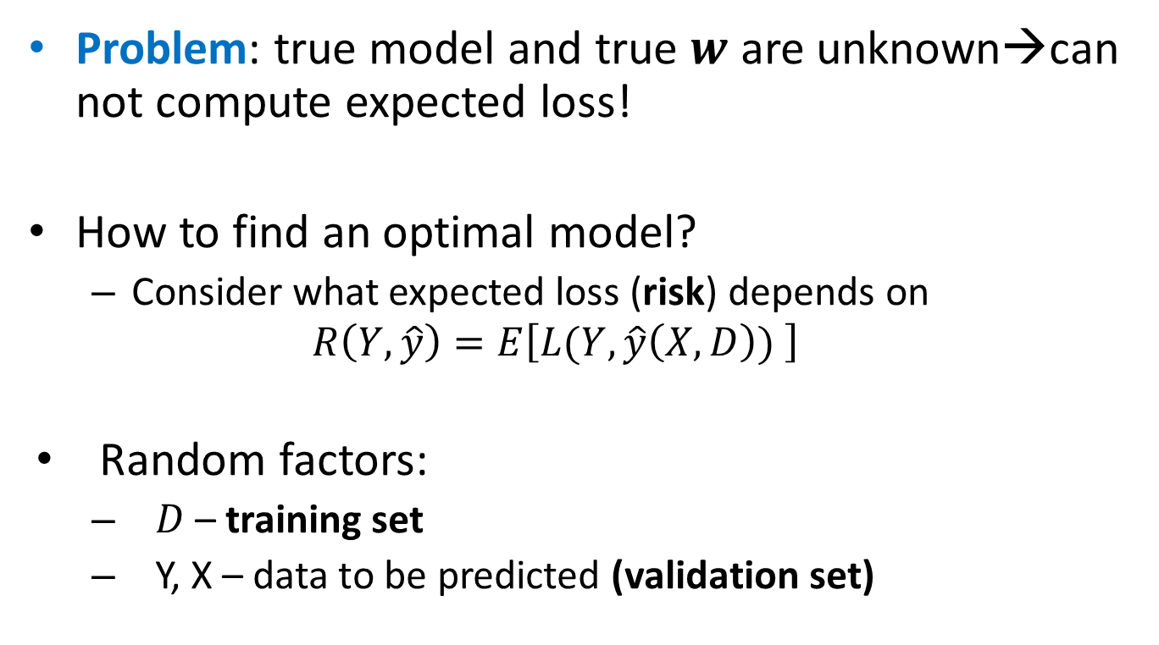
Model selection
Problem: true model and true $w$ are unknown→can not compute expected loss!
How to find an optimal model?
Consider what expected loss (risk) depends on
$$R\left(Y, \hat{y}\right)=E\left[L(Y,\hat{y}\left(X, D\right)) \right]$$
Random factors:
$D$ – training set
Y, X – data to be predicted (validation set)

Slide 12
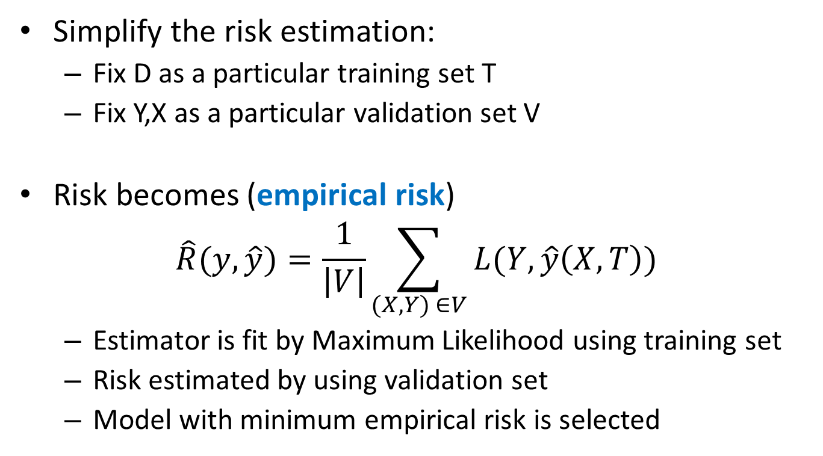
Holdout method
Simplify the risk estimation:
Fix D as a particular training set T
Fix Y,X as a particular validation set V
Risk becomes (empirical risk)
$$\hat{R}(y, \hat{y})=\frac{1}{\left|V\right|}\sum_{(X,Y) ∈V}{L(Y,\hat{y}\left(X,T\right))}$$
Estimator is fit by Maximum Likelihood using training set
Risk estimated by using validation set
Model with minimum empirical risk is selected

Slide 13



General model selection strategy
Given data $D=\left\{X_{i},Y_{i}, i=1…n\right\}$
When fitting data, Maximum Likelihood is usually used
$α_{i}$ can be different things:
Type of distribution
Number of variables in the model
Regulatization parameter value
…
Decide models
$$Y\sim M(x,w,α_{1})$$
$$Y\sim M\left(x,w,α_{2}\right)$$
…
Learning step
Fit models
$$Y\sim M(x,\hat{w},α_{1})$$
$$Y\sim M\left(x,\hat{w},α_{2}\right)$$
Decision step
Select model
..that minimizes the risk

Slide 14
Holdout method
Divide into training, validation and test sets
Choose proportions in some way
Training
Validation
Test

Slide 15
Holdout method
Given: training, validation, test sets and models to select between
M1(?,?)
M2(?,?,?)
M3(?,?,?,?,?)
Training
Validation
Test

Slide 16
Holdout method
Training set is to used for fitting models to the dataset by using maximum likelihood
M1(a1,b1)
M2(a2,b2,c2)
M3(a3,b3,c3,d3,e3)
Training
Validation
Test

Slide 17
Holdout method
Validation set is used to choose the best model (lowest risk)
Best!
M1(a1,b1)
M2(a2,b2,c2)
M3(a3,b3,c3,d3,e3)
Traning
Validation
Test

Slide 18
Holdout method
Test set is used to test a performance on a new data
M2(a2,b2,c2)
Training
Validation
Test

Slide 19
Holdout method
Easy model, a few parameters
OK
Complex model,
many parameters
minimum
risk!

Slide 20
Holdout in R
How to partition into train/test?
Use set.seed(12345) in the labs to get identical results
How to partition into train/valid/test?
n=dim(data)[1]
set.seed(12345)
id=sample(1:n, floor(n*0.7))
train=data[id,]
test=data[-id,]
n=dim(data)[1]
set.seed(12345)
id=sample(1:n, floor(n*0.4))
train=data[id,]
id1=setdiff(1:n, id)
set.seed(12345)
id2=sample(id1, floor(n*0.3))
valid=data[id2,]
id3=setdiff(id1,id2)
test=data[id3,]

Slide 21
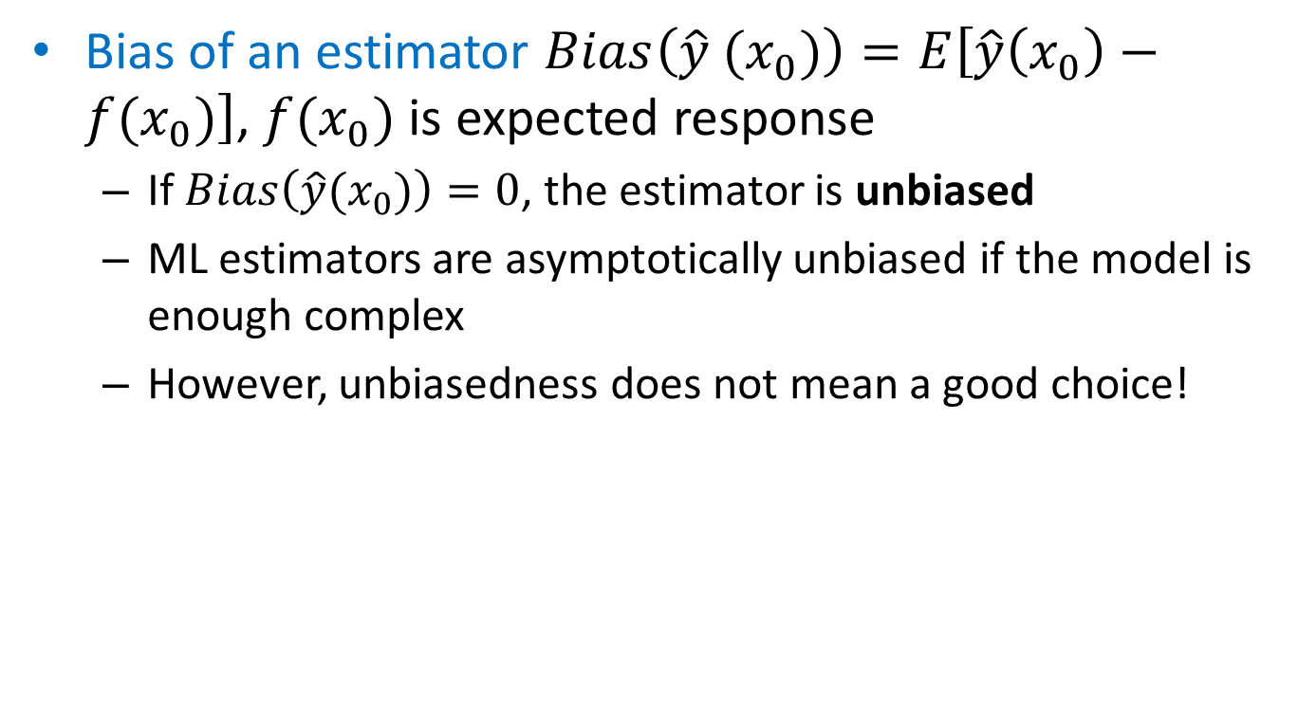
Bias-variance tradeoff
Bias of an estimator $Bias\left(\hat{y} (x_{0})\right)=E\left[\hat{y}\left(x_{0}\right)−f(x_{0})\right]$, $f(x_{0})$ is expected response
If $Bias\left(\hat{y}(x_{0})\right)=0$, the estimator is unbiased
ML estimators are asymptotically unbiased if the model is enough complex
However, unbiasedness does not mean a good choice!

Slide 22
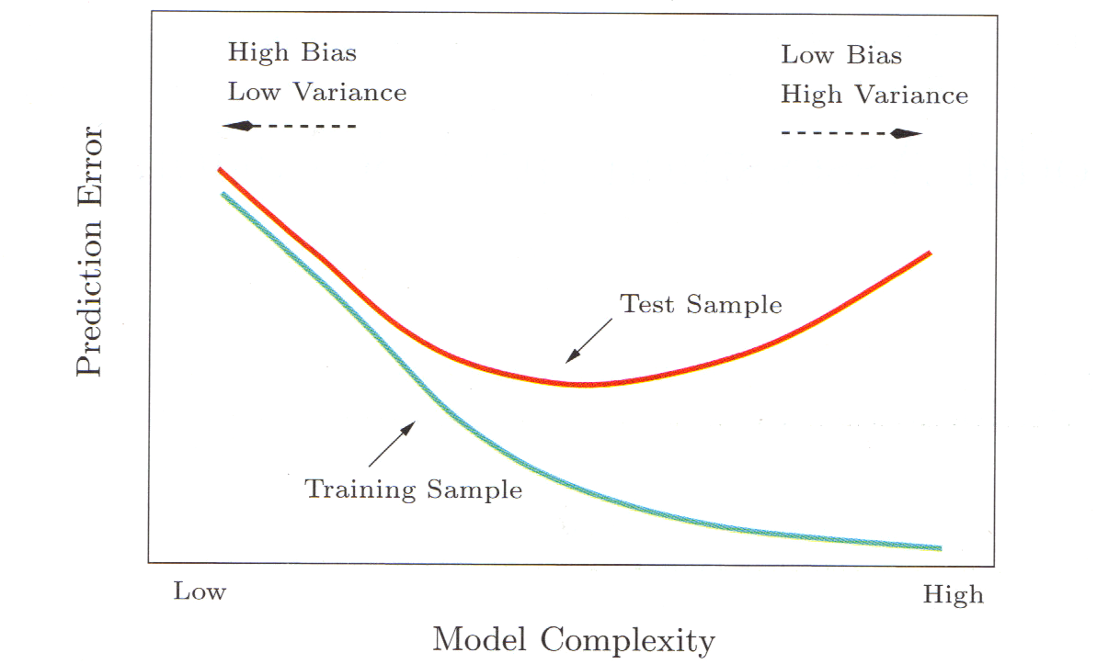

Bias-variance tradeoff
Assume loss is $L\left(Y, \hat{y}\right)={\left(Y−\hat{y}\right)}^{2}$
$$R\left(Y\left(x_{0}\right),\hat{y}\left(x_{0}\right)\right)=σ^{2}+Bias^{2}\left(\hat{y}\left(x_{0}\right)\right)+Var(\hat{y}\left(x_{0}\right))$$
When loss is not quadratic, no such nice formula exist

Slide 23
Cross-validation
Compared to holdout method:
Why do we use only some portion of data for training- can we use more (increase accuracy)?
Cross-validation (Estimates Err)
K-fold cross-validation (rough scheme, show picture):
Permute the observations randomly
Divide data-set in K roughly equally-sized subsets
Remove subset #i and fit the model using remaining data.
Predict the function values for subset #i using the fitted model.
Repeat steps 3-4 for different i
CV= squared difference between observed values and predicted values (another function is possible)

Slide 24
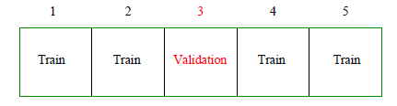

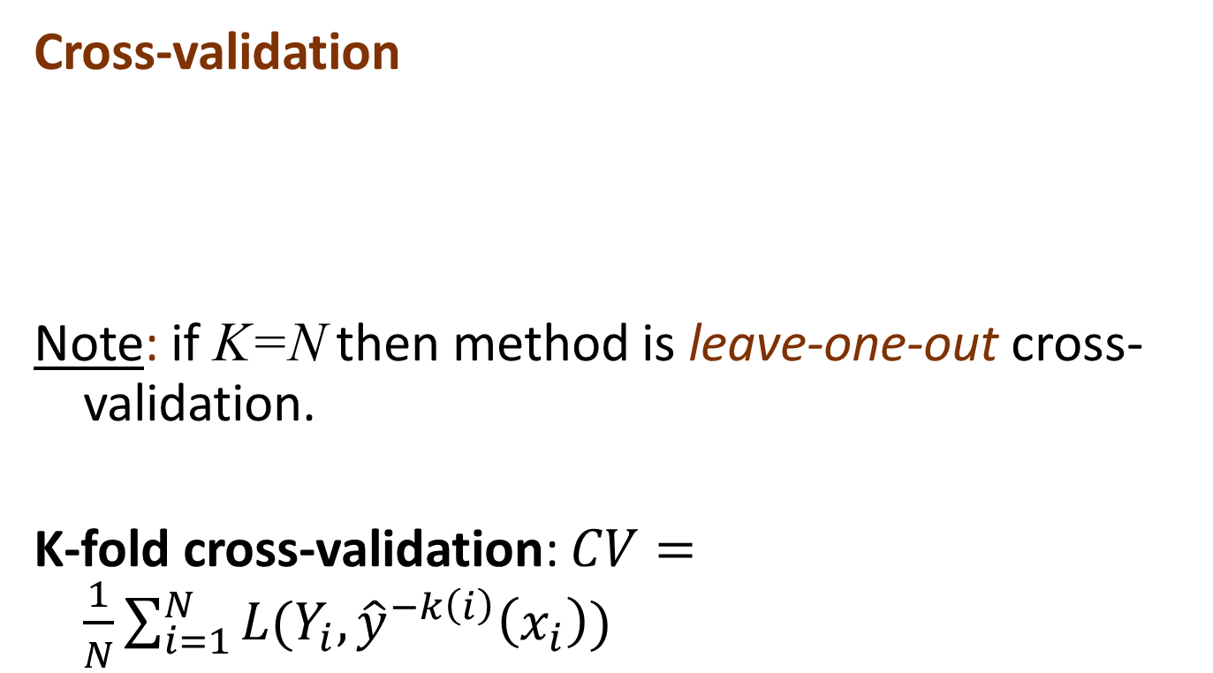
Cross-validation
Cross-validation
Note: if K=N then method is leave-one-out cross-validation.
K-fold cross-validation: $CV=\frac{1}{N}\sum_{i=1}^{N}{L(Y_{i}, {\hat{y}}^{−k\left(i\right)}\left(x_{i}\right))}$
What to do if N is not a multiple of K?

Slide 25
Cross-validation vs Holdout
Holdout is easy to do (a few model fits to each data)
Cross validation is computationally demanding (many model fits)
Holdout is applicable for large data
Otherwise, model selection performs poorly
Cross validation is more suitable for smaller data

Slide 26
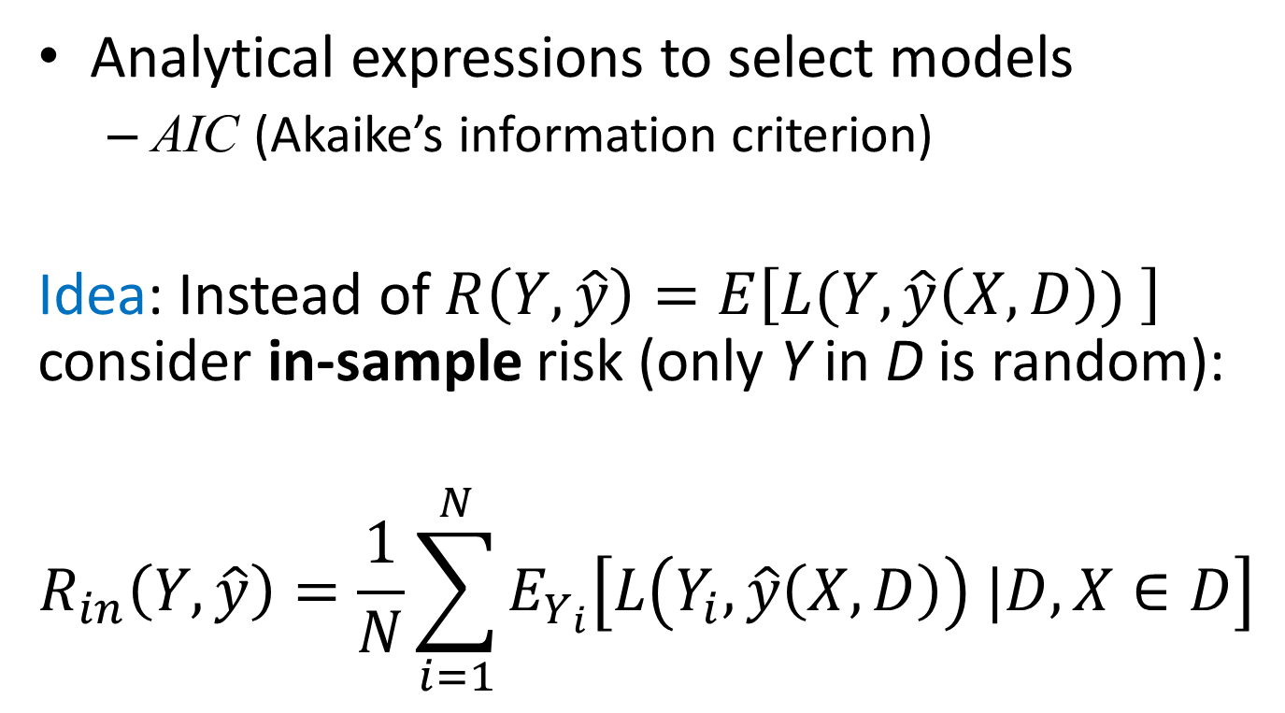
Analytical methods
Analytical expressions to select models
AIC (Akaike’s information criterion)
Idea: Instead of $R\left(Y, \hat{y}\right)=E\left[L(Y,\hat{y}\left(X, D\right)) \right]$ consider in-sample risk (only Y in D is random):
$$R_{in}\left(Y, \hat{y}\right)=\frac{1}{N}\sum_{i=1}^{N}{E_{Y_{i}}\left[L\left(Y_{i},\hat{y}\left(X, D\right)\right) |D, X∈D\right] }$$

Slide 27
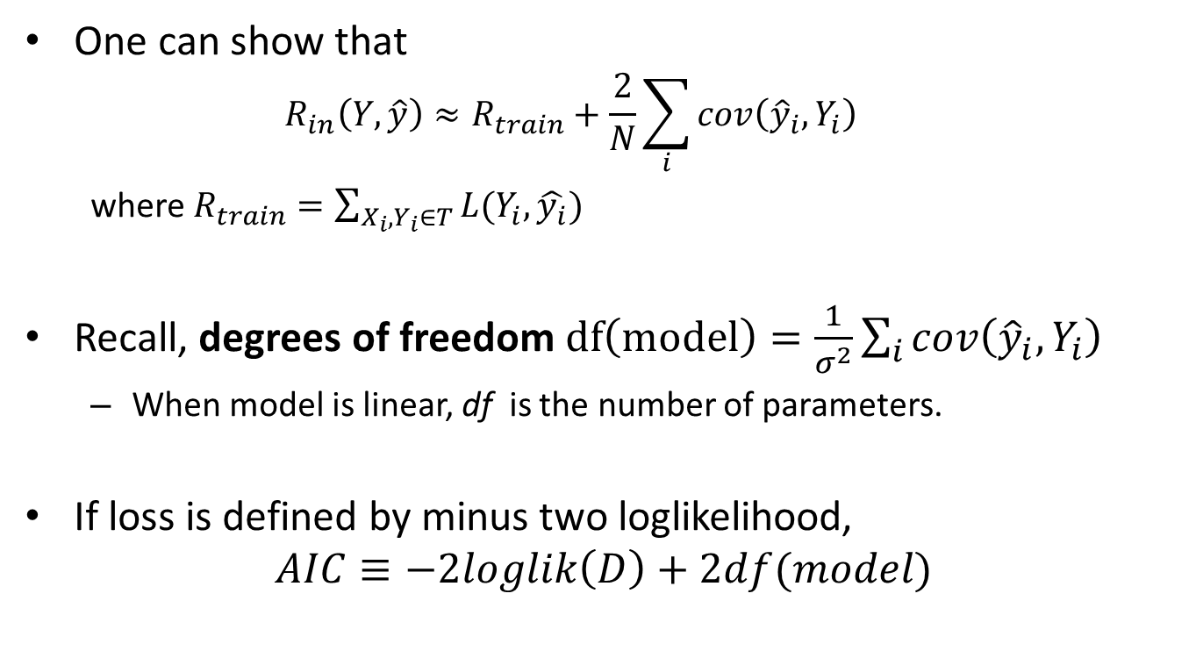
Analytical methods
One can show that
$$R_{in}\left(Y,\hat{y}\right)≈R_{train}+\frac{2}{N}\sum_{i}{cov\left({\hat{y}}_{i},Y_{i}\right)}$$
where $R_{train}=\sum_{X_{i},Y_{i}∈T}{L(Y_{i},\hat{y_{i}})}$
Recall, degrees of freedom $df\left(model\right)=\frac{1}{σ^{2}}\sum_{i}{cov\left({\hat{y}}_{i},Y_{i}\right)}$
When model is linear, df is the number of parameters.
If loss is defined by minus two loglikelihood,
$$AIC≡−2loglik\left(D\right)+2df(model)$$

Slide 28

Model selection
Example Computer Hardware Data Set : performance measured for various processors and also
Cycle time
Memory
Channels
…
Build model predicting performance

Slide 29
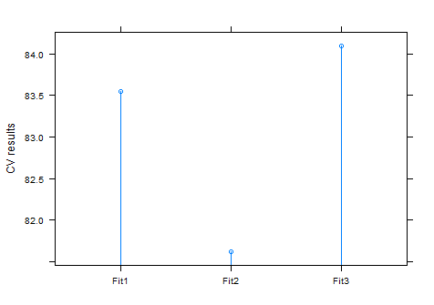
Cross-validatation
Try models with different predictor sets
data=read.csv("machine.csv", header=F)
library(cvTools)
fit1=lm(V9~V3+V4+V5+V6+V7+V8, data=data)
fit2=lm(V9~V3+V4+V5+V6+V7, data=data)
fit3=lm(V9~V3+V4+V5+V6, data=data)
f1=cvFit(fit1, y=data$V9, data=data,K=10, foldType="consecutive")
f2=cvFit(fit2, y=data$V9, data=data,K=10, foldType="consecutive")
f3=cvFit(fit3, y=data$V9, data=data,K=10, foldType="consecutive")
res=cvSelect(f1,f2,f3)
plot(res)

