Slide 1
Rush Mart - E-Commerce Product Management System
Scalable Microservices-Based Product Lifecycle Management Platform

Slide 2
Project Overview
Built a scalable E-Commerce Product Management platform using ASP.NET Core Microservices and Angular.
Supports product onboarding, pricing, inventory, workflow approvals, publishing, and reporting.
Uses Ocelot API Gateway for centralized routing and JWT-based authentication.
Designed with Clean Architecture for modularity, maintainability, and testability.
Each microservice owns an isolated database for scalability and loose coupling.

Slide 3
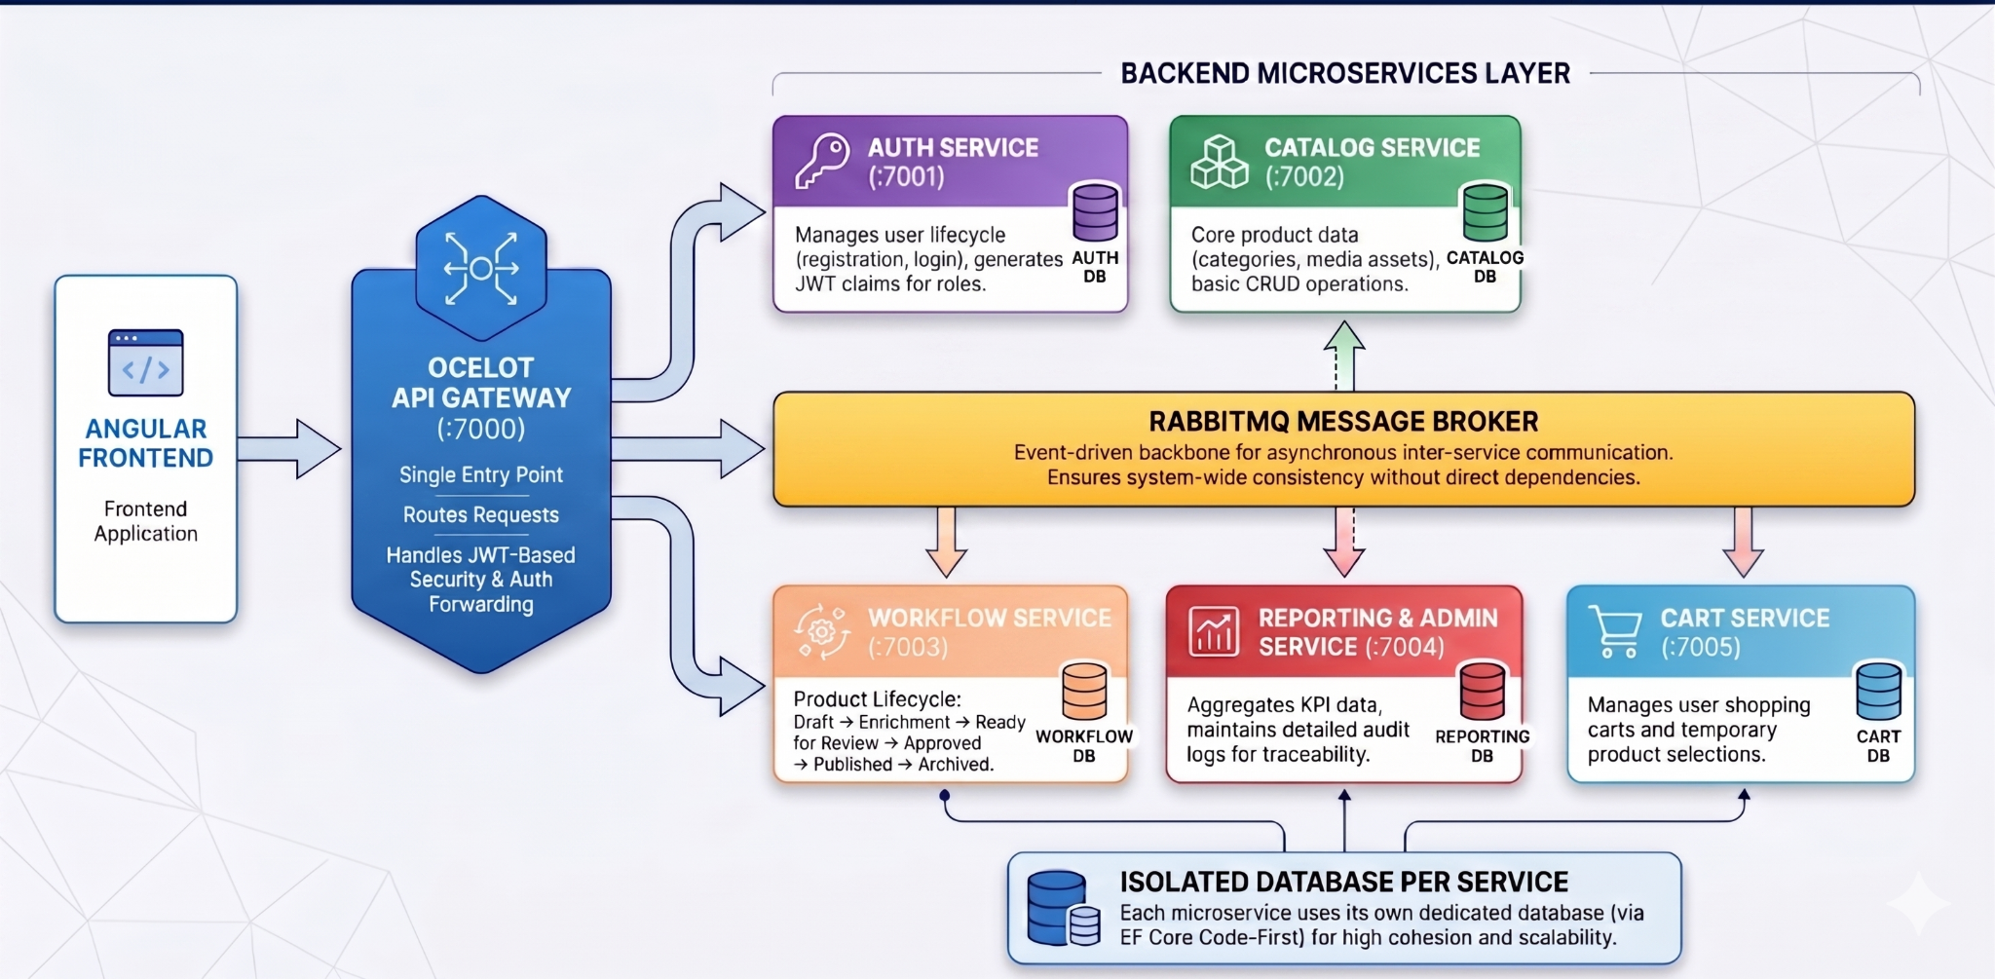
System Architecture
Microservices architecture with API Gateway, RabbitMQ messaging, and isolated databases.

Slide 4
Technology Stack
Frontend: Angular
Backend: ASP.NET Core Web API
API Gateway: Ocelot
Database Access: Entity Framework Core (Code-First)
Authentication: JWT Token-Based Authentication
Messaging: RabbitMQ
Testing: NUnit
Documentation & Testing: Swagger / Postman

Slide 5
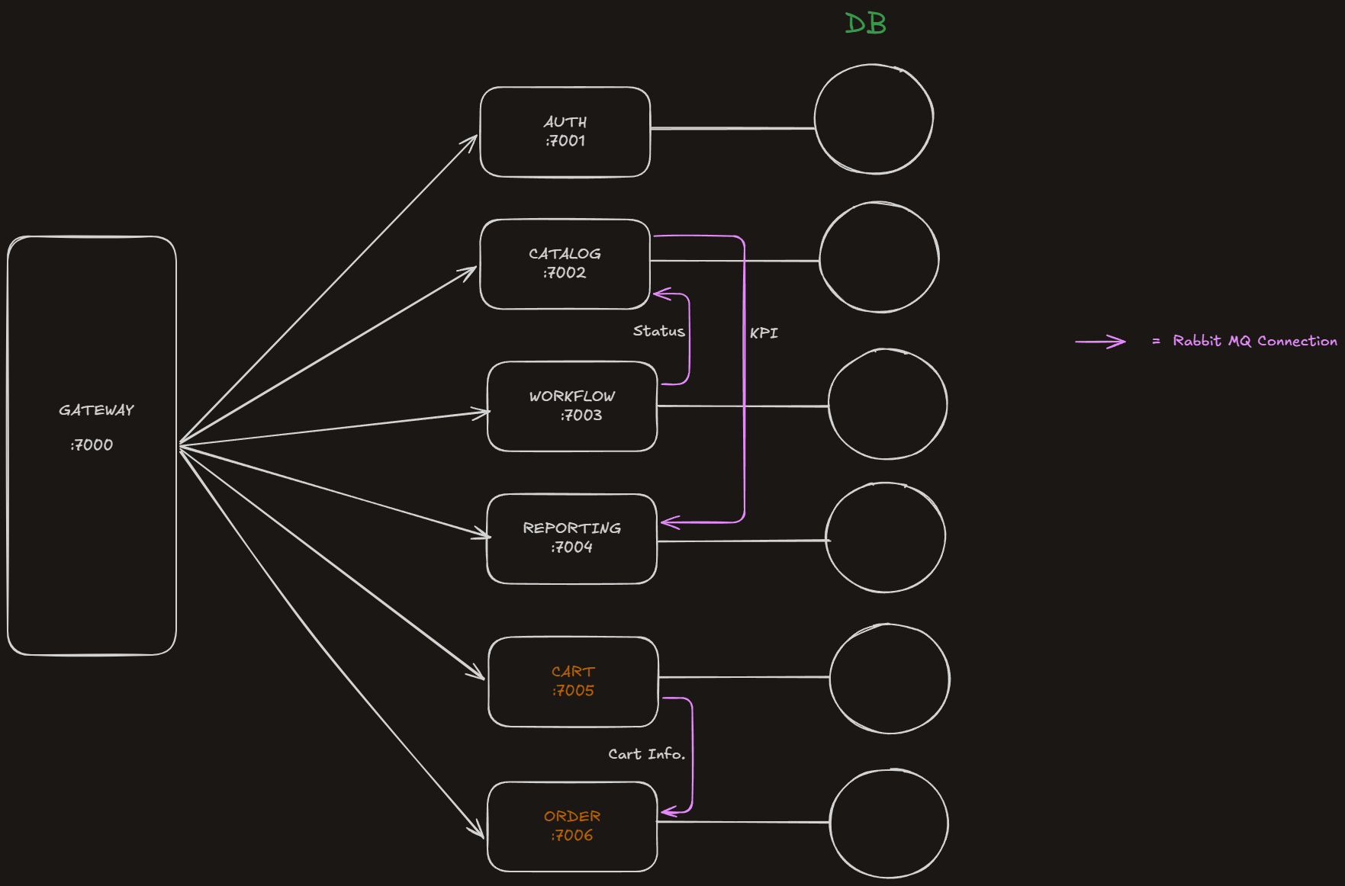
Workflow & Service Communication
Shows communication flow between gateway, microservices, databases, and RabbitMQ.

Slide 6
Microservices Breakdown
Auth Service: Handles registration, login, JWT generation, and role management.
Catalog Service: Manages product data, categories, media assets, and CRUD operations.
Workflow Service: Handles pricing, inventory, review, approval, and lifecycle states.
Reporting/Admin Service: Provides KPI dashboards, reports, and audit logs.
Cart & Order Services: Handle shopping cart operations and order processing.

Slide 7
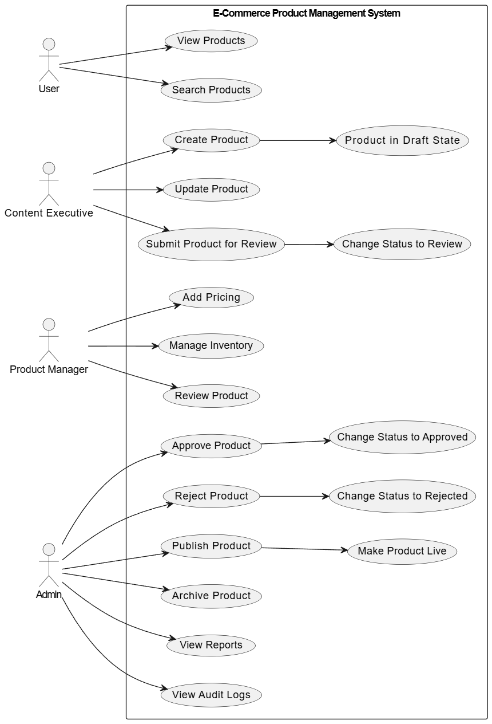
Use Case Diagram
Illustrates role-based operations for User, Content Executive, Product Manager, and Admin.

Slide 8
Product Lifecycle & Business Rules
Lifecycle: Draft → Enrichment → Ready for Review → Approved → Published → Archived.
Rejected products can be reworked and resubmitted.
Sale Price must not exceed MRP.
Only Admin users can approve, publish, or archive products.
Audit logs maintain full traceability for product changes.

Slide 9
Security, Scalability & Design Patterns
JWT-based authentication and role-based authorization using claims.
API Gateway Pattern for centralized request routing.
Repository Pattern and DTO Pattern for clean data access and transfer.
Microservices architecture enables independent deployment and scaling.
Future-ready design with RabbitMQ-based asynchronous communication.

Slide 10
Key Achievements & Future Enhancements
Implemented modular microservices with independent databases.
Built complete product lifecycle workflow management.
Integrated secure authentication and centralized gateway routing.
Added audit logging and reporting for traceability.
Future Enhancements: Redis caching, distributed logging, recommendation engine, analytics, and event-driven scaling.

