Slide 1

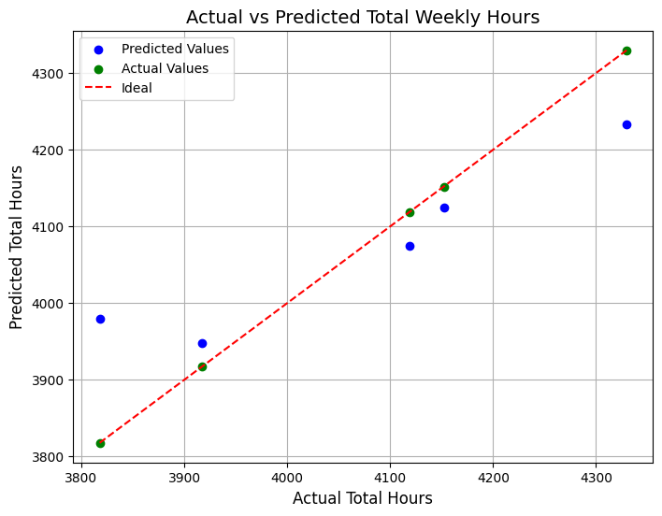
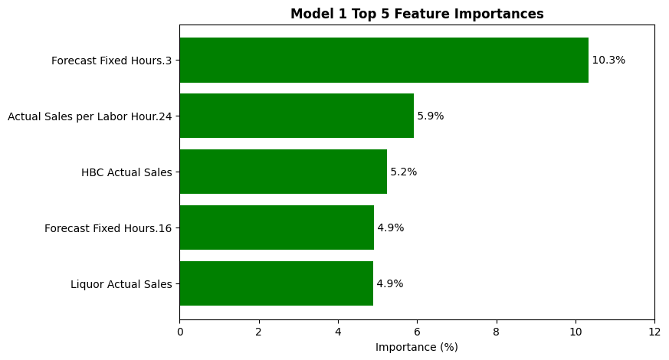
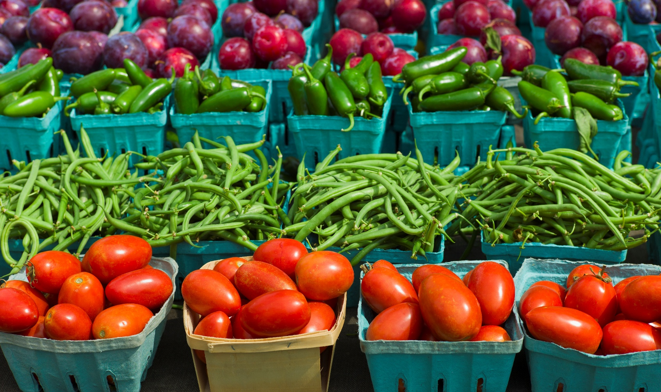
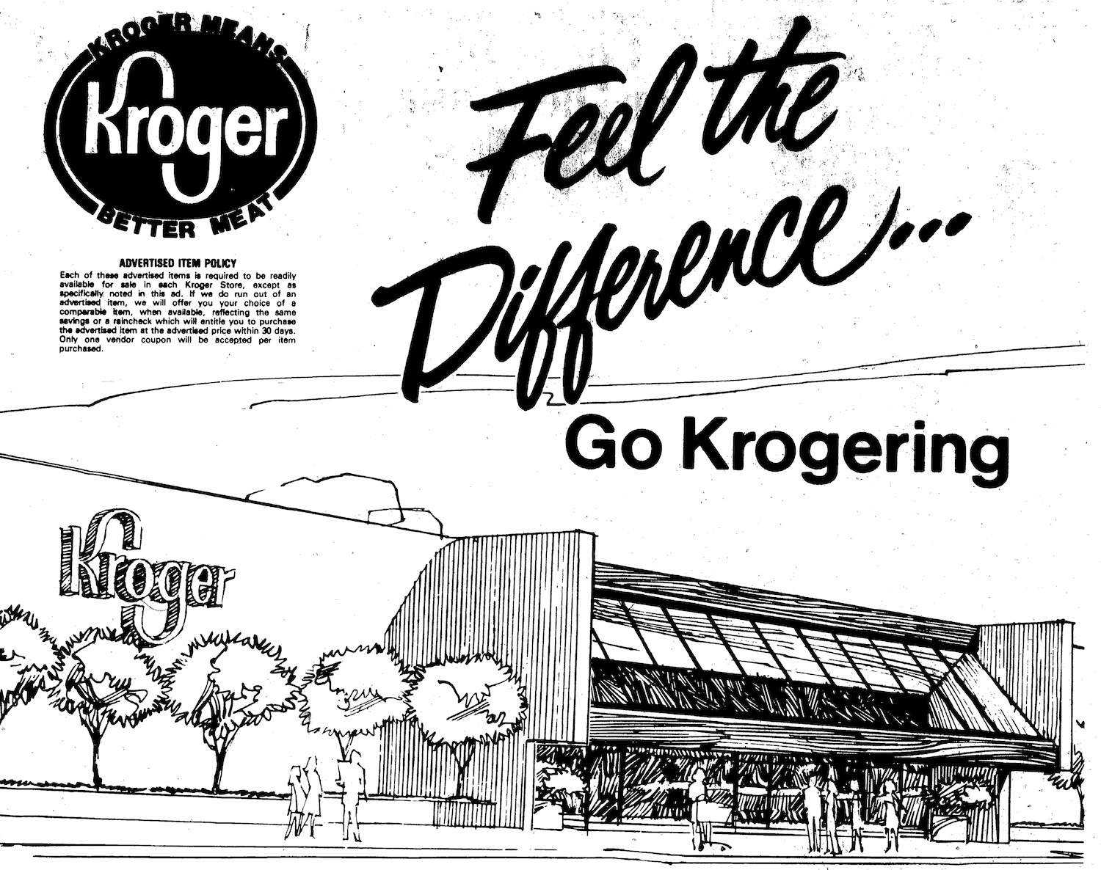
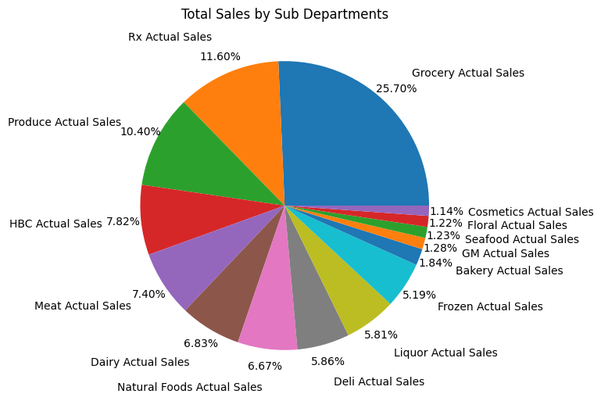
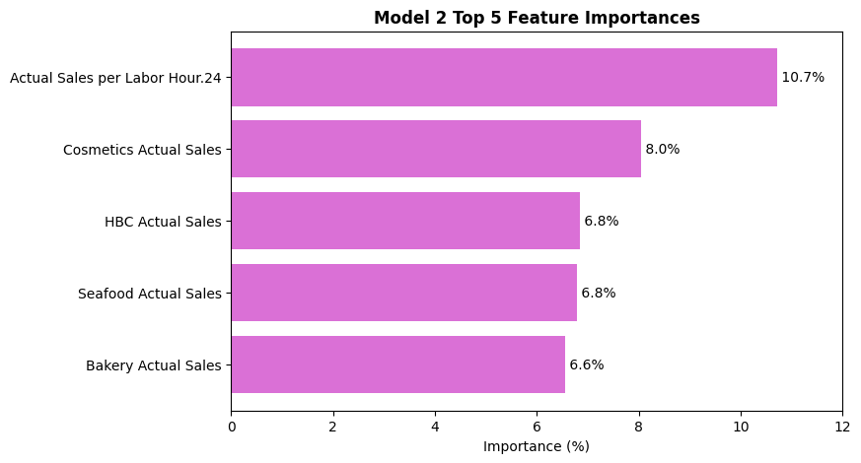
We’re Krogering: Predicting Grocery Store Total Labor Hours
Nikola Mrdak
Bellarmine University: Data Science Program
Abstract and Introduction
Materials and Methods
Future Work
Abstract
This project develops a predictive model for total labor hours given operational and sales variables from a Kroger grocery store.
The results are comparing importance of these variables, specifically, different store departments, and their influence on total weekly hours worked in the store. Using this model and its future improvements hopefully can provide insight into productive labor-planning.
Introduction
For large grocers like Kroger, it is critical to understand the relationships acting within their operations to best utilize resources for maximizing routine efficiency.
Materials
Materials included Excel for preprocessing, and Python for exploratory data analysis, model building, and interpretation. The time series data for this project was sourced from a Kroger grocery store in Louisville, Kentucky.
Methods
Splitting the data into two pieces for the Random Forest model to train and test on, one with forecasted fixed and variable labor hours, and one without.
Using statistical measures to gauge the success of the model and differences in outputs.
My aim to refining this project is exploring deeper into the relationships different departments may have on other aspects of Krogering.
Are overtime hours worked influenced by change in fixed hours or sales?
Are there factors significant in changing sales through self-checkout versus a checklane?
Figure 3: Scatter plot comparing reserved actual sales and predicted from model 2.
References
Figure 4: Histogram of top five significant variables in model one, where .3 is Grocery, .24 is Bakery, and .16 is Floral.
FMI. Food industry facts. Food industry facts
Pedregosa, F., Varoquaux, G., et al. RandomForestRegressor. Scikit-learn documentation
Wikipedia contributors. (n.d.). Decision tree learning. https://en.wikipedia.org/wiki/Decision_tree_learning
Software and Libraries: Matplotlib, Numpy, Open AI Chat GPT, Pandas, Scikit-learn, Seaborn.
Figure 1: Let’s Go Krogering
Figure 2: Pie chart, total sales by department as percentages, 2023-25.
Figure 5: Histogram of top five significant variables in model one, where .24 is Bakery.
Contact and Acknowledgements
Results
Conclusions
Contact: nmrdak@bellarmine.edu
Thank you to Dr. Karem and all my current and previous professors for your teachings, wisdom, and guidance. Thank you to Brad Maudlin and those at The Kroger Company who gave me the opportunity and support in completing this project. Thank you to my fiancée who has always pushed me to strive for success.
Objectives
Model 1: All Variables
Mean Absolute Error: 122.59
R2 Score: 0.37
Model 2: Excluding Forecasted Hours
Mean Absolute Error: 129.38
R2 Score: 0.34
Model 1 infers that planned labor drives total hours, while model 2 shows productivity determines hours.
Model 1 depends on preexisting planning from forecasted hours, while model 2 relies on department sales, even when those departments do not generate the greatest number of sales.
The aim of this project is to utilize grocery store data to understand the significance of department-specific operation and sales variables and their influence on total labor hours worked in a given week.

