Slide 1
Data Science Capstone: Let's Go Krogering
Nikola Mrdak
DS-450-01

Slide 2
Roadmap
Lay the Foundation
Materials and Methodology
Three Models
Results
Analysis
Wrap Up

Slide 3
Background
The Kroger Company: Founded in 1883 and is the largest supermarket grocer in the United States.
Operates in 35 states + DC
For businesses like Kroger, it is critical to optimize resource utilization to maximize routine efficiency.

Slide 4
Motivation
As a trained Kroger professional, I sought to blend my Kroger wisdom with my academic skill set.
Objective: To create predictive models that help better understand the relationships between grocery store departments and labor.

Slide 5
Materials
Excel
Python
Math and Modeling Libraries
Data Source: One Kroger Grocery Store in Louisville, KY.
From years (2023-25)

Slide 6
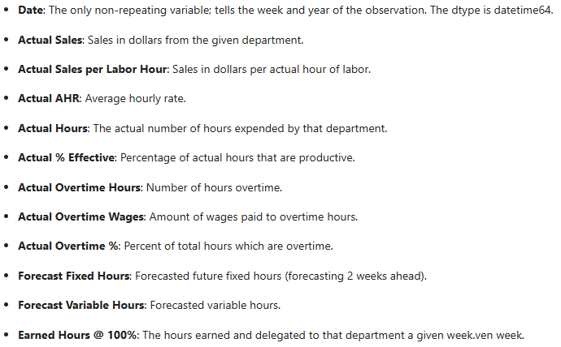
E.D.A.
Time series data with the following variables for each respective department:
Snapshot:
Dtypes – float64 and int64
Full data is 159 rows by 353 columns.
Slimmed down to 156 rows and 309 columns.
Each observation is a week
( 2023 Week1, Week2, etc)
Separated 'Date' into three new columns – week, month, and year.

Slide 7
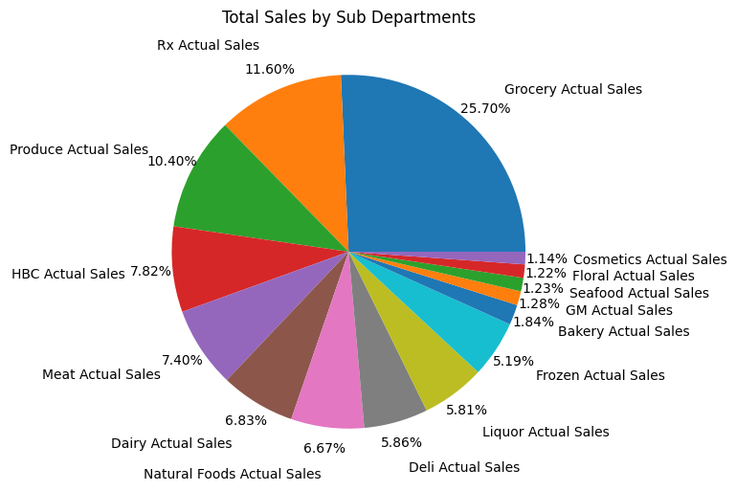
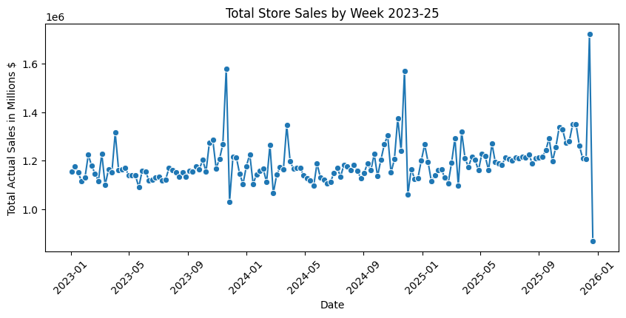

Slide 8
The Method
Three models utilized:
Random Forest Regression
Can I predict total hours in a week; with and without labor forecast?
Gradient Boosting
What features are significant in causing error in the forecast?
AdaBoosting
Classification: Will the forecast schedule sufficiently or understaff?

Slide 9
Model One

Slide 10
Model 1: Predicting Total Store Hours
Using Random Forest Regression to predict total store hours given department specific variables.
With and without forecasted fixed and variable hours.
The aim is to find any performance differences when the model has access to the forecast.

Slide 11
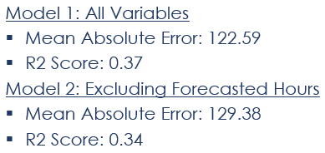
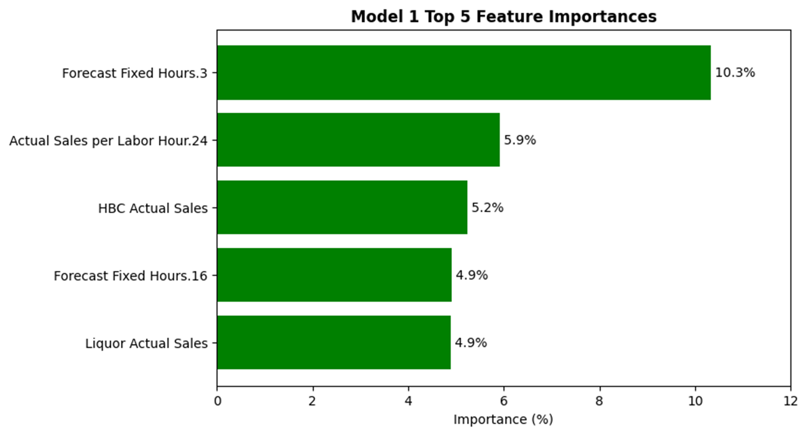
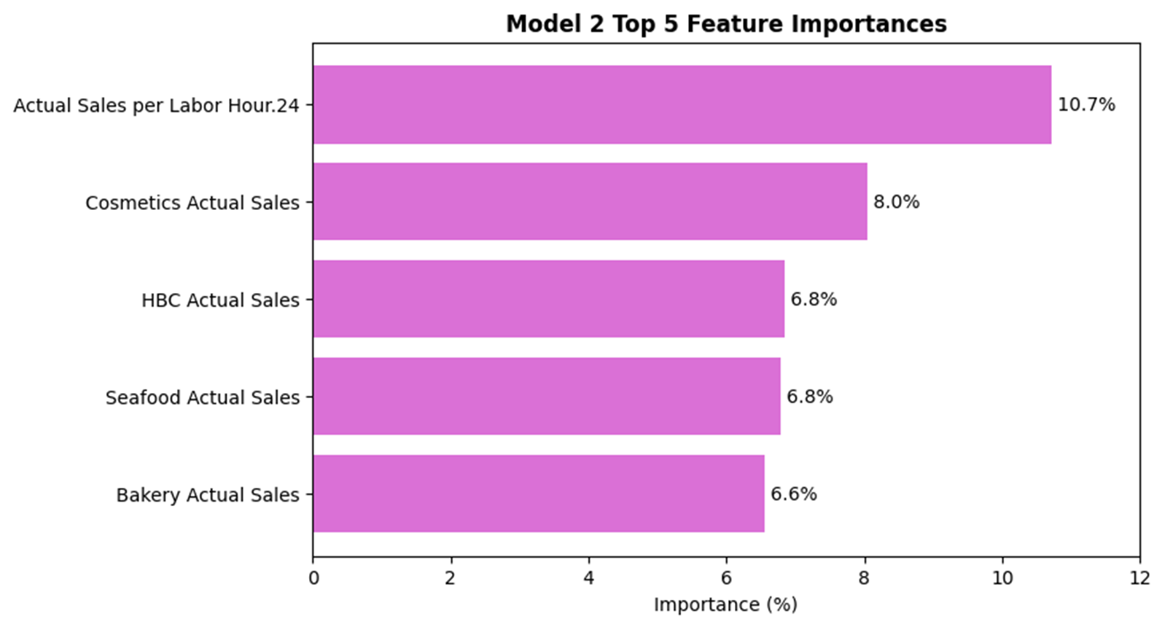
Results
Grocery
Bakery
Bakery
Floral

Slide 12
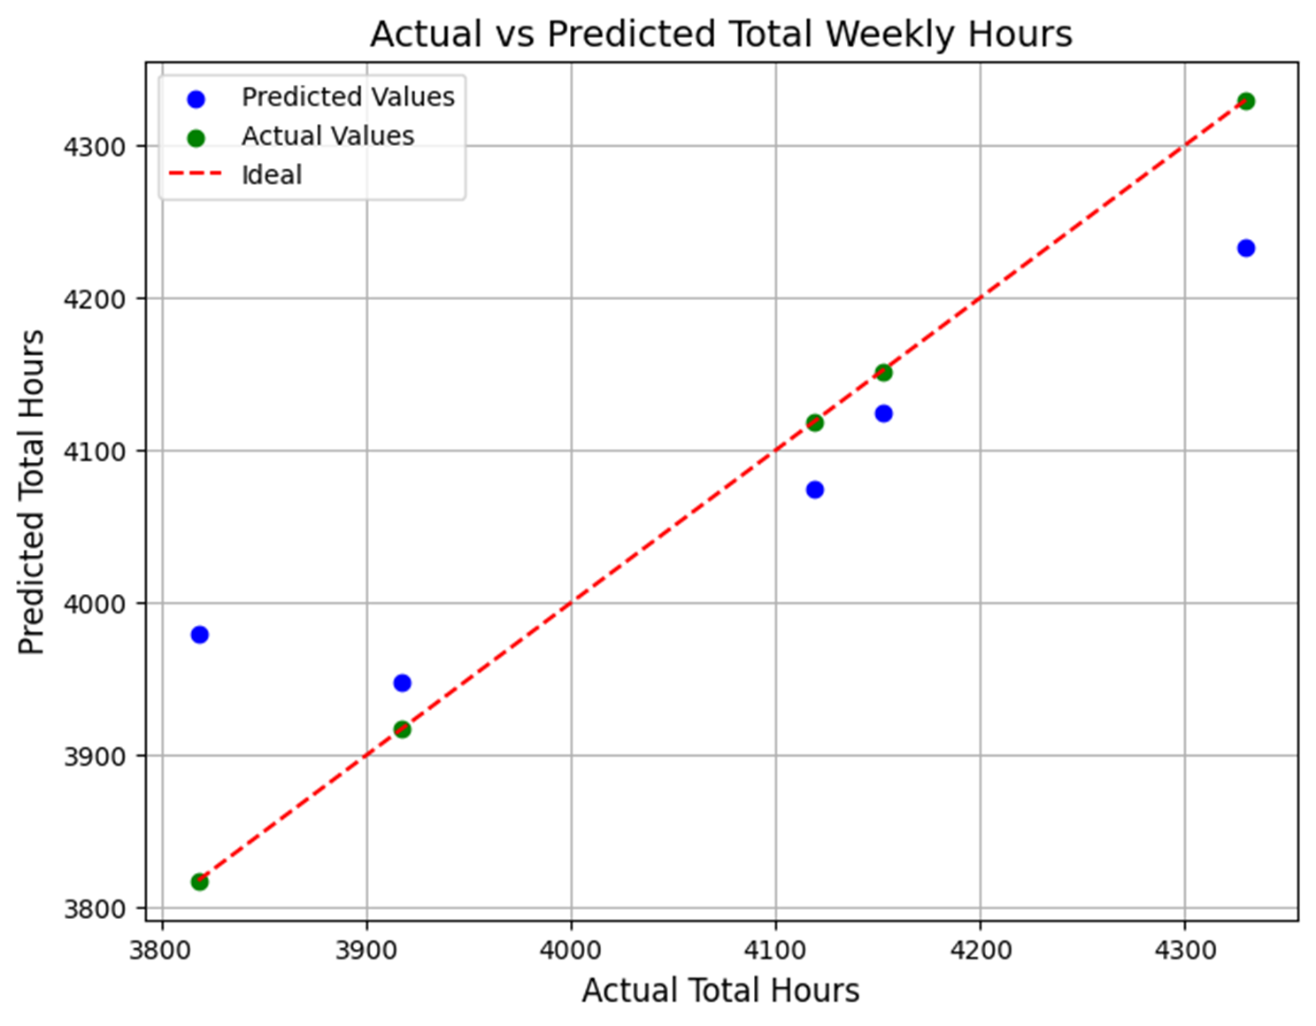
Analysis
The first model infers planned labor drives total hours. Depends on the preexisting labor planning.
Model two shows productivity determines hours. Relies on department sales, even those that contribute less sales volume.
Takeaway: Model uses the forecasted hours as a shortcut to sales. Sales determine total store hours.

Slide 13
Model Two

Slide 14
Model 2: Finding the Source of Forecast Error
Using Gradient Boosting to find what features are significant in causing forecast inaccuracies.
Created two new variables:
Forecast Total Hours – The sum of fixed and variable forecasted hours.
Forecast Error – Actual Hours minus Forecast Total Hours.
If Forecast Error:
Positive == understaffing
Negative == overstaffing
Using just department sales and sales per labor hour.

Slide 15
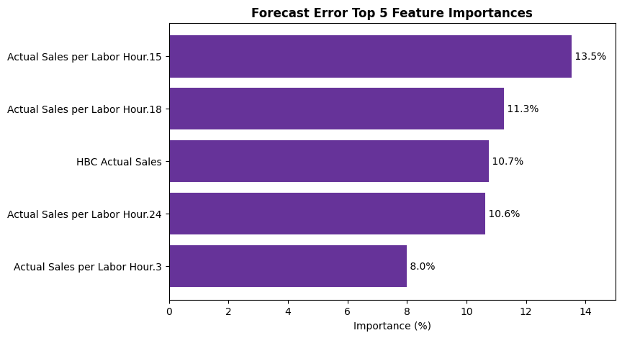
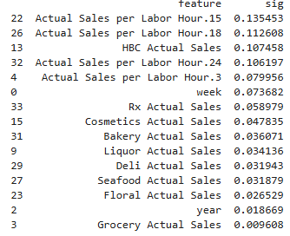
Results
R2: 0.42
MAE: 119.50
RMSE: 163.68
Produce
Meat
Bakery
Grocery

Slide 16
Analysis
Feature significances show that sales per labor hour are much more important in causing forecast error.
The top four per labor hour departments: Produce, Meat, Bakery, and Grocery.
All prep and labor intense.
'Week' is sixth most important feature, indicative of some seasonality influence.
Takeaway: Sales do not cause error in the forecast; labor intense departments will if they face trouble getting labor needed to make those sales.

Slide 17
Model Three

Slide 18
Model 3: Will this Week be Sufficient or Under Scheduled?
Using AdaBoosting to classify if a week's forecast will under-schedule or not.
New target variable 'Staffing Class' created with a threshold of 50 hours over the forecast to be considered an understaffed week.
The goal: Using the same variables when finding what causes forecast error; can we predict when the forecast will under-schedule?

Slide 19
Getting the Result...
My Original Plan: Understaffed, Sufficient, and Overstaffed
Only 156 observations proved futile in trying to classify three variables.
=> Simplified to only two
My Original Plan: Run Smoothly
Int32 => Numerous failed attempts to run the model to find the problem was a single variable's datatype.

Slide 20
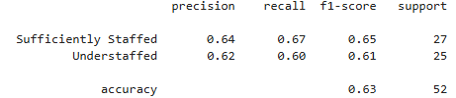
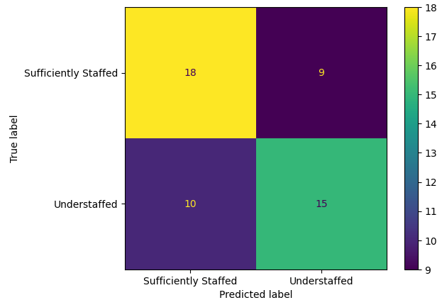
Results
Model was split .33 / .67 train test
Roughly balanced classes:
Understaffed = .52
Sufficient = .48
Accuracy: .63

Slide 21
Analysis
63% of understaffed weeks were predictable with this model.
Adequately balanced precision and recall show minimal bias towards predicting understaffed or sufficiently staffed.
Yes, but:
Precision and recalls under .7 still misses ≈ 30 - 40% of true positives / true negatives.
Takeaway: Instances of understaffing by the forecast are not random, but predictable by patterns in the data.

Slide 22

Models United
Quantity: How many hours will be needed?
Accuracy: What will cause the forecast to be inaccurate?
Risk: Will the inaccuracy create understaffing?
Labor demand is predictable, forecast mistakes are identifiable, and understaffing risk is preventable.

Slide 23
Recap
The aim for this project was to uncover the relationships between grocery store departments and labor.
The result:
Random Forest Regression that predicted total store hours.
Gradient Boosting Regression that found significances in forecasting error.
Ada Boosting Classification that predicted when the forecast may under-schedule.
Although none of the three models performed exceptionally, it showed the relationships between different store departments and labor for the store as a whole.

Slide 24
Thank You

