Slide 1
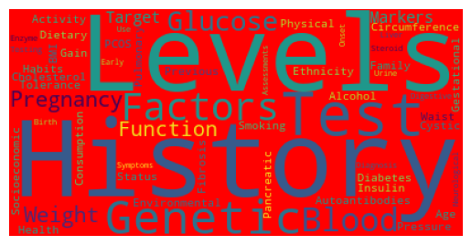
Diabetes Data Set
Allie Baker and Nik Mrdak

Slide 2
Introduction
Overview of various types of diabetes
Medical, genetic, and lifestyle
Key features include:
Target
BMI
Autoantibodies
Insulin levels
Age
Blood Glucose Levels

Slide 3
Why?
Neither of us were very knowledgeable about this topic. This gave us the opportunity to learn more about this disease as it is one of the leading causes of death in America.

Slide 4
Description
This data is 70,000 rows and 34 columns.
Our data types consisted of object and int64.
We had no missing data in our data set.

Slide 5
Target: The type of diabetes or prediabetic condition.
Genetic Markers: Indicates whether specific genetic markers associated with diabetes are present. A "Positive" value means the genetic.
Autoantibodies: Presence of autoantibodies. Often is associated with autoimmune diabetes.
Family History: Whether or not a family member has diabetes.
Environmental Factors: Notes any environmental influences that might contribute to the development of diabetes.
Insulin Levels: The insulin levels measured in the patient's blood measured in microunits per milliliter (µU/mL).
Age: The age of the patient.
BMI: The body mass index of the patient, a measure of body fat based on height and weight.
Physical Activity: The level of physical activity of the patient.
Dietary Habits: Describes the patient's eating habits, "Healthy" or "Unhealthy."
Blood Pressure: The blood pressure of the patient.
Cholesterol Levels: The level of cholesterol as milligrams (mg) of cholesterol per deciliter (dL) of blood.
Waist Circumference: Circumference of the patient's waist.
Blood Glucose Level: Amount of glucose in the blood.
Ethnicity: Measured as "Low Risk" or "High Risk".
Socioeconomic Factors: Measured as "Low", "Medium", or "High".
Smoking Status: Measured as "Smoker" or "Non-Smoker"
Alcohol Consumption: Measured as "Low", "Moderate", "High".
Glucose Tolerance Test: Measured as "Abnormal" or "Normal".
History of PCOS: Measured as "True" or "False".
Previous Gestational Diabetes: Measured as "True" or "False".
Pregnancy History: Measured as "Normal" or "Complications".
Weight Gain During Pregnancy: Measures the amount of weight gained during a pregnancy.
Pancreatic Health: Numerical value for the health of the patient's pancreas.
Pulmonary Function: Numerical value for pulmonary functionality.
Cystic Fibrosis Diagnosis: Measured as "Ture" or "False".
Steroid Use History: Measured as "Ture" or "False".
Genetic Testing: Measured as "Positive" or "Negative".
Neurological Assessments: Measured as "1", "2", or "3".
Liver Function Tests: Measured as "Normal" or "Abnormal".
Digestive Enzyme Levels: Numerical value for the level of digestive enzymes of each patient.
Urine Test: Measured in "Normal", "Protein Present", "Ketones Present", or "Glucose Present".
Birth Weight: Birth weight of patient in grams.
Early Onset Symptoms: Measured as "Ture" or "False".

Slide 6
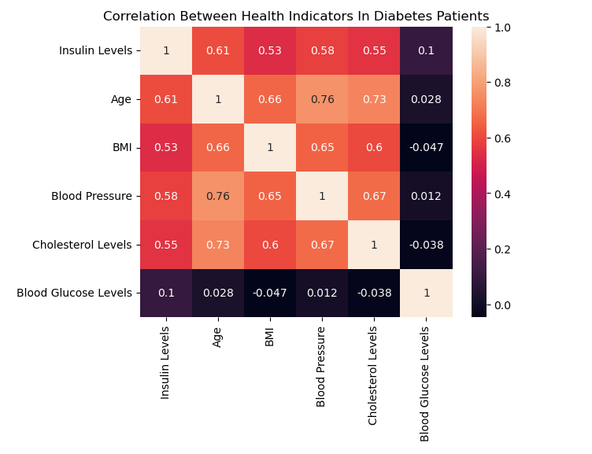
Heat Map

Slide 7
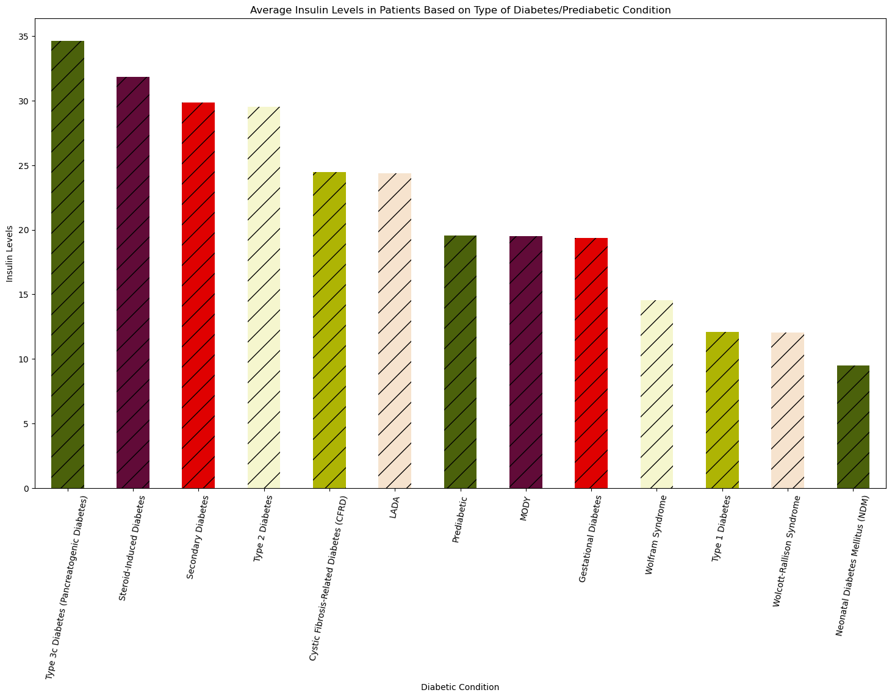
Bar Chart

Slide 8
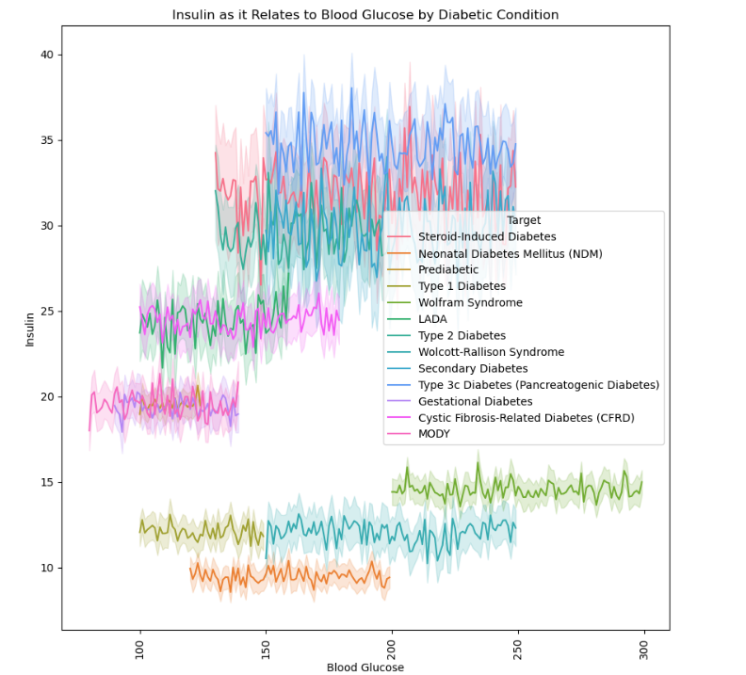
Line Plot
-Steroid Induced Diabetes: Steroids (glucocorticoid drugs) contribute to high blood glucose levels, naturally resulting in increased insulin levels to control glucose levels.
-Neonatal Diabetes: This type of diabetes occurs in premature babies without a fully developed pancreas. This explains the low insulin level and high glucose level.
-Prediabetic: Prediabetes is due to consuming too much glucose, and the body produces higher levels of insulin to compensate.
-Type 1: Type one diabetes is a genetic insulin deficiency. Independent of glucose consumption, the low amount of insulin produced cannot accommodate the higher levels of blood glucose.
-Gestational Diabetes: Similar to prediabetes, gestational diabetes is a result of consuming too much glucose during pregnancy, and insulin levels increase to control blood glucose levels.
-Type 2: In type 2 diabetics, long-term overconsumption of glucose results in insulin-resistance, which explains the high blood glucose and high insulin levels.

Slide 9
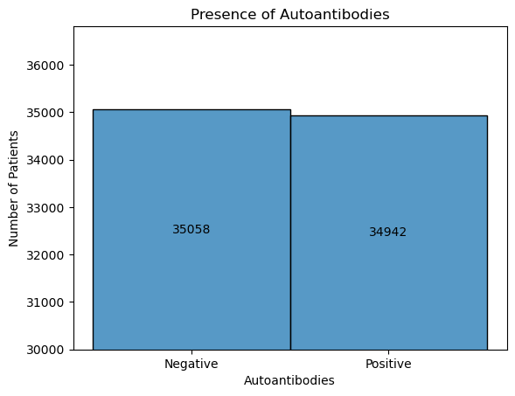
Bar Chart

Slide 10
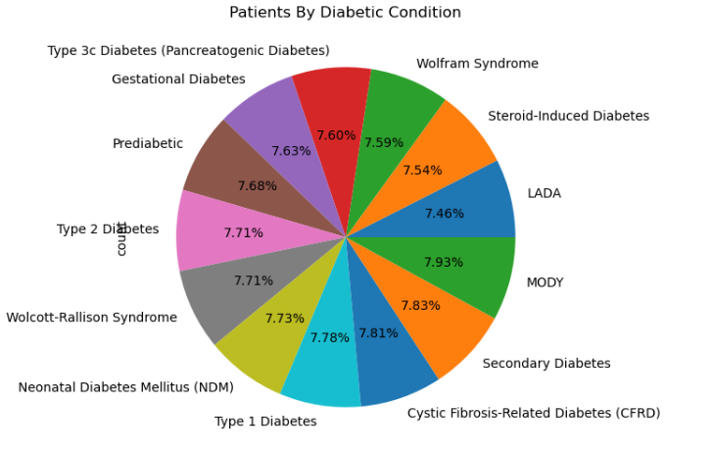
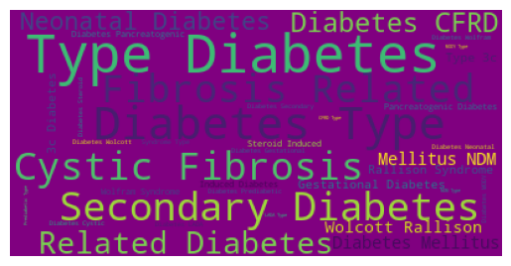
Pie Chart

Slide 11
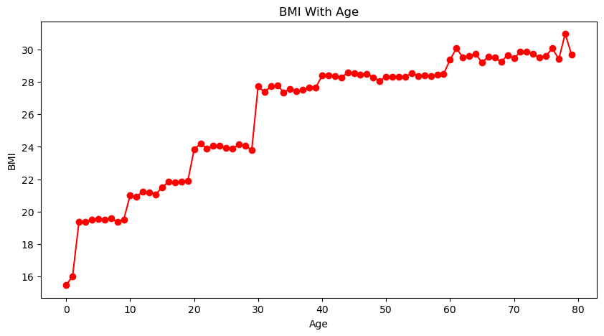
Line Graph

Slide 12
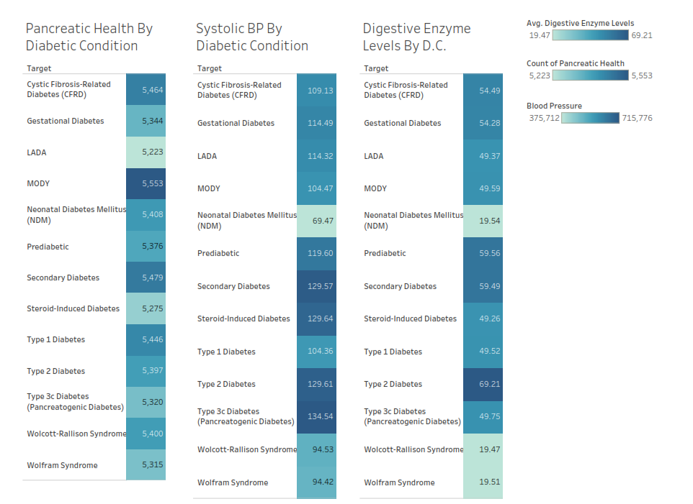
Tableau Graph

Slide 13
Findings
Age is strongly correlated with other health factors, making it a key risk factor in the progression of diabetes.
Glucose levels show a weaker correlation with other indicators due to their fluctuating and independent nature.
Insulin-related conditions like Type 1 and neonatal diabetes involve insulin deficiency, while Type 2 and steroid-induced diabetes are linked to insulin resistance or overproduction.
The even distribution of diabetic conditions across the dataset is important for visualizing the spectrum of diabetic conditions.
A clear upward trend in BMI with age indicates an increasing risk of diabetes as individuals grow older.
Diabetes includes a range of conditions, but they share common patterns in age, BMI, and insulin regulation, highlighting the importance of personalized treatment approaches.

