Slide 1

Movie Classification Dataset
Allie Baker and Nikola Mrdak

Slide 2
Introduction
Movies are a significant part of our culture and entertainment
Comprehensive information essential for movie enthusiasts, analysts, and researchers
Key features:
Production expense
Budget
Genre
Oscar winning or not
*Description was not found on Kaggle

Slide 3
Dataset Overview
This dataset contain 506 samples with 19 columns
Data types consisted of Floast64, Int64, and Object (changed)
There was missing values in the Time_taken column. To solve this issue, we filled the missing values with the mean.

Slide 4
Columns
Marketing expense (float64): Amount spent on marketing for the movie in monetary units.
Production expense (float64): Total cost of movie production in monetary units.
Multiplex coverage (float64): Proportion of multiplexes showing the movie, represented as a decimal.
Budget (float64): Overall budget allocated for the movie in monetary units.
Movie_length (float64): Length of the movie in minutes.
Lead_ Actor_Rating (float64): Rating of the lead actor on a numerical scale.
Lead_Actress_rating (float64): Rating of the lead actress on a numerical scale.
Director_rating (float64): Rating of the director on a numerical scale.
Producer_rating (float64): Rating of the producer on a numerical scale.
Critic_rating (float64): Rating from critics on a numerical scale.
Trailer_views (int64): Number of views the movie's trailer received.
3D_available (object): Indicates whether the movie is available in 3D (values: "YES" or "NO").
Time_taken (float64): Total time spent on the movie's production in days.
Twitter_hastags (float64): Number of Twitter hashtags related to the movie.
Genre (object): Genre category of the movie (e.g., Thriller, Drama, Comedy).
Avg_age_actors (int64): Average age of the main actors in the movie.
Num_multiplex (int64): Number of multiplex theaters screening the movie.
Collection (int64): Total collection or revenue generated by the movie in monetary units.
Start_Tech_Oscar (int64): Binary indicator of whether the movie won an Oscar (1 = Yes, 0 = No).

Slide 5
What are we trying to predict?
Linear Regression
How much money a movie will collect?
Logistic Regression
Whether a movie will be awarded an Oscar?

Slide 6
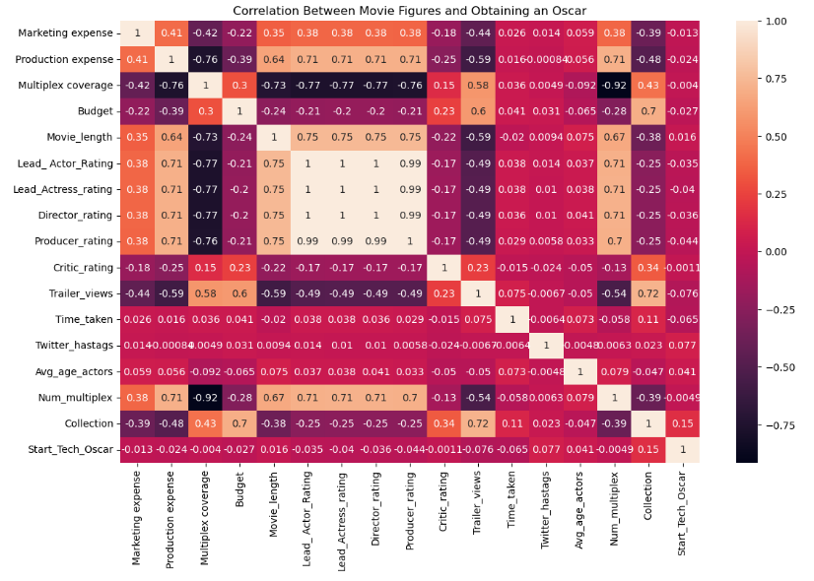
Correlation Matrix

Slide 7
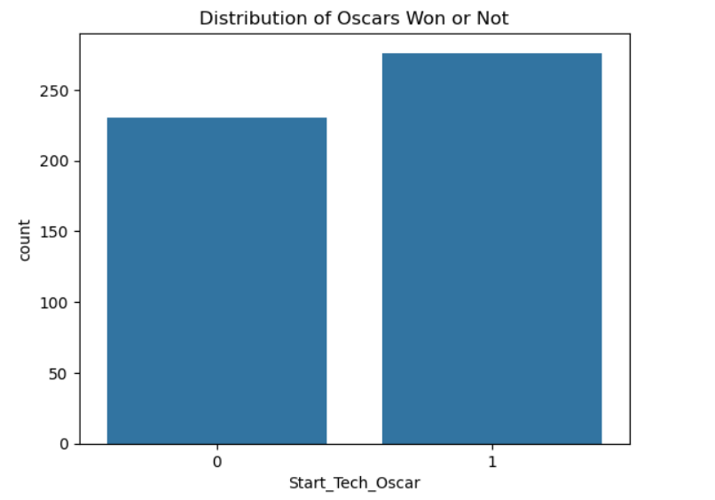
Distribution of Oscars Won

Slide 8
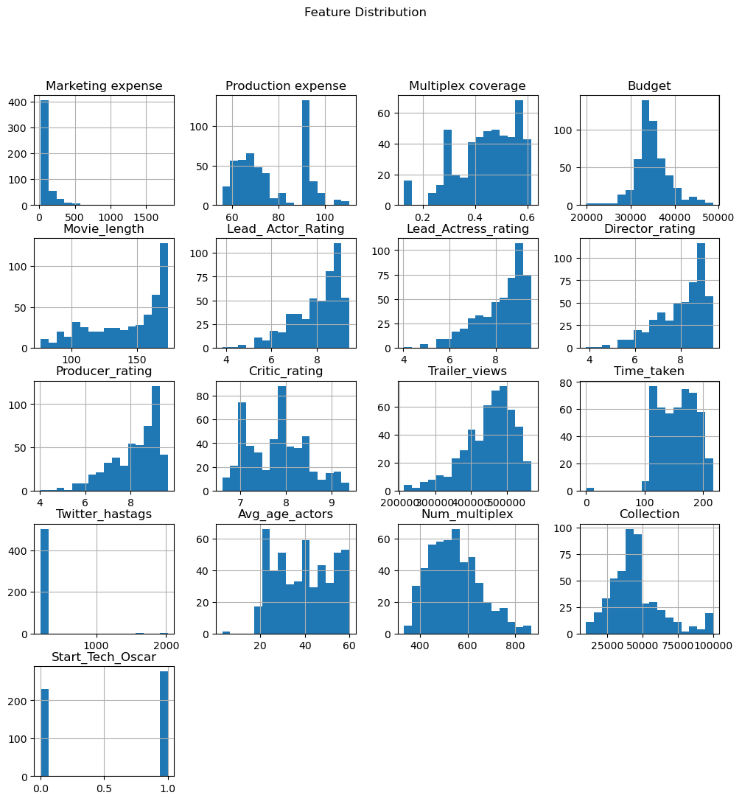
Feature Distribution

Slide 9
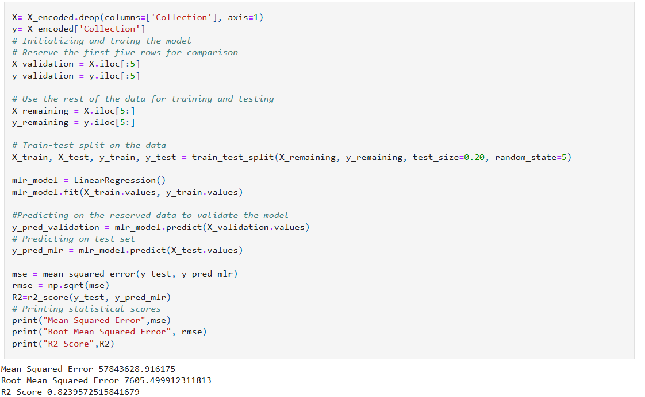
Linear Regression Model

Slide 10
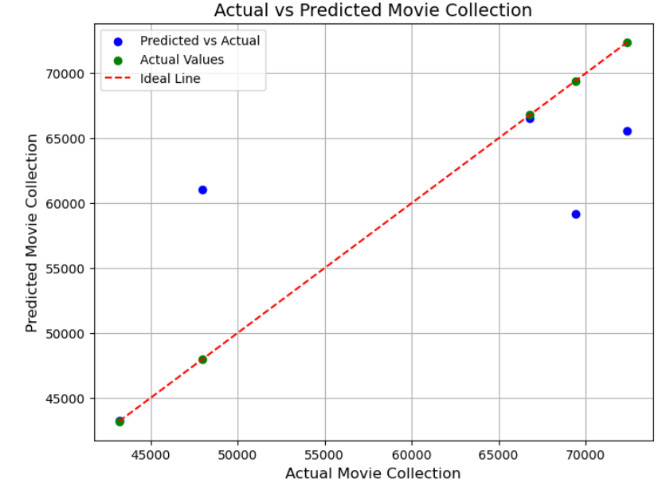
Reserved Rows Comparison: Actual Predicted 0 48000 61015.855871 1 43200 43256.691388 2 69400 59184.368582 3 66800 66543.515119 4 72400 65584.715546

Slide 11
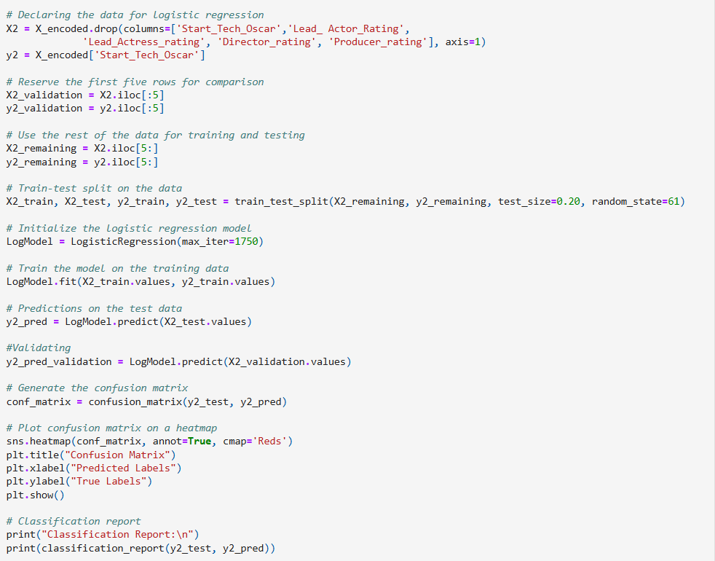
Logistic Regression Model

Slide 12

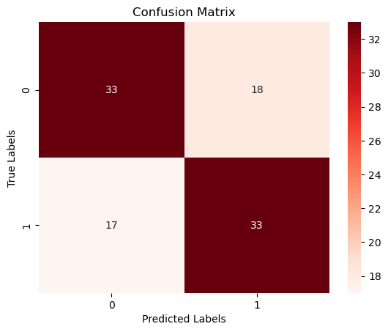
Confusion Matrix
Classification Report: precision recall f1-score support 0 0.66 0.65 0.65 51 1 0.65 0.66 0.65 50 accuracy 0.65 101 macro avg 0.65 0.65 0.65 101 weighted avg 0.65 0.65 0.65 101

Slide 13
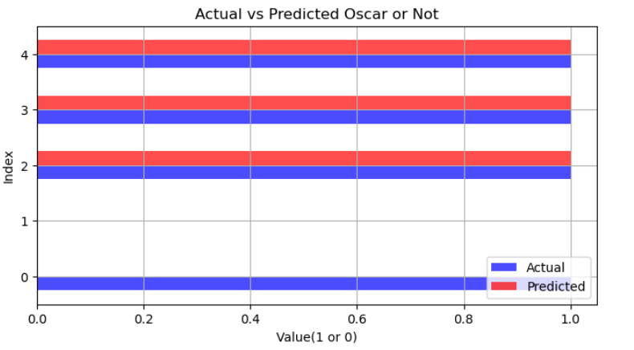

Slide 14
Conclusion
Overall, these two models made adequate predictions on the target variables
MLR makes some accurate predictions with an r2 score of 0.82, but is inconsistent.
Logistic Classification accurately predicted 4 out of 5 Oscars. With an F1-score of 0.65, reflects a consistent balance between precision and recall.
The strength of these models could improve with additional data and a broader scope of variables.

