Slide 1


Booleo

Slide 2
Content
Team
Game description
Used Technologies

Slide 3





Team Никола Крушков-Designer , back-end developer and front-end developer.

Slide 4
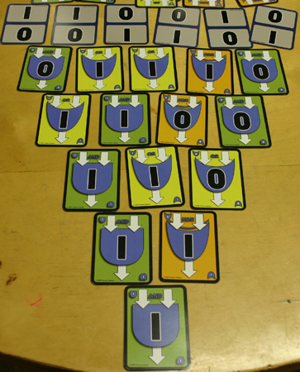
Game description
A strategical game which forces the player to use their brain in order to defeat their enemy with logic.

Slide 5



Used technologies
Power Point​
Teams
GitHub

Slide 6
Now let’s continue to the game.

