Slide 1
Convolutional Neural Network AleXNet implementation on the CIFAR-10 dataset
Nikola Mitrevski ¹
¹ Faculty of Engineering, University of Kragujevac, Kragujevac, Serbia

Slide 2

Introduction
Convolutional Neural Networks (CNN) are designed to work with 2D structures (e.g. images) on which they achieve significant results. Unlike a Regular Neural Network (RNN), CNN layers have neurons distributed in 3 dimensions (width, height and depth (RGB, 0-255)).
When we use CNN (Figure 1), the network works faster because, with CNN, some outputs of neurons from one hidden layer do not have to be connected to neurons from the next hidden layer, so there are less parameters to adjust.
Figure 1. Example of CNN architecture

Slide 3
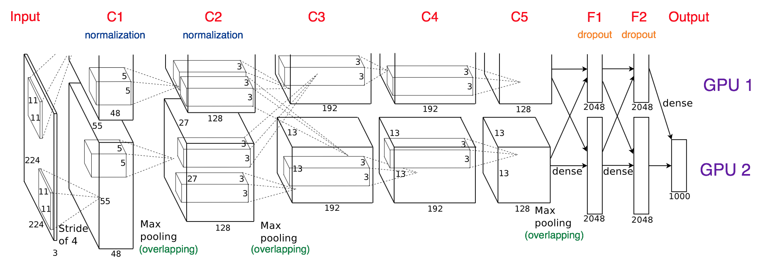
Introduction
In 2012, the AlexNet architecture (Figure 2) won the challenge of classifying a large number of images, with a classification accuracy of 84.7%. The Imagenet dataset was used (about 14 million images in a thousand classes).
It was proposed in 2012 in a research paper called "Imagenet Classification with Deep Convolution Neural Network“ by Alex Krizhevsky and his colleagues.
Figure 2. AlexNet architecture

Slide 4
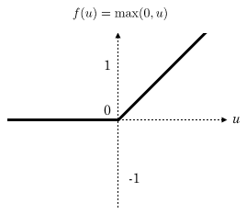
Introduction
Alex Krizhevsky and his colleagues found out that using the ReLU as an activation function (Figure 3) accelerated the speed of the training process by almost six times. They also used the dropout layers, that prevented their model from overfitting.
Figure 3. ReLU activation function

Slide 5
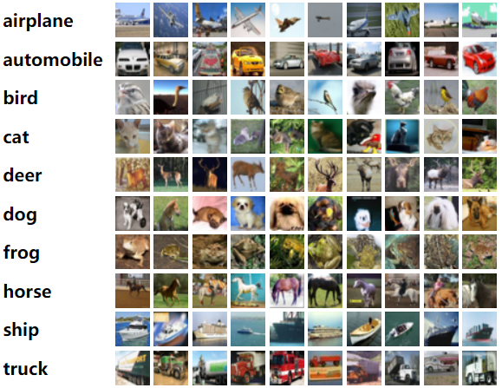
The CIFAR-10 dataset
The CIFAR-10 dataset (Figure 4) consists of 60000 images. Each image in this dataset is represented by a size of 32x32 pixels (width x height) and a channel depth of size 3.
Figure 4. The CIFAR-10 dataset

Slide 6
Loading the CIFAR-10 dataset
Loading the CIFAR-10 dataset:
Figure 5. Loading dataset
After loading the training and test datasets, it is necessary to perform a suitable transformation of the data so that it can be used with TensorFlow:
Figure 6. Tranformation of datasets
The total number of elements in the training and test dataset after loading the data is:
Figure 7. Size of training and test datasets

Slide 7
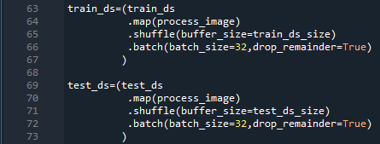
Preprocessing, shuffling and batching of datasets
The following operations are used after transforming the training and test datasets:
Figure 8. Preprocessing, shuffling and batching of datasets

Slide 8
Preprocessing, shuffling and batching of datasets
The batch_size parameter is a hyperparameter used to group data. This hyperparameter is equal to the number of inputs that are passed through the network before back propagation is done. The value of this hyperparameter ranges from 1 to the size of the training/test dataset. The lower the value of this hyperparameter, the longer the training time, but the higher the accuracy.
The process_image method is used to standardize and resize images.

Slide 9
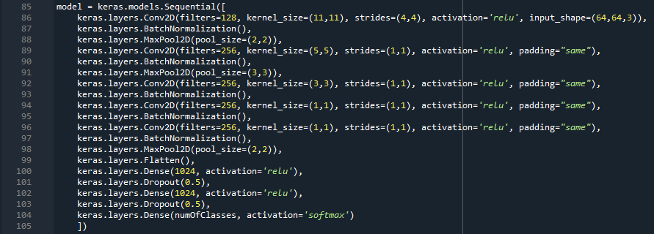
Implementation of the AlexNet model
Figure 9. Implementation of the model

Slide 10
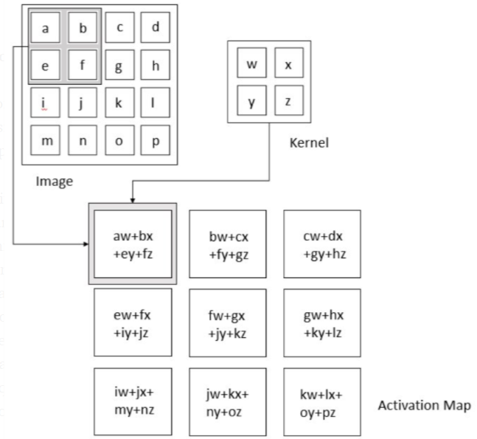
Implementation of the AlexNet model
The Conv2D layer is a convolution layer and its purpose is to create a property map from the loaded image.
Figure 10. View of the convolution operation
Figure 11. The input image is 4x4, the filter is 2x2, and the property map is 3x3

Slide 11
Implementation of the AlexNet model
The BatchNormalization layer is used to normalize and standardize the input pixels. Pixel normalization means that the value of each pixel is divided by the number 255, i.e. the value of each pixel is reduced from the range 0-255 to the range 0-1. Pixel standardization means subtracting the mean pixel value from the current pixel value, and then dividing the new pixel value by the pixel standard deviation value.
The MaxPool2D layer is a compression layer and its purpose is to reduce the dimension of the property map.
The Flatten layer is used to convert data into a one-dimensional array.
The Dense layer represents a fully connected layer and its purpose is to use the obtained data to perform classification.

Slide 12

Compilation of the AlexNet model
Model compilation is the process of configuring the model before training it.
The parameters used to configure the model are:
Figure 12. Compilation of the model
The loss parameter represents the loss (cost) function. It is used to calculate a value known as a loss. If the loss is lower, the model's performance is better. One of the most used loss functions is called cross entropy.

Slide 13
Compilation of the AlexNet model
The metrics parameter represents the functions used to evaluate the performance of the model. These functions are similar to loss functions, except that the results of the estimates are not used when training the model.
The optimizer parameter is used to optimize the model. The two most commonly used algorithms for model optimization are the Stochastic Gradient Descent (SGD) optimizer and the Adam optimizer. One of the parameters that is most often passed to the mentioned optimizers is a hyperparameter called learning rate (lr).
The hyperparameter learning rate "tells" how fast the network learns and the loss depends on it. If the value of this hyperparameter is too high, weights and activation thresholds will be adjusted on each pass, while if the value is too low, the adjustment will be very slow. Any of the above two conditions can result in the network never converging.

Slide 14
Compilation of the AlexNet model
Some of the ways to find the best value for the learning rate are:
Using a constant value for the learning rate.
Decreasing learning rate values over time. For example, for the first 10 epochs, you may use 0.001 for the learning rate. At epoch 11, you drop the learning rate to 1e-4. At epoch 20, it drops to 1e-5. The reason for having the learning rate drop over time is so the adjustments to the weights become less variable as the network learns. It's like getting a haircut. The barber first cuts off long lengths of hair. Then they make some adjustments and cut shorter lengths. Finally, they make very small cuts around your ears for the final polishing. This is exactly what happens when the learning rate drops after a period of time.
Taking a high value for the learning rate of 0.1 and then taking a low value for the learning rate of 1e-7. Learning rates typically range between 0.1 and 1e-7, with the majority of the time falling somewhere in the middle. Then one can try the values of 0.01 and 1e-6, etc. Finally, the results are compared to find the best value for the learning rate.

Slide 15
Training the AlexNet model
The epoch parameter is a hyperparameter that "tells" how many times to go through the entire training dataset. The value of this hyperparameter ranges from 1 to infinity.
Figure 13. Training the model
Figures 14, 15, 16, 17 and 18 show the training epochs of the AlexNet model.

Slide 16
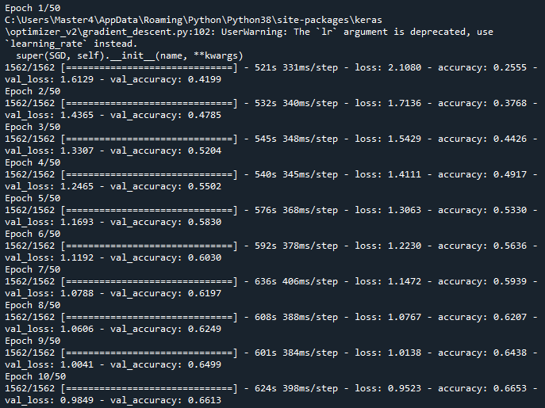
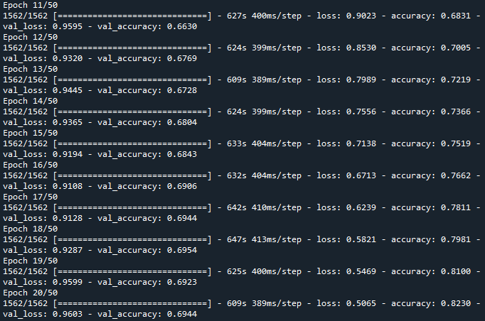
Training the AlexNet model
Figure 14. Training, the first ten epochs
Figure 15. Training, the other ten epochs

Slide 17
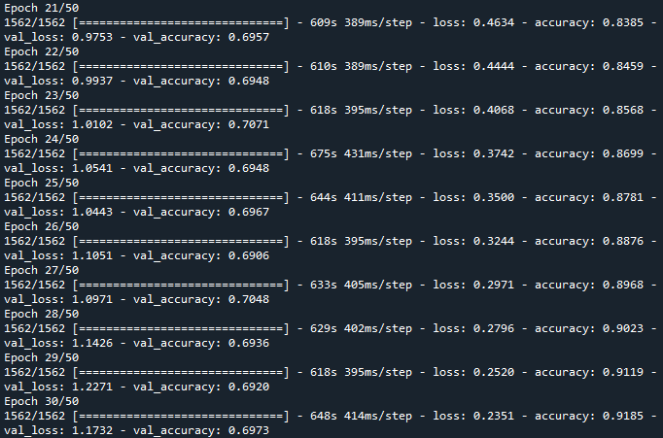
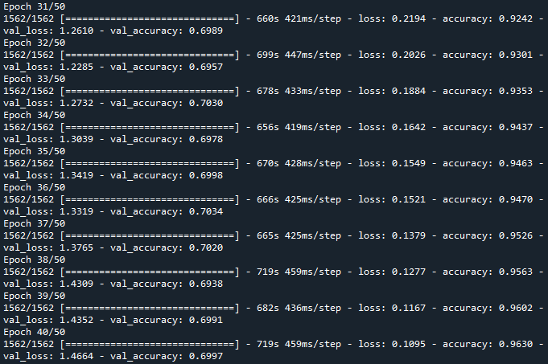
Training the AlexNet model
Figure 16. Training, the third ten epochs
Figure 17. Training, the fourth ten epochs

Slide 18
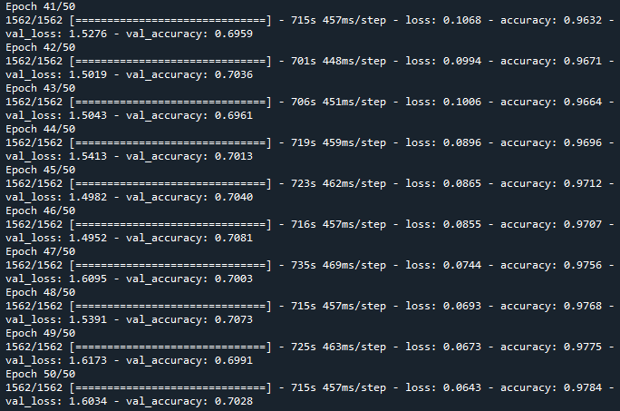
Training the AlexNet model
Figure 18. Training, the fifth ten epochs

Slide 19
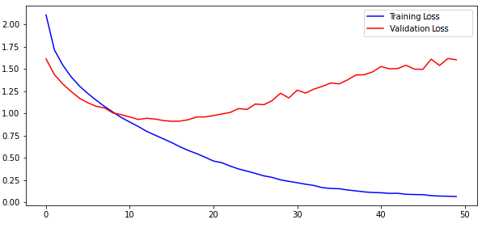
Results and discussion
Visualization of the loss of the AlexNet model:
Figure 19. Visualization of the loss

Slide 20
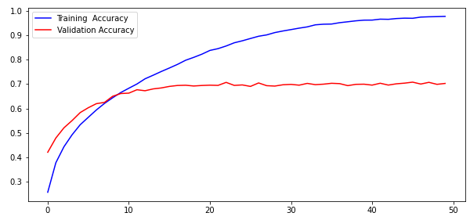
Results and discussion
Visualization of the accuracy of the AlexNet model:
Figure 20. Visualization of the accuracy

Slide 21
Results and discussion
The average accuracy of the AlexNet model with hyperparameters set as follows: batch_size=32, lr=0.001, epochs=50 is:
Figure 21. Accuracy of the model

Slide 22
Conclusions
This model overfits.
Different options for solving overfits:
Reduce the network’s capacity by reducing the number of elements in the hidden layers.
Setting the values of hyperparameters (batch size, learning rate and epochs).
Train with more data.
Data balancing.

Slide 23
Thank you for your attention
Contact information:
Nikola Mitrevski
Faculty of Engineering, University of Kragujevac, Kragujevac, Serbia
email: nikola.mitrevski1998@gmail.com

