Slide 1
Java Basic
Loops and Arrays

Slide 2
Agenda
1. Loops
For
While
Do … while
2.Arrays

Slide 3
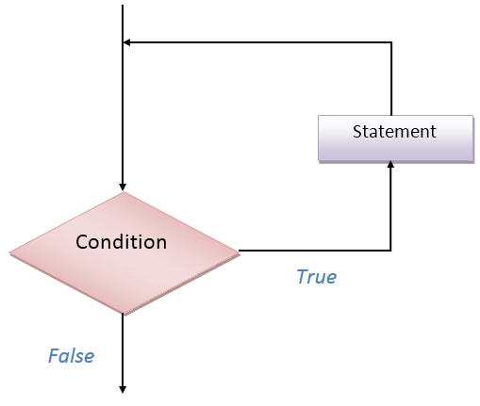
Loops
Execute some code multiple times
Iterate through some sets of data

Slide 4
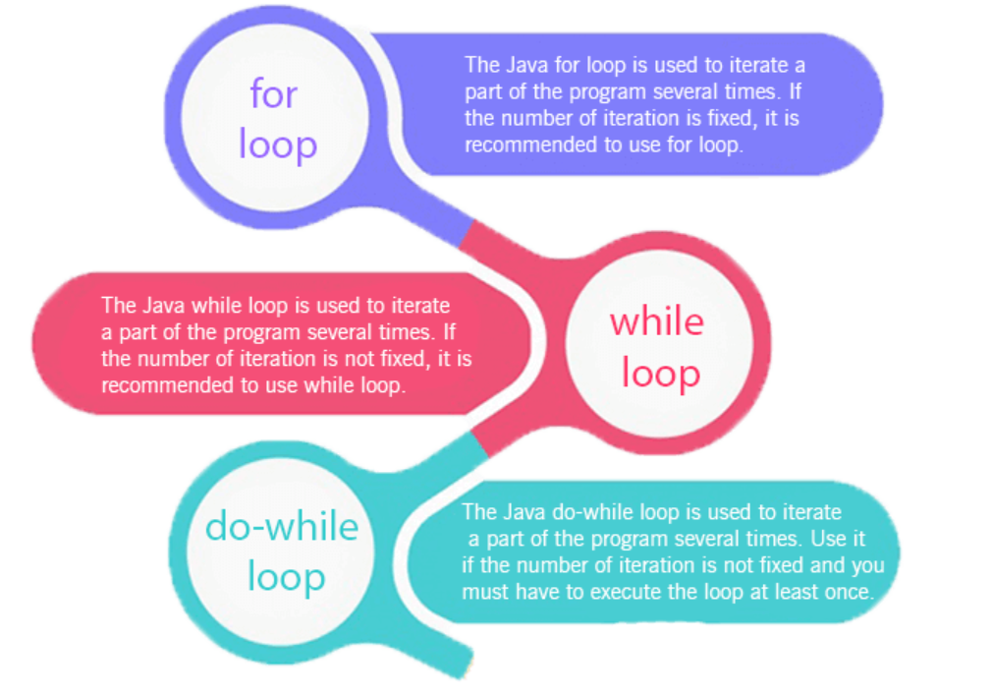
Loops in Java

Slide 5
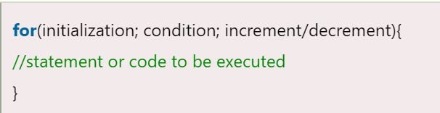
Java FOR Loop
We can initialize the variable, check condition and increment/decrement value. It consists of four parts:
Initialization: It is the initial condition which is executed once when the loop starts. Here, we can initialize the variable, or we can use an already initialized variable. It is an optional condition.
Condition: It is the second condition which is executed each time to test the condition of the loop. It continues execution until the condition is false. It must return boolean value either true or false. It is an optional condition.
Increment/Decrement: It increments or decrements the variable value. It is an optional condition.
Statement: The statement of the loop is executed each time until the second condition is false.

Slide 6
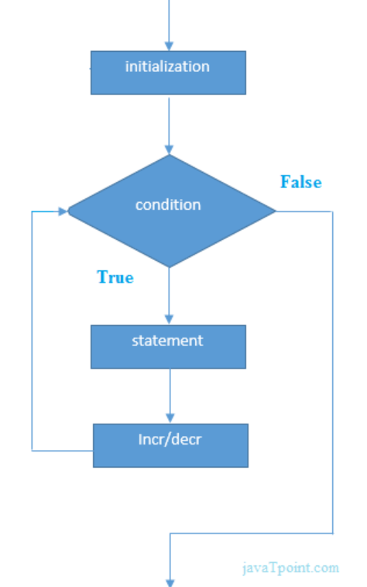
Java FOR Loop
public class ForExample {
public static void main(String[] args) {
//Code of Java for loop
for(int i=1;i<=10;i++){
System.out.println(i);
}
}
}

Slide 7
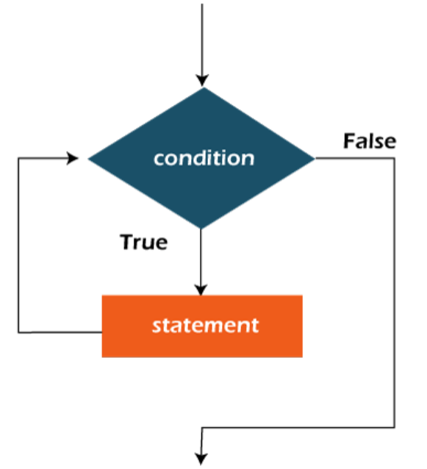
Java While Loop
The Java while loop is used to iterate a part of the program repeatedly until the specified Boolean condition is true. As soon as the Boolean condition becomes false, the loop automatically stops.

Slide 8
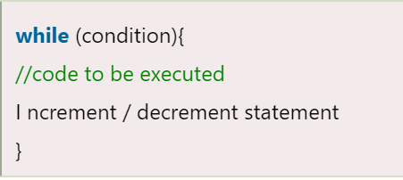
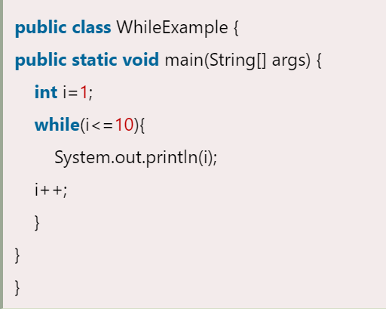
Java While Loop Example

Slide 9
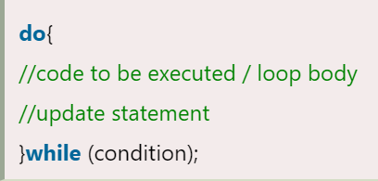
Java do-while Loop
Java do-while loop is used to iterate a part of the program repeatedly, until the specified condition is true. If the number of iteration is not fixed and you must have to execute the loop at least once, it is recommended to use a do-while loop.

Slide 10
Java do-while Loop Example
public class DoWhileExample {
public static void main(String[] args) {
int i=1;
do{
System.out.println(i);
i++;
}while(i<=10);
}
}

Slide 11
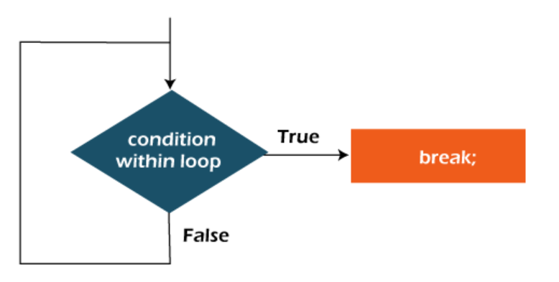
Java Break Statement
When a break statement is encountered inside a loop, the loop is immediately terminated and the program control resumes at the next statement following the loop.

Slide 12
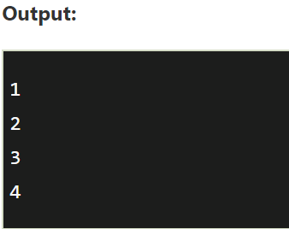
Java Break Statement
public static void main(String[] args) {
//using for loop
for(int i=1;i<=10;i++){
if(i==5){
//breaking the loop
break;
}
System.out.println(i);
}
}

Slide 13
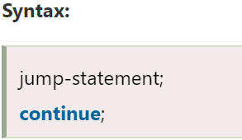
Java Continue Statement
The continue statement is used in loop control structure when you need to jump to the next iteration of the loop immediately. It can be used with for loop or while loop.

Slide 14
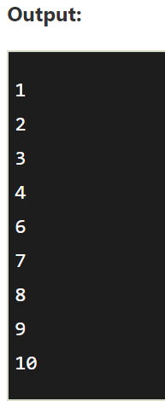
Java Continue Statement
public static void main(String[] args) {
//for loop
for(int i=1;i<=10;i++){
if(i==5){
//using continue statement
continue;//it will skip the rest statement
}
System.out.println(i);
}
}

Slide 15
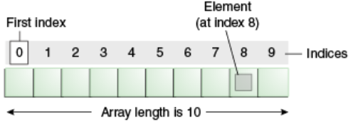
Java Arrays
Java array is an object which contains elements of a similar data type. Additionally, The elements of an array are stored in a contiguous memory location. It is a data structure where we store similar elements. We can store only a fixed set of elements in a Java array.
Advantages
Code Optimization: It makes the code optimized, we can retrieve or sort the data efficiently.
Random access: We can get any data located at an index position.
Disadvantages
Size Limit: We can store only the fixed size of elements in the array. It doesn't grow its size at runtime. To solve this problem, collection framework is used in Java which grows automatically.

Slide 16
Single Dimensional Array in Java
Syntax to Declare an Array in Java
dataType[] arr; (or)
dataType []arr; (or)
dataType arr[];
arrayRefVar = new datatype[size];
arrayRefVar[i] = var;
arrayRefVar = {var,var,var};
public static void main(String args[]){
int a[] = new int[5];//declaration and instantiation
a[0]=10;//initialization
a[1]=20;
a[2]=70;
a[3]=40;
a[4]=50;
//traversing array
for(int i=0;i<a.length;i++)//length is the property of array
System.out.println(a[i]);
}

Slide 17
Anonymous Array in Java
//Java Program to demonstrate the way of passing an anonymous array
//to method.
public class TestAnonymousArray{
//creating a method which receives an array as a parameter
static void printArray(int arr[]){
for(int i=0;i<arr.length;i++)
System.out.println(arr[i]);
}
public static void main(String args[]){
printArray(new int[]{10,22,44,66});//passing anonymous array to method
}}

Slide 18
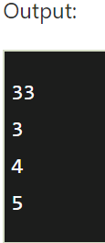
For-each Loop for Java Array
//Java Program to print the array elements using for-each loop
class Testarray1{
public static void main(String args[]){
int arr[]={33,3,4,5};
//printing array using for-each loop
for(int i:arr)
System.out.println(i);
}}

Slide 19
Multidimensional Array in Java
dataType[][] arrayRefVar; (or)
dataType [][]arrayRefVar; (or)
dataType arrayRefVar[][]; (or)
dataType []arrayRefVar[];
int[][] arr=new int[3][3];
arr[0][0]=1;
arr[0][1]=2;
int arr[][]={{1,2,3},{2,4,5},{4,4,5}};

Slide 20
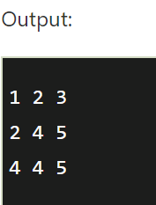
Multidimensional Array in Java
public static void main(String args[]){
//declaring and initializing 2D array
int arr[][]={{1,2,3},{2,4,5},{4,4,5}};
//printing 2D array
for(int i=0;i<3;i++){
for(int j=0;j<3;j++){
System.out.print(arr[i][j]+" ");
}
System.out.println();
}
}}

Slide 21
Practice and QA time
https://javarush.ru/groups/posts/klass-scanner

