Slide 1
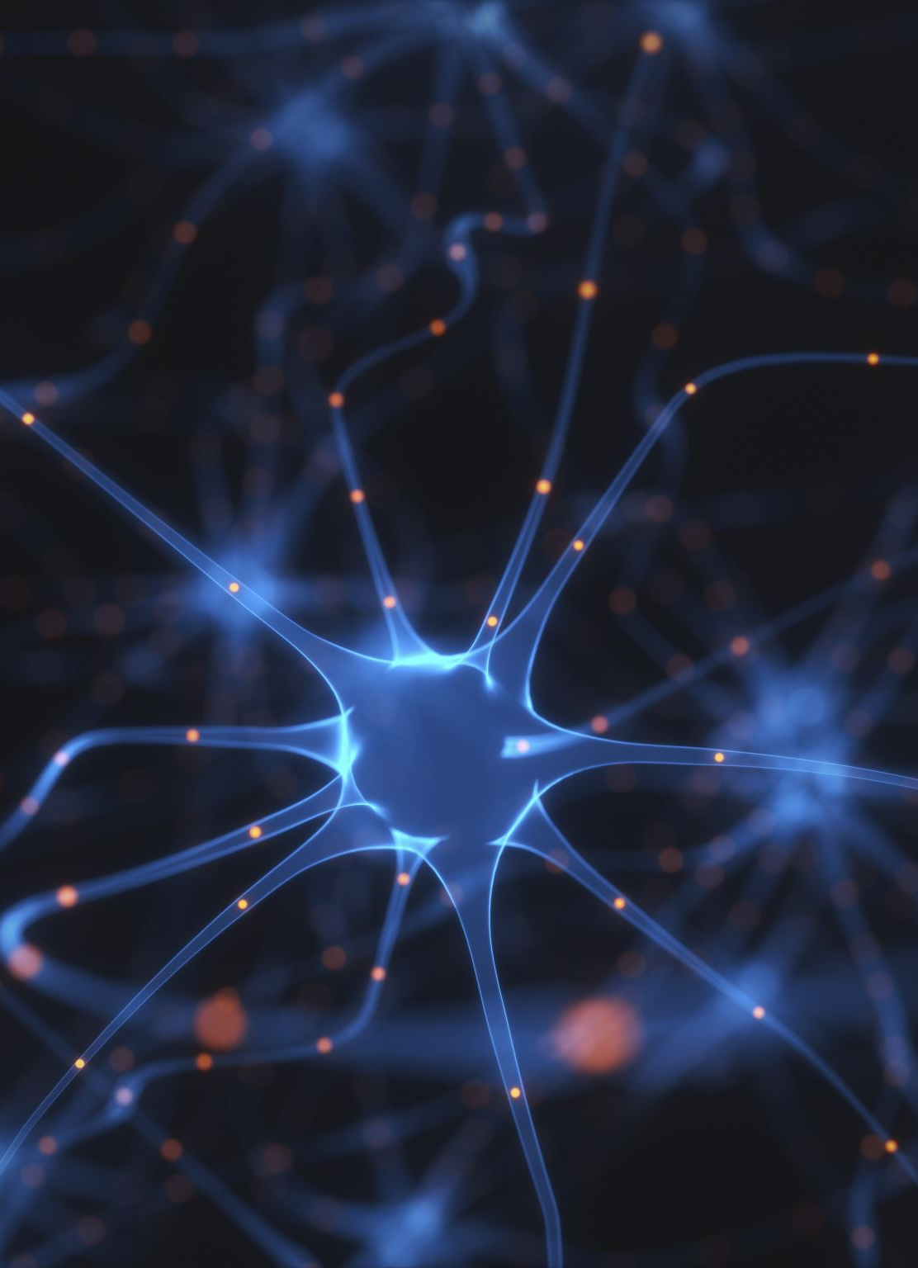
Animation of virtual characters using the OpenPose neural network

Slide 2
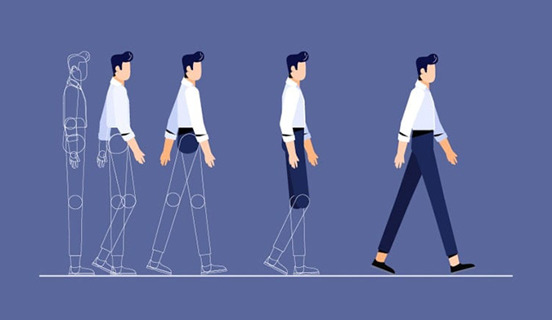
INTRODUCTION
What is our task?
OpenPose,Blender
2D Virtual animation
Notes:
Our task is to make a 2d virtual animation using the openPose neural network. We made animation through recordings of our movementas which will openpose process and make keypoints that we will later use in blender to make a 2d charcther

Slide 3
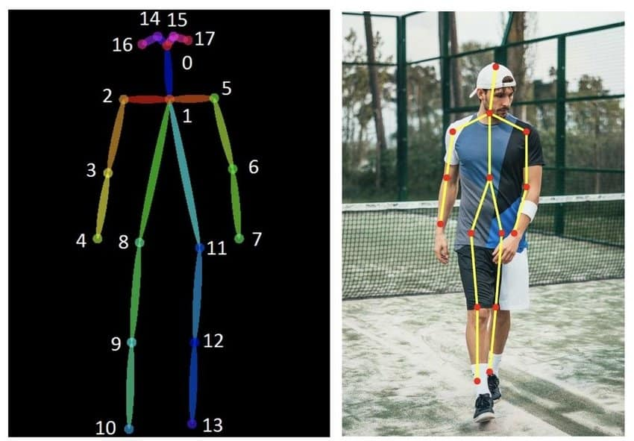
OpenPose
What is OpenPose
Common uses
How we used OpenPose
Notes:
OpenPose is an open-source computer vision system that uses deep neural networks to detect and track human body poses from images or video.
In practical terms, it identifies keypoints on the human body—such as joints, limbs, hands, and facial landmarks—and connects them into a skeletal representation. This works in real time and supports multiple people simultaneously in a single frame.
Common uses for OpenPose: Animation of virtual characters Motion capture without physical markers, Sports and movement analysis ,Human–computer interaction, Augmented and virtual reality
Research in biomechanics and AI
We installed Docker and used it to run OpenPose, which we pulled from uoresearch/openpose using the command:
docker pull uoresearch/openpose-cpu
We used the CPU-only version of OpenPose because the GPU versions are not compatible with the newer drivers. The CPU version is slower, but it was sufficient for our purposes.

Slide 4
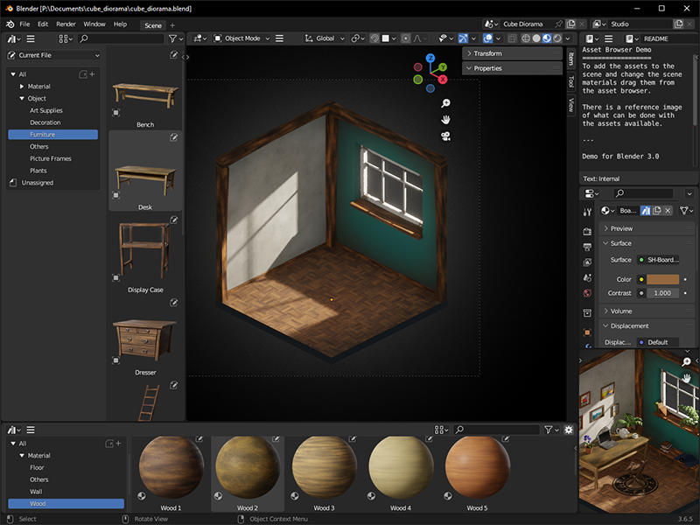
Blender
What is blender
Common uses
How we used it
Notes:
Blender is free, open-source 3D software used to create digital 3D or 2D content. It allows users to model objects, animate characters, render images and videos, and produce visual effects. It is commonly used in animation, games, films, simulations, and virtual character production.
Its used for 3D modelling animation and rigging rendering images and videos visual effects ..
We used it to animate 2d characther through a json file that we got from openpose

Slide 5
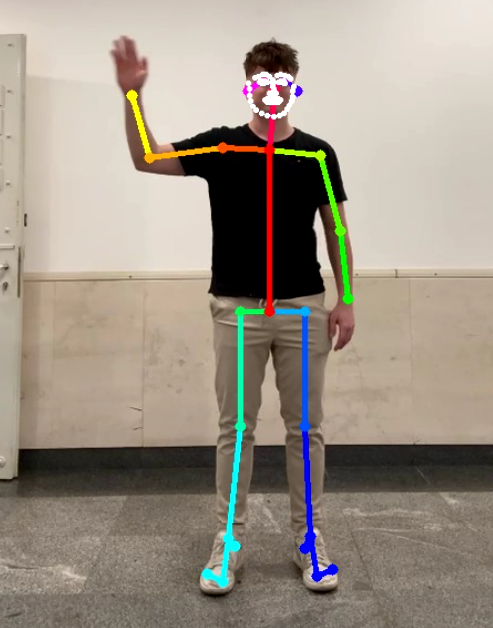
What we did
Recorded the vide
Used the openPose to extract keypoints
Converted JSON file
Made blender script
2D animation
Notes:
First we recorded 5 videos that we will use to extract keypoints from. Its important that we showed the whole body and that the video has good lightning. We ran open pose command to extract the keypoints from videos with focus on the face to have many keypoints on face. We got a json file for every frame with keypoints which we later all combined to one json file so that blender script can use it. We combined json files with script.py. In blender with all the keypoints made the animation which we will show later

Slide 6
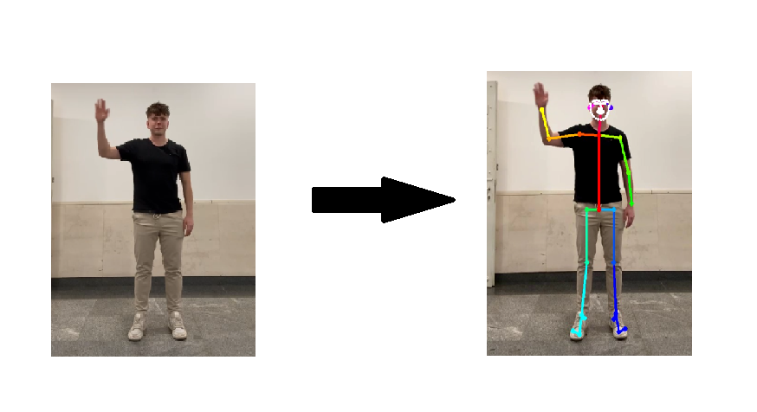
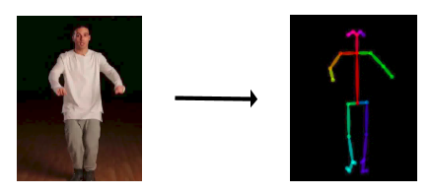
Comparison with other projects

Slide 7
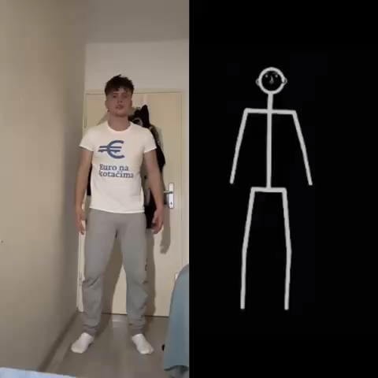
Full result

Slide 8
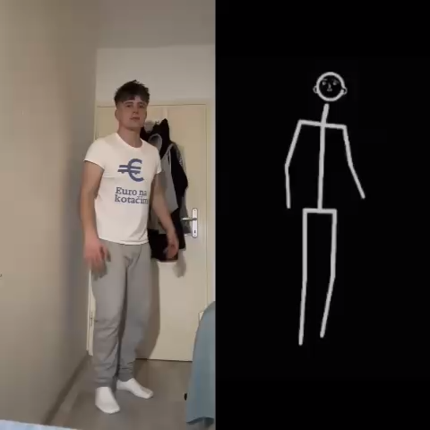
Result 2

Slide 9

Thank you

