Slide 1

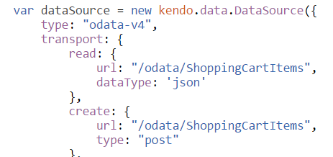
Kendo UI DataSource intro
What is Kendo UI DataSource object used for?
Interact with remote points. (Transport property)
Maintain structure and type of the data. (Schema Property)
Synchronize CRUD operations.
Responsible for data operations – sort, filter, page, aggregates.
Many more.
Notes:
Retrieve data from a remote endpoint.
Maintain the structure and type of the data (schema).
Process serialization formats to and from a remote endpoint.
synchronize updates—create, update, delete to and from a remote endpoint.
Maintain an in-memory cache of data, including changes for updating to a remote endpoint.
Calculate and maintain aggregates, sorting order and paging.
Provide a query mechanism via filter expressions.

Slide 2
DataSource overview
Widgets consuming data have dataSource property
Grid, ListView, TreeView,
PivotGrid, TreeList, AutoComplete,
ComboBox, DropDownList,
MultiSelect Charts, Etc.
Widget Binding
http://dojo.telerik.com/abAmE
Share data between widgets
http://dojo.telerik.com/onusU

Slide 3
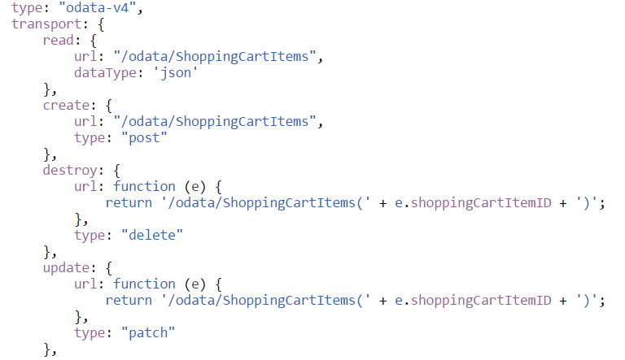
Configuring Data Operations
Transport property

Slide 4
Configuring Data Operations
Setup dataSource for remote services
transport;
read – could be replaced with ajax call;
url – address of the request (“function”);
type – type of request (“GET”, “POST”, etc.);
dataType – expected result (“json”, “jsonp”);
data – additional parameters to pass (“function”);
cache – Boolean sets if the result will be cached in the browser or not;

Slide 5
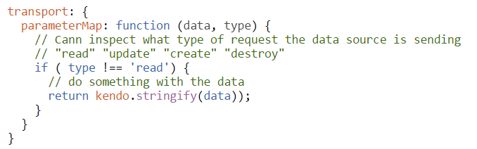
Parameter Map
Transport parameter map
The function which converts the request parameters to a format suitable for the remote service.

Slide 6
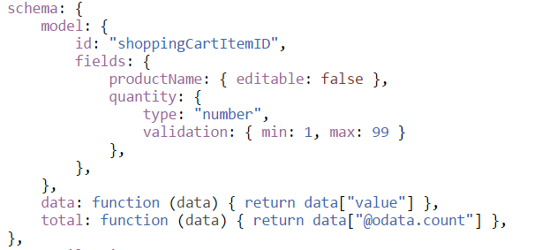
Schema configuration object
Schema property

Slide 7
DataSource - remote end point
Data type returned from web service
What is JSON format
JSON vs JSONP vs XML
Reading data from remote endpoint:
Local web service
Remote web service
CORS – Cross Origin Resource Sharing

Slide 8
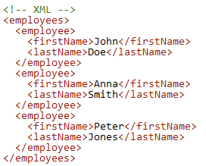
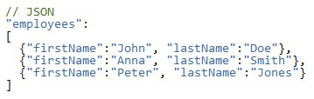
What is JSON
JavaScript Object Notation – usually uses XMLHTTPRequest object
Open data format for transmitting data between server and web applications
Used to represent objects between languages in common format
JavaScript object vs JSON object
JSON can’t represent functions or dates
JSON is alternative to XML
Example:

Slide 9
What is JSONP
JavaScript Object Notation with Padding
Method commonly used to bypass cross-domain policies in web browsers
Security limitations
JSONP can be dangerous when used from untrusted domains
Uses callback function to execute code in the page
JSON vs JSONP
Response is passed as argument to a callback function
https://en.wikipedia.org/wiki/JSONP
Example of JSONP:
http://demos.telerik.com/kendo-ui/service/Products

Slide 10
DataSource methods
Methods;
data- Gets or sets the data items of the data source.
view- Retrieves the current page items.
add - Adds item to the data source.
remove- Removes item from the data source.
read- Reads data from server.
fetch- Reads data from server and calls callback function when ready.
Filter- Filters the items with the spcified filter.
Sort- Sorts the items ascending or descending..
page- Gets or sets the current page.
Sync- Synces items with the server.
cancelChanges- Cancels any pending changes in the data source.

