Slide 1

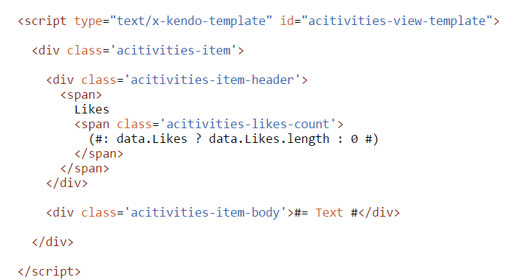
Kendo UI Templates
Supported by most of the widgets.
Simple yet very fast;
Use #(hash) notations;
HTML rendering: #= … #
HTML encoded rendering: #: … #
Allow JavaScript execution: # … #

Slide 2
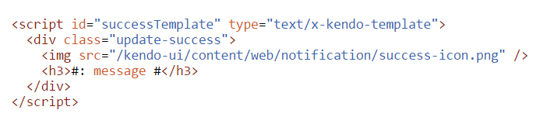
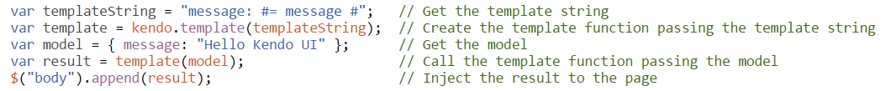
Templates syntax
To create and use a template, we need:
template string
model as JSON object or array
Template:
Usage:
http://dojo.telerik.com/AgaGE

Slide 3
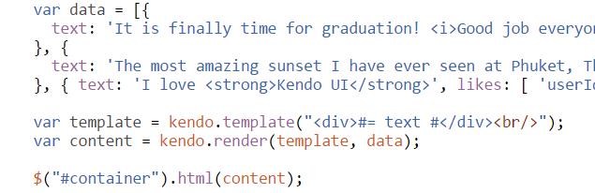
Raw values #= #
Used for:
Plain text with no special characters
Injecting HTML code
Unsafe for
Data entered by user
Data from untrusted source
Examples:
http://dojo.telerik.com/EfejO

Slide 4
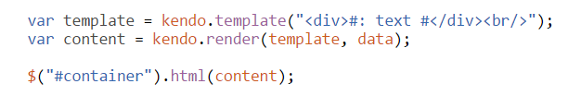
HTML encoded values #: #
Used for:
Escaping special characters
Showing HTML code to the user
Examples:
http://dojo.telerik.com/orATA

Slide 5
JavaScript code # #
Used for:
Conditional rendering of the data
Preparing the data before render
Using custom business logic
Examples:
http://dojo.telerik.com/UKObe

Slide 6
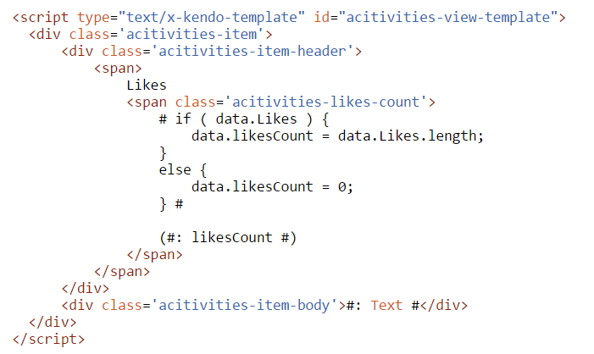
External templates
Don’t forget to add

Slide 7
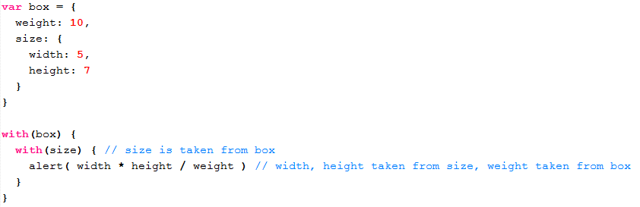
Performance considerations
The "with" operator
Deprecated and is not recommended
May degrade performance

Slide 8
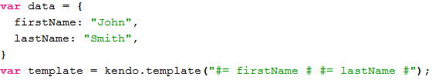
Performance optimizations
Kendo UI Templates use "with" blocking by default
Disable the "with" blocking
The keyword data is not related to the variable name

Slide 9
Remote templates
Pros
Templates stored in separate files
Templates can be shared between pages
Delayed loading can imporove page app performance
Cons
Extra code is required to load the template
Delayed (async) loading needs special considerations
Don’t forget to add
Notes:
Remote templates will be discussed in kendo advanced
Performance considerations / optimizations mentioned in kendo standard

Slide 10
Working with remote templates
Steps to load a remote template:
Load the template string and parse it
Pass template string and data
Load the data and parse it
Pass data array
Compile the template using template string
Render the content using template and data
Example:
http://dojo.telerik.com/UleLa

Slide 11
Q & A

