Slide 1
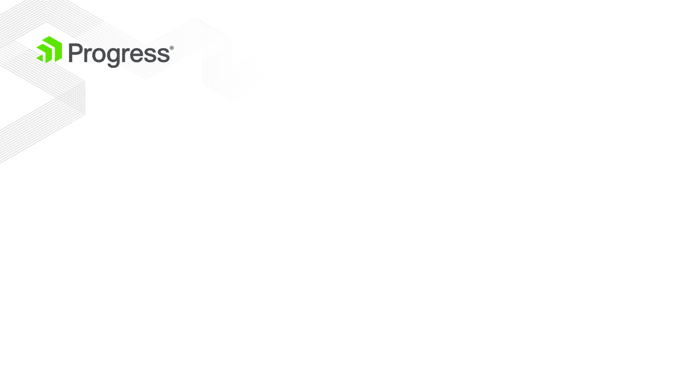
History of MVVM pattern
MVVM was originally designed by Microsoft for use with Windows Presentation Foundation (WPF) and Silverlight, having been officially announced in 2005.
The main goal was clean separation between application logic and the UI.

Slide 2
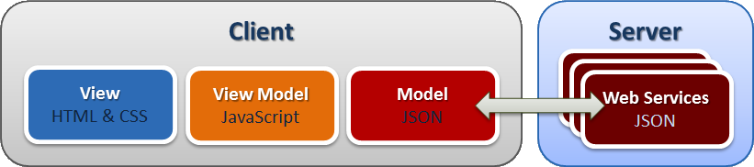
The components of MVVM
Model
Implementation of the application's domain model that
includes a data model along with business and validation logic
View
Responsible for defining the structure, layout and
appearance of what the user sees on the screen.
ViewModel
Acts as an intermediary between the view and the model
and is responsible for handling the view logic

Slide 3
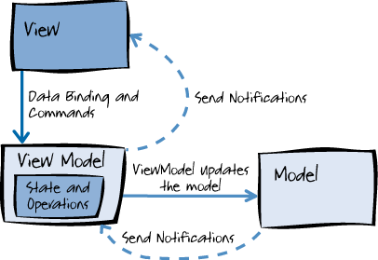
The MVVM pattern workflow
The view "knows about" the view model
The view model "knows about" the model
The model is unaware of the view model
The view model is unaware of the view.

Slide 4
The Benefits of MVVM
Data binding process is simple. No code changes required
ViewModel can abstract the data to help the View
The UI can be easily modified or even replaced by new one
Two-way data binding between View and ViewModel
True separation between View and Model

Slide 5

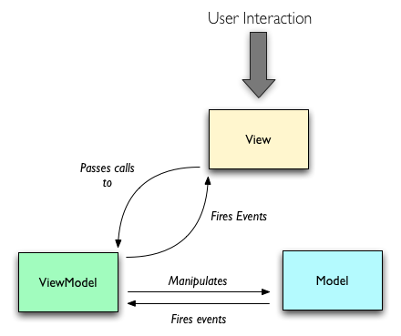
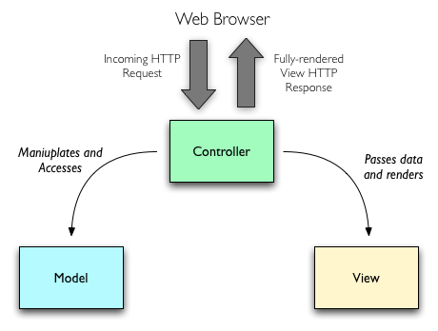
MVC vs MVVM
Notes:
http://blog.nodejitsu.com/scaling-isomorphic-javascript-code/

Slide 6

Defining the data bindings
You can bind HTML attributes, events, styles
value is attribute of the HTML element
name is field of the ViewModel
click is event of HTML element
displayGreeting is method of ViewModel
Bindings are not JavaScript!

Slide 7
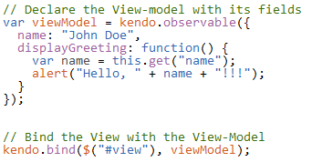
Defining the ViewModel

Slide 8
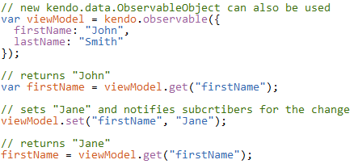
ObservableObject
Tracks object’s changes
Notifies subscribers
How to initialize and use ObservableObject:

Slide 9
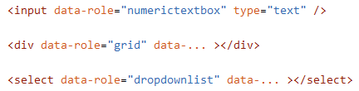
Widget binding
Setting up Kendo UI widgets in-line:
To apply the data roles you need to call:
By using data-role attribute, there is no need to
setup each widget by calling

Slide 10
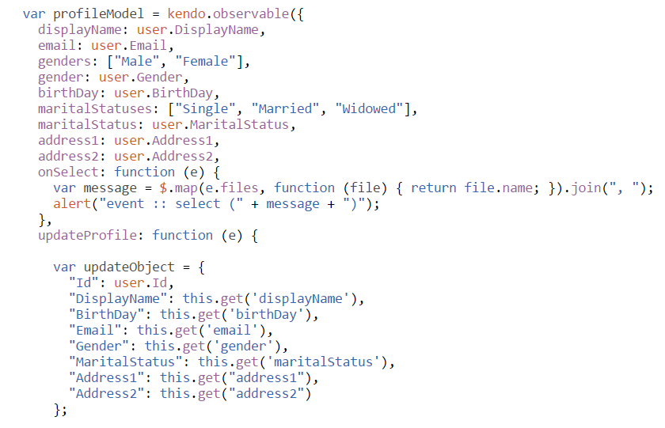
Demo - project

Slide 11
Q & A

